Slide 2



Diving into Mastery Guidance for Educators
Each activity sheet is split into three sections, diving, deeper and deepest, which are represented by the following icons:
These carefully designed activities take your children through a learning journey, initially ensuring they are fluent with the key concept being taught; then applying this to a range of reasoning and problem-solving activities.
These sheets might not necessarily be used in a linear way. Some children might begin at the ‘Deeper’ section and in fact, others may ‘dive straight in’ to the ‘Deepest’ section if they have already mastered the skill and are applying this to show their depth of understanding.
Diving
Deeper
Deepest

Slide 3
Aim
Describe movements between positions as translations of a given unit to the left/right and up/down.

Slide 4
Describe Movement on a Grid
Diving
10
The rectangle has been translated from position A to position B. Can you describe how it has been translated?
9
A
8
7
6
It has been translated right 3 and down 4.
5
B
4
3
2
1
0
0
1
2
3
4
5
6
7
8
9
10

Slide 5
Describe Movement on a Grid
Diving
What is the translation from triangle A to triangle B?
left 5, up 2
What is the translation from triangle B to triangle A?
right 5, down 2
Discuss what you notice about these translations.
5
B
4
3
A
2
1
0
0
1
2
3
4
5
6
7
8
9
10

Slide 6

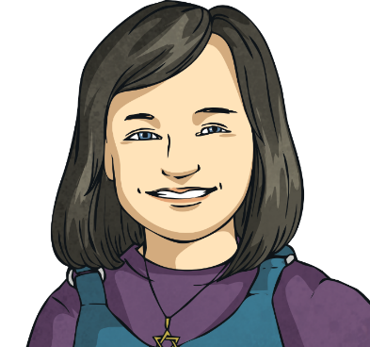
Describe Movement on a Grid
Deeper
Translating a shape 7 right and 2 up is the same as translating a shape 2 up and 7 right.
Do you agree with Sofia? Explain your reasoning, using the grid to help you.
5
4
It is the same. The triangle will move to the same place with either set of instructions, because the instructions are the same but in a different order. In maths, we usually describe the movement on the x-axis first, so we would usually describe the translation as '7 right, 2 up'.
3
2
1
0
0
1
2
3
4
5
6
7
8
9
10

Slide 7
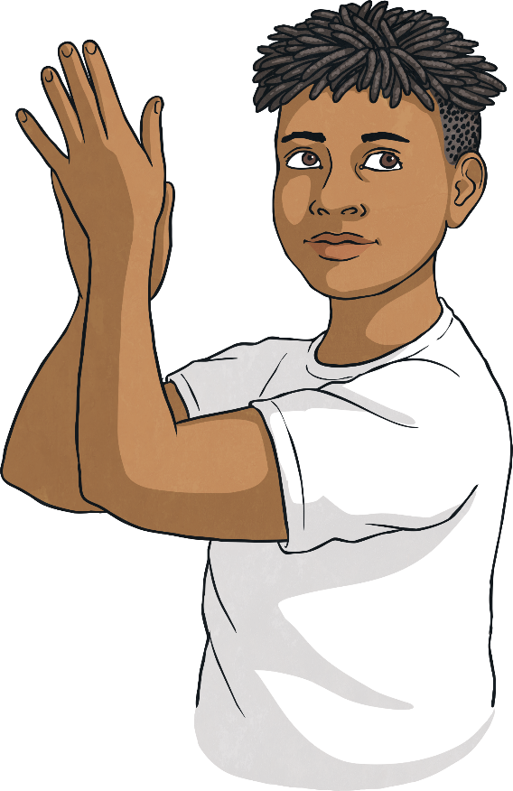
Describe Movement on a Grid
Deeper
This rectangle has been translated from position A to position B, 3 right and 2 down.
Do you agree with Thomas? Explain your reasoning, using the grid below to help you.
5
A
4
Thomas has counted from the right vertex of rectangle A to the left vertex of rectangle B, and from the bottom vertex of rectangle A to the bottom vertex of rectangle B. The correct translation is right 6 and down 3.
3
2
A
1
0
0
1
2
3
4
5
6
7
8
9
10

Slide 8

Describe Movement on a Grid
Deepest
11
A
Describe the translations you could do to piece together the shapes to make new shapes.
10
D
9
8
7
You could translate shape C right 5 and up 7 to join with shape D to make a square.
6
5
B
4
You could translate rectangle B left 7 and up 6 to join with rectangle A to make a square.
3
C
2
1
0
0
1
2
3
4
5
6
7
8
9
10
11

Slide 9


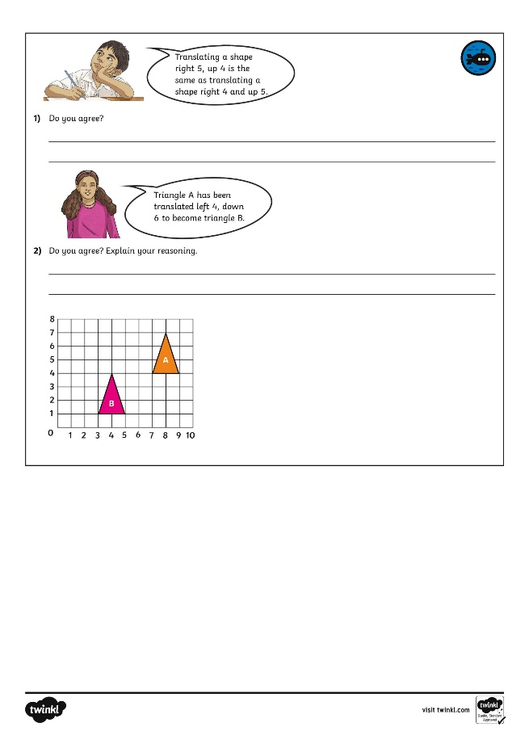
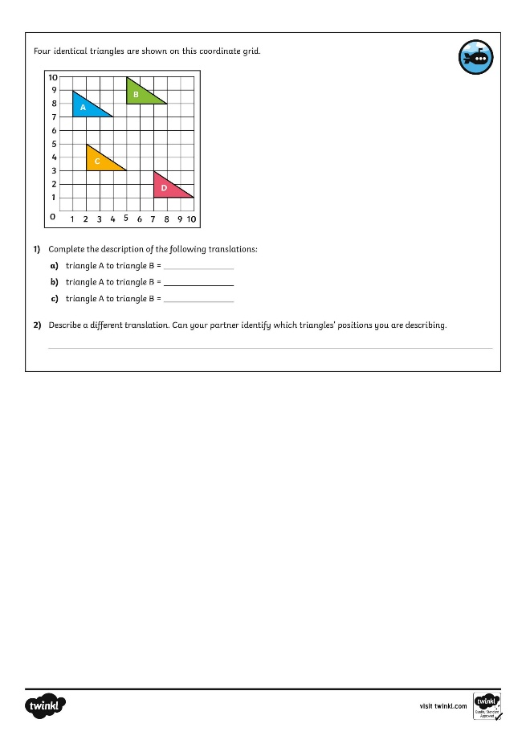
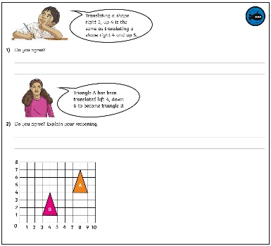
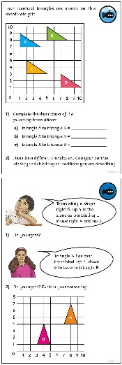
Describe Movement on a Grid
Dive in by completing your own activity!

Slide 10
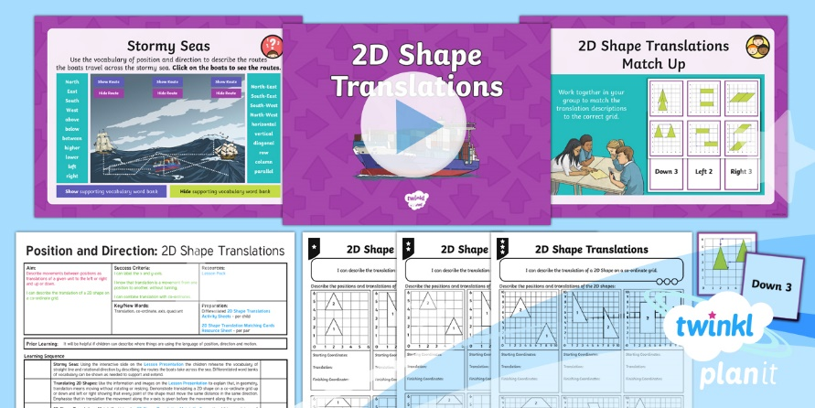
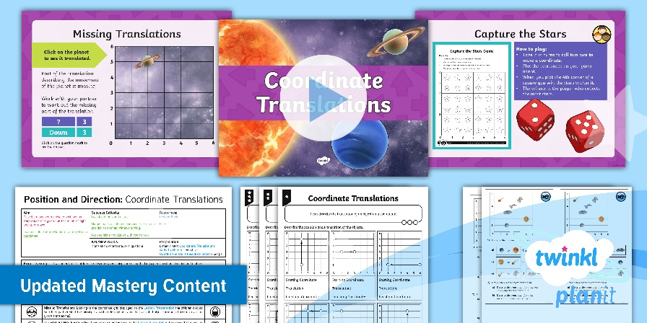

Need Planning to Complement this Resource?
National Curriculum Aim
Describe movements between positions as translations of a given unit to the left/ right and up/ down.
For more planning resources to support this aim, click here.
Twinkl PlanIt is our award-winning scheme of work
with over 4000 resources.

