Slide 2
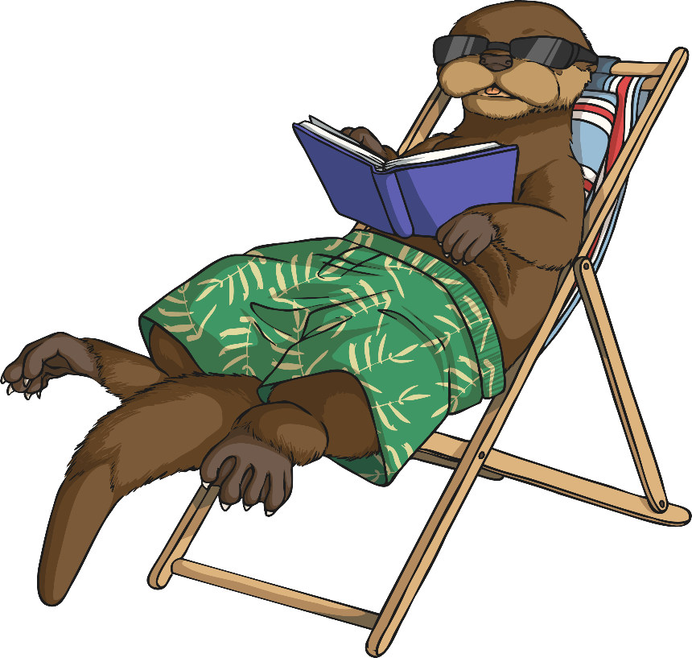
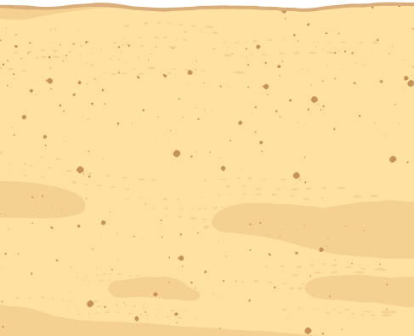
Year 4 Project Pack:
Anywhere Island
During this project you will:
develop your problem-solving and creative thinking skills;
make decisions and choices;
use a range of geographical skills;
discuss your opinions on important issues;
let your imagination run wild and;
Have fun!

Slide 3
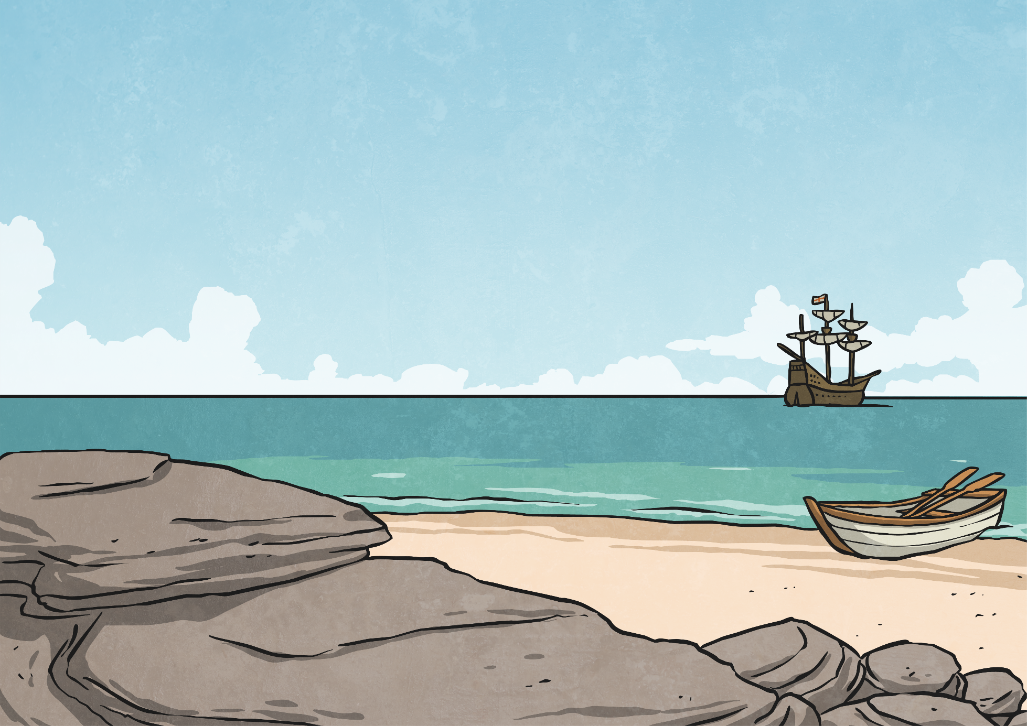
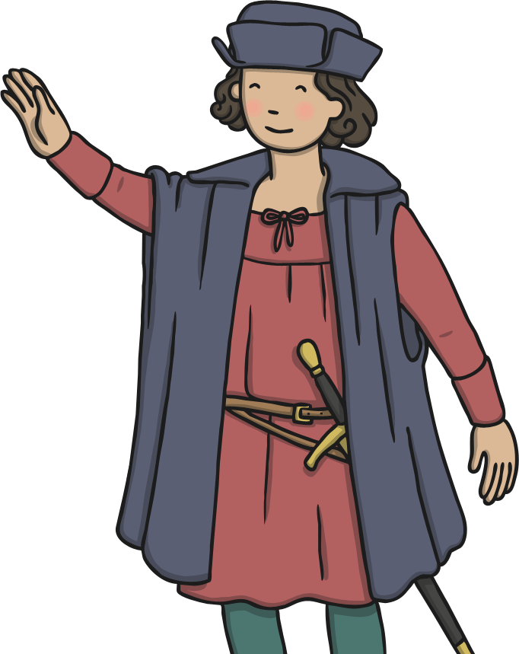
The Discovery
Whilst out exploring, you have found an uninhabited, undiscovered island, which you can now claim as your own kingdom!
You’re like a modern-day version of me, Christopher Columbus…
And if you don’t know who I am then try and find out!

Slide 4
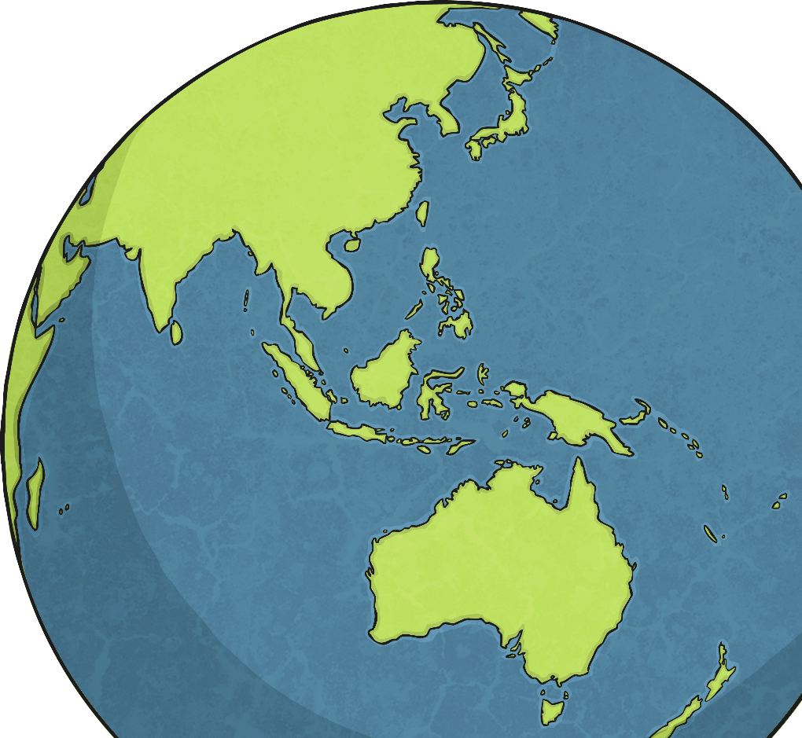
Where in the World Are You?
Where in the world would you like your island to be?
Use atlases, globes or interactive maps on the internet, to decide where you’d like your newly discovered island to be.
Which sea or ocean does your island lay in?
Which countries and other islands are closest to it?
  How close?
Which continent may claim it?

Slide 5
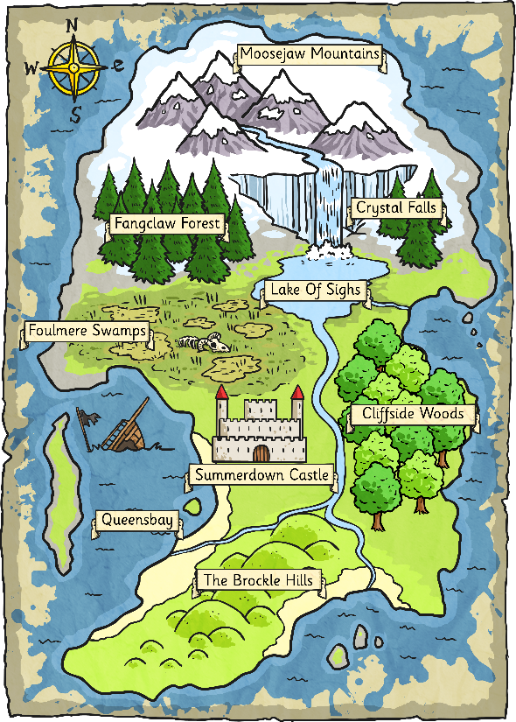
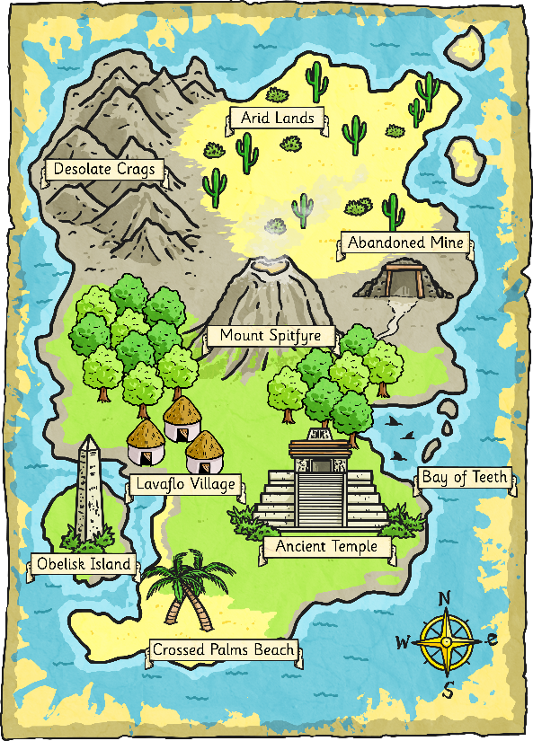
Designing Your Island
Now is your chance to design your island.
What will it be called? What geographical features will it have? Can you include any abstract nouns e.g. 'River Of Forgiveness'?
Look at these maps for some inspiration…
Remember, this does not need to be a desert island. You can have whatever you want on it. Perhaps it is a holiday island. What attractions will you have there?
Or is it a private island, where only a few people live?

Slide 6
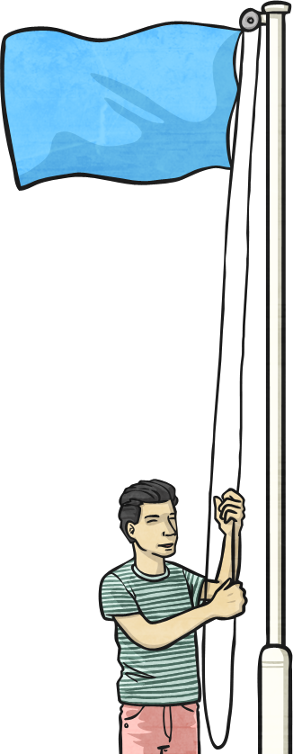
National Flags
The national flag of a country can often have a deep meaning and hold symbolic significance for the people of a nation.
Let’s test your flag knowledge – can you name the country that these national flags belong to?
Could you guess the meaning behind each one’s colours, symbols or shapes?

Slide 7
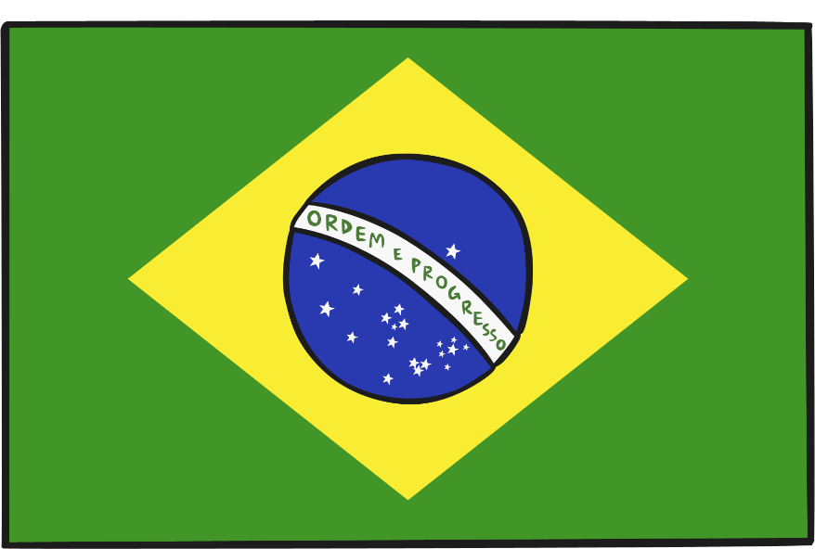
The National Flag of…
Do you know which country this flag belongs to?
Do you know the meaning behind it?
Each colour of the Brazilian flag symbolises something very important to Brazilian culture. The yellow represents the country’s gold reserves, the green represents the country’s tropical landscape and the blue is a globe with 27 white stars upon it (one for every district in Brazil).
Across the globe, the banner reads ‘Ordem E Progresso’, which is a Brazilian motto meaning ‘Order and Progress’.
Brazil

Slide 8
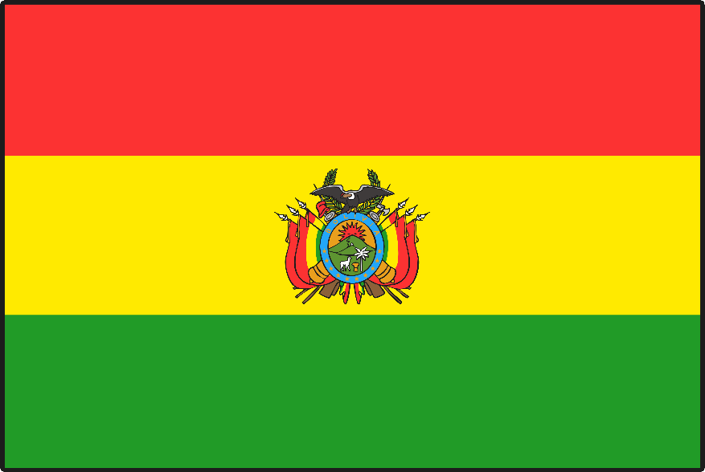
The National Flag of…
Do you know which country this flag belongs to?
Do you know the meaning behind it?
Again, the colours of this flag are significant to their people. The red is said to represent their brave soldiers, the green – their fertile land and the yellow – the country’s mineral deposits.
The ‘coat of arms’ in the middle of the flag is the country’s national symbol. It contains many other symbolic images, including their national animal (the llama), and laurel leaves to bring peace.
Bolivia

Slide 9
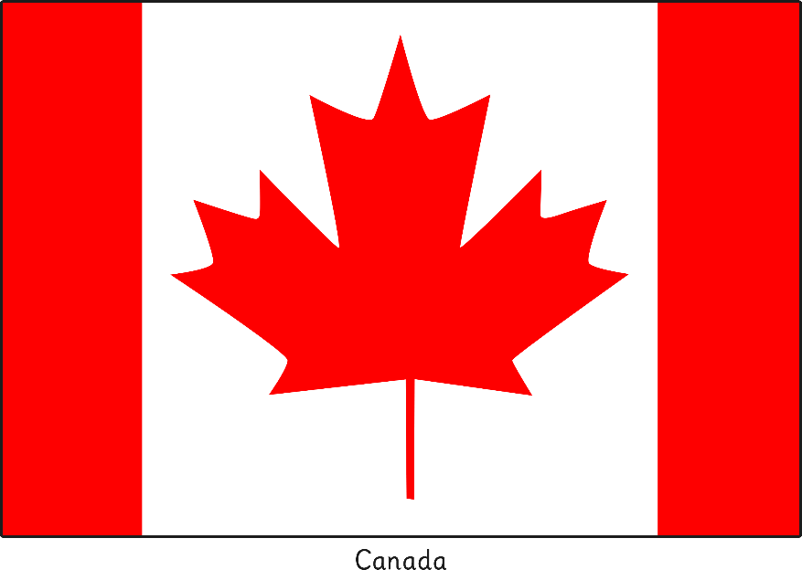
The National Flag of…
Do you know which country this flag belongs to?
Do you know the meaning behind it?
The red maple leaf has been the national symbol of Canada for over 150 years. For Canadian people, it is a symbol of unity, tolerance and peace.
Red and white are the official colours of Canada, proclaimed by King George V in 1921.
Canada

Slide 10
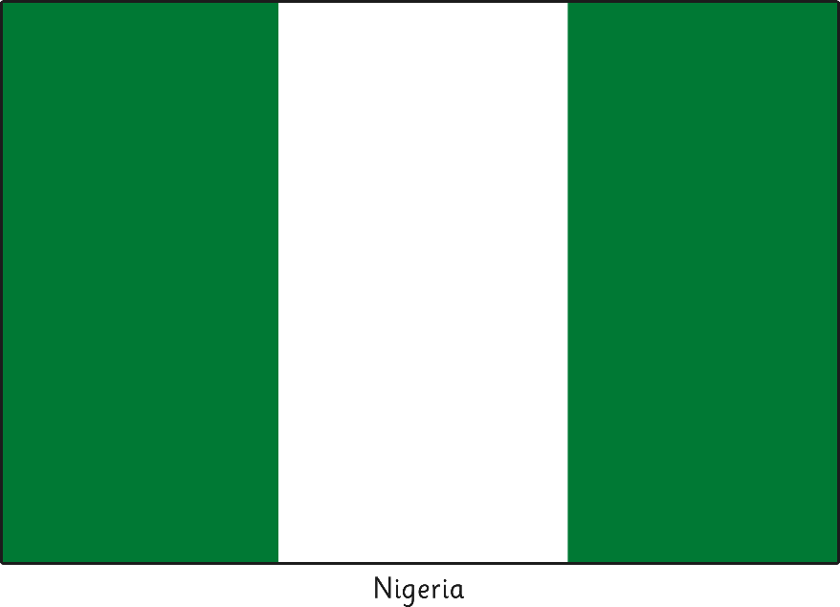
The National Flag of…
Do you know which country this flag belongs to?
Do you know the meaning behind it?
The green stripes of Nigeria’s flag represent their lush vegetation and its agriculture industry (that the Nigerians would call their natural wealth).
While the white stripe represents their desire for peace.
Nigeria

Slide 11
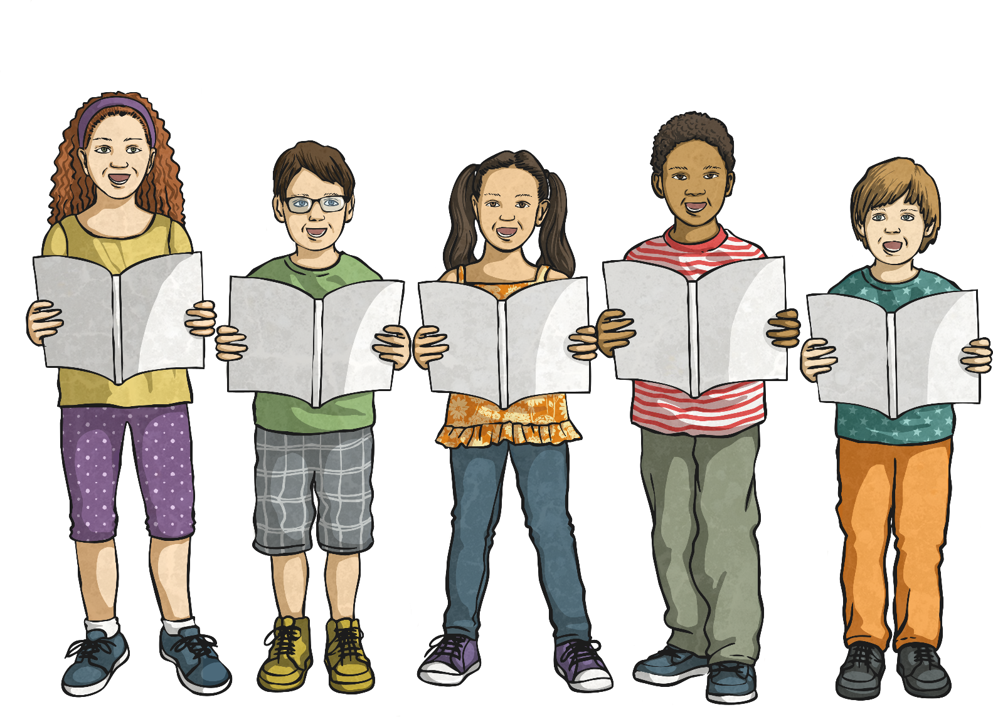



A National Anthem
A national anthem is a patriotic song that is officially adopted by a country as an expression of their national identity.
Do you know the national anthem for the country you live in?

Slide 12
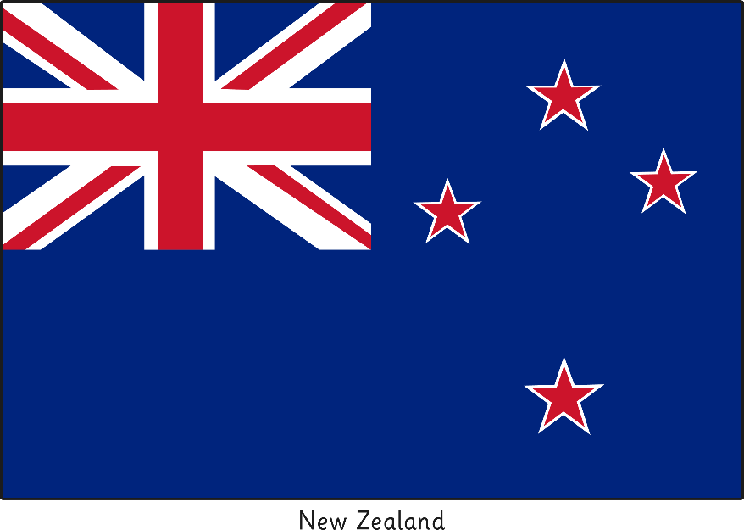
National Anthem Lyrics
The lyrics (words) of a national anthem often tell the story of a country’s history traditions and sometimes the struggles of its people.
Which country are these national anthem lyrics from?
God of Nations at Thy feet,
In the bonds of love we meet,
Hear our voices, we entreat,
God defend our free land.
Guard Pacific's triple star
From the shafts of strife and war, Make her praises heard afar,
God defend __________________.
New Zealand

Slide 13
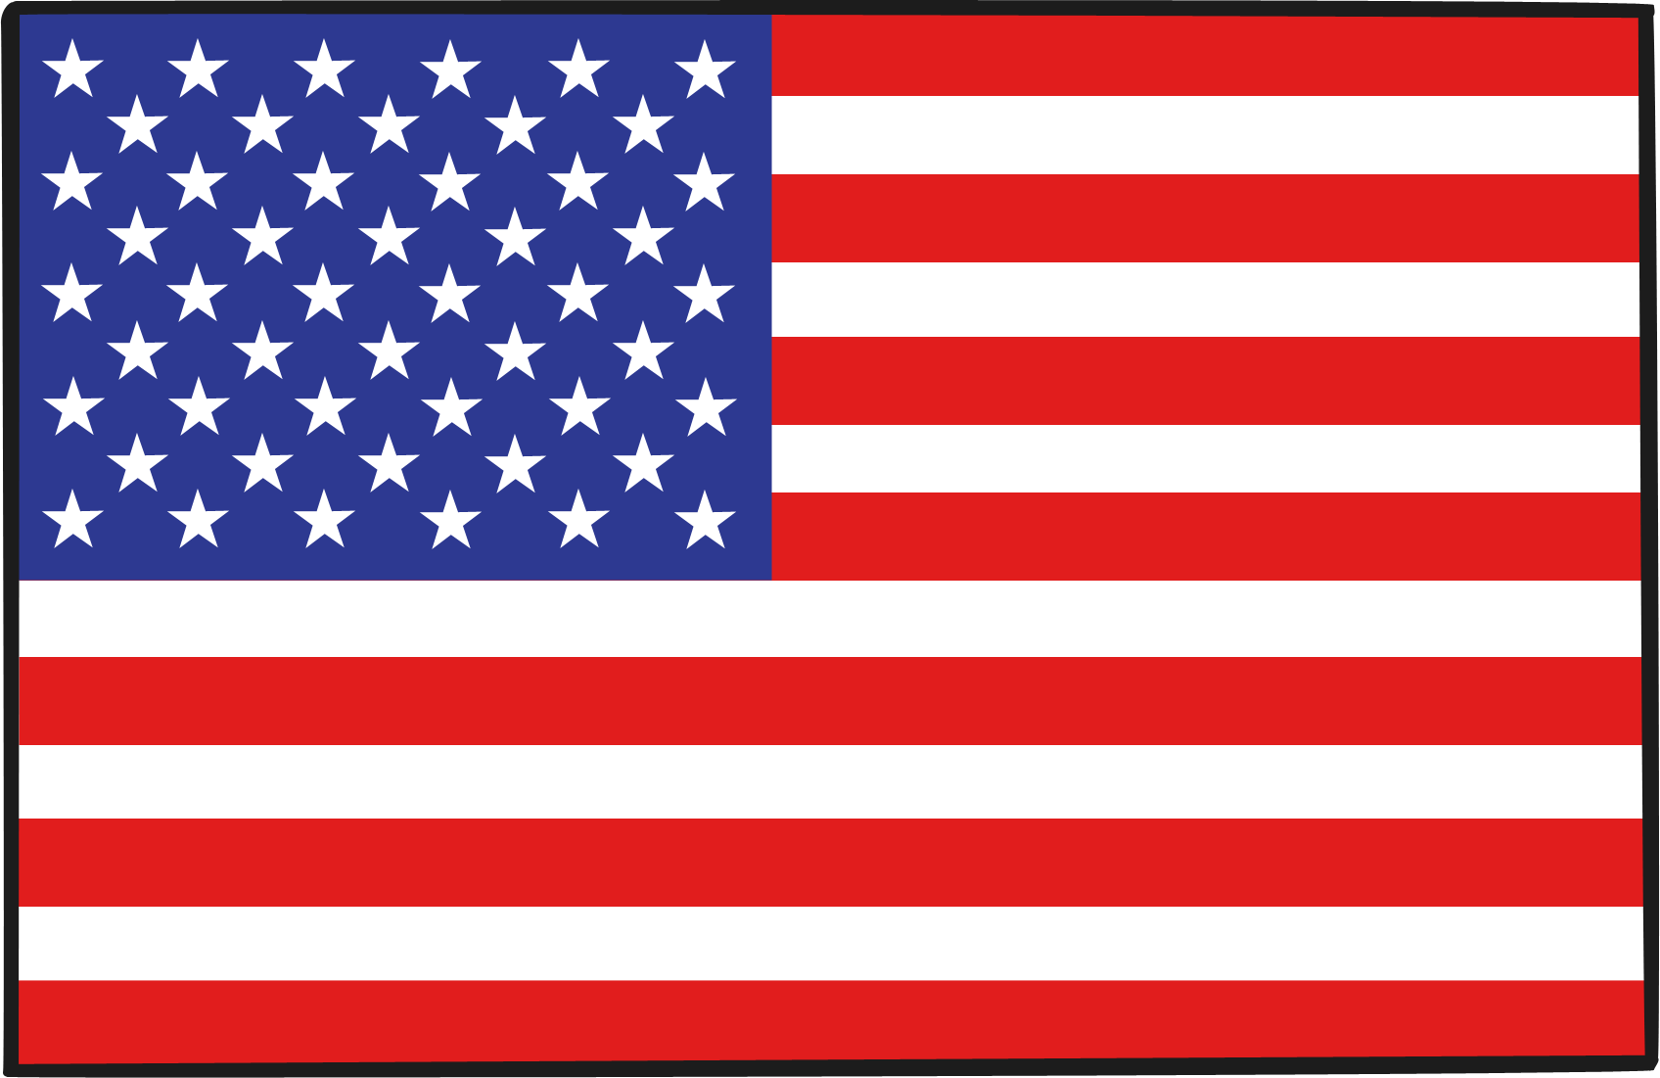
National Anthem Lyrics
Which country are these national anthem lyrics from?
What do you think they mean?
Oh, say! Can you see by the dawns early light
What so proudly we hailed at the twilights last gleaming;
Whose broad stripes and bright stars,
Through the perilous fight,
O’er the ramparts we watched were so gallantly streaming?
And the rocket’s red glare, the bombs bursting air,
Gave proof through the night that our flag was still there:
Oh say! Does that star-spangled banner yet wave
O’er the land of the free and the home of the brave?
United States of America

Slide 14

National Anthem Lyrics
Which country are these national anthem lyrics from?
What do you think they mean?
This land of my fathers is dear to me
Land of poets and singers, and people of stature
Her brave warriors, fine patriots
Shed their blood for freedom.
Land! Land! I am true to my land!
As long as the sea serves as a wall for this pure, dear land
May the language endure forever.
Old land of the mountains, paradise of the poets,
Every valley, every cliff a beauty guards’
Through love of my country, enchanting voices will be
Her stream and rivers to me.
Wales

Slide 15

Composing Your National Anthem
You now need to think of some national anthem lyrics to symbolise your island.
They could relate to…
your island’s landscape;
your island’s history;
your island’s values or a country motto;
and/or
the person who discovered your island… you!

Slide 16

Reflection
Reflection Questions
How did you design your flag? Why?
What do the colours represent on your flag?
Who would like to share their national anthem?
What specific words have you used in your song? Why?

