Slide 1

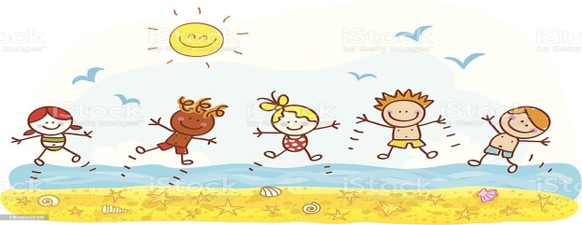
L.O. To write a recipe for the perfect Summer
Steps to success:
Think about what makes a perfect Summer
Think of some units of measure, adverbs of time and imperative verbs
Write the recipe

Slide 2
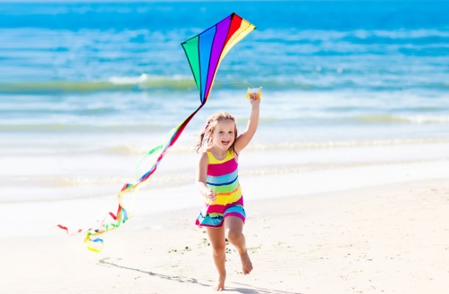
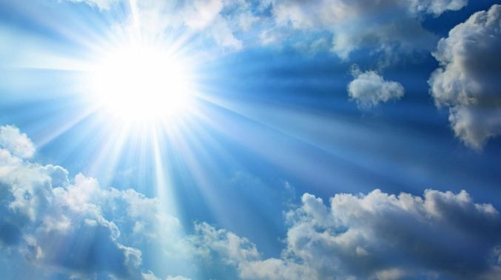
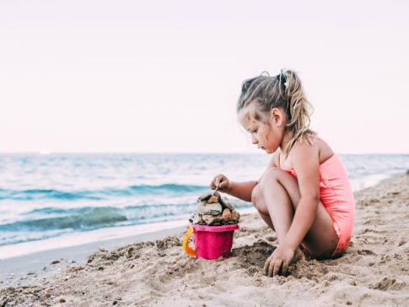
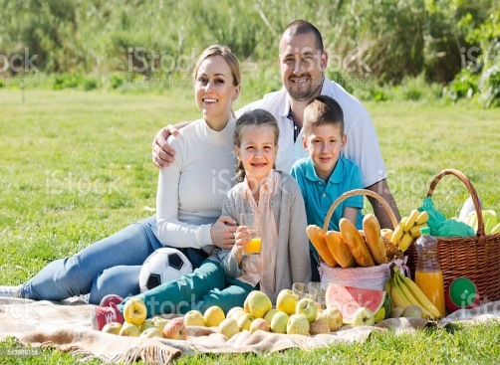
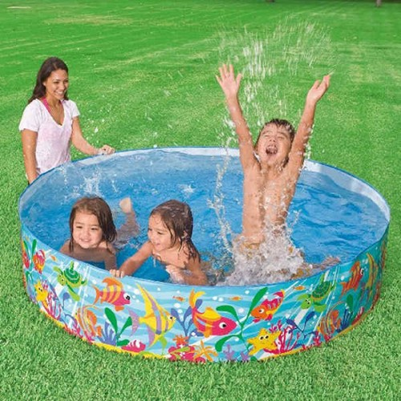
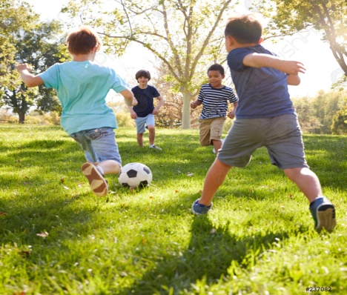
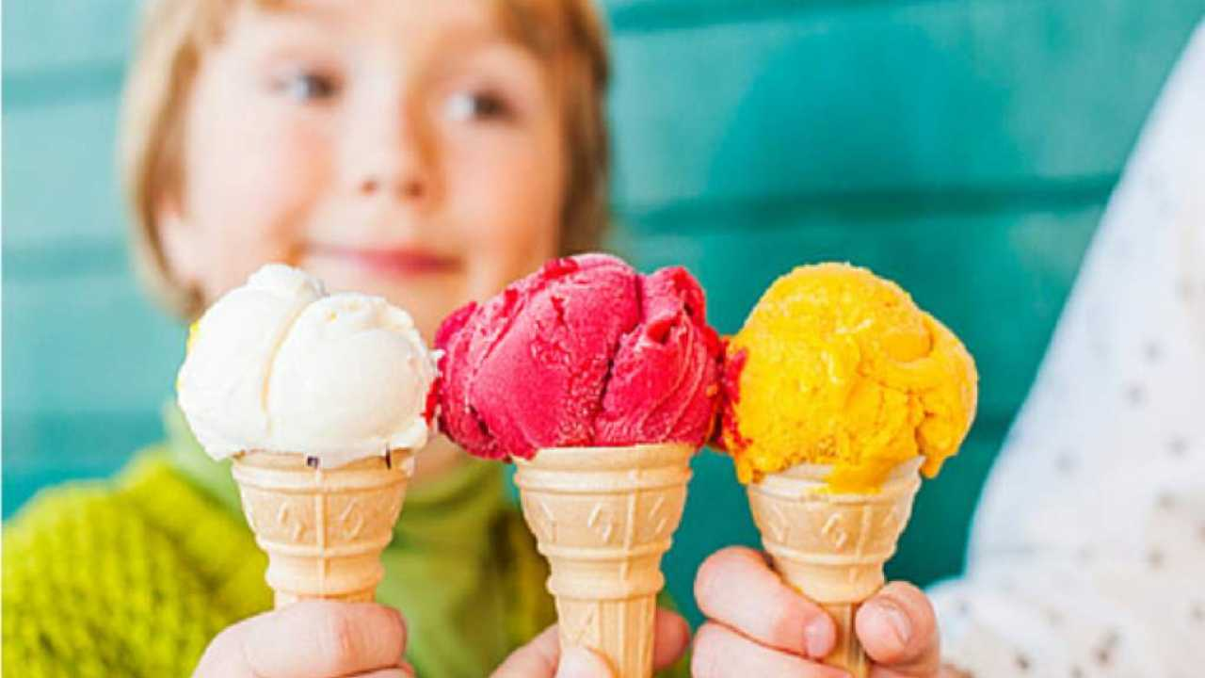
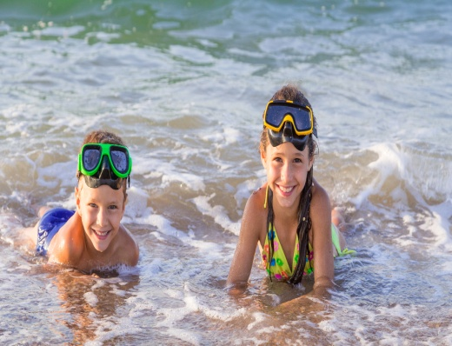
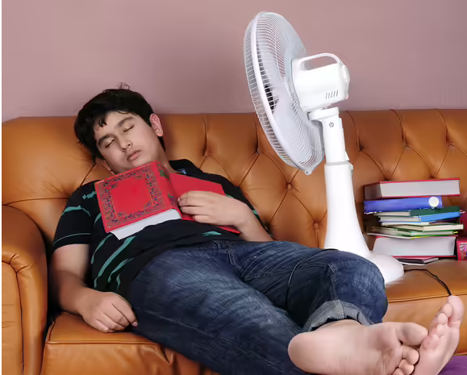
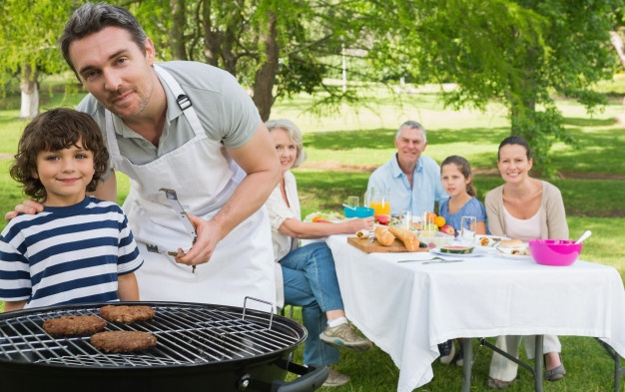
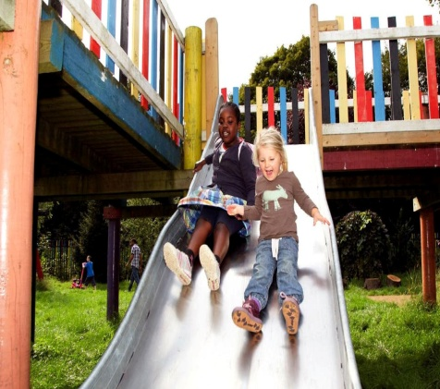

What do you think of when you think about Summer?

Slide 3


What units of measure can we use in our recipe?
a bottle of
a sprinkle of
a millilitre of
a pinch of
a packet of
a cupful of
a handful of
a tin of
a kilogram of
a box of
a dusting of
a spoonful of
a litre of
a gram of
a tub of

Slide 4
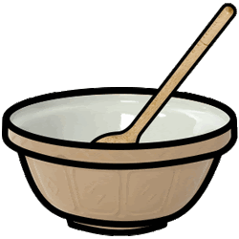

What adverbs of time can
we add to our recipe?
next
finally
after that
first
a few minutes later
then
soon after that
secondly
A short time later
now

Slide 5


What imperative verbs can
we include in our recipe?
whisk
sift
mix
melt
stir
bake
blend
slice
chop
add
grate
pour
sprinkle

Slide 6

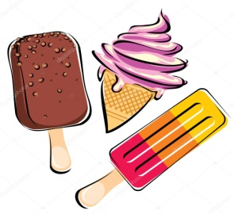
My recipe for
the perfect Summer
First, add in box of shiny, yellow sunshine.
Secondly, pour in a bucketful of soft, fine sand.
Then, sprinkle in a pinch of fun, happy family time.
A short time later, splash in some icy, cool water.
Next, mix in a kilogram of delicious, cold ice-cream.
After that, sift in a warm, gentle breeze.
Now, blend in a packet of kind, joyful friends.
Finally, bake for 6 amazing, enjoyable weeks!
Enjoy!

