Slide 1
Welcome to Year 5
with Mrs Righton

Slide 2
We understand that the move from Year 4 to Year 5 is an important step in your child's education.

Slide 3
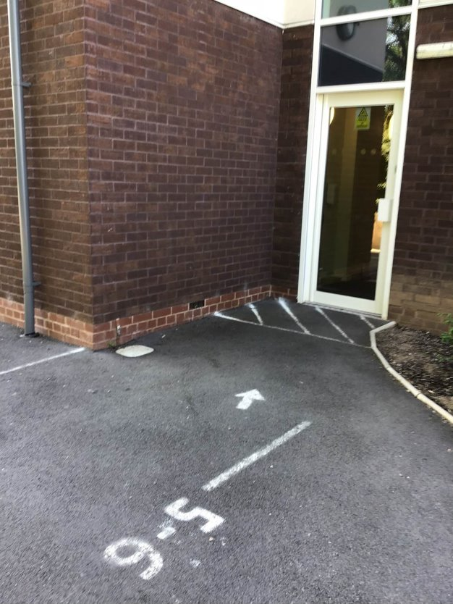
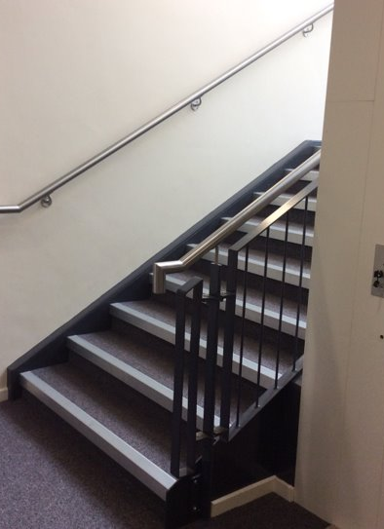
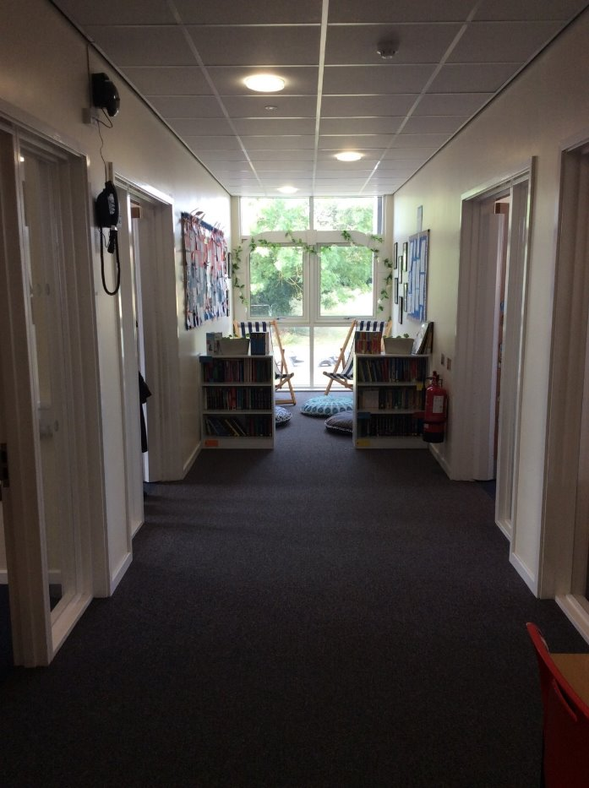
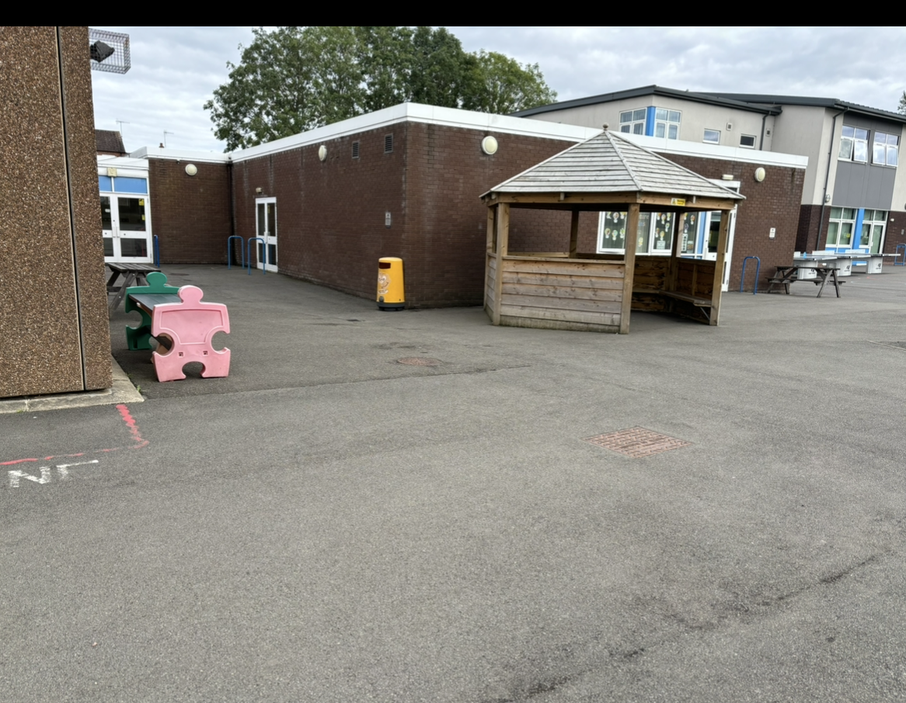
Changes

Slide 4
Maths
We will be continuing with Power Maths, which is a mastery approach to maths.
Teaching of all areas of maths through reasoning and problem-solving activities.
Children will be encouraged to reason using sentence stems such as: There are ten tenths in one whole. One whole is the same as ten tenths.
Children have their own workbooks and a range of resources during the lessons.
Ninja Maths
Notes:
We continue with power maths. Children will have their own workbook for each term, which has a focus on reasoning and problem solving as well as fluency. Children complete maths fluency tasks daily either through Big Ma We look at place value to include both higher numbers (tens of thousands) and decimal numbers to two decimal places.

Slide 5
English
We will continue with whole class reading and class texts. Sometimes these will overlap.
Where appropriate our text links to the half termly topic to further their learning.
Literacy lessons will focus on writing over a two week period including discrete grammar and comprehension to enable children to develop skills for writing.
Children will continue to have weekly spelling tests- given out on a Monday and tested the following Monday.
New handwriting award- handwriting hero given out in class on a Friday.

Slide 6
Science
We follow the KS2 science curriculum covering a broad range of scientific topics such as space, forces and changes in materials
Science will learn how to work scientifically, including being able to run and record finding from their own investigations.
Where possible science lessons are practical to allow all children to make progress.

Slide 7
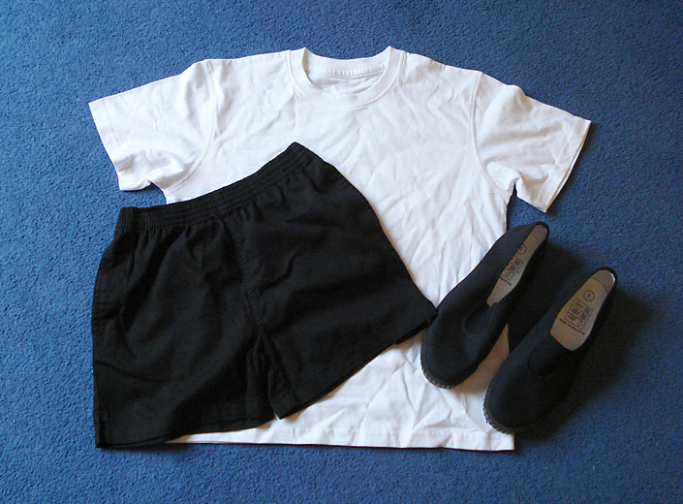
PE Kit
School T-shirt or plain white top
Black or navy-blue shorts or joggers
Black pumps/trainers
In the Autumn term children will resume their swimming lessons.

Slide 8
How can you help?
Reading! Please listen to your child read every day or allow them time to read. This is extremely important and will help to develop their reading and writing skills throughout the year.
Help your child to learn their spellings for their test every Monday. Spellings will be given out every Monday and tested the week after.
Support homework and home learning tasks.
Tell us if there are circumstances which may affect your child. We may be able to help.
Support us about homework club-

Slide 9
Home learning
We have a mixture of more traditional homework tasks and ‘home learning’ projects.
We have decided not to set formal written English homework this year. Key spellings for year 5 children will be available on the website.
To run alongside the topics we are covering in the foundation subjects children will have a home learning sheet with a range of activities to involve other family members.

Slide 10
Ability in reading has a huge impact on what children achieve in future – far more than economic background.
We ask that all children read at home at least three times a week.
This could be reading with an adult or by themselves but they must have an adult sign their reading record.
Children will receive merits for reading 3 times a week. Please record every time your child reads in their home readers. Star Reader!

Slide 11



Slide 12
How can we help?
We have a Twitter account! @bishoptonprim. You can get up to date information about events and pictures of the children also appear here.
Newsletters are sent out weekly electronically.
Parental information sheets are sent out termly with information about the new topics.

Slide 13
Still not sure?
Come and speak to us (we’re pretty friendly!)
Email us – email addressed will be sent on the termly letter

