Slide 1

Welcome to Year 6

Slide 2
Year 6 Staff
There will be two Year 6 classes this year:
Year 6G- Mrs Graver (class teacher) Teresa (class TA)
Year 6CJ Mrs Charman and Mrs Jones (class teachers) Maryna (class TA) Mrs. Lawrence (1:1)

Slide 3
What to Expect in Year 6
Expectations are high in Year 6 as this is the transitional year into secondary school: independence, responsibility and maturity are key.
Reading is paramount as we move towards secondary school expectations- children should be reading at least 3 times per week for 30 minutes to develop stamina and vocabulary.
Maths will involve reviewing, consolidating and exploring new fields, such as algebra. Maths homework will continue to be given on a weekly basis with the Schofield and Sims mental maths books.
Written work needs to be of a very high standard as all children are externally assessed before moving into secondary school.

Slide 4
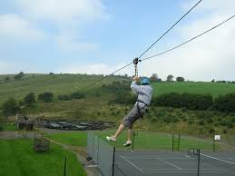
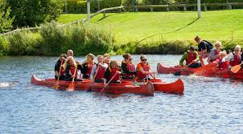
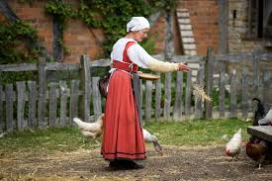

Exciting Opportunities
But it’s not all hard work!
We have already planned some amazing activities for Year 6 to be involved in:
Bellboating in September
The RSC’s production-BFG
A visit to Mary Arden’s Farm for a traditional Tudor Christmas
Year 6 residential trip to Red Ridge in the final summer term

Slide 5

Greater Responsibility
There are many responsibilities and privileges of being in Year 6.
Here are just some of them:
House Captains
Role Models
Reception readers
Maths Champions
And best of all…you get to sit on chairs in assembly!
This Photo by Unknown Author is licensed under CC BY-NC-ND

Slide 6
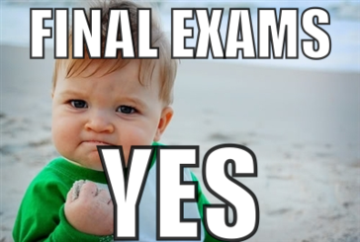
SATs Tests
Part of Year 6 involves sitting SATs tests in the second part of the Spring Term. These tests are an opportunity to consolidate all previous learning and to ensure children have a good working knowledge of maths and english skills which they can apply in test conditions.
The following areas are tested on different days during the period of one week in May:
Grammar, Punctuation and Spelling
Reading Comprehension
Arithmetic
Maths Reasoning

Slide 7

Any Questions?
Year 6 is always one of the busiest and most exciting years at primary school but it does fly past very quickly!
Is there anything you would like to ask about Year 6?

