Slide 1


Slide 3



1) Let’s count up in 5s
2) Which two numbers can you add together to make 4?
3) Which two tens can you add together to make 40?
4) The parcel’s mass is ___ grams

Slide 4
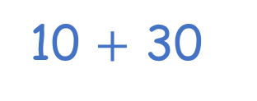

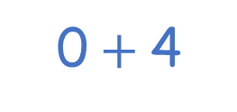
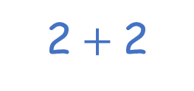
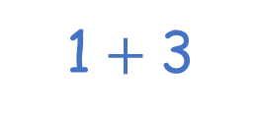
1) Let’s count up in 5s
2) Which two numbers can you add together to make 4?
3) Which two tens can you add together to make 40?
4) The parcel’s mass is ___ grams
0, 5, 10, 15, 20, 25, 30, 35, 40, 45 …
2$+$2
1$+$3
0$+$4
20 $+$ 20
10 $+$ 30
100

Slide 6


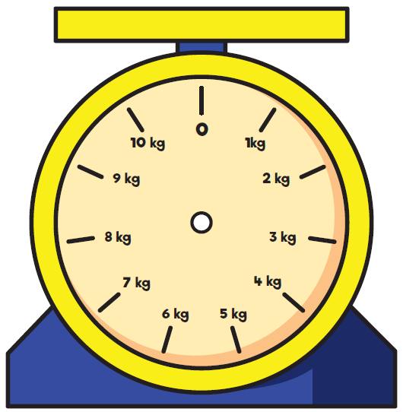
Notes:
Family going on holiday, they are measuring their luggae

Slide 7


Slide 8
Whose is heavier?

Slide 9
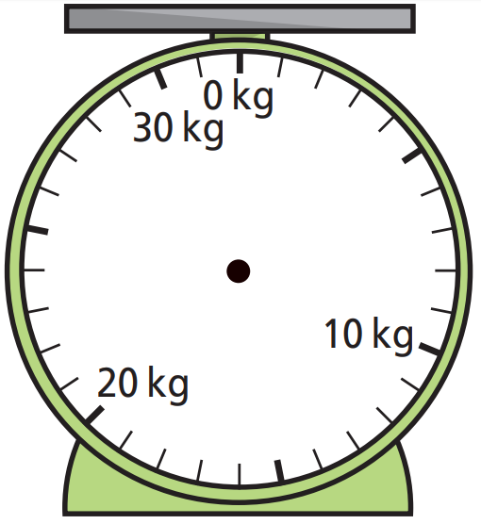



10 kg
Have a think

Slide 10
15 kg
Have a think

Slide 11
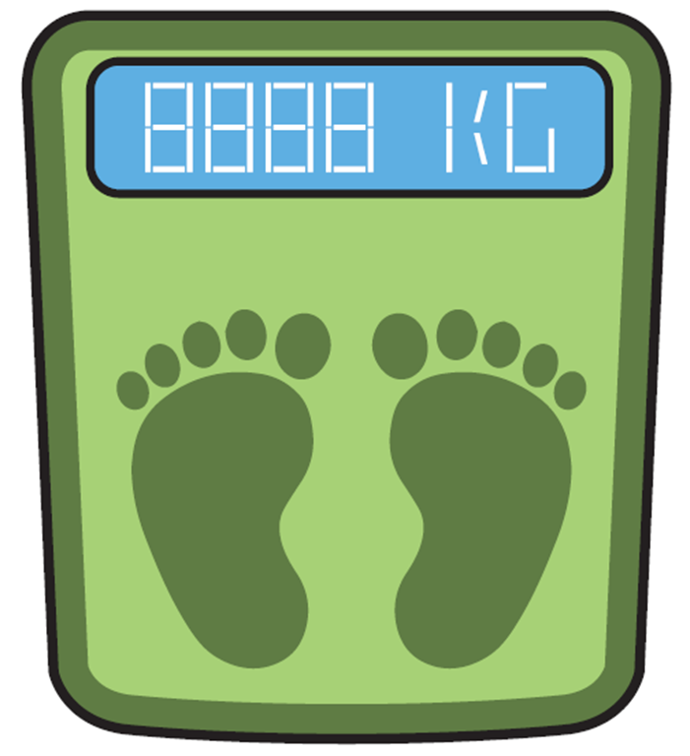
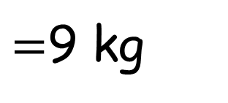
I must have a mass of 39 kg
You have a mass of 21 kg
Have a think
$=$9 kg

Slide 12

3 kg
4 kg
Have a think
5 kg
Notes:
She like the scales to say 30 too

Slide 13
Have a go at the questions on the worksheet

