Slide 1


Slide 3





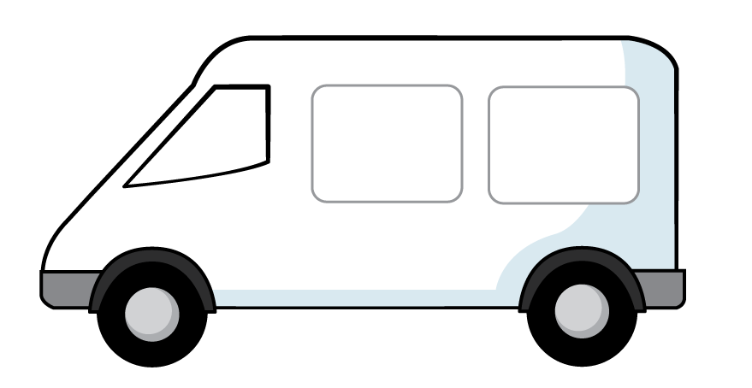
1) How do you spell 15 ?
2) What number comes next? 22, 23, __
3) What is this called?
4) The van’s mass is __ cubes

Slide 4
1) How do you spell 15 ?
2) What number comes next? 22, 23, __
3) What is this called?
4) The van’s mass is __ cubes
fifteen
24
triangle
5

Slide 6
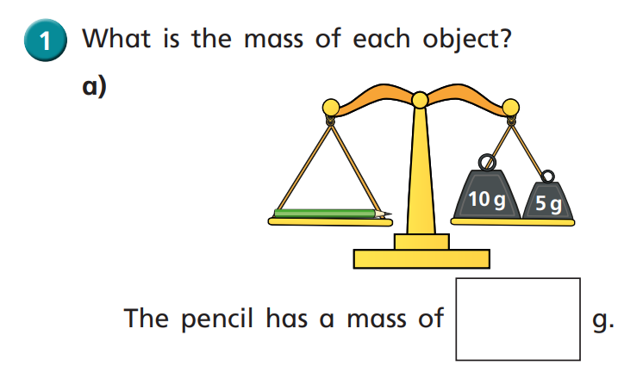

15
Have a think

Slide 7
Have a go at questions 1 and 2 on the worksheet

Slide 8
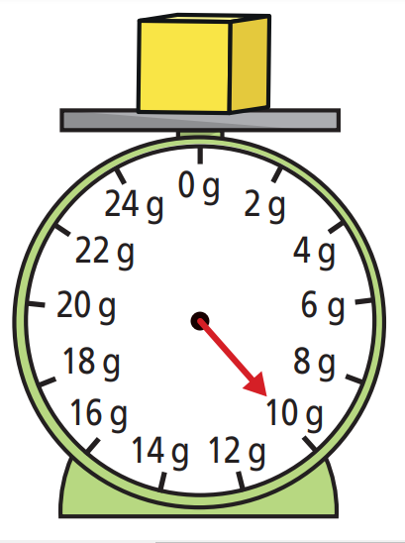
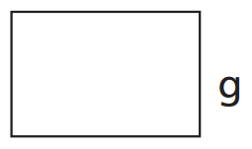
14
4
9

Slide 9
Have a go at questions 3, 4 and 5 on the worksheet

Slide 10
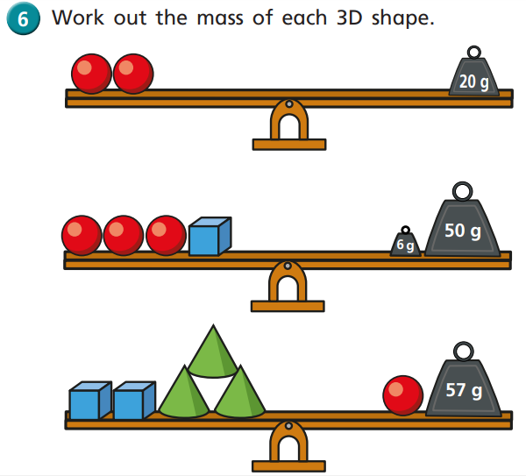
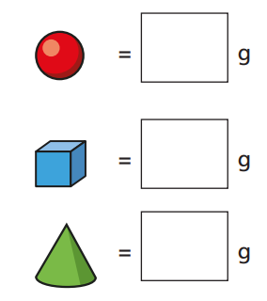
10 g
10 g
10
Have a think

Slide 11
Have a go at question
6 on the worksheet and then come back

Slide 12
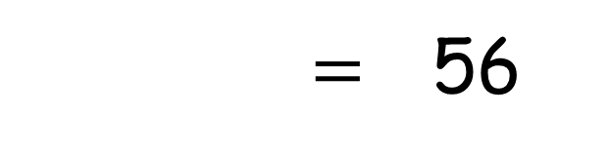
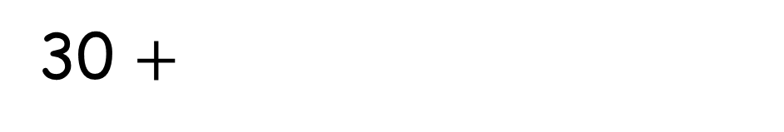
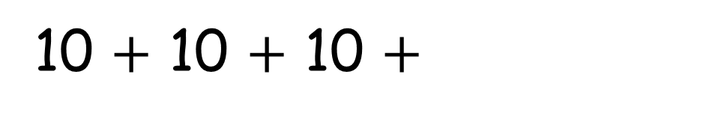
10 $+$ 10 $+$ 10 $+$
$=$ 56
30 $+$
20
10
26
Have a think
10
26

