Slide 1
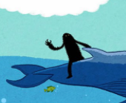
Literacy
Thursday 24th June
L.O. To plan a party for the Lonely Beast

Slide 2
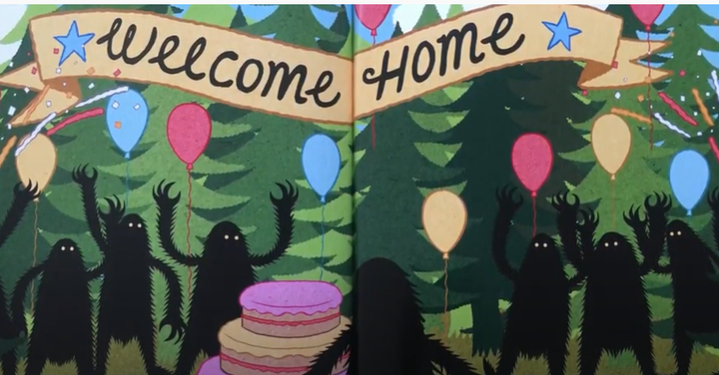
We are going to focus on the happy ending of our story.
The other beasts plan a surprise party for the Lonely Beast.
What can we see in the picture that shows that they are having a party?

Slide 3
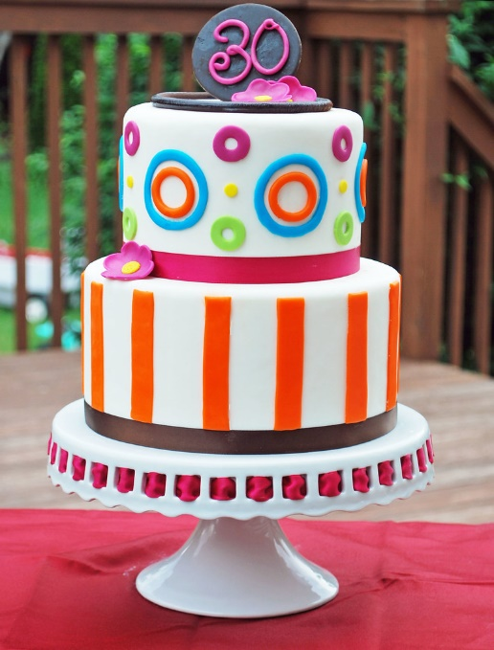

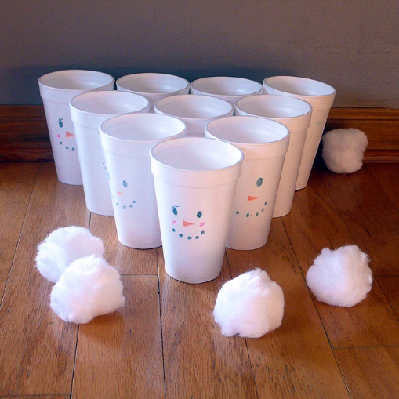
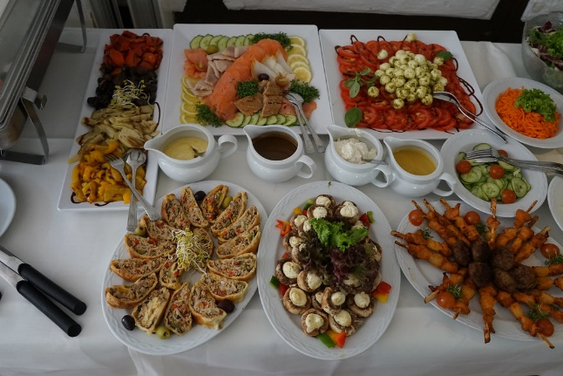
We are going to pretend to be the other beasts.
We will plan the party for the Lonely Beast.
What things will we need for the party?
Party cake
balloons and decorations
Party food
Party games and entertainment

Slide 4
We will need to write some lists of things we need.
How to write a list
Put a comma between items on your list.
Use ‘and’ between the last two items.
E.g.
Party Food
Sausages, crisps, sandwiches and pizza.

Slide 5
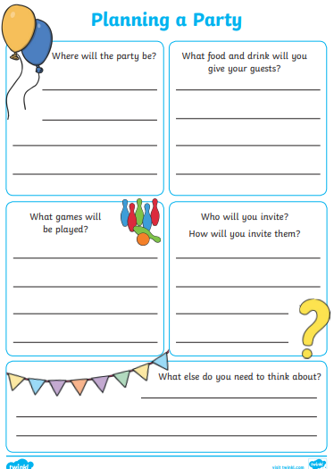
Your Task
Read the headings on the Party planner sheet.
Write in the boxes with either a full sentence or a list.
Remember to use commas and ‘and’ in your list.
Extension
If you finish your plan, design a cake for the party!

