Slide 1


Slide 3


1) How do you spell 14?
2) What number comes next? 31, 30 ___
3) What is this shape called?
4) Tiny has a mass of __

Slide 4
1) How do you spell 14?
2) What number comes next? 31, 30 ___
3) What is this shape called?
4) Tiny has a mass of __
fourteen
29
cuboid
2

Slide 6
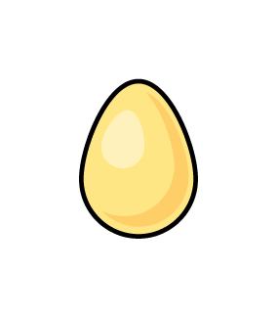
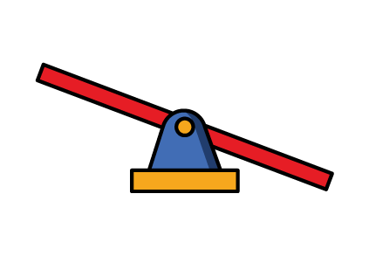
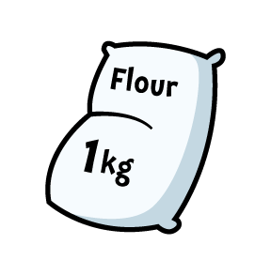
Lighter
Heavier
Notes:
Jack has built some towers using cubes. Let’s have a look.
How many towers has he built? Well there are 1, 2, 3, 4 towers
Jack hs built 4 towers
How many cubes are there in each tower? Well there are 1, 2, 3, 4, 5 cubes in each tower
So how many towers has Jack usef in total? Well there are 4 towers with 2 cubes in each tower, so Jack has used 2, 4, 6, 8 cubes
Did you see how I used my 2 times-table to help me then? Counting in 2s is rsally useful.
We can write this as a multiplication sentence. Something multiplied by something is equal to something.
Well Jack built 4 towers with 2 cubes in each tower and he used 8 cubes in total. So 4 multiplied by 2 is 8
OR
We can also write this as 2 multiplied by 4 is equal to 8

Slide 7


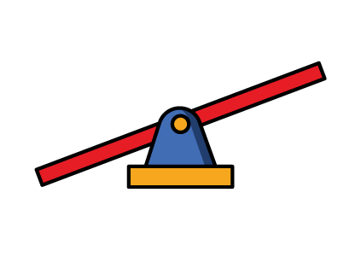
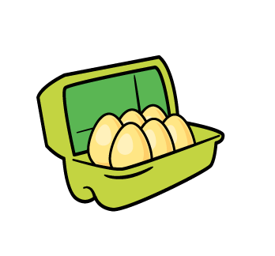
Lighter or heavier
What do you notice?
The eggs are heavier than the cherries.
Notes:
Whitney has also been building towers using cubes. Let’s havwe a look.
Pause the video here and see if you can answer these questions.
How did you get on?
Did Whitney use more or less cubes than Jack? That’s right she used less cubes because she built less towers

Slide 8
Lighter or heavier
Have a think
The cherries are lighter than the eggs.
Notes:
Whitney has also been building towers using cubes. Let’s havwe a look.
Pause the video here and see if you can answer these questions.
How did you get on?
Did Whitney use more or less cubes than Jack? That’s right she used less cubes because she built less towers

Slide 9
Have a go at questions 1 and 2 on the worksheet

Slide 10


How many cubes?
Have a think
Eva is heavier than 1 cube.
Notes:
Whitney has also been building towers using cubes. Let’s havwe a look.
Pause the video here and see if you can answer these questions.
How did you get on?
Did Whitney use more or less cubes than Jack? That’s right she used less cubes because she built less towers

Slide 11

Eva is heavier than 2 cubes.
Notes:
Whitney has also been building towers using cubes. Let’s havwe a look.
Pause the video here and see if you can answer these questions.
How did you get on?
Did Whitney use more or less cubes than Jack? That’s right she used less cubes because she built less towers

Slide 12


Eva is heavier than 4 cubes.
Notes:
Whitney has also been building towers using cubes. Let’s havwe a look.
Pause the video here and see if you can answer these questions.
How did you get on?
Did Whitney use more or less cubes than Jack? That’s right she used less cubes because she built less towers

Slide 13
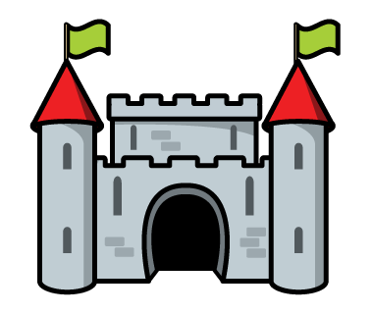

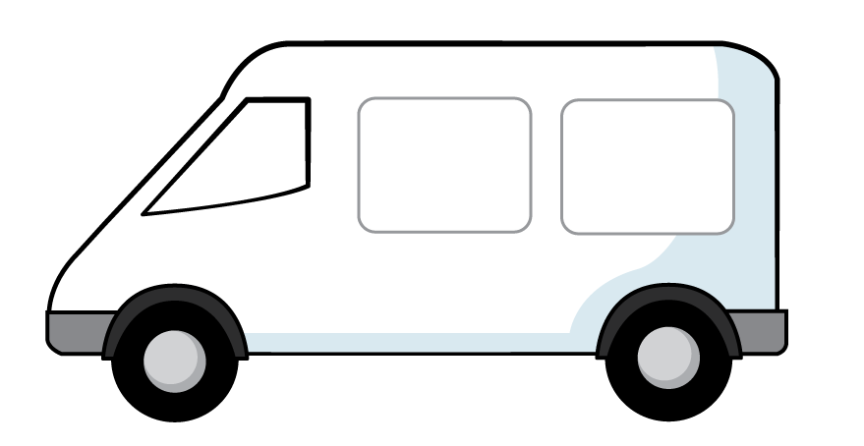
Have a think
The castle’s mass is 2 cubes.
The van’s mass is 5 cubes.
Notes:
Which object is heavier?

Slide 14
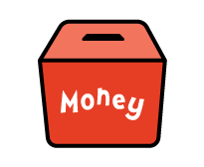

Have a think
The money box’s mass is 4 cubes.
The vase’s mass
is 6 cubes.
Notes:
Whitney has also been building towers using cubes. Let’s havwe a look.
Pause the video here and see if you can answer these questions.
How did you get on?
Did Whitney use more or less cubes than Jack? That’s right she used less cubes because she built less towers

Slide 15
The van and vase together have the same mass as Eva.
Notes:
Whitney has also been building towers using cubes. Let’s havwe a look.
Pause the video here and see if you can answer these questions.
How did you get on?
Did Whitney use more or less cubes than Jack? That’s right she used less cubes because she built less towers

Slide 16
Notes:
Blocks keep falling off so he trys to find some heavier blocks

Slide 17
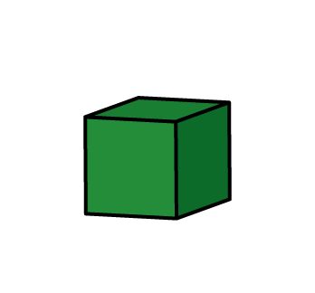
1 green block has the same mass as 5 cubes.
What do you notice?
Have a go
2 green blocks have the same mass as 10 cubes.
Notes:
Blocks keep falling off so he trys to find some heavier blocks

Slide 18
Have a think
Notes:
Blocks keep falling off so he trys to find some heavier blocks

Slide 19
Notes:
Blocks keep falling off so he trys to find some heavier blocks

Slide 20
Have a go at the rest of the questions on the worksheet

