Slide 1
LO: To create your very own clay ‘wave’ model.
Tuesday 23rd June 2021

Slide 2
Take a look at these clay models.
Which is your favourite?
Why do you like it?
How do you think the artist has created the effects?
How are some of the models similar?
How are some of the models different?

Slide 3
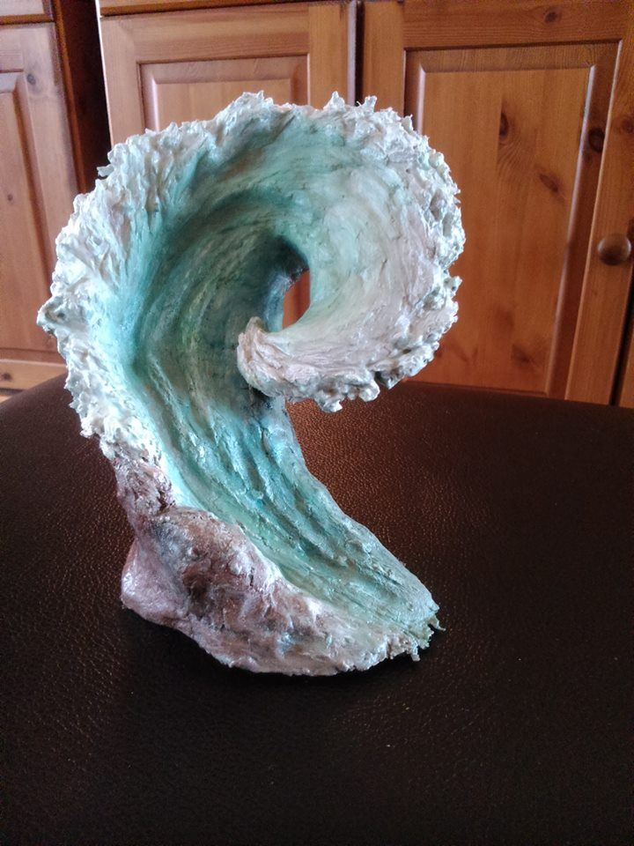
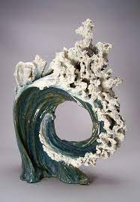
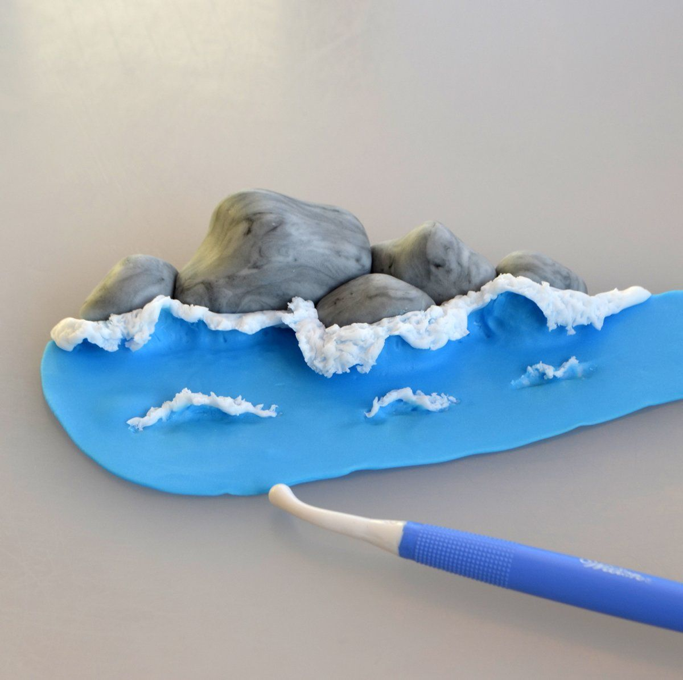
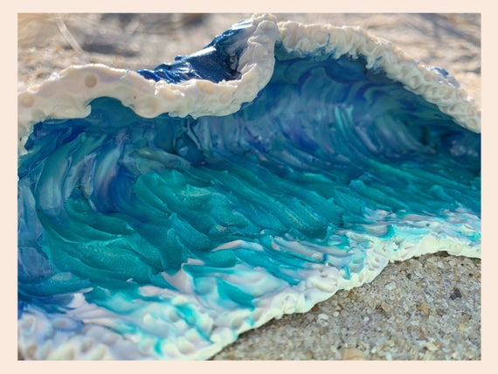
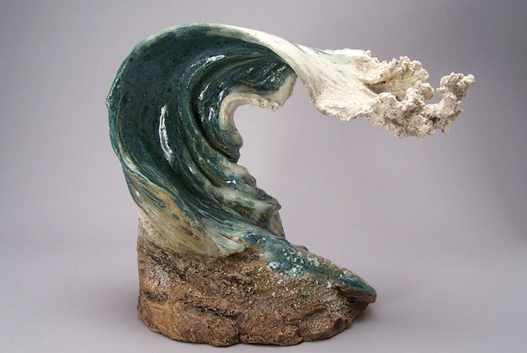

Slide 4
How will you create the effects?
What colours will you use?
Will you use flat textures or rough?
Your Task:
Have a look at these models. Your task is to create your own model using clay. Think about textures, style and any details you wish to add.
You will get a chance to paint your model properly next week!

Slide 5
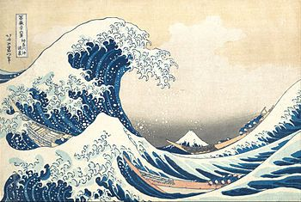
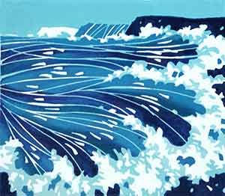
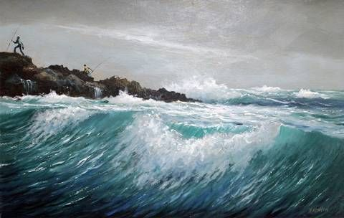
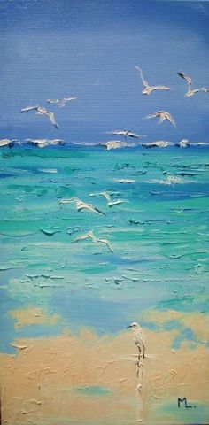
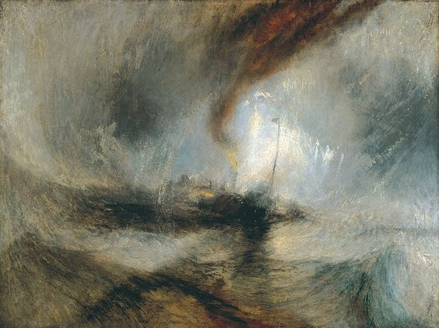
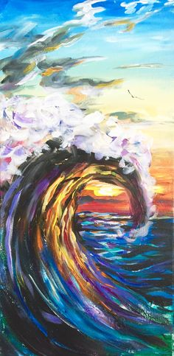
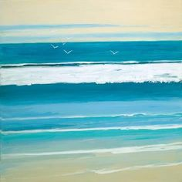
How will you create the effects?
Your Task:
Have a look at these paintings. Your task is to sketch your ideas for your own painting. Think about colour, style and any details you wish to add.
You will get a chance to paint your picture properly next week!
Will you use flat textures or rough?
What colours will you use?

