Slide 1


Slide 3

1) How do you spell 6?
2) What number comes next? 48, 49, __
3) What is this called?
4) Can you think of a heavy animal?

Slide 4
1) How do you spell 6 ?
2) What number comes next? 48, 49, __
3) What is this called?
4) Can you think of a heavy animal?
six
50
cube
Elephant, Giraffe, Hippopotamus, Whale

Slide 6
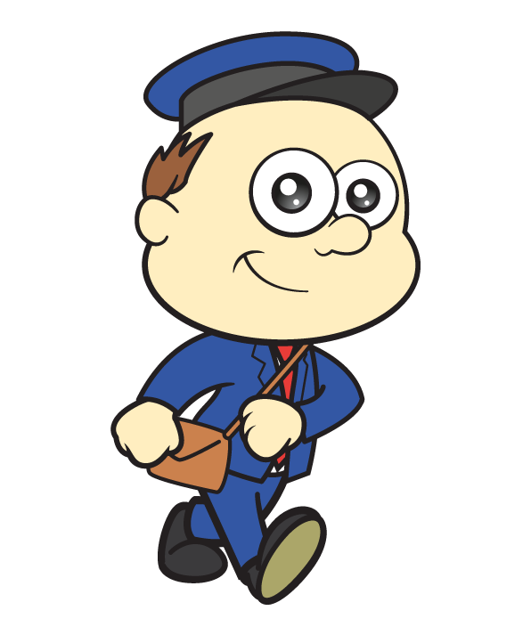
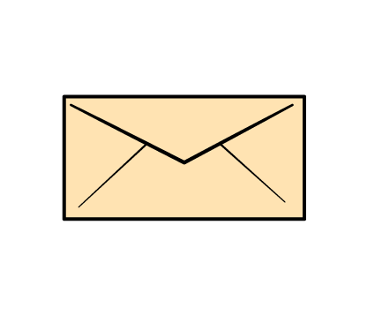
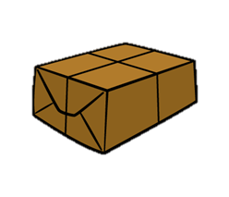
Let’s talk about mass
Lighter

Slide 7
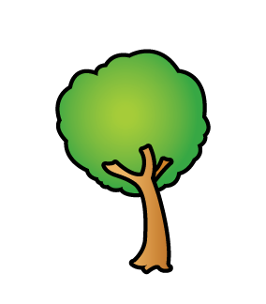

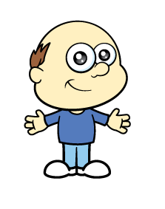
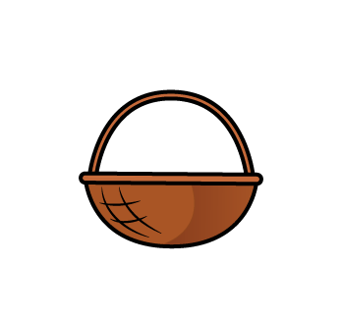
Let’s talk about mass
Heavier

Slide 8
Find a basket or a bucket.
Can you make it heavier and then lighter?

Slide 9

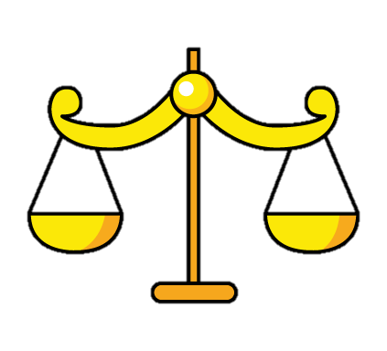
How can we measure mass?
We can use a balance scale.

Slide 10

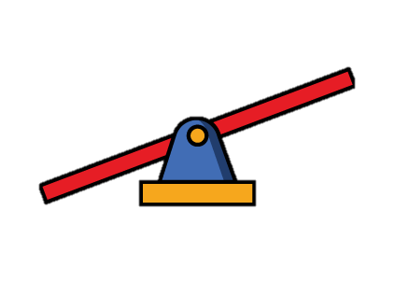
Have a think
Let’s measure mass.

Slide 11
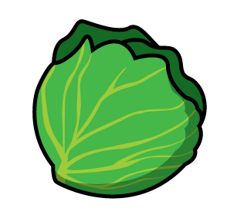
Let’s measure mass.

Slide 12
Let’s compare mass.
The is heavier than the
The is lighter than the

Slide 13


Have a think
The scale is balanced!
The has the same mass as the

Slide 14
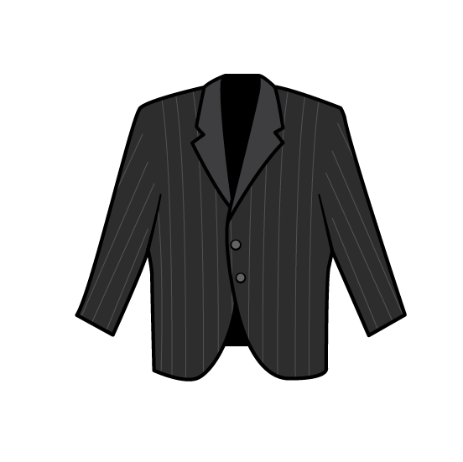
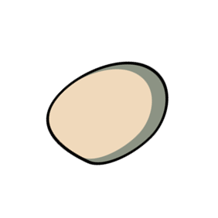
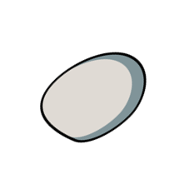
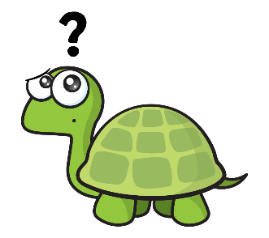
Have a think
Which parcel is heavier?

Slide 15
Can you find two objects?
Which one is heavier?

Slide 16

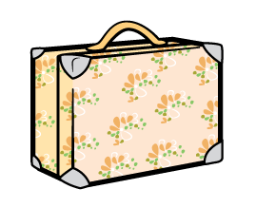
Which case is heavier?
is heavier than

Slide 17
Which case is lighter?
is lighter than

Slide 18
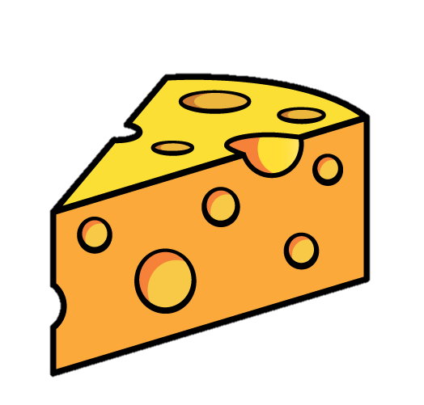
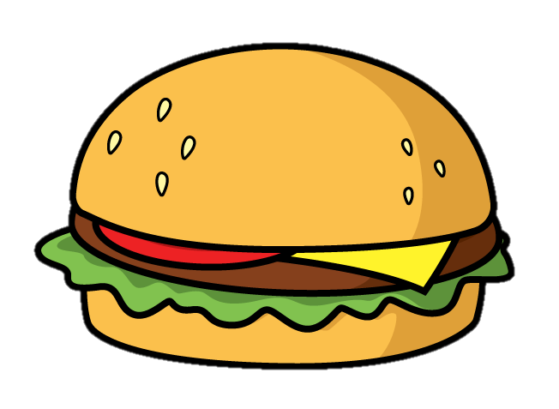
When the scale is balanced…
The objects have the same mass.

Slide 19
Have a go at questions 1 and 2 on the worksheet

Slide 20
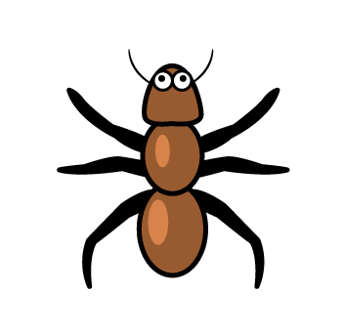

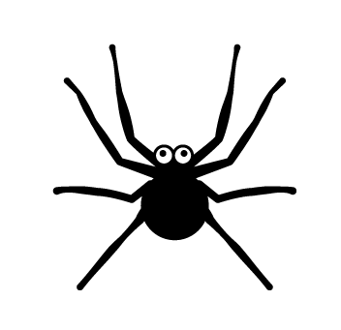
Have a think
What does the scale tell you?
The is heavier than the

Slide 21
Have a think
What does the scale tell you?
The is lighter than the

Slide 22
Have a think
What does the scale tell you?
The has the same mass as the

Slide 23
Have a go at question 3 on the worksheet

Slide 24
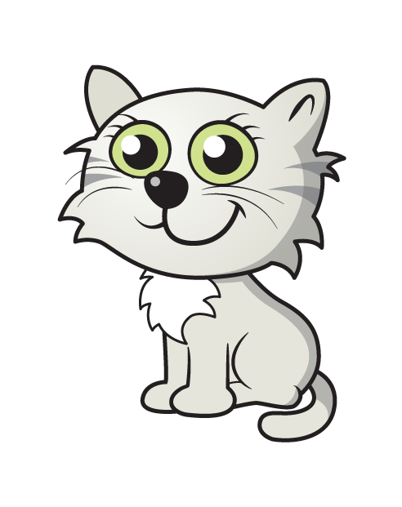
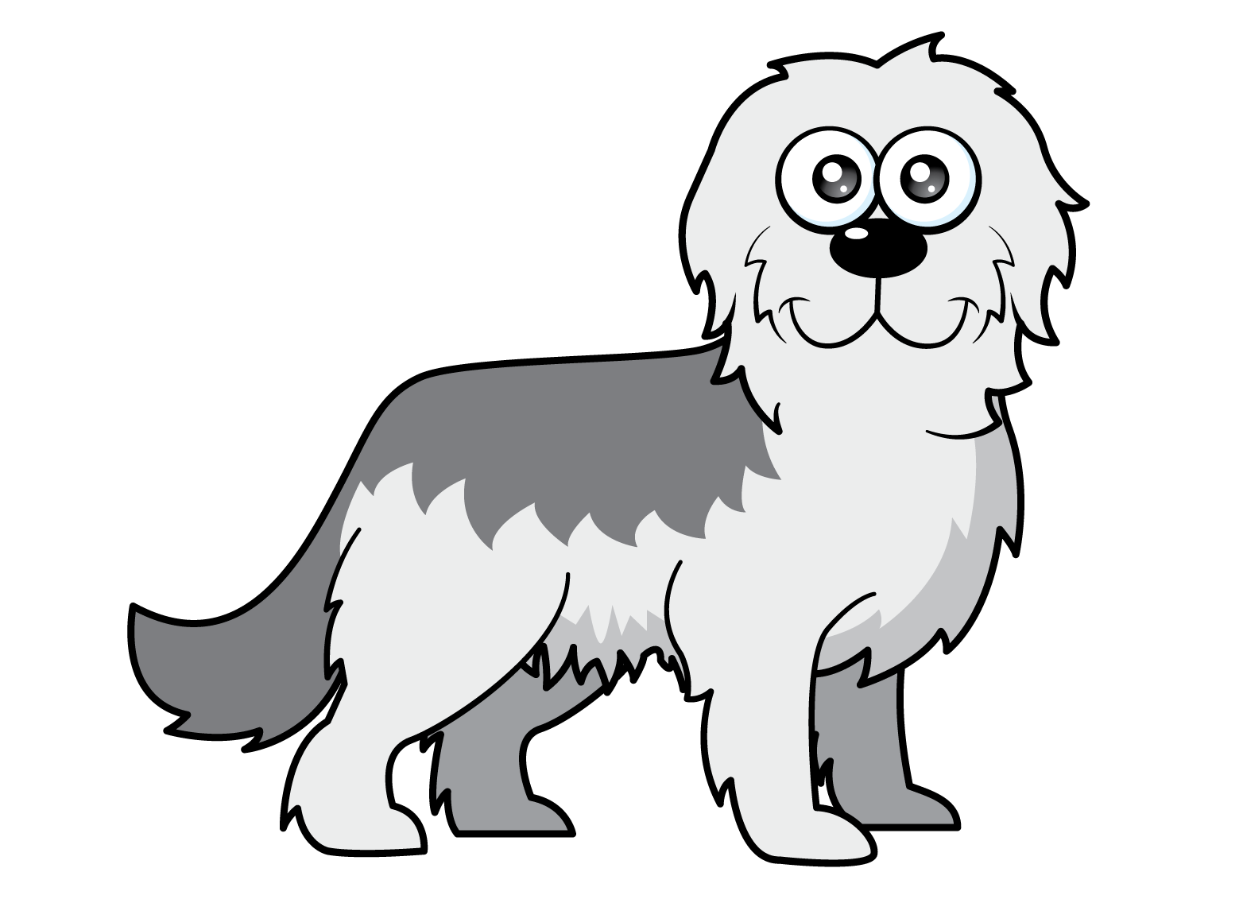
What do you think?
The is heavier than the

Slide 25
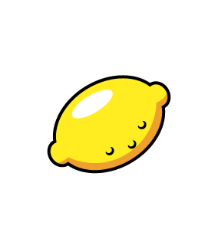
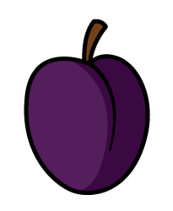
What do you think?
The has the same mass as the

Slide 26
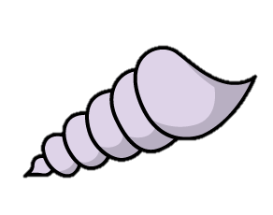
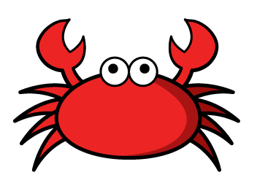
What do you think?
The is lighter than the

Slide 27
Have a go at question 4 on the worksheet

