Slide 1


Slide 3
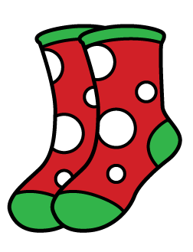
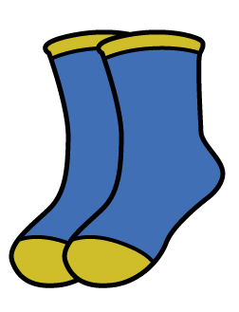
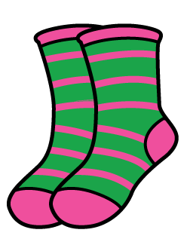
Which pair of socks has
1) Completed a full turn?
2) Completed a half turn?
3) Completed a quarter turn?

Slide 4
Which pair of socks has
1) Completed a full turn?
2) Completed a half turn?
3) Completed a quarter turn?

Slide 6
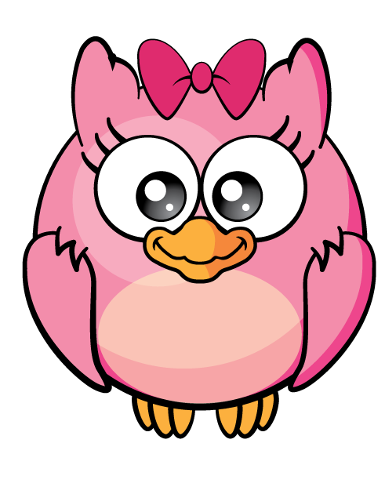

What’s different?

Slide 7
What’s different?

Slide 8
What’s different?

Slide 9
What’s different?

Slide 10
Have a go at question 1 on the worksheet

Slide 11
What’s different?
Anti-clockwise
A quarter turn

Slide 12
What’s different?
Anti-clockwise
A quarter turn

Slide 13

What’s different?
Have a think

Slide 14
Have a go at the rest of the questions on the worksheet

