Slide 1


Slide 3
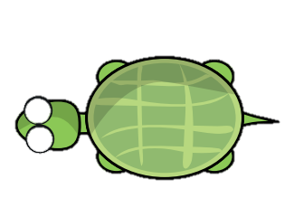

Will Tiny make these movements? or
1) A quarter turn clockwise 2) A half turn
3) A quarter turn anti-clockwise 4) A full turn

Slide 4
Will Tiny make these movements? or
1) A quarter turn clockwise 2) A half turn
3) A quarter turn anti-clockwise 4) A full turn

Slide 6

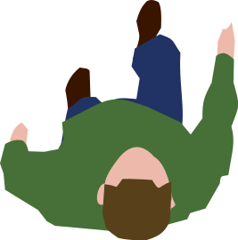

Slide 7


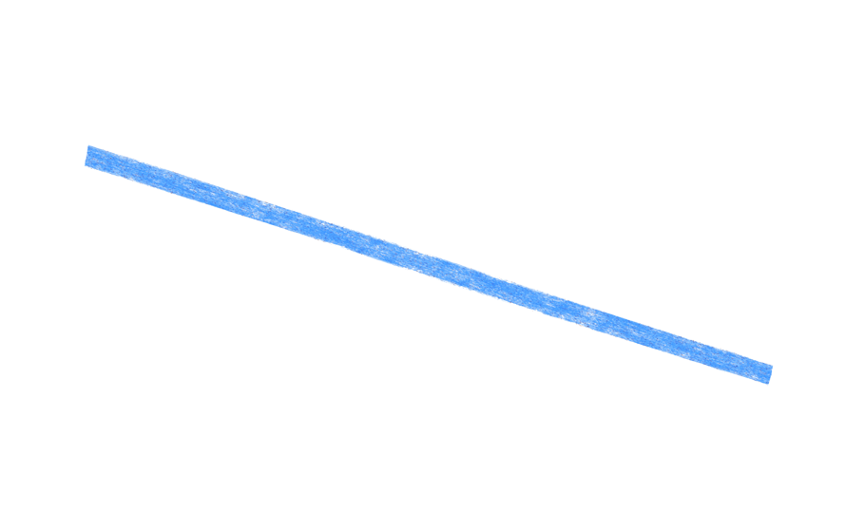
He’s turned clockwise
He’s turned right

Slide 8
A half turn clockwise
A full turn clockwise
A half turn clockwise

Slide 9
A three-quarter turn clockwise
A three-quarter turn right

Slide 10


A full turn anti-clockwise
A full turn clockwise
A full turn left
Have a go

Slide 11
Have a go at questions 4 and 5 on the worksheet

