Slide 1
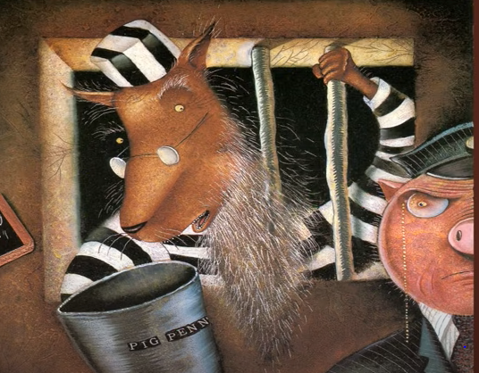
How did you get the cold?
It was a chocolate rabbit cake.
What sort of cake did you make?
The pigs died in their houses.
How did the pigs die?
I got the cold after a run in the rain.

Slide 2
How did you get the cold?
What sort of cake did you make?
How did the pigs die?

Slide 3
How did you get the cold?

