Slide 1


Slide 3

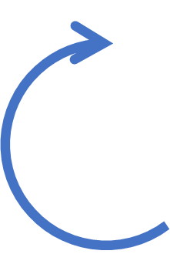

Clockwise or Anti-clockwise?
1)
2)
3)
4)
5)

Slide 4
Clockwise or Anti-clockwise?
Anti-clockwise
Anti-clockwise
1)
2)
3)
4)
5)
Clockwise
Clockwise
Anti-clockwise

Slide 6
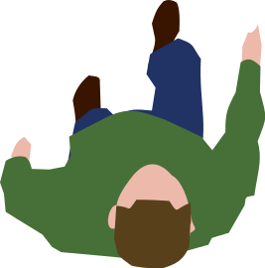
The person has done a turn.
full

Slide 7
The person has done a turn.
half

Slide 8
The person has done a turn.
half
Notes:
If he starts facing the table

Slide 9
The person has done a turn.
full
Notes:
If he starts facing the table

Slide 10
The person has done a turn.
half
Notes:
If he starts facing the table

Slide 11
The person has done a turn.
half
Notes:
If he starts facing the table

Slide 12
The person has done a turn.
quarter
Notes:
If he starts facing the table

Slide 13

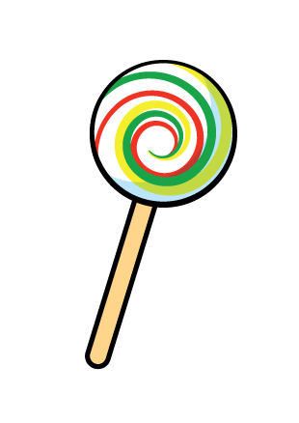
Amir says this lollypop has done a full turn.
Before
After
The lollypop has done a full turn.
Notes:
If he starts facing the table

Slide 14
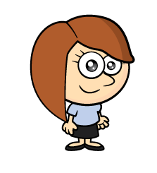
Rosie says this lollypop has done a full turn.
The lollypop has done a half turn clockwise.
The lollypop has done a half turn.
Notes:
If he starts facing the table

Slide 15
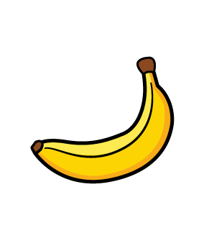
Before
After
The banana has done a half turn anti-clockwise.
Notes:
If he starts facing the table

Slide 16
Have a go at questions 1, 2 and 3 on the worksheet

Slide 17
If you feel really confident have a go at question 4 on the worksheet

Slide 18
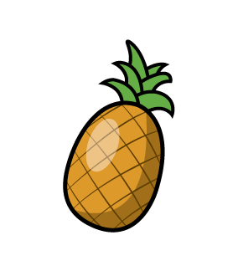
Before
After
The pineapple has done a three-quarter turn anti-clockwise.
The pineapple has done a quarter turn clockwise.

Slide 19
Have a go at question 4, 5 and 6 on the worksheet

Slide 20
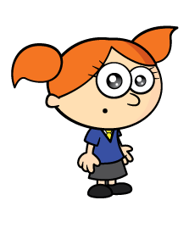
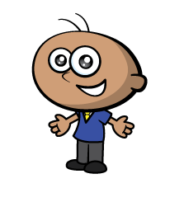

Before
After
A half turn anti-clockwise.
A half turn clockwise.
Have a think
Notes:
If he starts facing the table

Slide 21
Before
After
A quarter turn anti-clockwise.
A three-quarter turn clockwise.
Have a think
Notes:
If he starts facing the table

Slide 22
If you feel really confident have a go at question 6 on the worksheet

Slide 23
Before
After
A quarter turn?
A half turn?
A three-quarter turn?
A full turn clockwise?
A full turn.
A full turn anti-clockwise?
Notes:
If he starts facing the table

Slide 24
Have a go at question 6 on the worksheet

