Slide 1
MOnday 11th January 2021 Topic Session 1
LO: TO DESIGN YOUR OWN INSTRUMENT USING THINGS IN YOUR HOUSE.

Slide 2
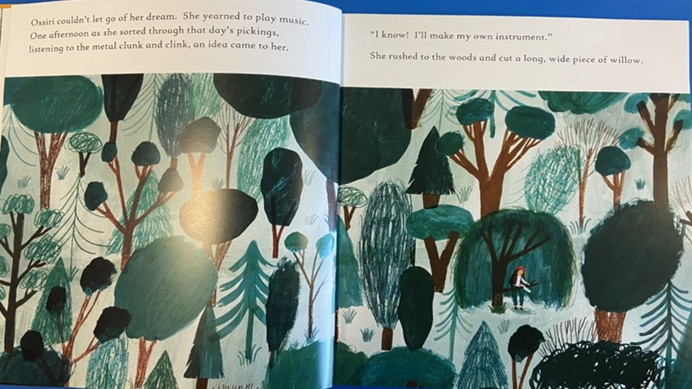
In Ossiri and the Bala Mengro, Ossiri designs and makes her own instrument out of things she finds around her.

Slide 3
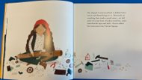
Think about things in your house you could use to make your own instrument...
Things you were going to recycle, old boxes, plastic bottles, card, coffee tins.
Elastic bands, rice to make shakers! You can use anything, just like Ossiri!
We would love to see your designs for an instrument.
Use the design sheet available on the next page or just use a blank piece of paper.

Slide 4
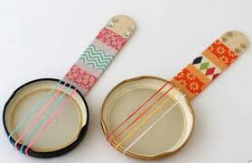
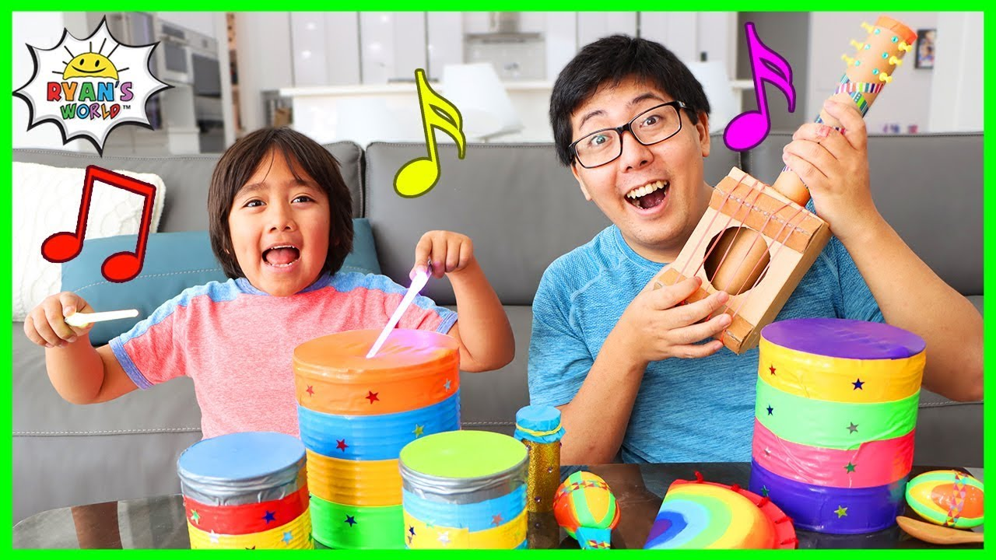
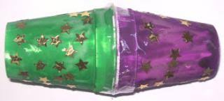
Here are a couple of ideas to inspire you!
Mini Banjos and Shaker
Ryan's World Instruments for Kids

Slide 5
Monday 11th January 2021
LO: To Design an instrument.
- Draw and label your design showing the parts of the instrument and what it might be made from. Eg. Strings to be made out of elastic bands.

