Slide 1
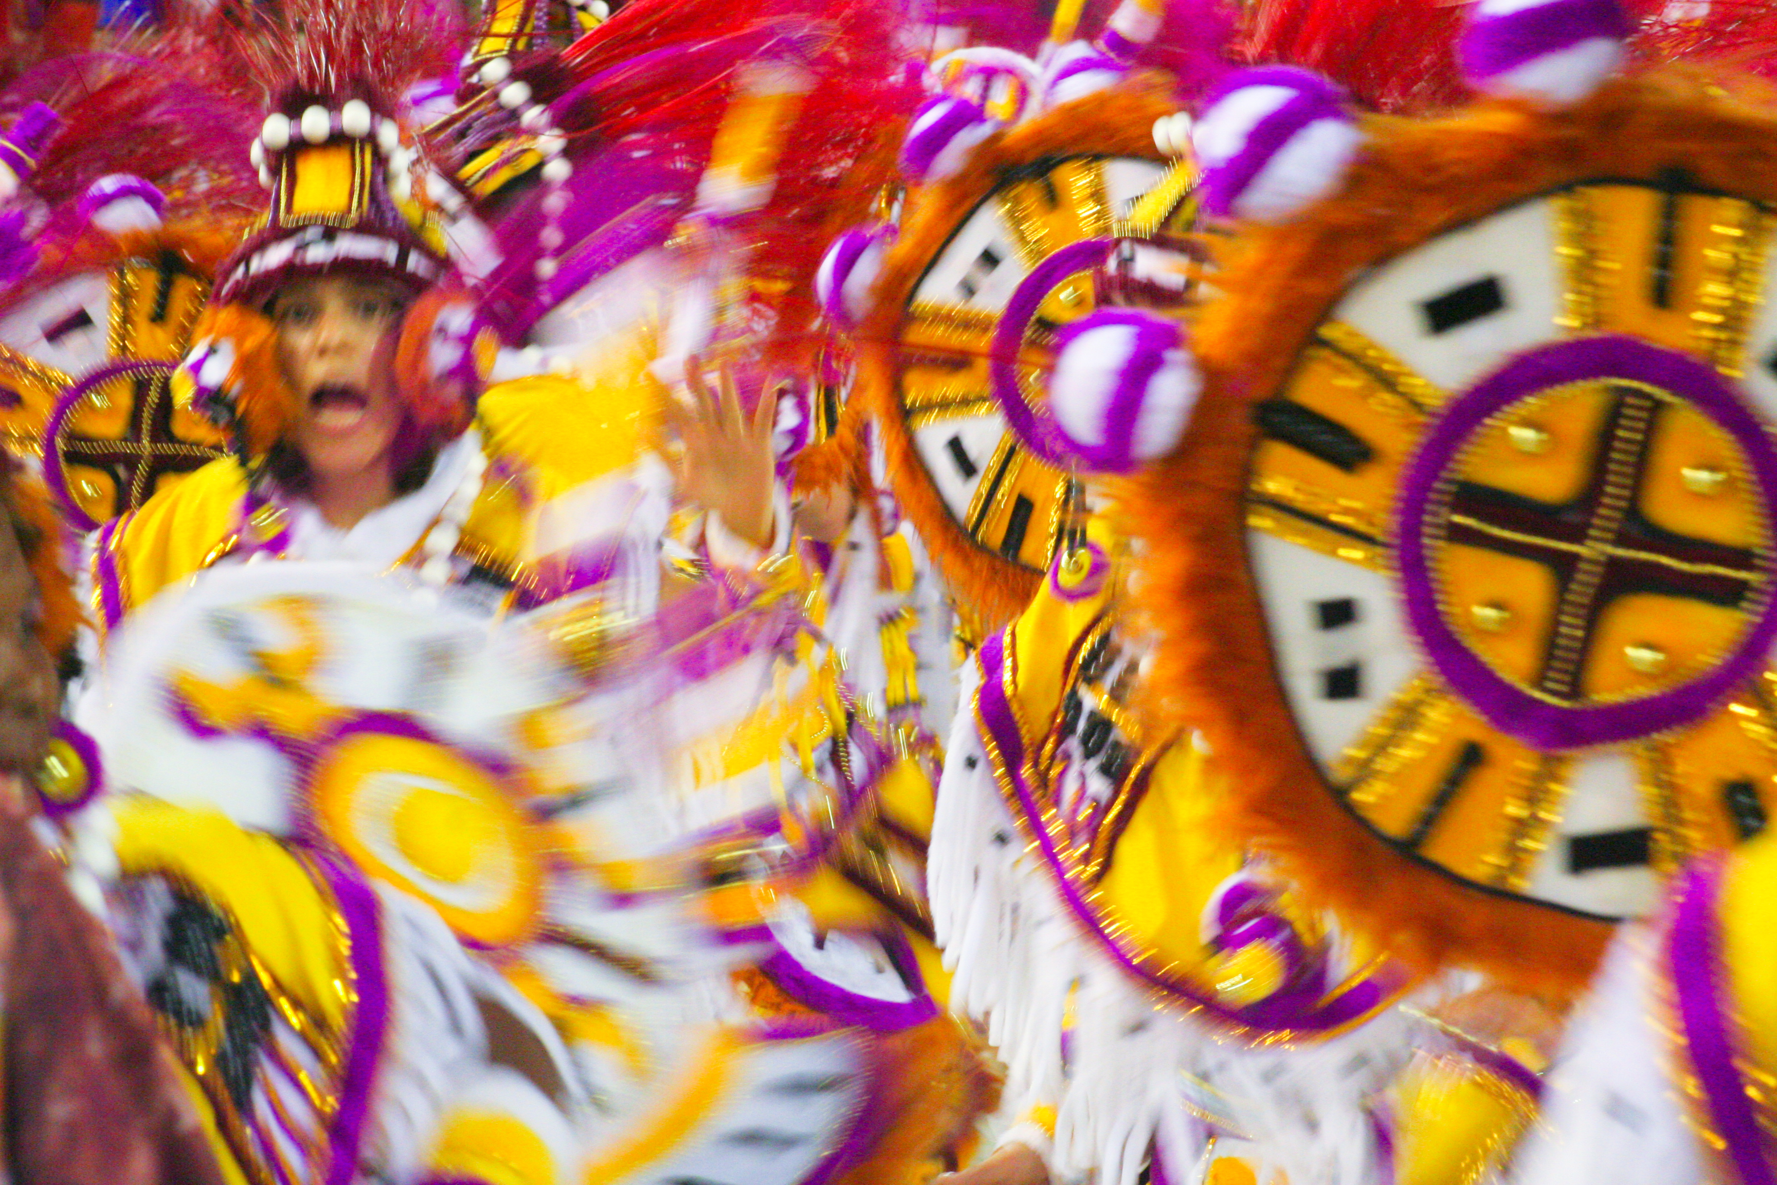
Thursday 14th January 2021
Topic - Geography
LO: To write a postcard from the Carnival in Rio de Janeiro.

Slide 2
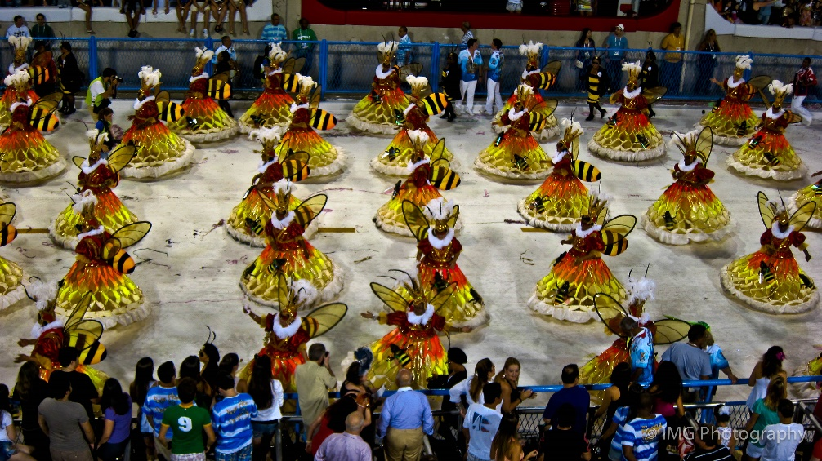
Your Task
Find out about the famous Carnival in the city of Rio de Janeiro in Brazil.
Can you imagine you have been to the Carnival?
Write a postcard to send home to tell your family about it.

Slide 3
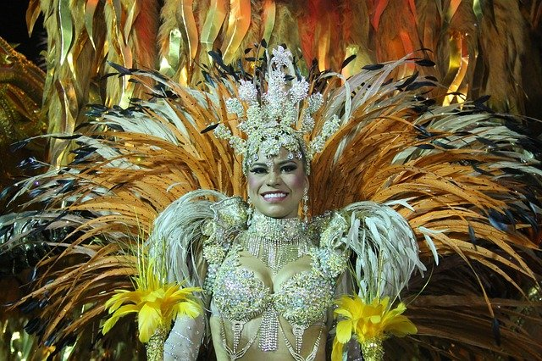
Here are some useful online links.
Cbeebies: Go Jetters Series 1 Episode 29. Rio de Janeiro, Brazil
Youtube
Brazil Carnival: The Rio de Janeiro parade in 1 minute
https://www.youtube.com/watch?v=Py0Tl2PvlJo
Carnival Rio de Janeiro Stunning Parade!
https://www.youtube.com/watch?v=kTc3pv7d5vY
Carnaval de Rio de Janeiro
https://www.youtube.com/watch?v=f2IpnYqoP-Q

Slide 4
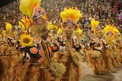
What to describe in your postcard:
What is a carnival?
What is the name of the special music at the carnival?
What instruments can you hear?
Which costumes do you like?
What would it be like to be there?

Slide 5
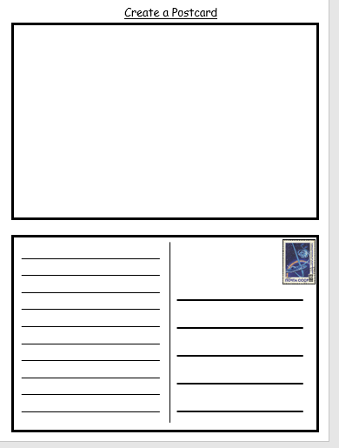
How to write your postcard. This template below is available in the Teams in Files, and it is on the class pages of the school website. You can also just create your own to avoid printing.
Draw a picture of the Carnival.
Who are you sending your postcard to?
Describe the Carnival.

