Slide 1
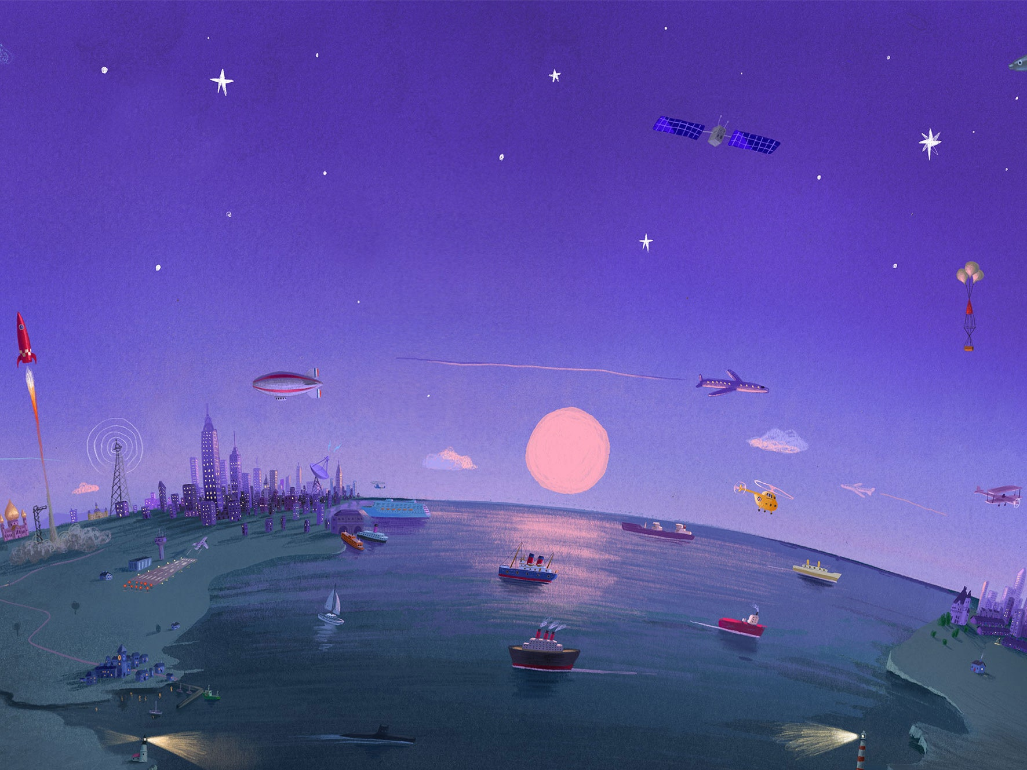
PSHE: Here we are By Oliver Jeffers.

Slide 2
Watch the story being read
https://www.youtube.com/watch?v=kkcjKbbF9JA

Slide 3
In the story we learn about all different aspects of living on planet Earth.
We have talked in class before about the different ways we can protect and take care of the Earth. Can you remember any?
Reuse e.g. shopping bags.
Recycle
Save water
Turn off switches

Slide 4


We have previously looked at environmentalists like David Attenborough and Greta Thunberg who prove it doesn’t matter how old you are you can still make a difference.

Slide 5
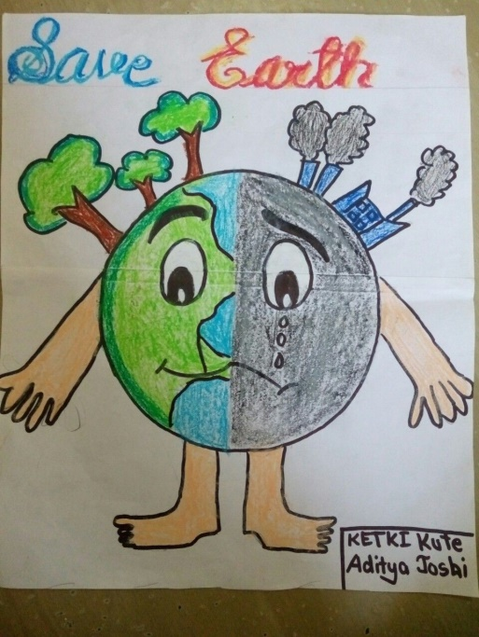
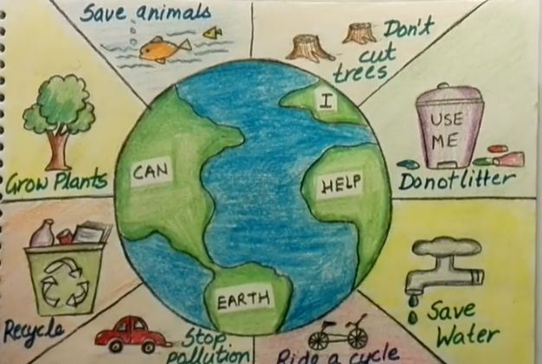
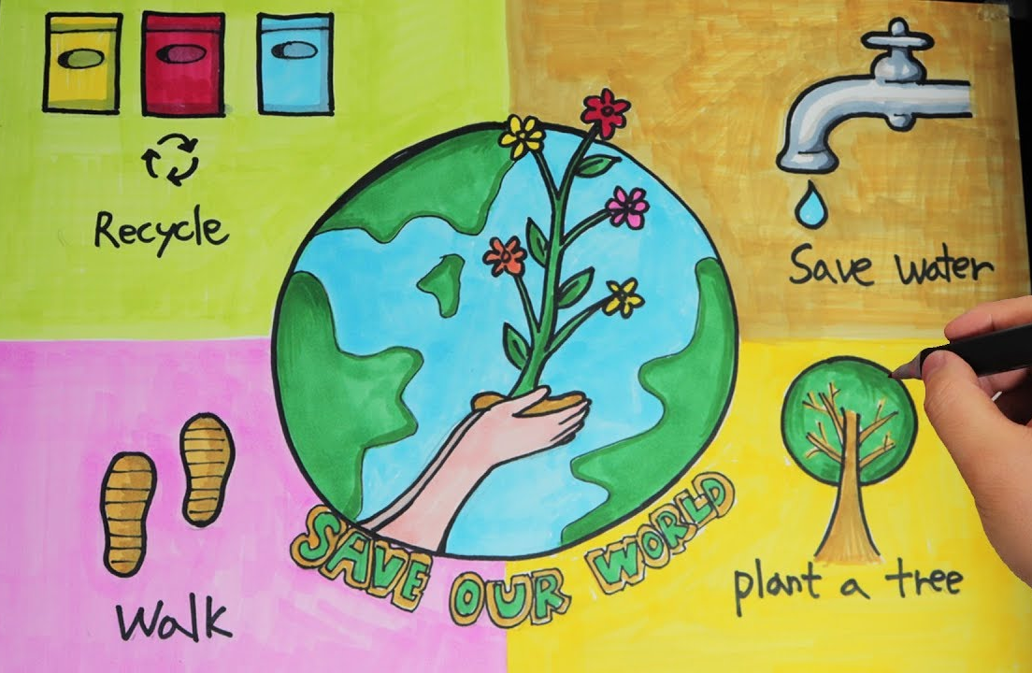
Your task
Create a poster showing how we can save the planet.

