Slide 1
Tuesday 12th January 2021
LO: To imagine what a character is like based on the words used to describe them by the author.

Slide 2

Read pages 13 to 17.
Think about the descriptions of the ogre.
Q. Can you remember what an adjective is?
Q. What adjectives (describing words) do you recognise?

Slide 3
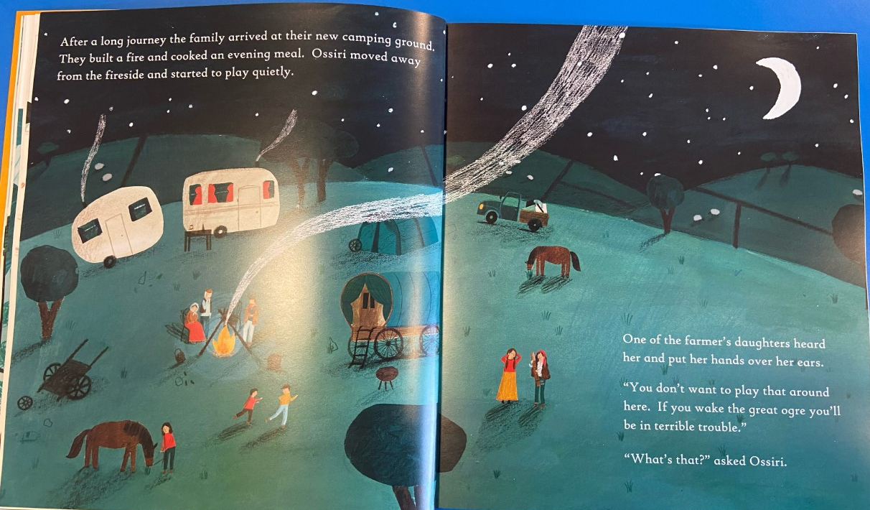
14
13

Slide 4
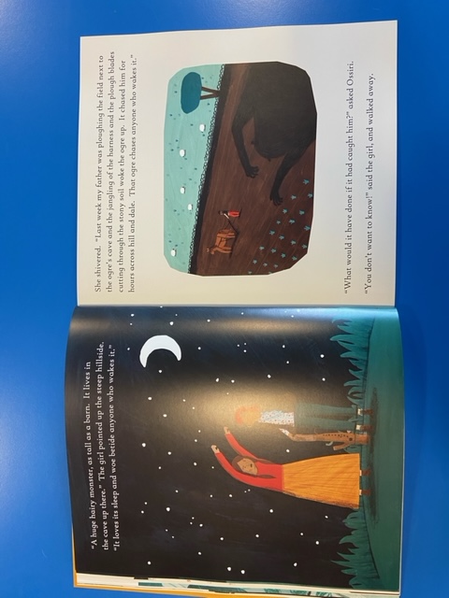
15
16

Slide 5
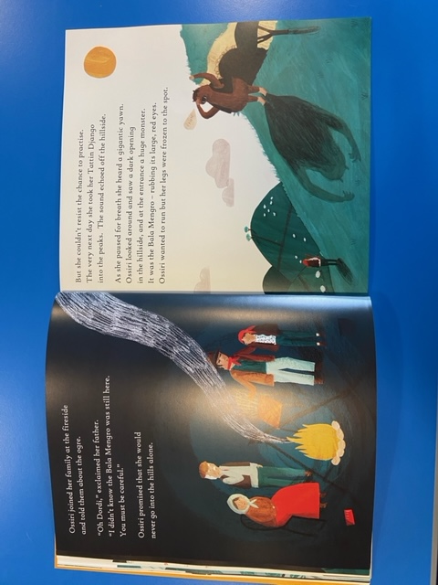
17

Slide 6
Your Task Today
First read pages 13 to 17 of ‘Ossiri and the Bala Mengro’.
Think about the adjectives used to describe the ogre.
Using the words the local people use to describe the ogre draw and label what you think the ogre is like.
Afterwards use adjectives and similes to write your own description of the ogre.
E.g. The ogre is as wide as a mountain (simile) and has a menacing (adjective) stare.

