Slide 1
Monday 11th January 2021
LO: To create a comic strip and use speech bubbles

Slide 2
Read the Book to page 10.
Talk about reactions of family and friends.
Q. What did they think of her music?
Q. Were they kind with their reactions?

Slide 3
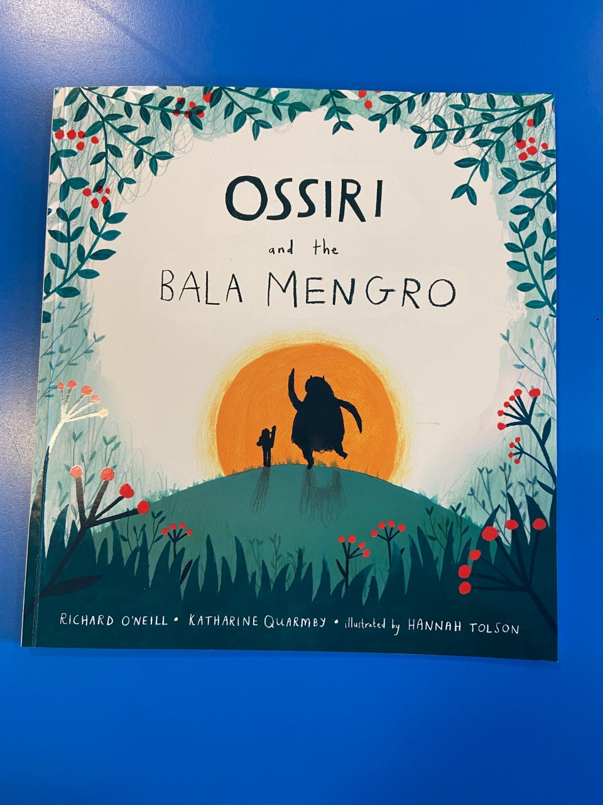

Slide 4
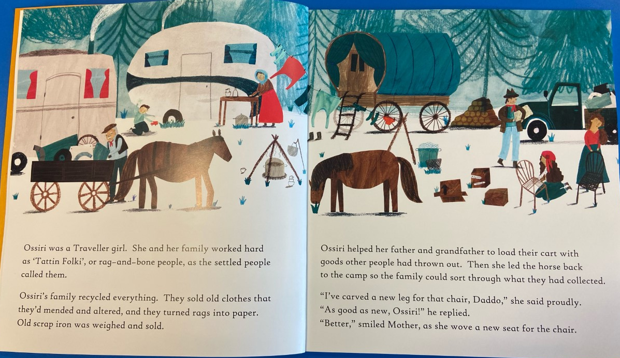

Slide 5
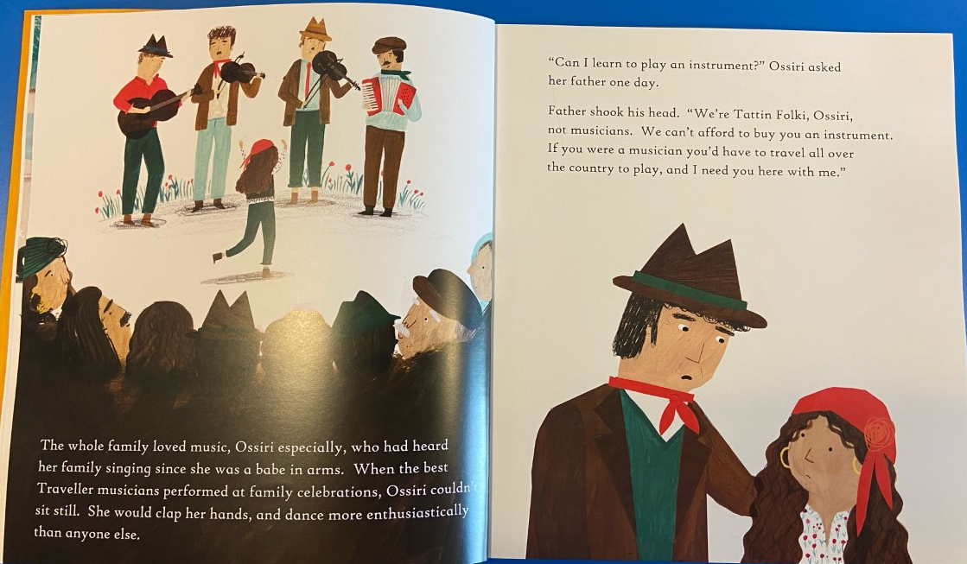

Slide 6
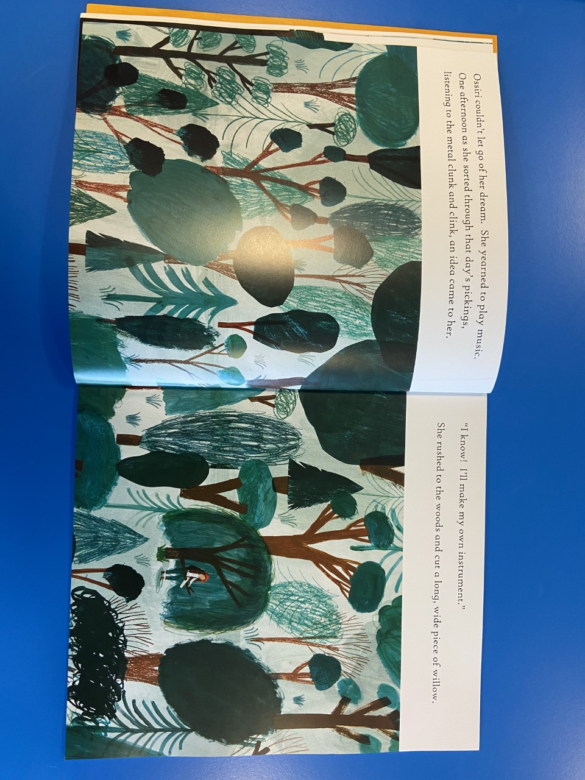

Slide 7
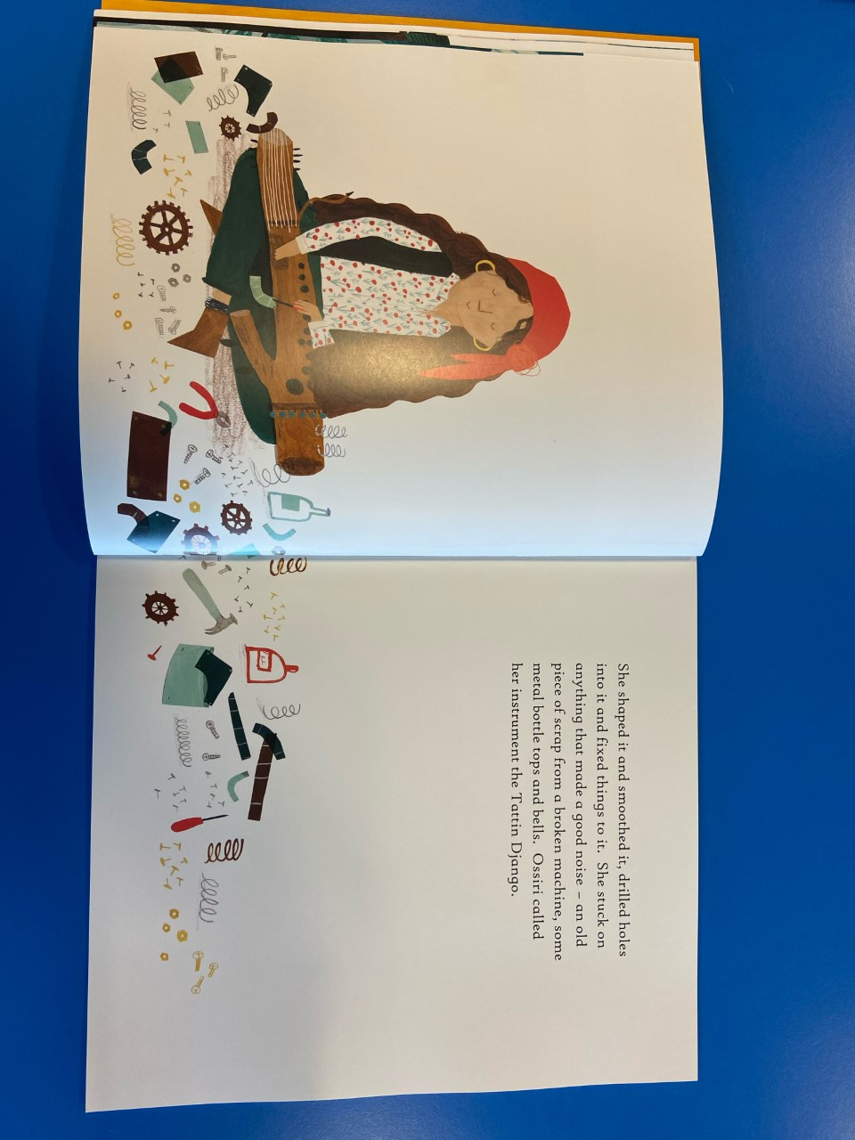

Slide 8
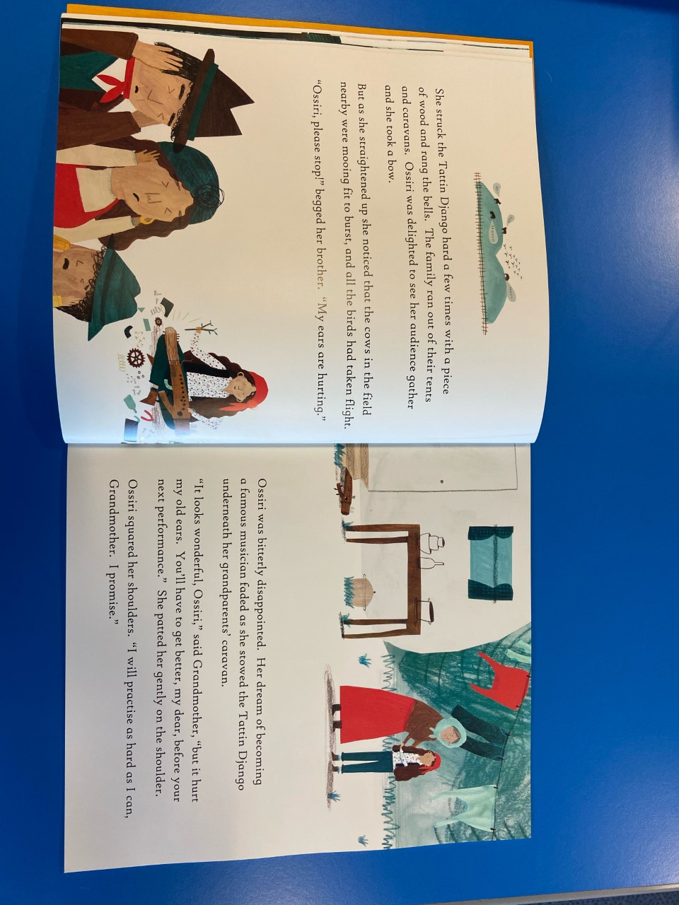

Slide 9


Your Task Today
My ears are hurting!
Don't play again!
Create a comic strip showing the different reactions of people in Ossiri's community and add speech bubbles.
The first box should show her playing the instrument and her friends and family listening.
For the next box choose a character from the pictures. Draw them talking to Ossiri and add speech bubbles to show what they said and what she said.
Complete the rest of the comic strip with other characters and their reactions.
The final box should be Ossiri at the end and how she is feeling.

Slide 10
Try to include different sentence types
Statement – Her music is terrible?
Question – Where is that awful noise coming from?
Command – Stop playing making that horrendous sound (Use . Or !)
Exclamation – What a horrible noise!

Slide 11
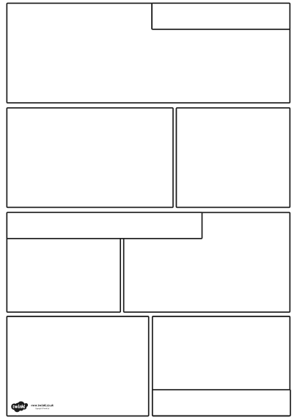
Choose a Comic Strip from the set available in the resources.
You can choose one with fewer boxes or more, depending on your child.
To create speech bubbles, you can rule a line for your child to write on...then they can draw the speech bubble around it.

