Slide 1

Friday 26th
February 2021
PSHE
Growth Mindset

Slide 2
What is growth mindset?
Children with a growth mindset tend to see challenges as opportunities to grow because they understand that they can improve their abilities by pushing themselves.
If something is hard, they understand it will push them to get better, rather than giving up and saying they can’t do it.

Slide 3
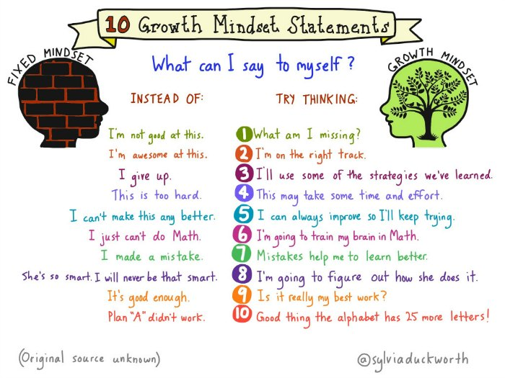

Slide 4
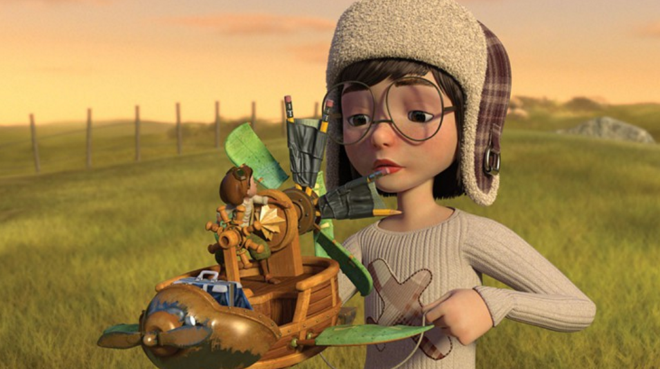
Watch this short animated film
https://www.youtube.com/watch?v=eDkpVwrhYfo

Slide 5
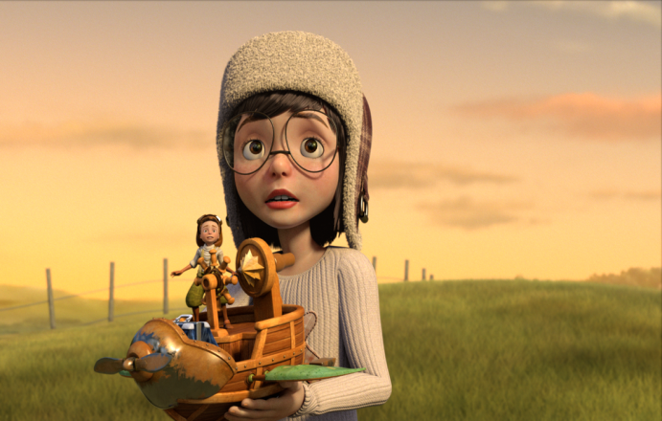
Although in the short film there are no words we are able to see the characters emotions through their actions.
At the beginning the girl was trying to make her plane fly but as hard as she tried it wouldn’t work. Just as she was about to give up she met an unexpected person who needed her help. The girl needed to try and overcome her own fixed mindset about not being able to make the plane fly to help her new friend.
Even though it was hard and they didn’t do it right the first time the pair continued to work together and were able to make the plane fly.

Slide 6
Your task
Think of a time you found something hard or struggled with something.
What did you do? Did you give up? Did you keep trying?
If you had given up what would you have missed out on?
This could be a discussion activity or you could draw pictures of things which you found difficult but are now able to do/ e.g. Learning to ride a bike without stabilisers

