Slide 1
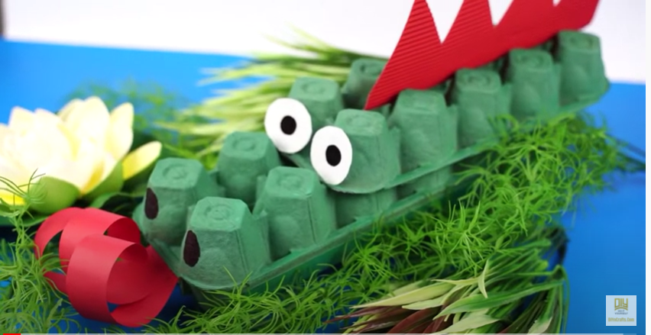
Literacy
Friday 26th February
L.O. To read instructions for making an Egg Box Dragon and put them into the correct order.

Slide 2

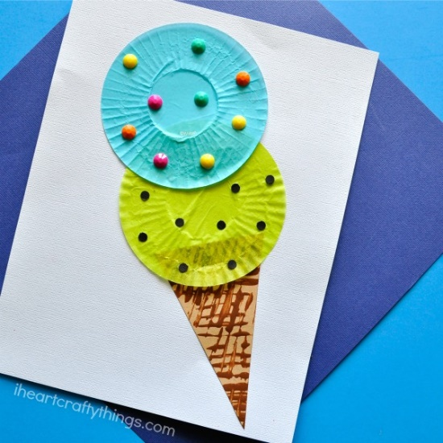
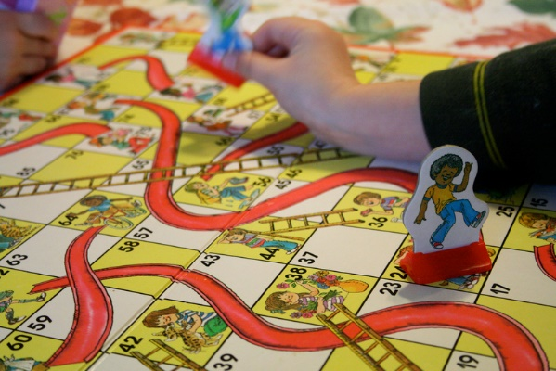
Instructions
When do we read instructions?
Reading a recipe to cook a meal.
Learning the rules of a new game.
Making something new.

Slide 3
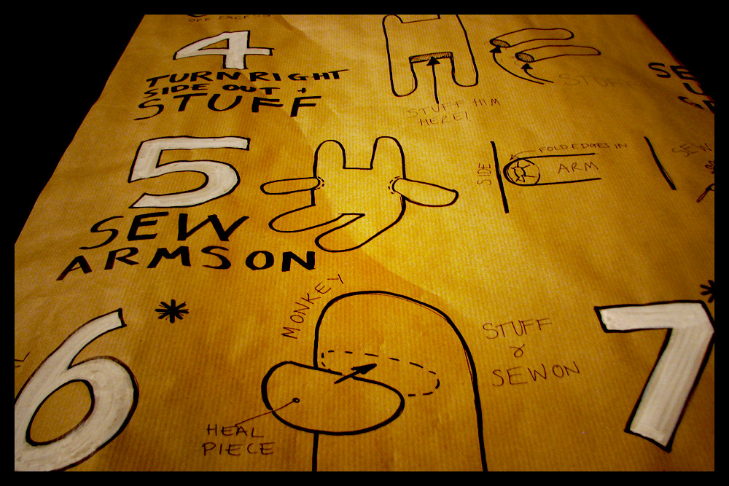
Instructions tell us how to do something.
They are a type of sentence called a command.
The verb (doing/action word) is often at the start of the sentence and it is in a ‘bossy’ form.
e.g.
Come over here.
Stop at the red light.
Tidy up the toys.

Slide 4
When we read instructions to make something, we need to follow them in the right order.
Instructions sometimes use ‘time’ words – called time connectives – to help show the order.
Here are some time connectives.
We use ‘first’ for the instruction at the start.
We use ‘finally’ for the instruction at the end.
first | then | next
after that | now | finally

Slide 5
Let’s have a go at finding the bossy verbs and time connectives in some instructions.
First, chop the apple.
Then, sprinkle on the sugar.
Next, put it in the oven.

Slide 6
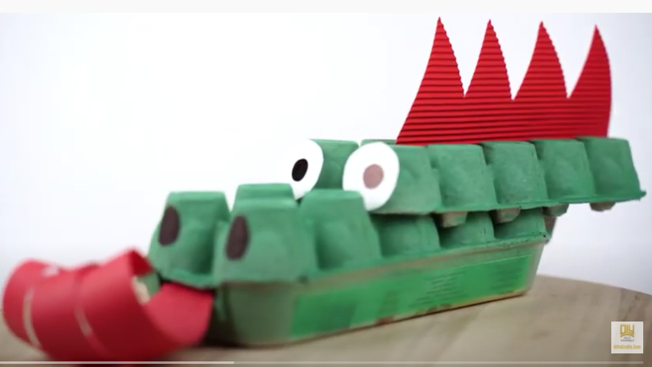
Your Task
Watch the youtube clip below that shows how to make an egg carton dragon.
https://www.youtube.com/watch?v=d7j8nzC0CcE
Can you put the written instructions for making this dragon into the right order?
Can you highlight or colour the bossy verbs and the time connectives in the instructions?
Options for recording the task
Use the powerpoint slide (the next slide of this powerpoint). Move the text boxes to put into the right order.
Print off the powerpoint slide and cut and stick the instructions into the right order.
Copy out the instructions in the correct order.

Slide 7
1
5
First, trim the flaps off your egg boxes. Cut one egg box into 2 pieces along the fold. Leave the other box whole.
After that, draw nostrils with a thick black pen onto the end of your dragon’s nose.
2
Now for the dragon tongue; cut strips of red paper. Roll them around a pencil to make them curly. Stick the ends of the paper strips together and stick into your egg box below the nostrils.
6
Next, turn the boxes so they are ‘bumpy side up’. Stick the cut-off bumpy piece on top of the bumpy whole box, leaving some bumps in front to make the dragon’s nose.
3
7
Then, paint your egg boxes the colour you want your dragon to be.
Then, stick googly eyes onto your model or draw eyes onto white stickers/card and stick them on.
4
Finally, cut red card to make a zig zag edge for the dragon spikes. Stick this along the middle of your egg box behind the eyes. Enjoy playing with your new dragon!

Slide 8
Friday 26th Feb pm: Art activity
L.O. To make your own Egg Box Dragon.
You can follow the youtube clip and the instructions you have read and ordered in Literacy today.
For this model, you will need:
2 egg boxes – preferably long (12 eggs) or short will also work
Paints to change the colour of your egg boxes
Red/orange/yellow paper to make a curly fiery tongue
Black marker pen/thick felt pen to draw on nostrils
Stick-on googly eyes or white address label stickers for eyes
Red card for dragon spikes
Glue
If you prefer, you can make your own Egg Box Dragon, using whatever materials you have. Whatever is the easiest for you!
We really look forward to seeing your dragons!

