Slide 1
LO: To Create your own story based on a dice throwing game.
Thursday 25th February 2021

Slide 2
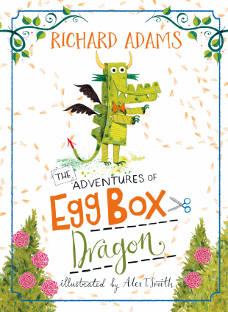

Slide 3
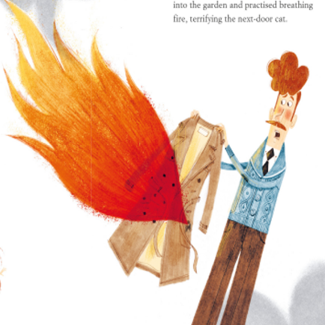




We know Egg Box Dragon had lots of adventures…
Now it’s time to come up with your own story for him!

Slide 4
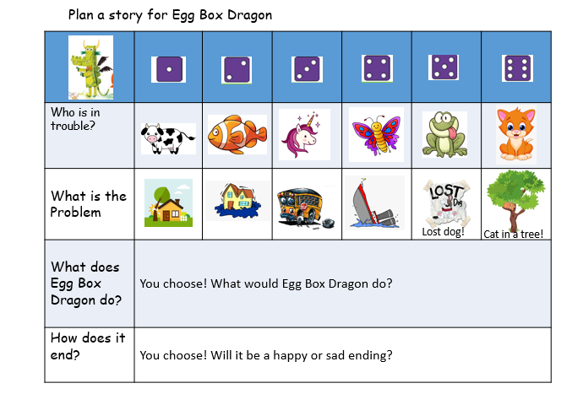

Get a dice and play this game…select your character who needs help, then select what the problem is using the dice to choose…
Write a short story about my adventure!

Slide 5
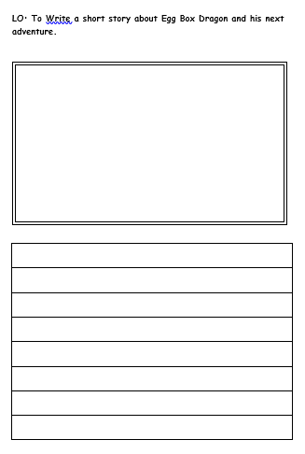
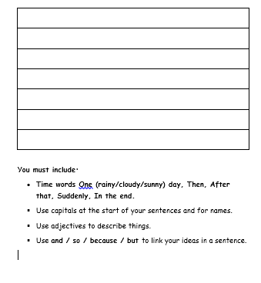
Your task today!
Task 1: Write a short story about Egg Box Dragon’s next adventure using the objectives below.
You must include:
Time words – One (rainy/cloudy/sunny) day, Then, After that, Suddenly, In the end.
Use capitals at the start of your sentences and for names.
Use adjectives to describe things.
Use and / so / because / but to link your ideas in a sentence.

