Slide 1


Slide 3

1) Which is a hexagon?
2) Which is a cube?
3) True or False?
Cones have a circular face.
4) What comes next?
Jump, clap, stomp, jump, clap, stomp, jump, ______

Slide 4
1) Which is a hexagon?
2) Which is a cube?
3) True or False?
Cones have a circular face.
4) What comes next?
Jump, clap, stomp, jump, clap, stomp, jump, ______
True
clap

Slide 6

1
1
5
2
6
2
5
6
3
3
4
4
Notes:
Can be backwards and forwards

Slide 7

2
3
1
5
4
1
5
2
6
3
4
Notes:
Can be backwards and forwards

Slide 8

Which face did he use?

Slide 9

1
2
Faces: 6

Slide 10
Have a go at questions 1 and 2 on the worksheet

Slide 11


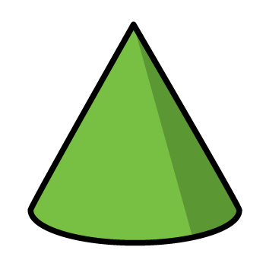
Curved surfaces

Slide 12
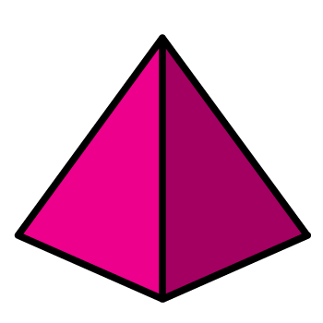
Curved surfaces

Slide 13



Flat faces

Slide 14
Have a go at the rest of the questions on the worksheet

