Slide 1
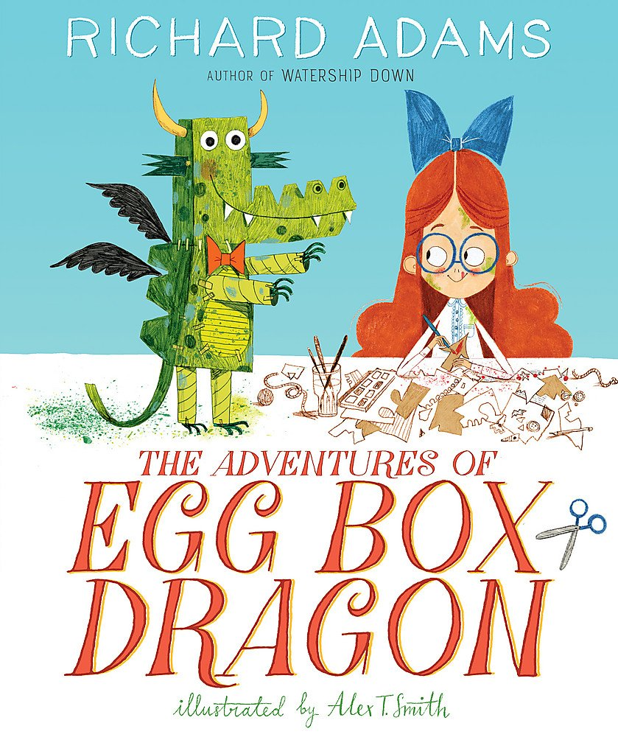
Wednesday 24th February 2021
LO: To Write a Letter from The Queen to Egg Box Dragon.

Slide 2
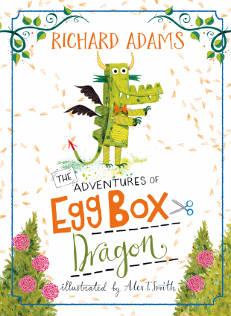

Slide 3
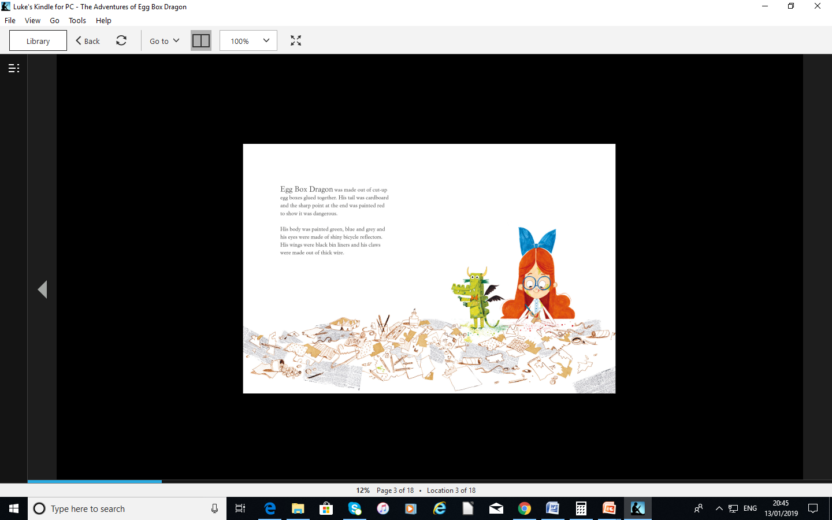

Slide 4
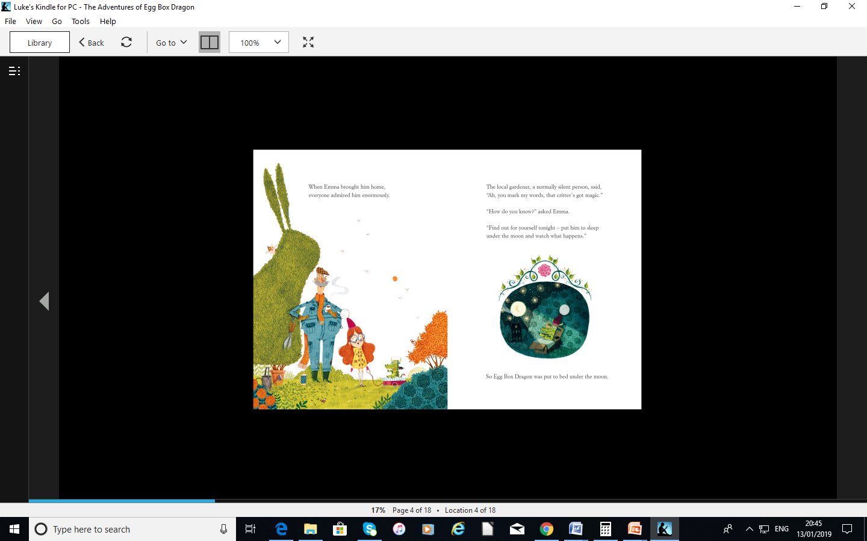

Slide 5
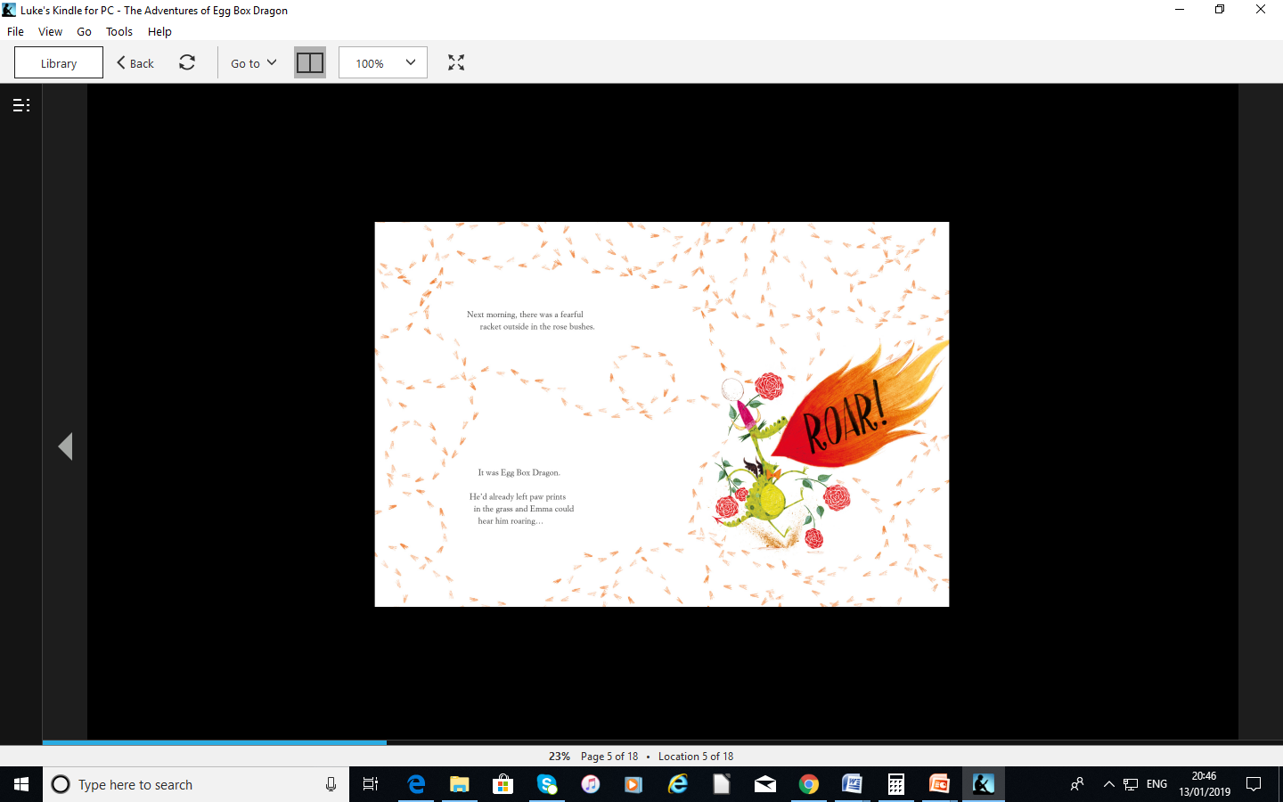

Slide 6
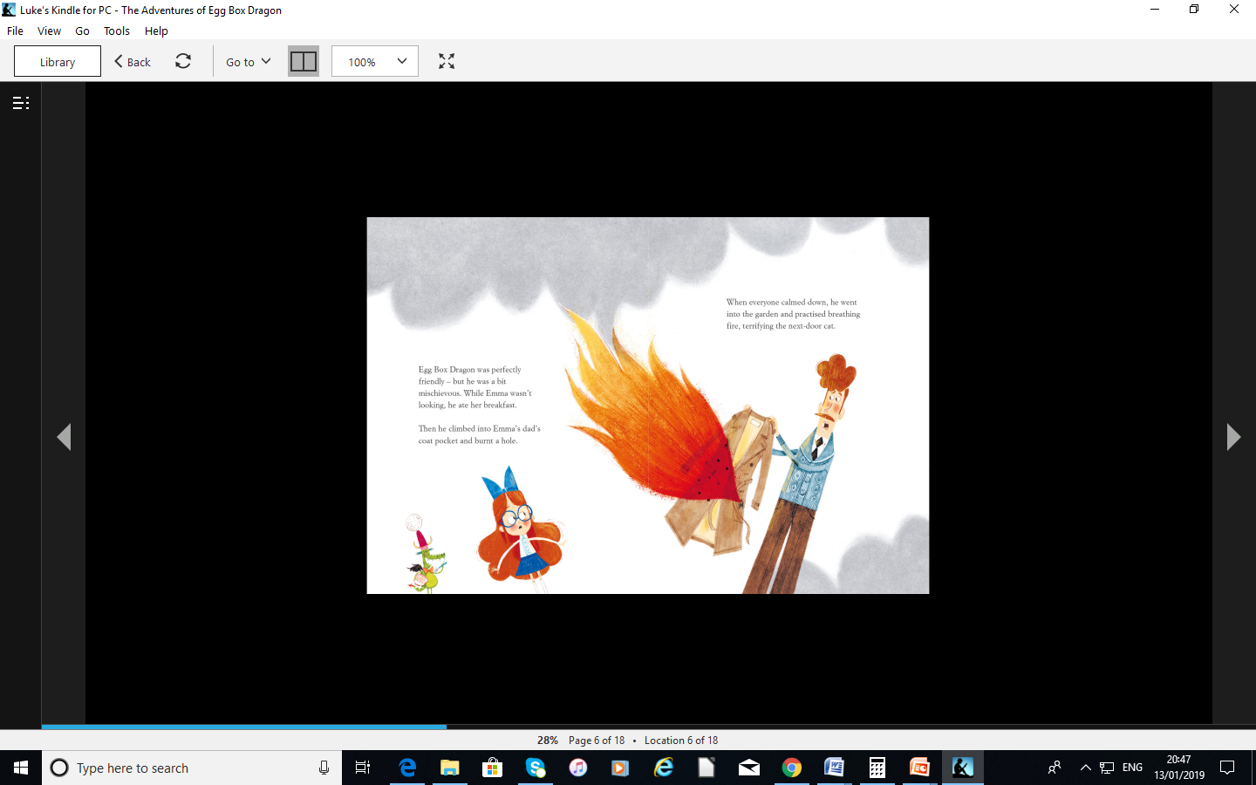

Slide 7
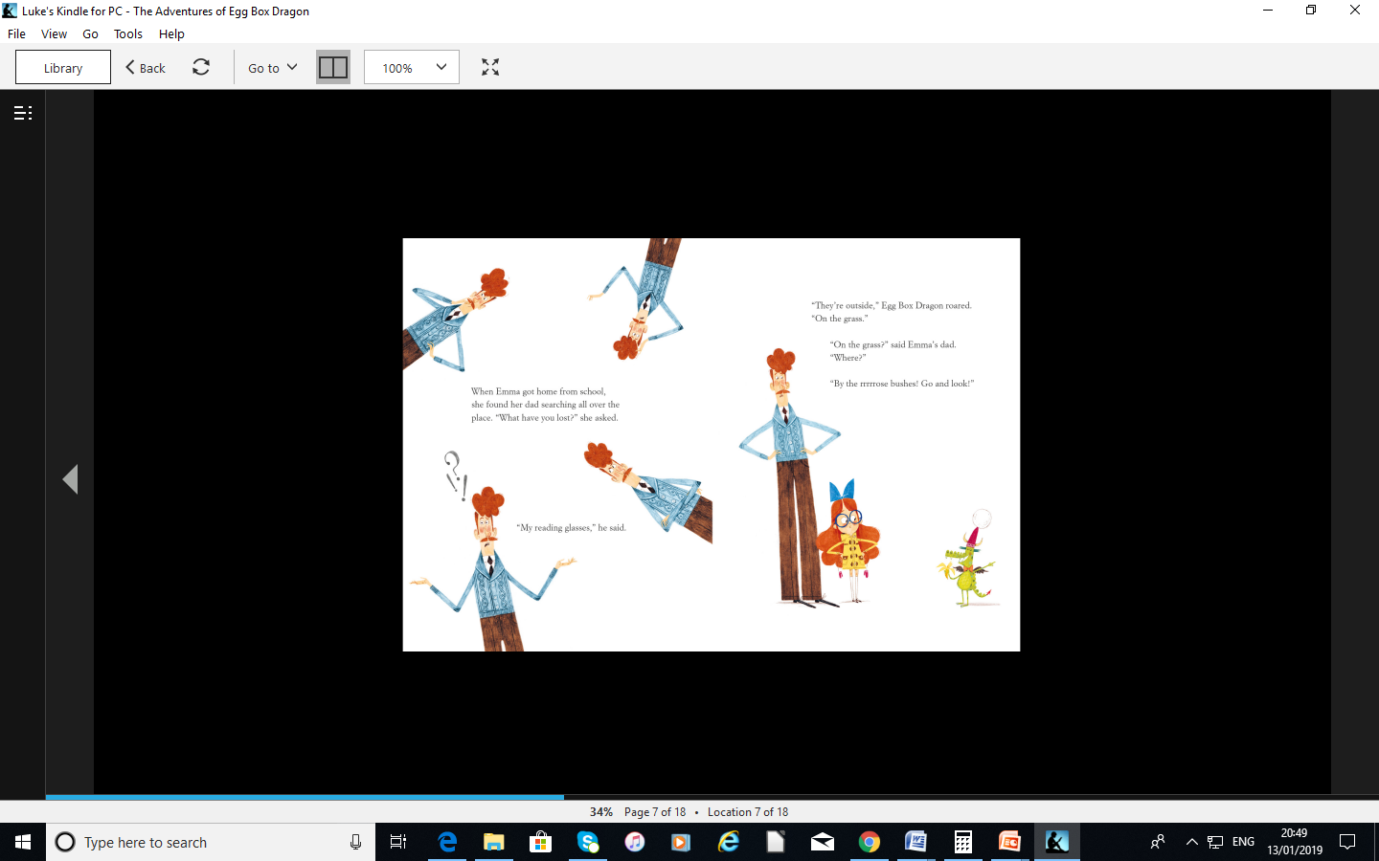

Slide 8
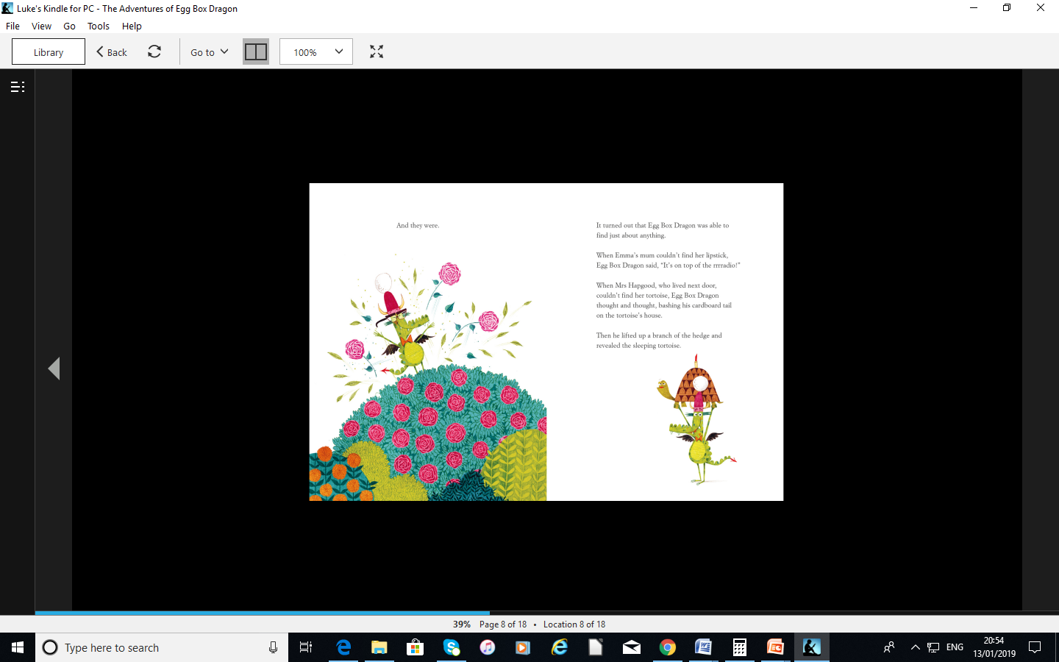

Slide 9
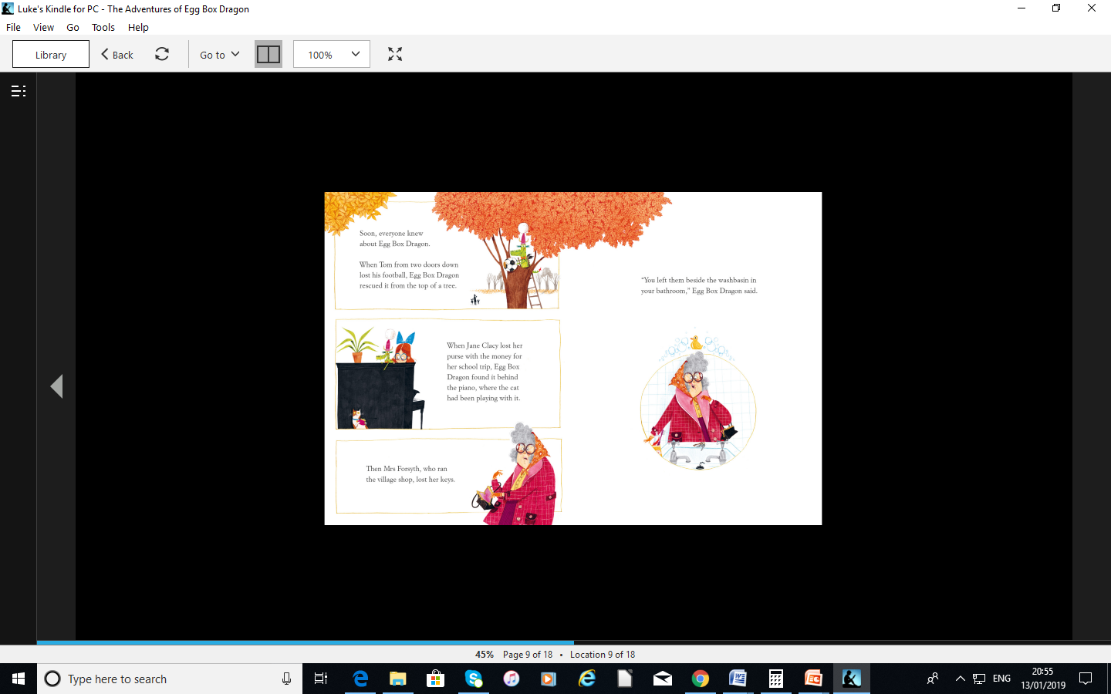

Slide 10
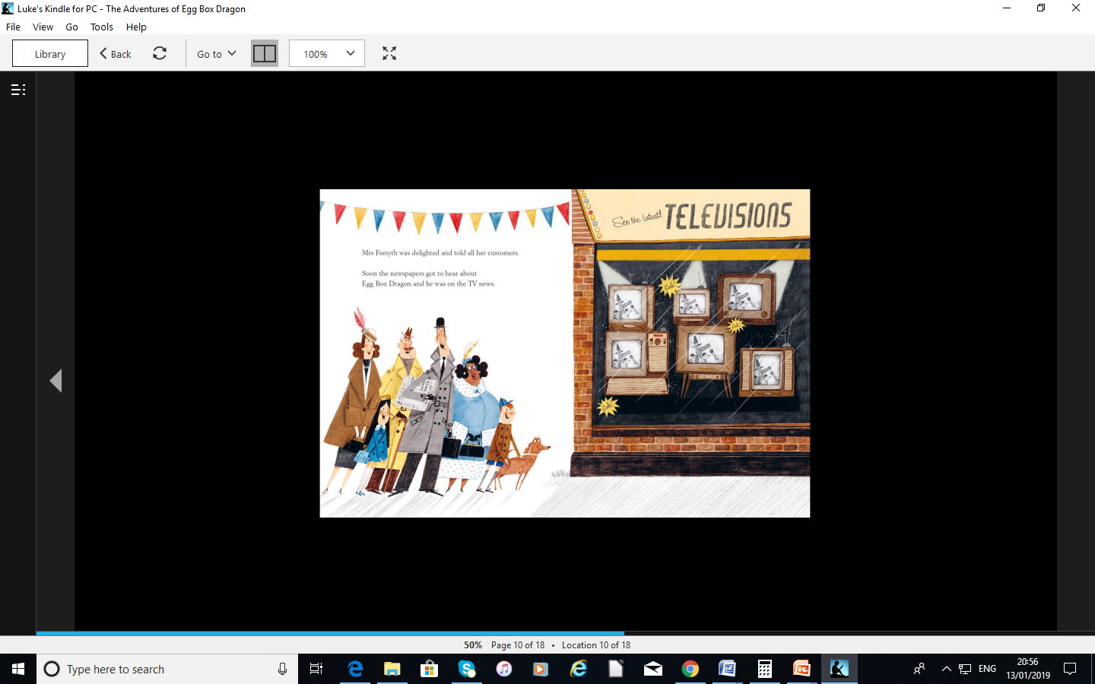

Slide 11
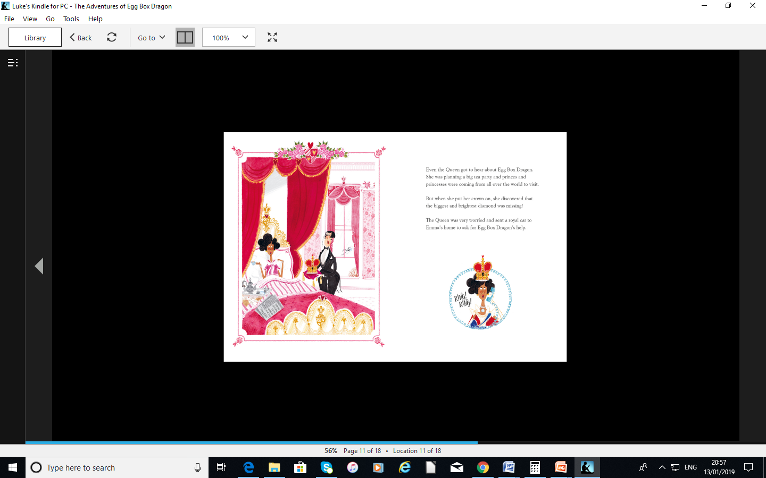

Slide 12
The Queen needs Egg Box Dragon’s help.
The Queen has lost the diamond from her crown so she decides to ask for Egg Box Dragon’s help to find it.
She writes Egg Box Dragon a letter asking for his help.

Slide 13
Letter
When you are writing to or from The Queen, you must always write in a formal style and follow certain rules of letter-writing etiquette.
To open the letter you must use: Dear Sir,
And to close your letter you should use the term: Yours faithfully,
The first time you mention The Queen in your letter, you must use her full title: Her Majesty The Queen

Slide 14
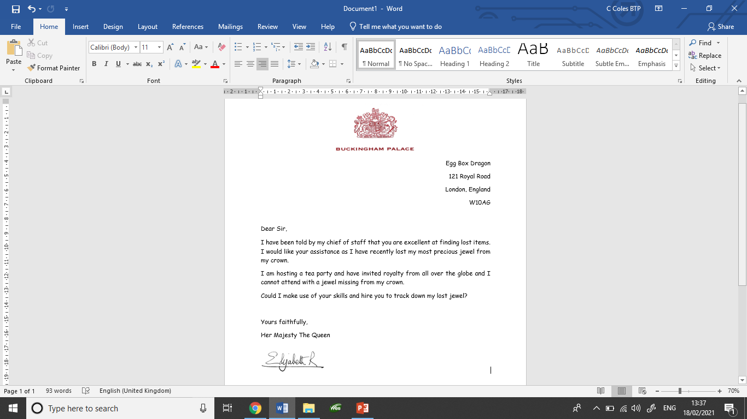
Dear Sir,
I have been told by my chief of staff that you are excellent at finding lost items. I have recently lost my most precious jewel from my crown.
Could I make use of your skills and hire you to track down my lost jewel?
Yours faithfully,
Her Majesty The Queen

Slide 15
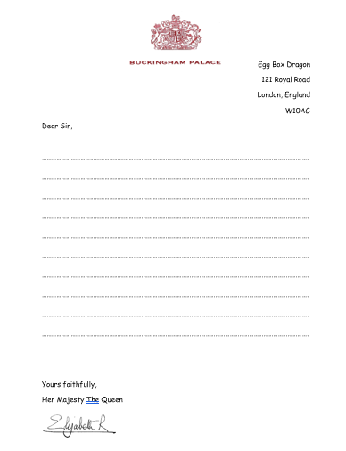
Your Task
To write a letter as if you are The Queen asking for Egg Box Dragon’s help.
Remember to use formal language.
You can;
type your letter,
write it on plain paper or
complete it on the template
from the class page

