Slide 1
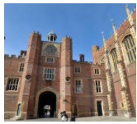
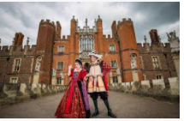
Tuesday 23rd February
Topic
L.O. To explore the features of an historic place:
Hampton Court Palace.

Slide 2

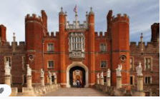
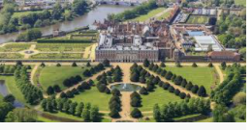
Hampton Court Palace is a very important building in our country.
Why is it important?
Let’s find out some facts about it.

Slide 3
Facts about Hampton Court Palace
It is in London, which is the capital city of the UK.
It is on the banks of the river Thames, which flows through London.
Henry VIII lived there about 500 years ago.
Other kings and queens also lived there after Henry VIII.
No kings or queens live there anymore.

Slide 4
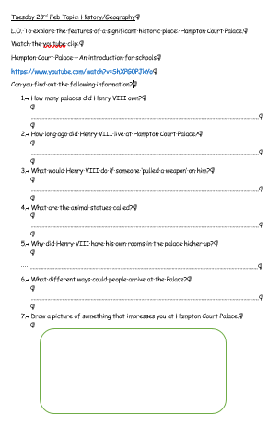
Your task
Watch the youtube clip:
Hampton Court Palace – An introduction for schools
https://www.youtube.com/watch?v=ShXPG0PJkYo
Can you find out the information to answer the questions on the activity sheet?
You can answer these in any way you choose e.g. typing up, writing out or talking through it together.

