Slide 1


Slide 3


1) Which is a 2-D shape?
2) Which is a 3-D shape?
3) Which word would come next?
Up, down, up, down, up, down, up, down, ____

Slide 4
1) Which is a 2-D shape?
2) Which is a 3-D shape?
3) Which word would come next?
Up, down, up, down, up, down, up, down, ____
up

Slide 6



What are patterns?
What do you notice?
Is this a pattern?
Where have you seen patterns?
Notes:
Patterns can be repeating objects
Say the shapes outloud

Slide 7

What objects are repeating?
What comes next?
?
I know what comes next if I say the pattern.

Slide 8




Have a
think

Slide 9
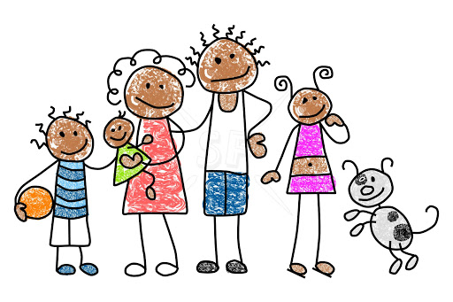
Have a think
Notes:
Can be backwards and forwards

Slide 10
Have a go at questions 1, 2 and 3 on the worksheet

Slide 11

Will you draw me a pattern that goes: rectangle, square, triangle, then repeats please
What will the 11th shape in the pattern be?
A square
Have a think

Slide 12
Which objects are repeating?
What has been knocked out of place?
?
?
Have a think

Slide 13
Have a go at questions 4, 5 and 6 on the worksheet

Slide 14
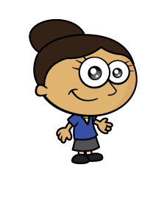
Have a think

Slide 16
Have a think

Slide 17
Have a go at question
7 on the worksheet

