Slide 1
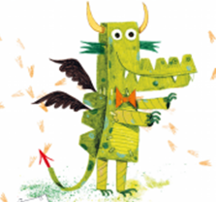
Tuesday 23rd February
LO: Write or act out and film a newspaper report about the Egg Box Dragon and his ability to find missing objects.

Slide 2
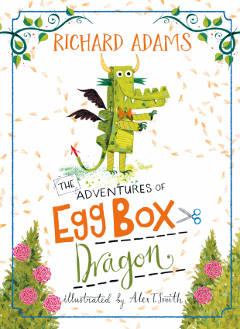
Let’s revisit the story.

Slide 3
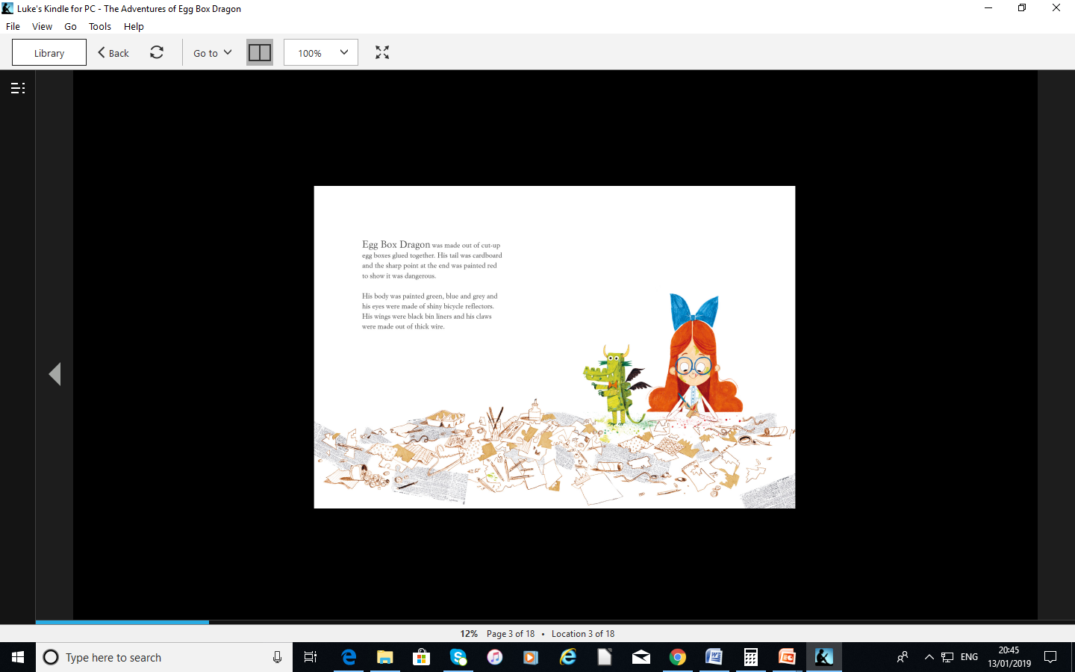

Slide 4
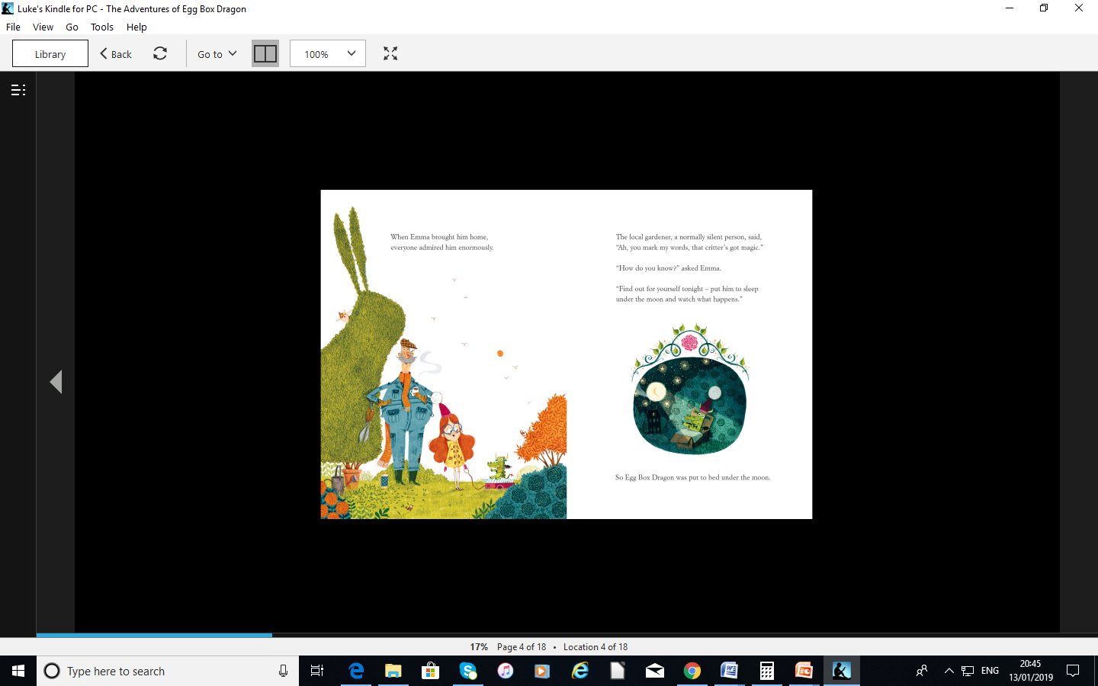

Slide 5
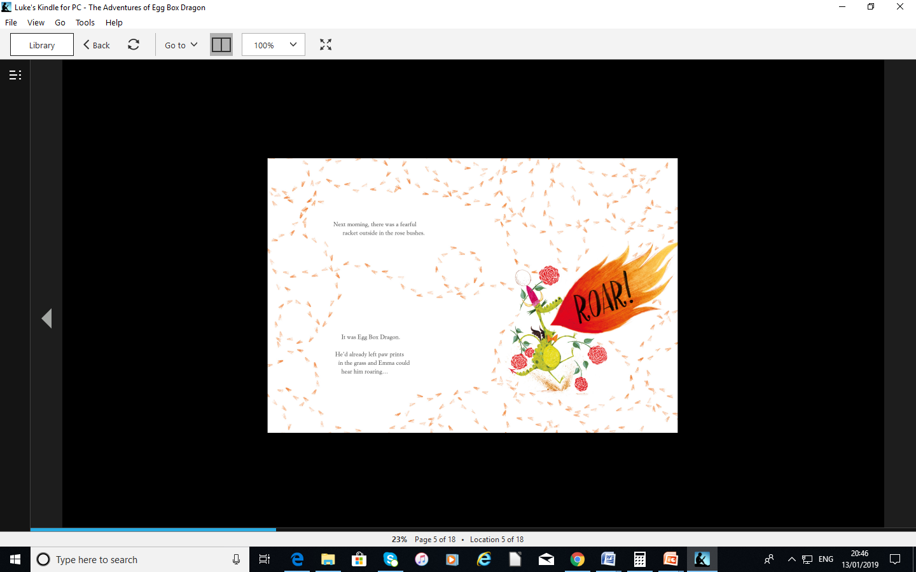

Slide 6
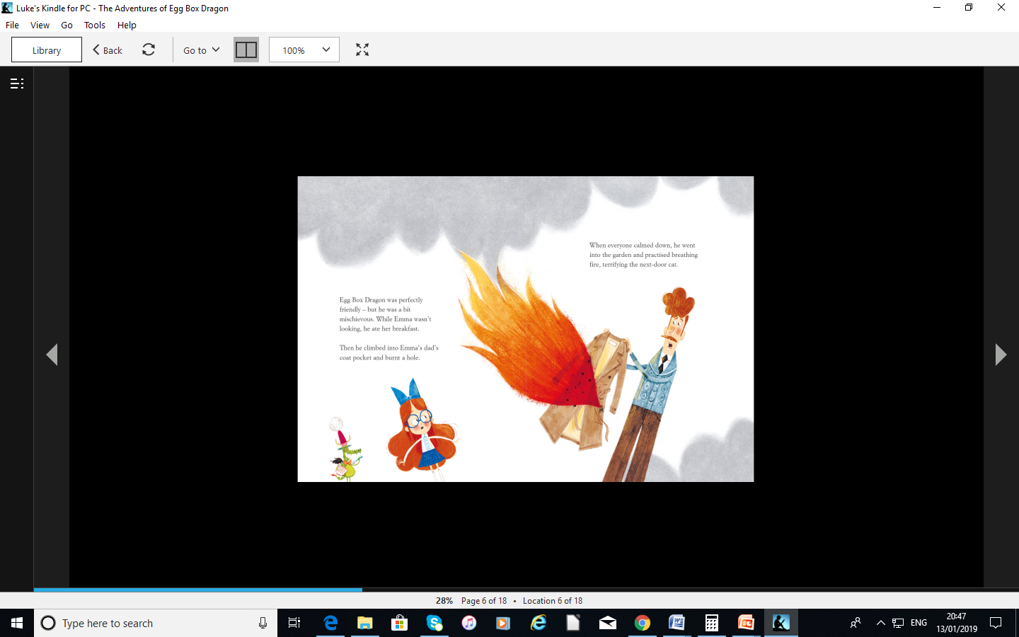

Slide 7
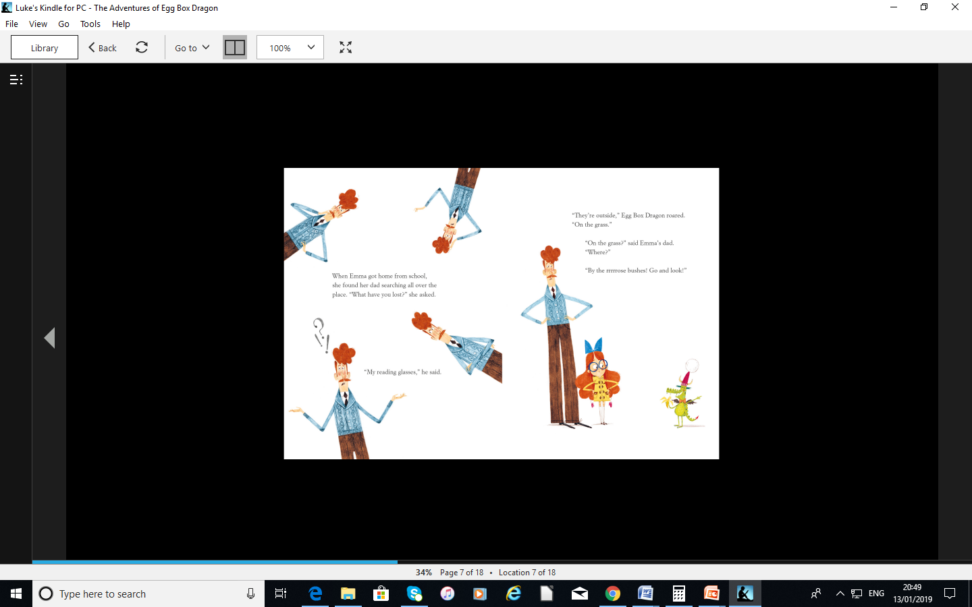

Slide 8
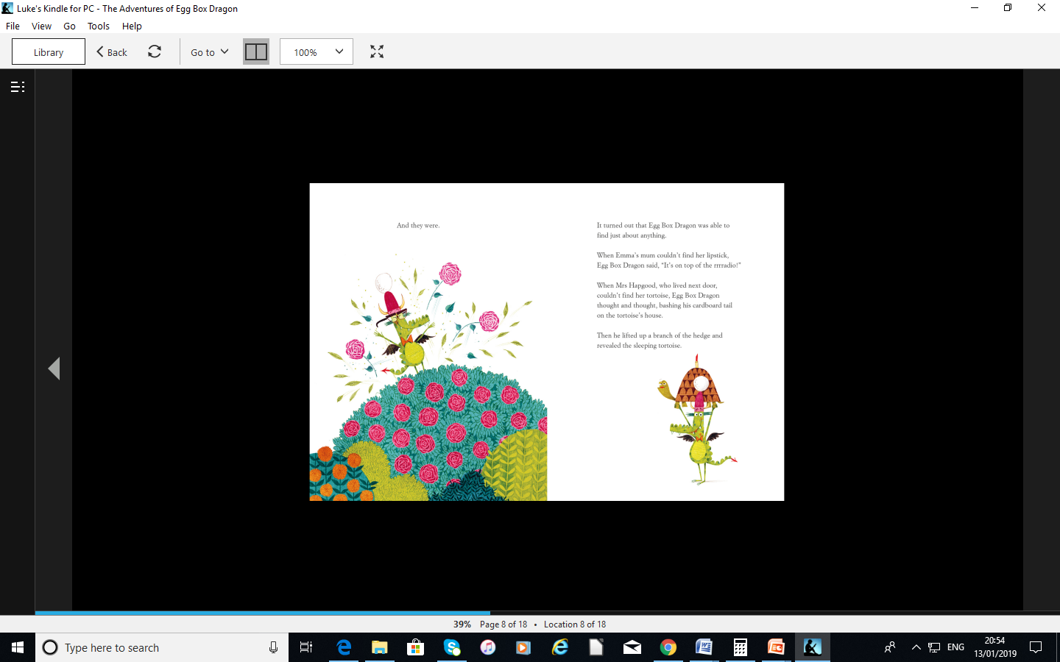

Slide 9
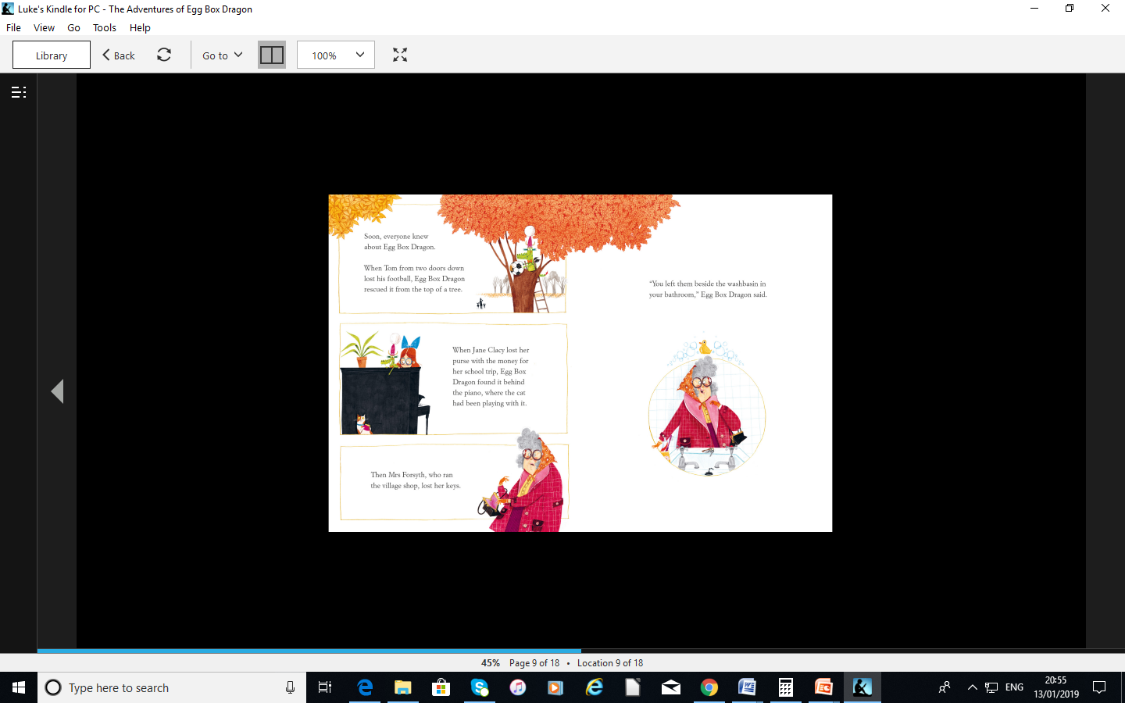

Slide 10
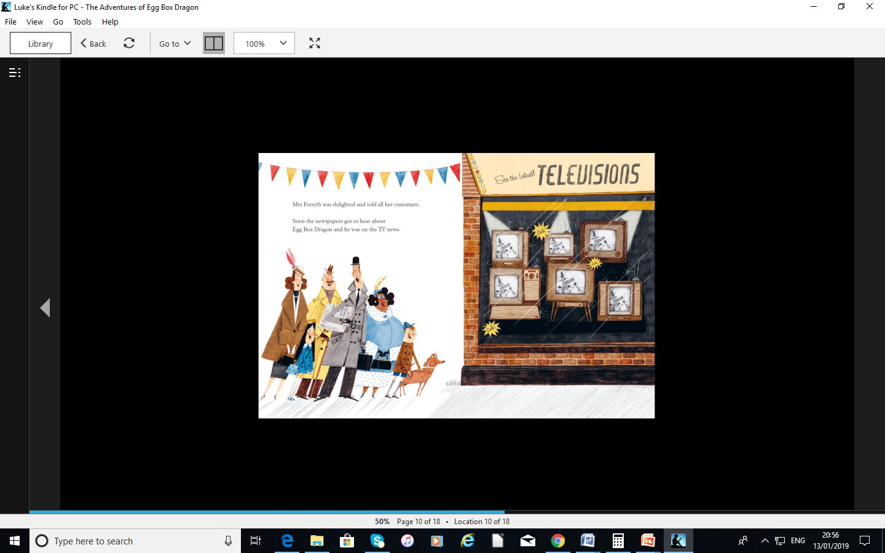

Slide 11
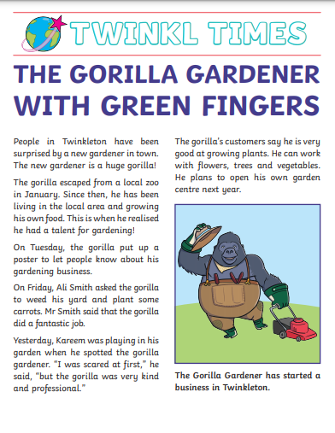
Today you will be creating a report about the Egg Box Dragon and his amazing talent, which is that he can find missing objects.
You can either write a newspaper report or film a report as if it is going to be broadcast on the News.
Newspaper Report
Click the link to watch a news report presented by children.
https://www.youtube.com/watch?v=AvpLCQxSPQA
When filming a news report remember to use a loud, clear voice. You could play the news reporter in the studio and a reporter who is interviewing someone from the story. You could also have a line to use at the end of your report e.g. This was (Your name) reporting for Bishopton News. Goodnight everybody.

Slide 12
Both filmed and written newspaper reports give the reader/listener information about an event. They must include information about ...
Who – Who is involved?
What – What happened?
Where – Where did the events happen?
When – When did the events happen?
How – How did the event happen?

Slide 13
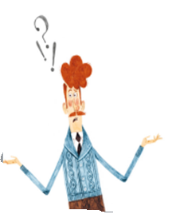



Who is involved in the event?
Egg Box Dragon – Found missing objects.
Dad –Lost his reading glasses.
Emma – Made Egg Box Dragon
Mrs Forsyth – Lost her keys.
Tom – Lost his football.
Mrs Hapgood – Lost her tortoise
Mum – Lost her lipstick.
Jane Clancy –Lost her purse

Slide 14
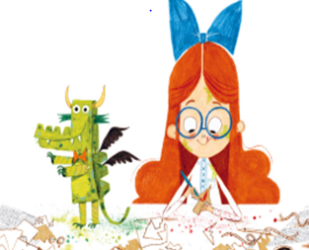
What happened?
Event 1
Emma made Egg Box Dragon.
Event 2
Dad –Lost his reading glasses. Egg Box Dragon found them in the rose bush.
Event 3
Mum – Lost her lipstick. Egg Box Dragon found it on top of the radio.

Slide 15
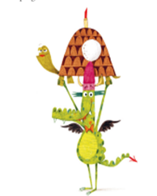
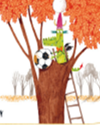
Event 4
Mrs Hapgood – Lost her tortoise. Egg Box Dragon found him in a hedge.
Event 5
Tom – Lost his football. Egg Box Dragon found it in a tree.

Slide 16

Event 6
Jane Clancy –Lost her purse. Egg Box Dragon found it behind the piano. The cat had been playing with it.
Event 7
Mrs Forsyth – Lost her keys. Egg Box Dragon found them beside the wash basin in the bathroom.
Event 8
Egg Box Dragon becomes famous for finding lost objects.

Slide 17
Where did the events happen?
The events took place :
In gardens
In houses

Slide 18
When did the events happen?
Use time sequencing words:
On Monday 5th September
Today
Yesterday
Last week
First , Second, Third
Finally

Slide 19
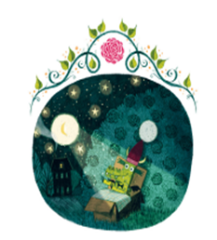
How did the events happen?
Egg Box Dragon used his magical powers to find the missing objects.

Slide 20
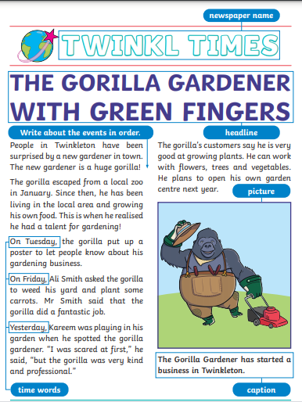
Important features to include:
Name of the newspaper.
Headline – Something catchy to make someone want to read the article. You could use alliteration.
Write the events in order using time sequencing words.
Include a picture/photo of the event.
Use a caption to explain what the picture/photo is showing.
Include a quote from a witness (someone who saw the event).
Finish with a sentence that will make the reader want to know what will happen next.

Slide 21
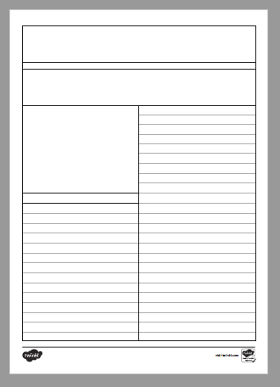
Your Task
Option 1 – Print out template and write newspaper report.
Option 2 – Film yourself being a news reporter. Describe what the magical dragon has done.
Option 3 – Fold blank paper in half and write newspaper report.

Slide 22
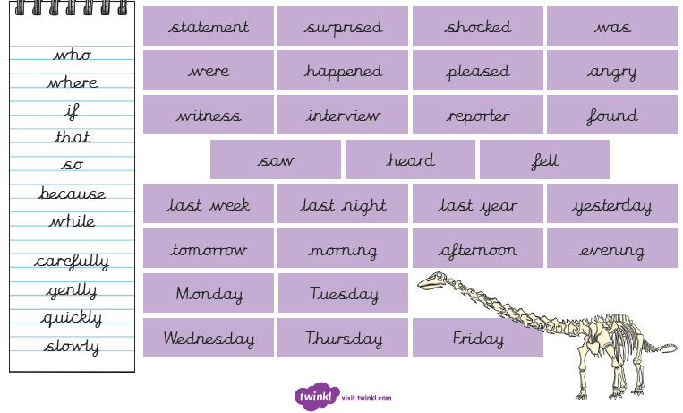
Useful Words

