Slide 1
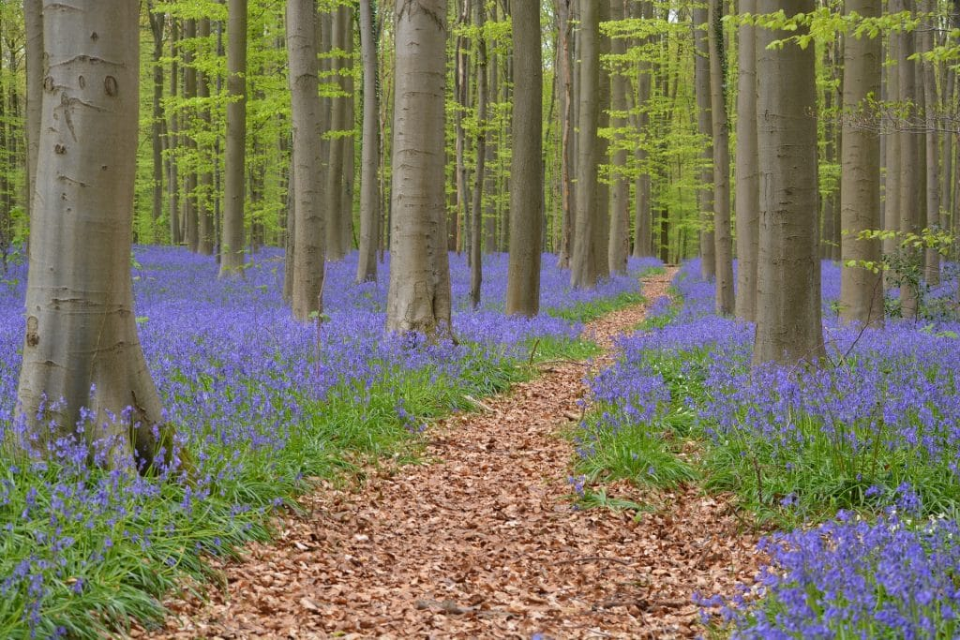
Thursday 27th May
L.O. To write a non-fiction text about woodlands.

Slide 2
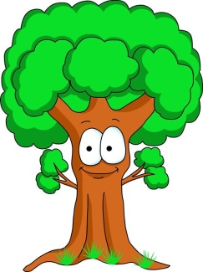

Before we start writing lets think about what we have learnt this term.
Let’s see what you can remember?

Slide 3

Can you name the parts of a tree?

Slide 4
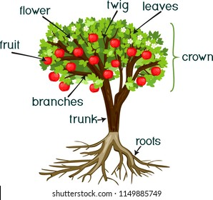
Answer

Slide 5
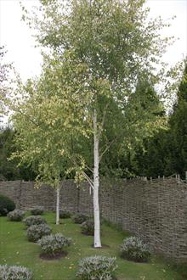
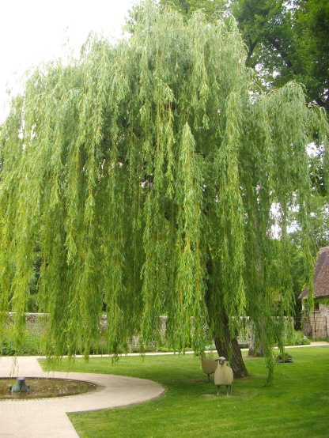
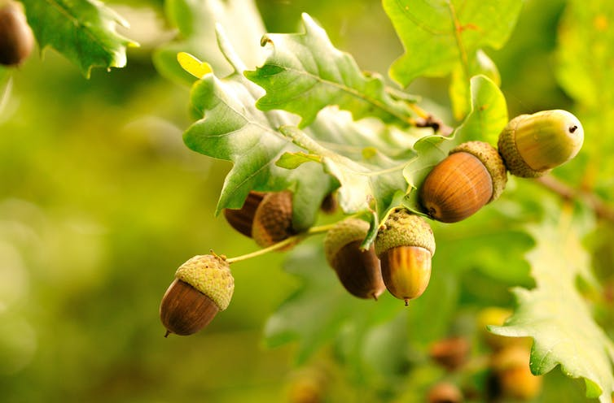
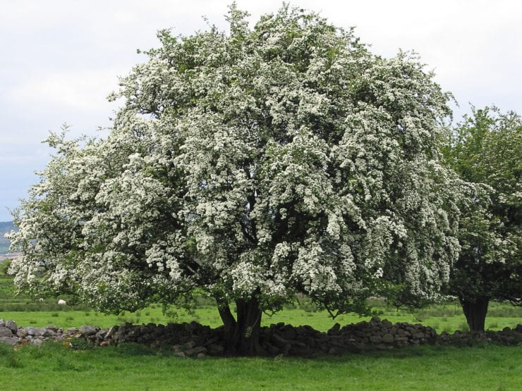
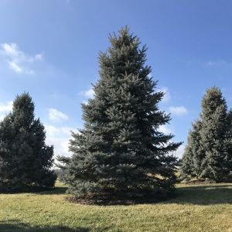
Can you name and identify different trees?

Slide 6
Answers
Oak tree
Willow tree
Silver Birch tree
Conifer tree
Hawthorn tree

Slide 7
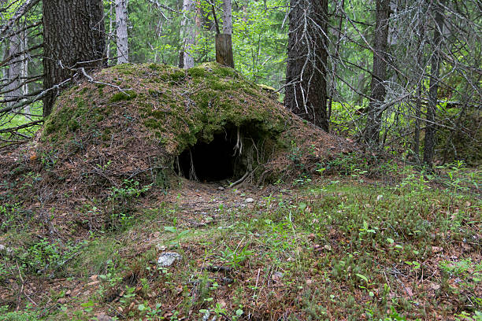
What animals live in a woodland?

Slide 8
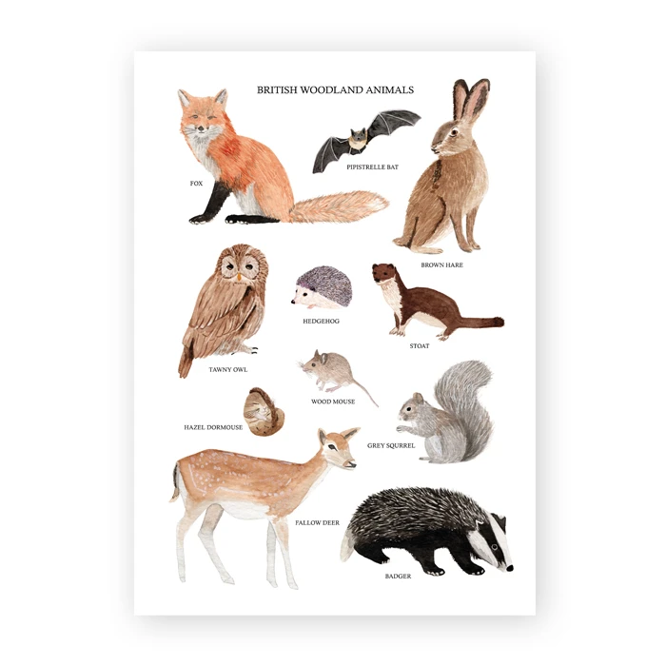
Answers

Slide 9
Which animals used to live in the British woodland but are now extinct?
?

Slide 10
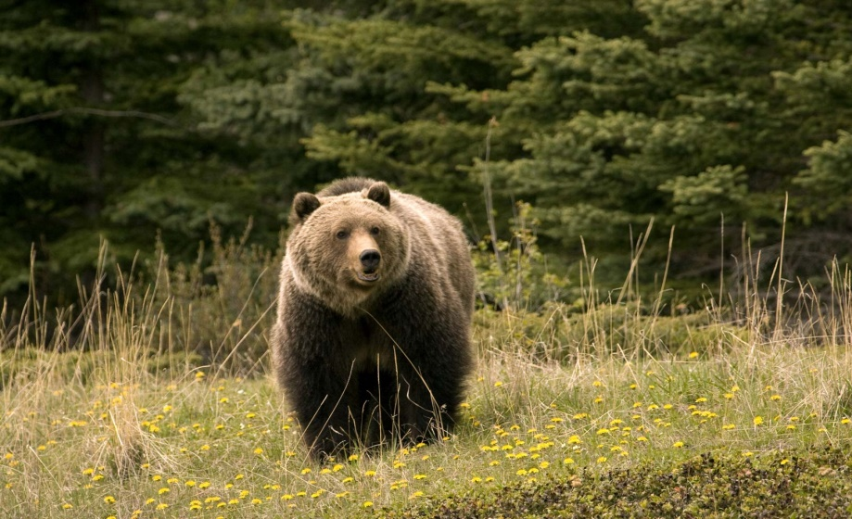
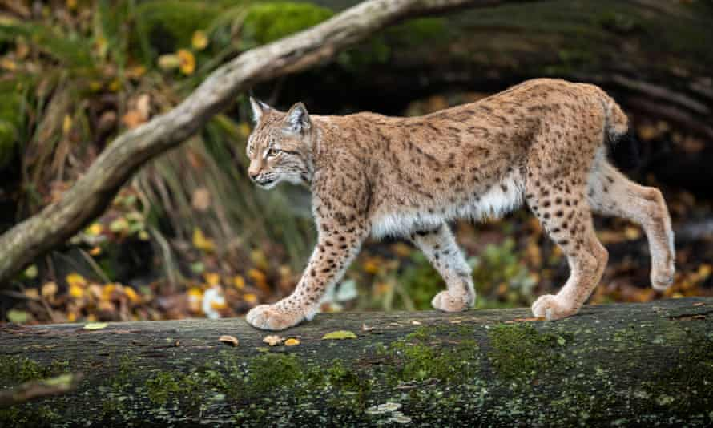
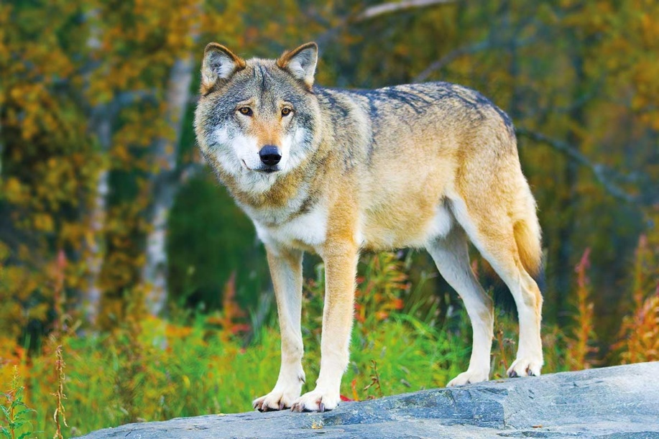
Answer
Bears
Lynx
Wolves

Slide 11
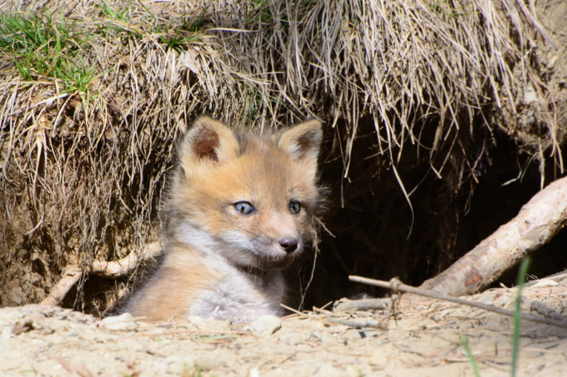
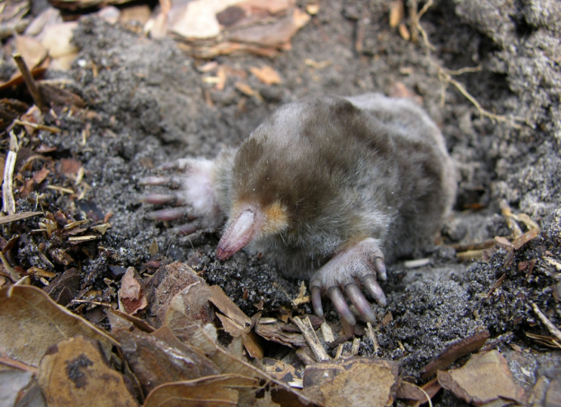
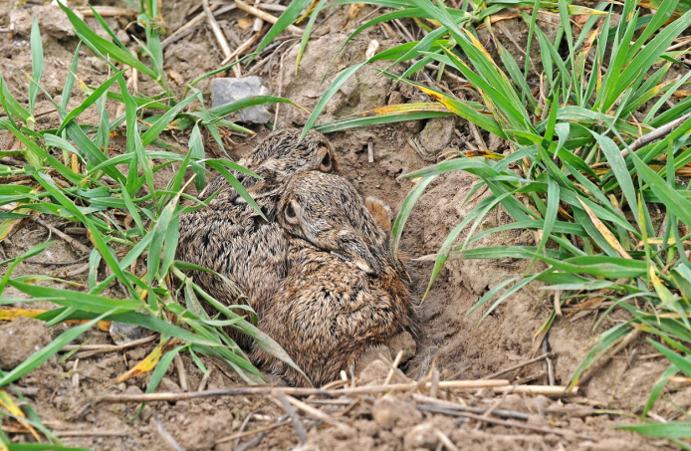
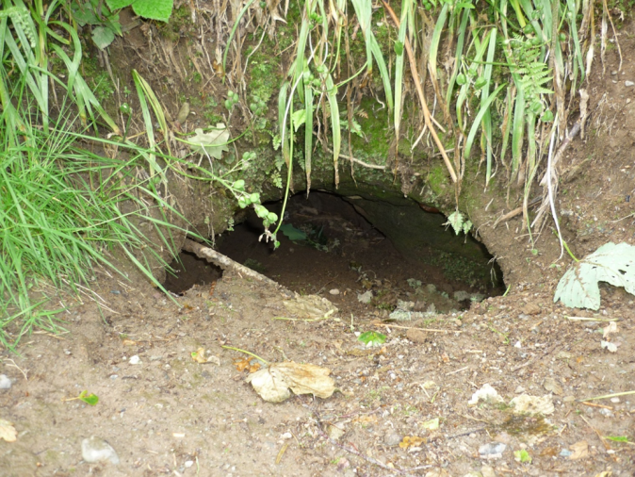
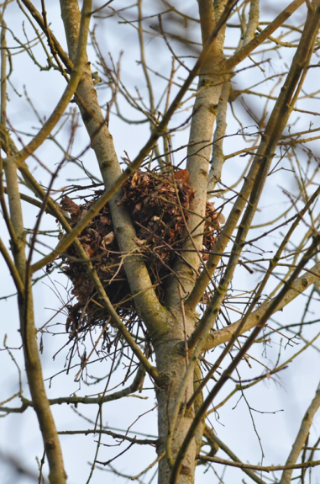
What do we call different woodland animal homes?

Slide 12
Answers
Den
Burrow
Form
Sett
Drey

Slide 13
Well done! You were able to remember lots of facts.
Your Task – Present the information you have in the form of a non-fiction text.

Slide 14
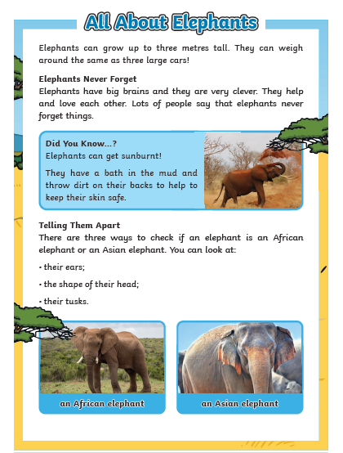
Remember to include …
Heading
Paragraphs
Fact box
Sub-Heading
Bullet points
Don’t forget to include labelled diagrams.
Photographs

