Slide 1
LO: To write a story
Tuesday 25th May 2021

Slide 2
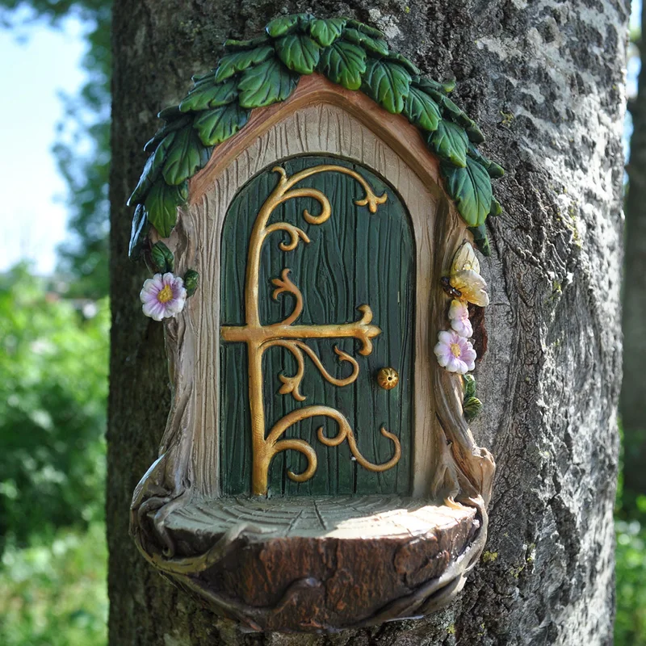
Have a look at this fairy door…

Slide 3
What might happen when someone goes through the door?
What might be on the other side of the door?
What will the character see when they go through the door?
What will happen when they go through the door?

Slide 4

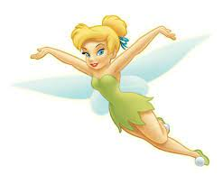
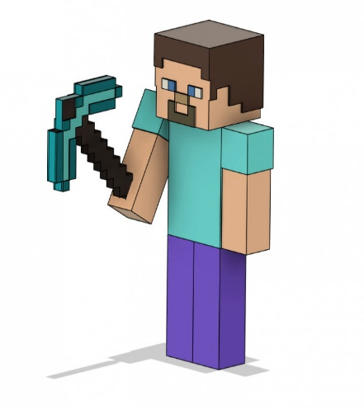

Your task today is to write a story independently about the fairy door.
Here are some characters you could choose from to be the star of your story!

Slide 5
When you write your story think about…
What happens at the start of the story…
What can the character see?
What does the character do?
Is there a problem?
How does the story finish?

Slide 6
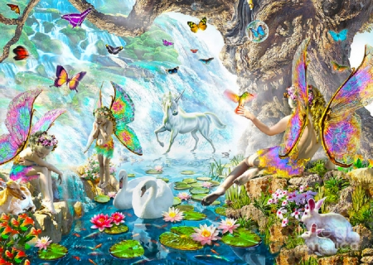
For those of you who find writing a little tricky. Try labelling this picture OR writing a simple sentence about what you can see in this land.

