Slide 1
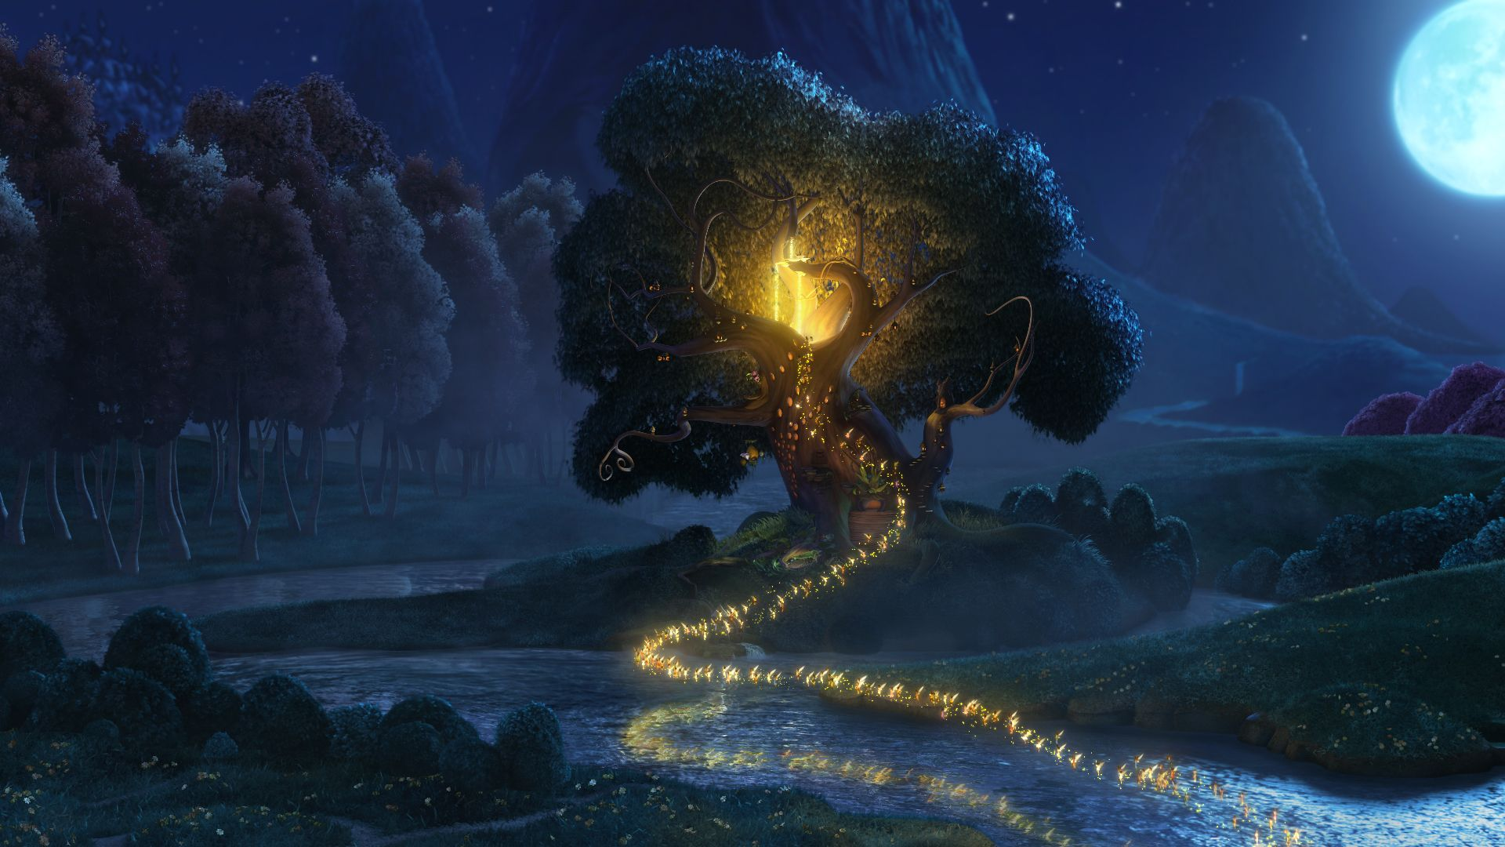
Monday 24th May 2021
Design your own fairy.

Slide 2
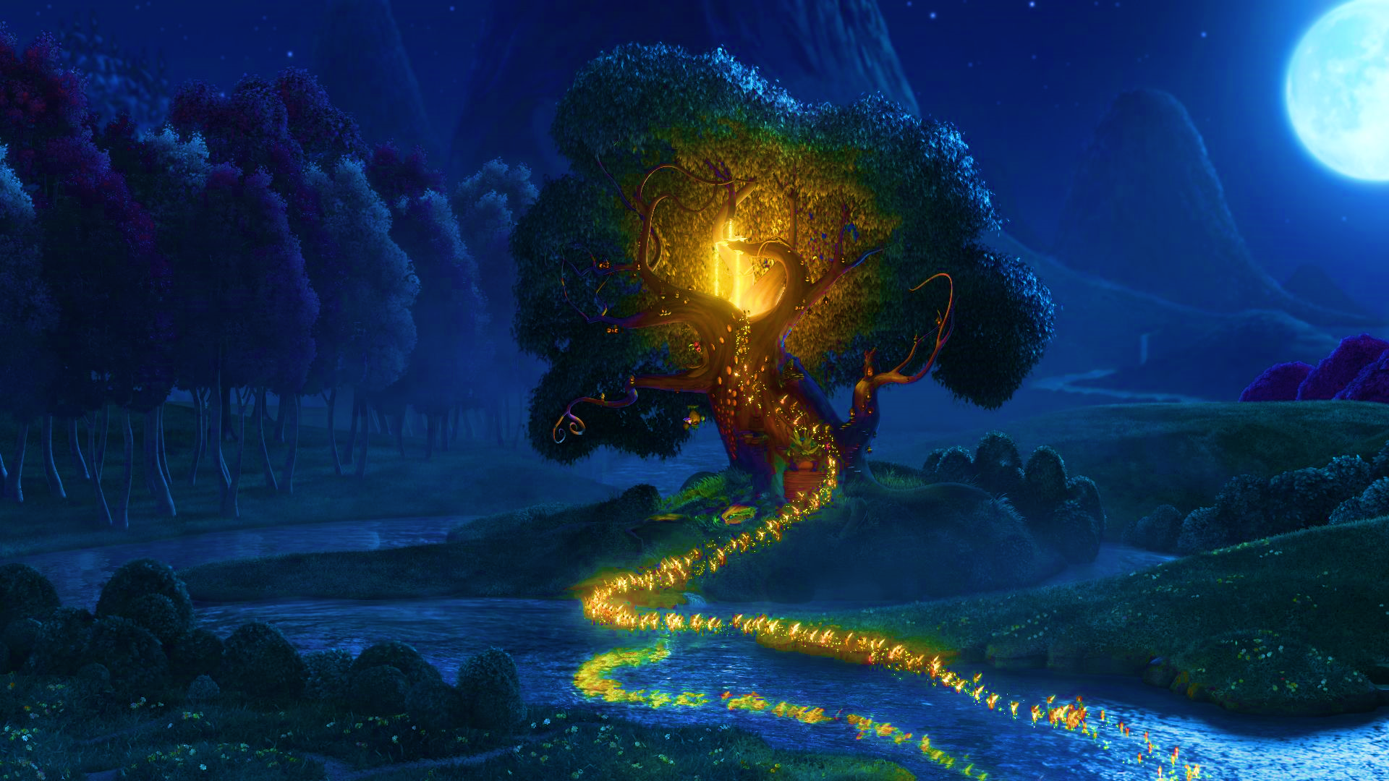
What types of fairies are there?
https://www.youtube.com/watch?v=-XG1D_7aGi8
Watch this video clip from the movie Tinkerbell to see how a fairy comes to be and the different types of fairies.

Slide 3
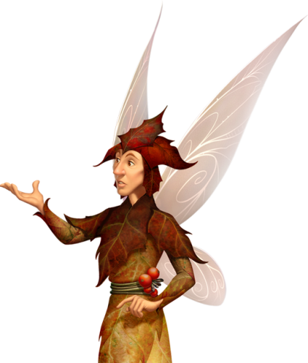
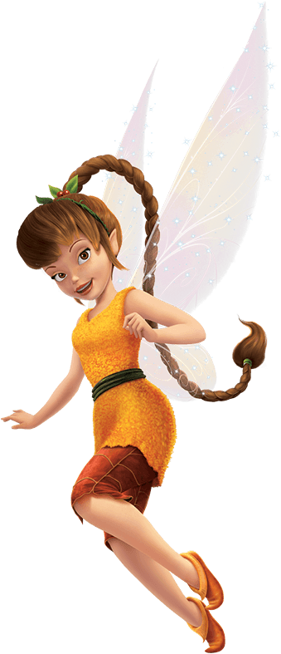
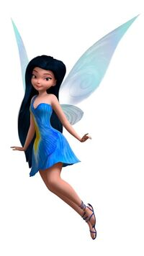
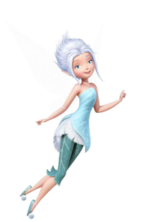
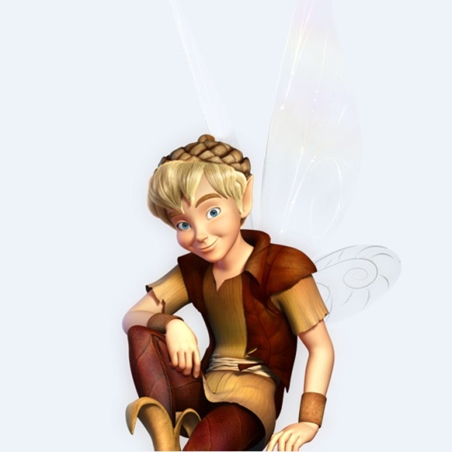
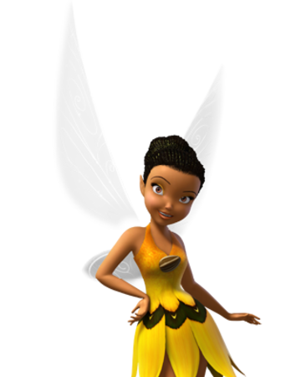
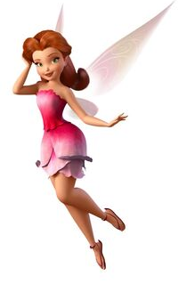
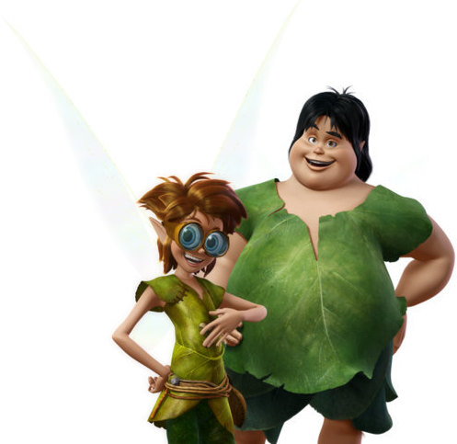
There are lots of types of fairies and they can have different powers.
Water
Winter
Autumn
Animal
Garden
Dust keeper
Light
Tinker

Slide 4
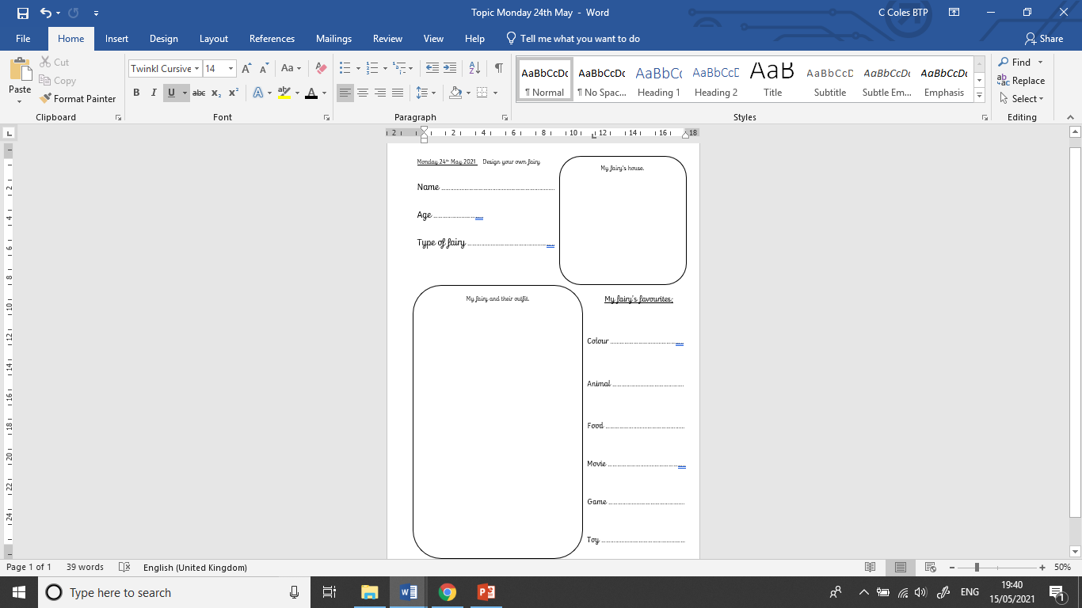
Complete the fact file about your fairy.
Your Task

Slide 5
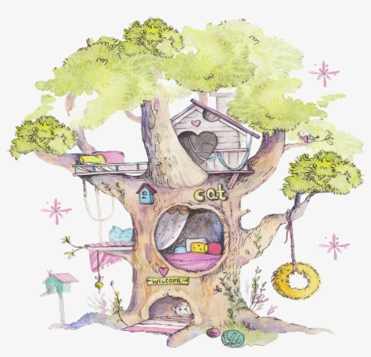
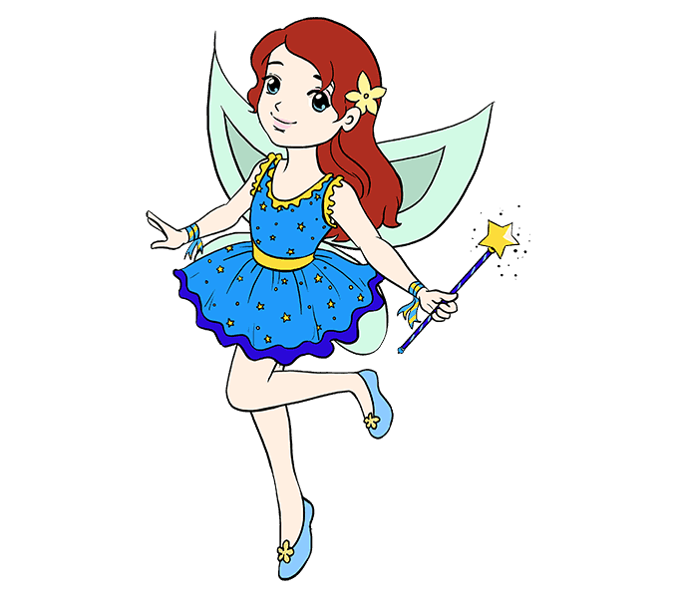
Here is my fact file about my fairy Elenora.
Elenora
134
Water fairy
Flower hair clip
blue
Friendship
bracelets
dolphin
pizza
Little mermaid
Blue dress
with yellow
stars
Magic wand
Stuck in the mud
Polly pocket
Blue dolly shoes

