Slide 1
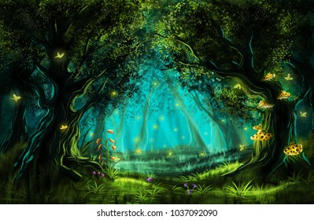
Friday 21st May 2021
Music: Create your own piece of fairy music

Slide 2
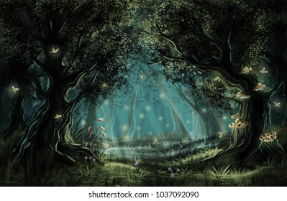
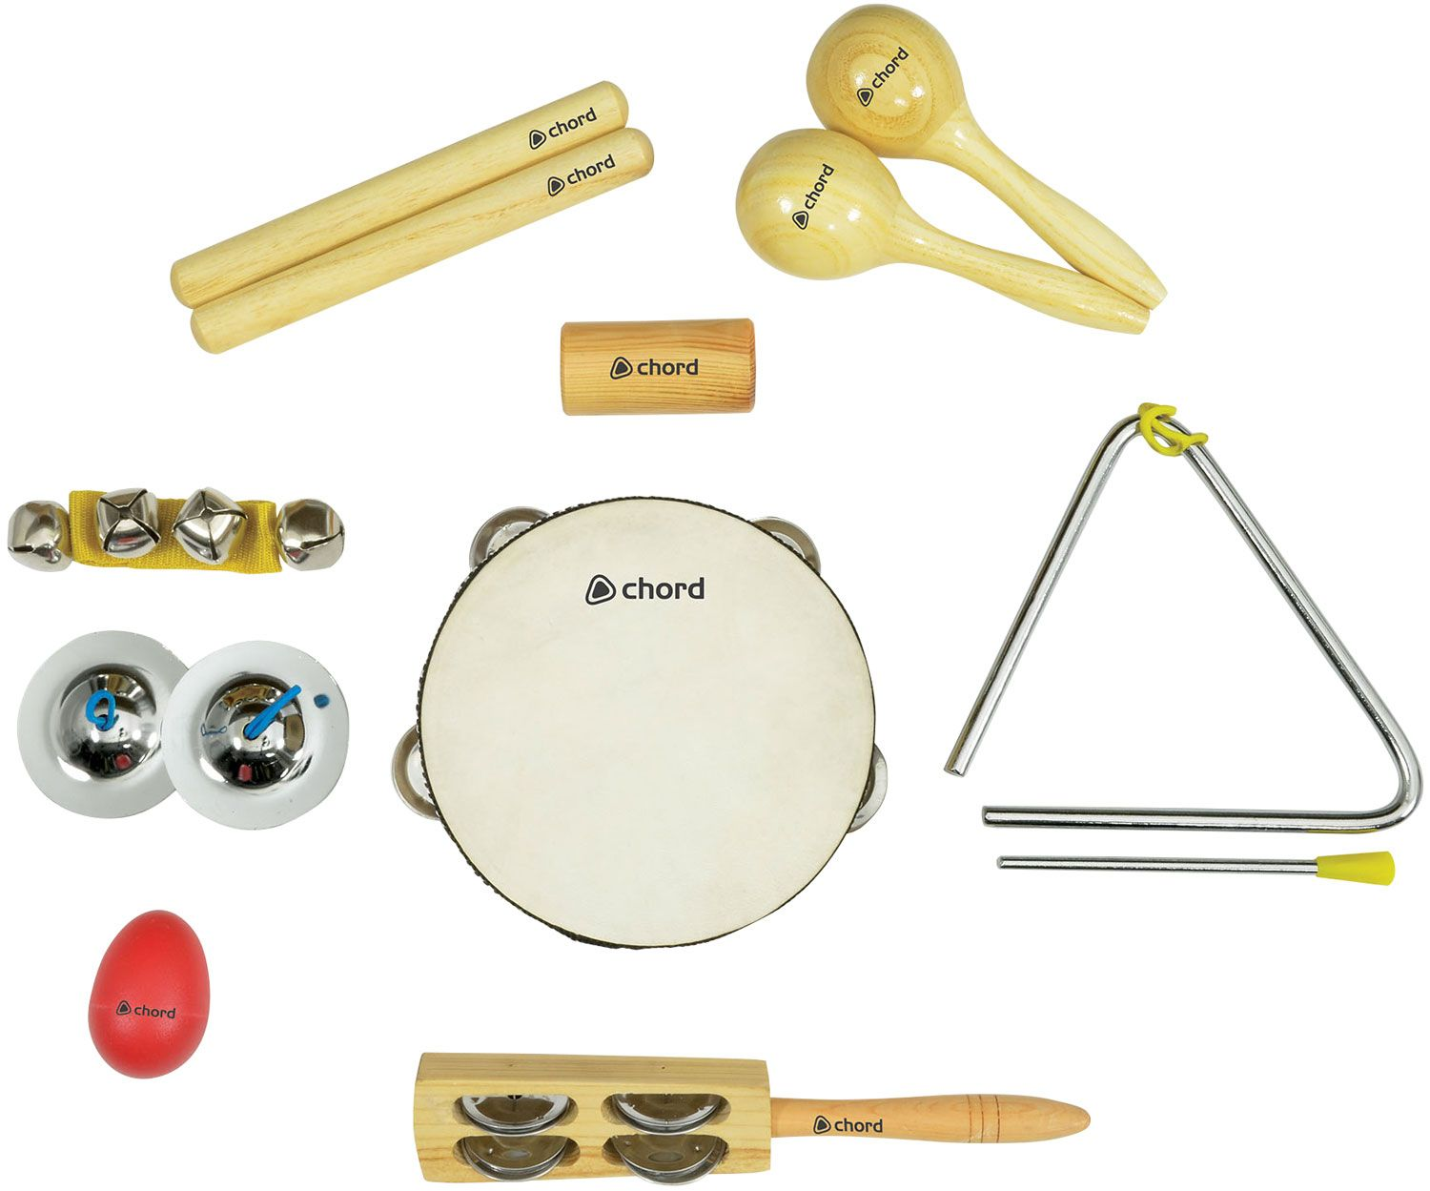
What musical instruments could we use?

Slide 3
Let’s listen to a famous piece of music called ‘The Sugar Plum Fairy’
https://www.youtube.com/watch?v=JZuZwfQR0dE

