Slide 1

Thursday 21st May
Literacy
L.O. To write a poem based on our book ‘Leaf’.

Slide 2
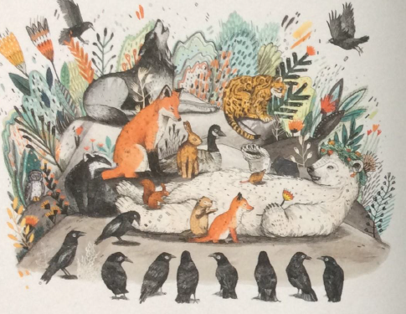
Our book ‘Leaf’ has beautiful illustrations of different places.
You are going to write descriptive sentences about these different landscapes.
Your sentences will form a poem.

Slide 3
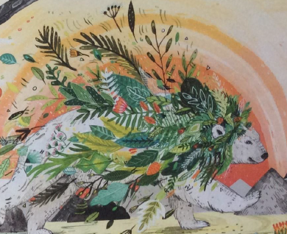
How can you describe a place?
Use adjectives and phrases to describe something
E.g. The gentle waves rippled in the moonlight.
Use a simile to say what something is like. We often use ‘like’ or ‘as’ in a simile.
E.g. The cave was as dark as night.
Use a metaphor to use our imagination
E.g. The leaves danced in the breeze.
Let’s create some descriptive sentences
of the places.

Slide 4

The leaves of the forest were of every shape and size.

Slide 5
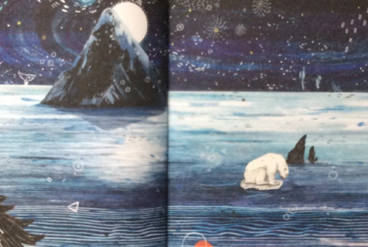
The moonlight dances on the rippling sea.

Slide 6
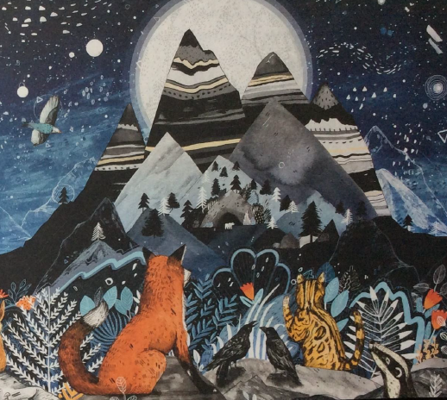
The mountains stood tall like soldiers.

Slide 7
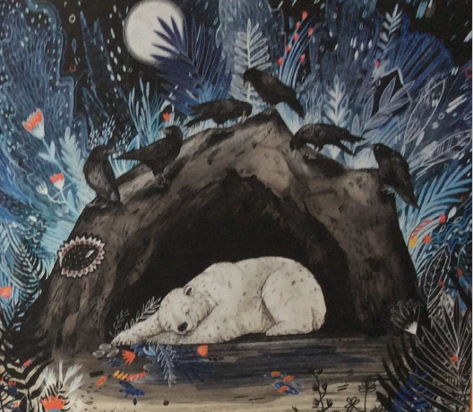
The gloomy cave was inky black.

Slide 8
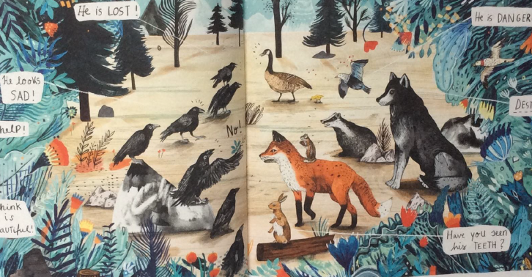
The voices and cries of the worried animals echoed around the wood.

Slide 9
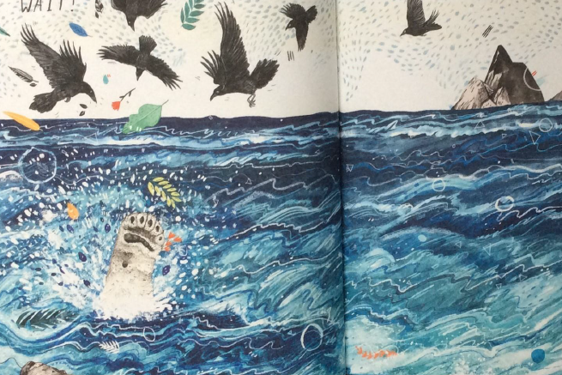
The choppy sea with rolling waves.

Slide 10
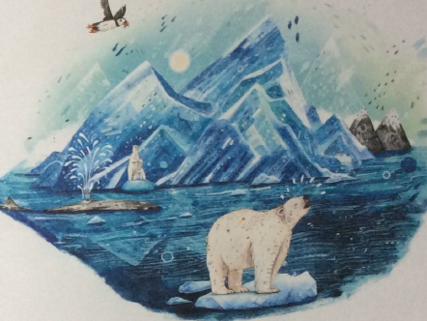
The glistening icebergs are as shiny as glass.

Slide 11
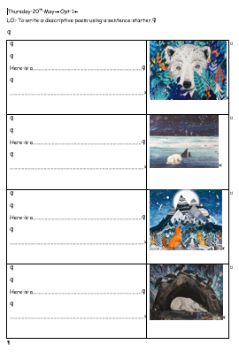
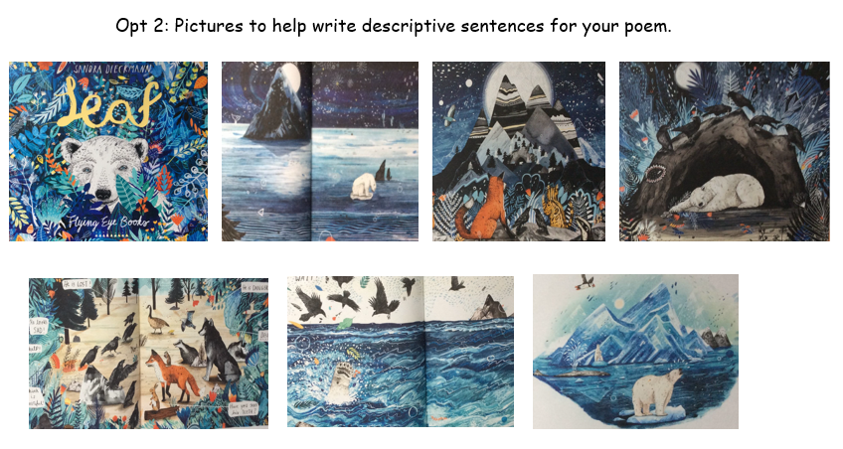
Your Poem: Start each sentence on a new line.
Opt 1
Continue the sentence; Here is … to describe the picture.
Opt 2
Use the picture sheet to help you write your sentences.

Slide 12
Opt 2: Pictures to help write descriptive sentences for your poem.

Slide 13
Thursday 20th May
L.O. To write a poem based on ‘Leaf’.
Use adjectives and describing phrases
Use similes and metaphors
Thursday 20th May
L.O. To write a poem based on ‘Leaf’.
Use adjectives and describing phrases
Use similes and metaphors
Thursday 20th May
L.O. To write a poem based on ‘Leaf’.
Use adjectives and describing phrases
Use similes and metaphors
Thursday 20th May
L.O. To write a poem based on ‘Leaf’.
Use adjectives and describing phrases
Use similes and metaphors
Thursday 20th May
L.O. To write a poem based on ‘Leaf’.
Use adjectives and describing phrases
Use similes and metaphors
Thursday 20th May
L.O. To write a poem based on ‘Leaf’.
Use adjectives and describing phrases
Use similes and metaphors
Thursday 20th May
L.O. To write a poem based on ‘Leaf’.
Use adjectives and describing phrases
Use similes and metaphors
Thursday 20th May
L.O. To write a poem based on ‘Leaf’.
Use adjectives and describing phrases
Use similes and metaphors

