Slide 2
Aim
To learn about what you might see and experience at a Sikh gurdwara.
To learn about why it is an important place to many people.

Slide 3
I can list the things that are the same and different about Sikh gurdwaras around the world.
I can name and describe special objects that can be found inside.
I understand why the gurdwara is an important place by describing what happens there.
I can list rules for how to behave inside.

Slide 4
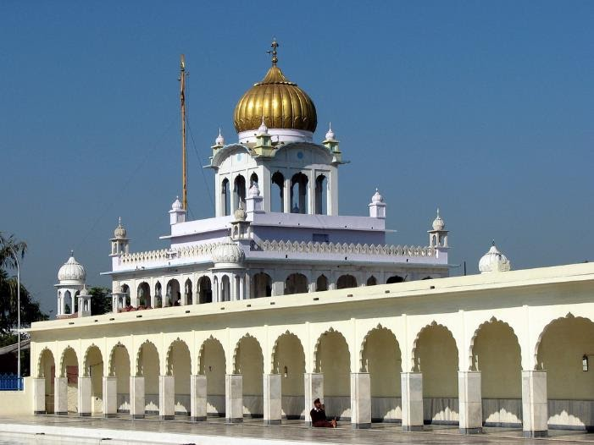
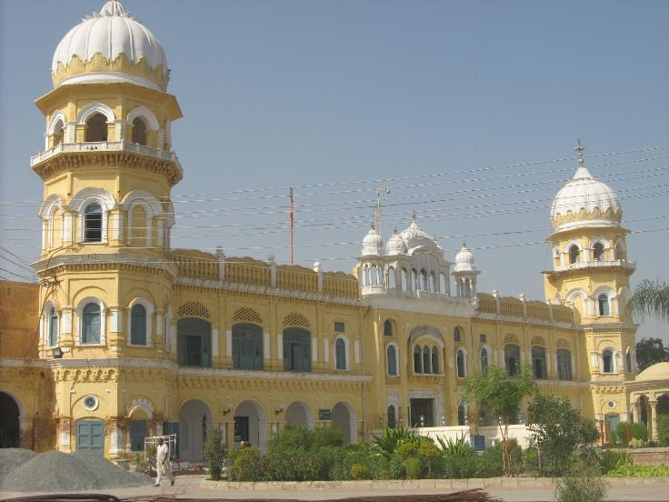
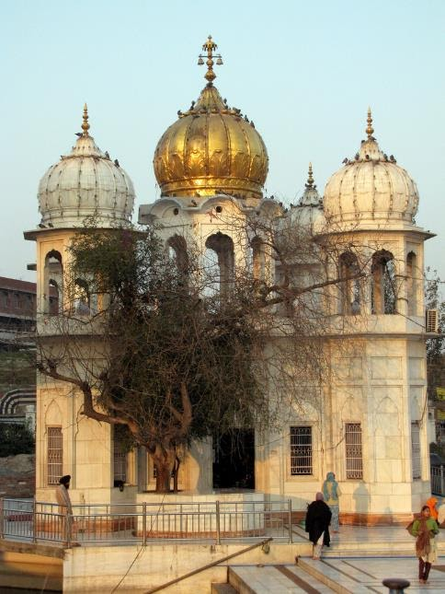
Starter Activity
What do all of these buildings have in common?
Photos courtesy of Shaun D metaclfe away in Thailand and jasleen_kaur (@flickr.com) - granted under creative commons licence - attribution

Slide 5
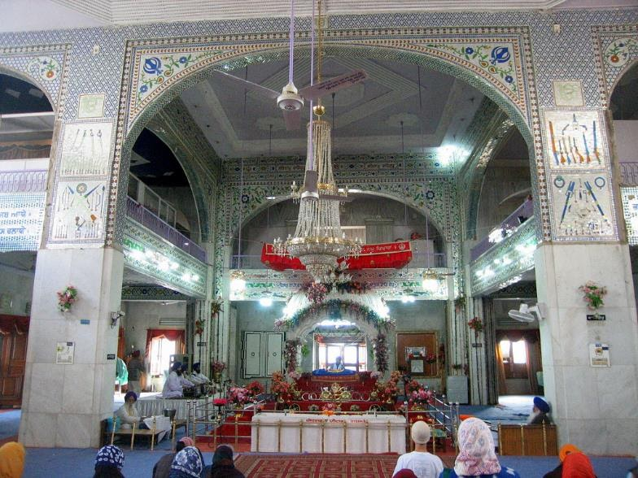
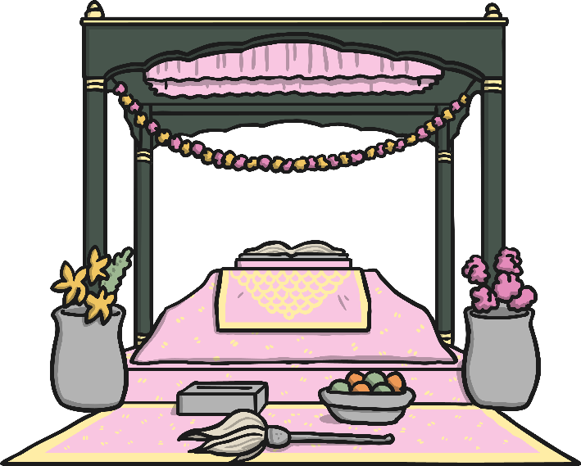
What Is It like inside a Sikh Gurdwara?
Photo courtesy Ajay Tallam (@flickr.com) - granted under creative commons licence - attribution

Slide 6
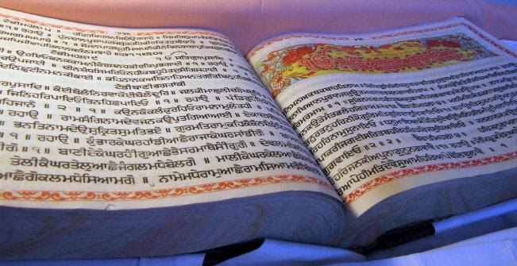
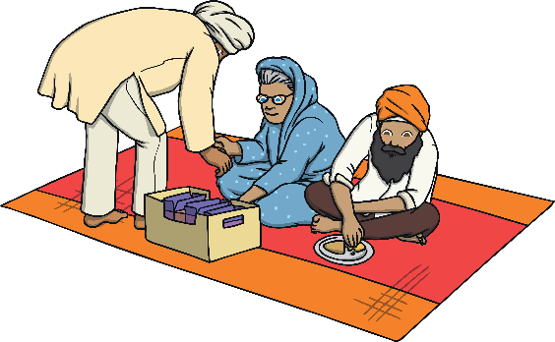

Important Features of a Sikh Gurdwara
What is it like inside a
Sikh gurdwara?
Guru Granth Sahib
This is the Sikh holy book. It is treated like a person and even has its own room during the night. The book is placed on a raised platform under a canopy and covered with an expensive cloth during the day.
Chaur
This is a fan which is waved over the Guru Granth Sahib as a sign of respect.
Langar
This is a free kitchen where food is served to worshippers without charge.
.

Slide 7
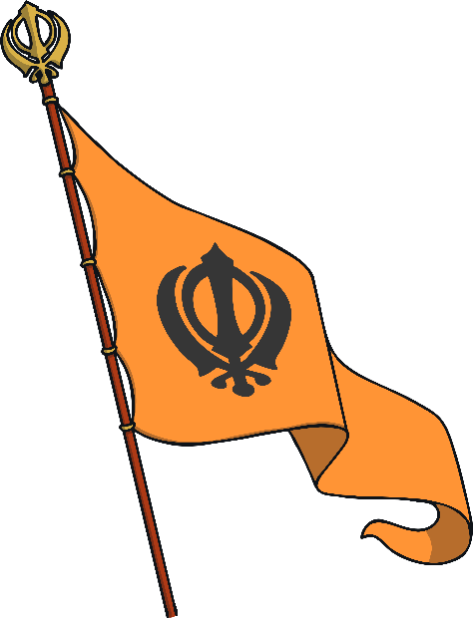

Important Features of a Sikh Gurdwara
What is it like inside a
Sikh gurdwara?
Flags
Gurdwaras fly flags outside to show that they are a special place of worship. The flag contains the Sikh symbol.
N
The Four Doors
There are four doors into the gurdwara to show that people from the north, east, south and west are welcome.
W
E
S

Slide 8
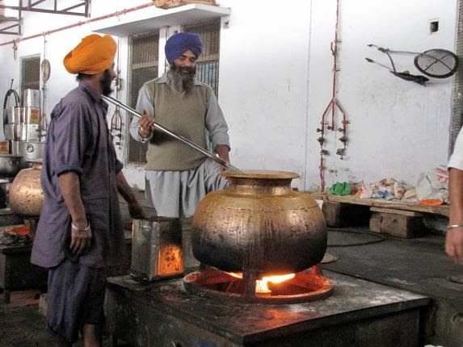
Why Do People Go to a Gurdwara?
Many Sikhs visit a gurdwara for worship. The gurdwara is also a place to learn more about Sikhism. The gurdwara is a community centre too, offering food, shelter and company for those who need it.
The morning service begins with singing a hymn. Then, there is a religious talk (called a sermon) and prayers are said. Next, there are readings from the Guru Granth Sahib (the holy book).Last of all, food is offered to everyone so people can eat and spend time together.

Slide 9
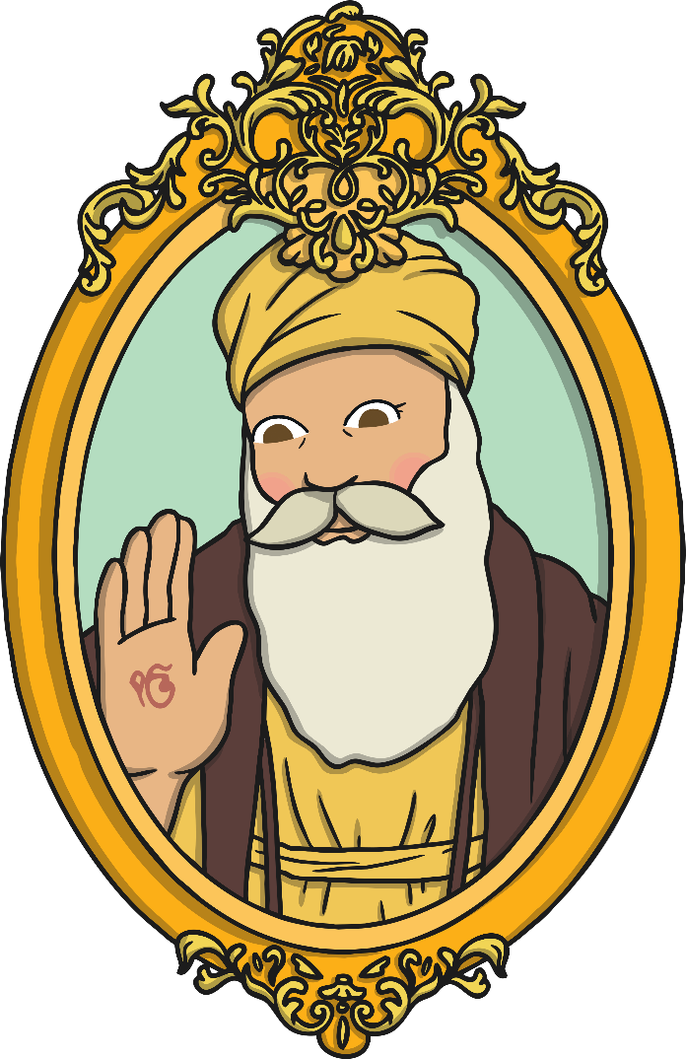
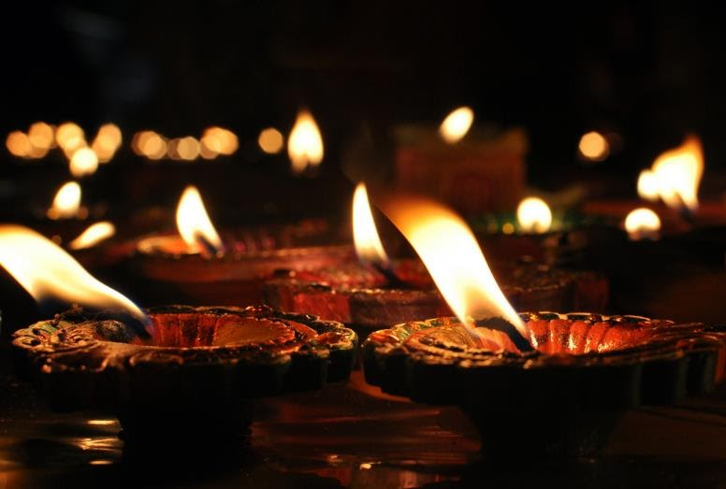
Why Do People Go to a Gurdwara?
What is it like inside a
Sikh gurdwara?
People also visit the gurdwara during special festivals to celebrate Gurus such as Guru Nanak because he started the Sikh faith.
Sikhs don’t have priests so any Sikh can lead the prayers and read from the Guru Granth Sahib.

Slide 10
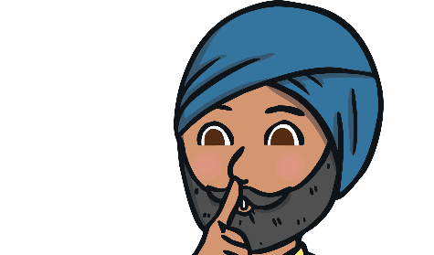
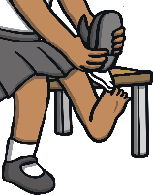
Showing respect
Anyone is welcome in a gurdwara but there are certain rules to follow:
Cover your head.
Sit quietly on the floor with your legs crossed, facing the Guru Granth Sahib.
Take off your shoes and wash hands and feet before entering.
Never point your feet at the Guru Granth Sahib as this is disrespectful.
When you enter the main prayer hall, bow in front of the holy book, touching the floor with your forehead.
Men and women sit in different places.
Offer a donation such as money, flowers or food.

Slide 11

Plenary
Why do you think it is important to many Sikhs to worship and eat
together in the gurdwara?
Do you have any other questions about this place of worship?

