Slide 1

Tuesday 18th May 2021
LO: To make a prediction from an illustration

Slide 2
Tuesday 18th May 2021
Have a look at the front cover of this book.

Slide 3
Tuesday 18th May 2021
Who do think the bear is?
Where is he?
How did he get there?
Does he have friends?

Slide 4
Tuesday 18th May 2021
Your task: Write a short story about how the polar bear found himself in the forest.
Example: I think the magical polar bear called Leaf was in a zoo with his family. One morning during feeding time one of the zoo keepers left the gate open. Leaf got very excited and left the zoo and then walked as fast as he could towards a delicious smell. He followed the smell for miles and when Leaf turned all Leaf could see was huge green trees and beautiful flowers. It was then that he realised he was lost.

Slide 5
sentence starters and word bank
Tuesday 18th May 2021
I think that the polar bear is called…..
He got into the forest by …………
………………. will make friends with ………….
white
looked
Polar bear
travelled
animals
forest
because
arrived

Slide 6

Now we are going to read the
story to see if your idea was correct
Tuesday 18th May 2021

Slide 7
Tuesday 18th May 2021

Slide 8
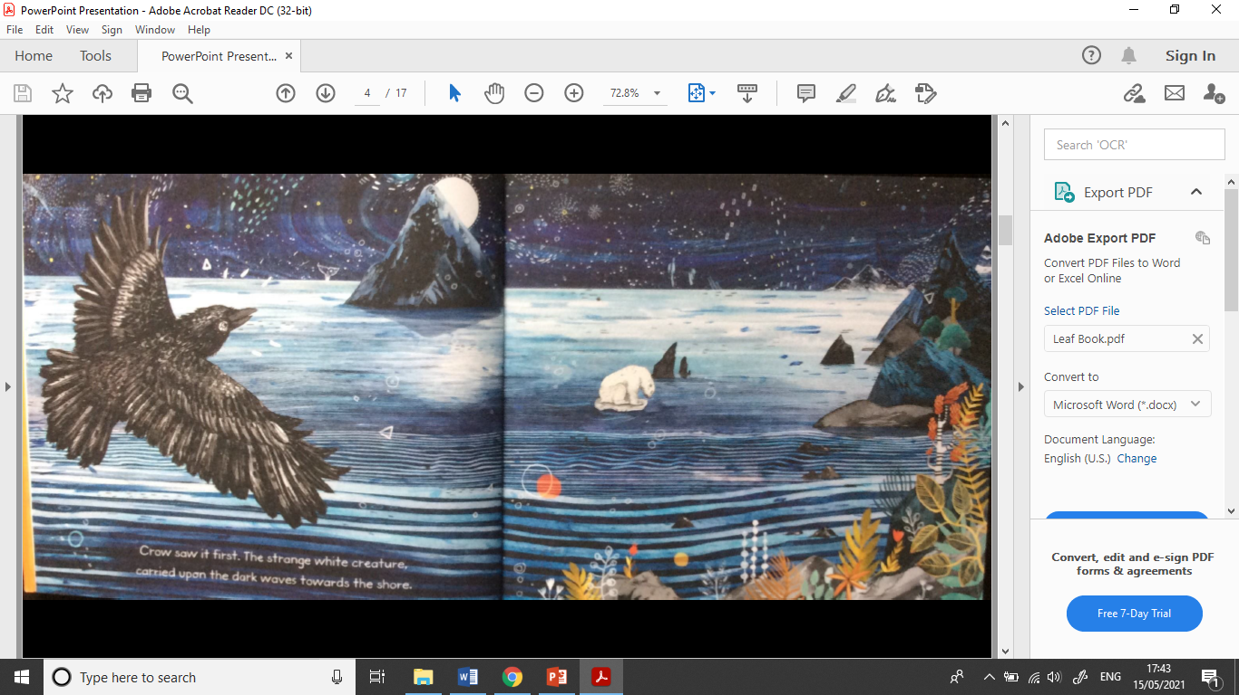

Slide 9
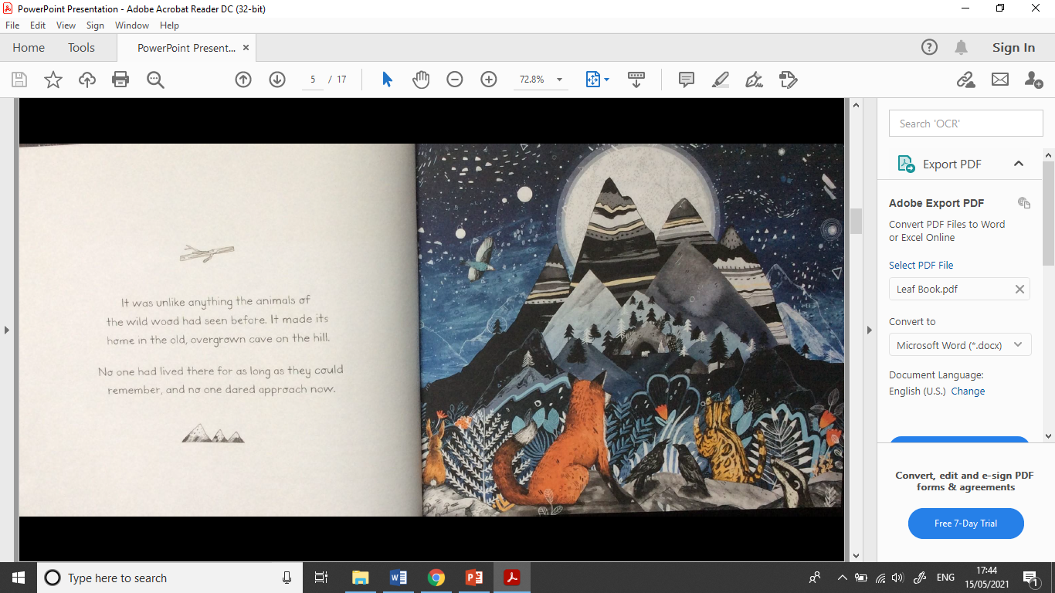

Slide 10
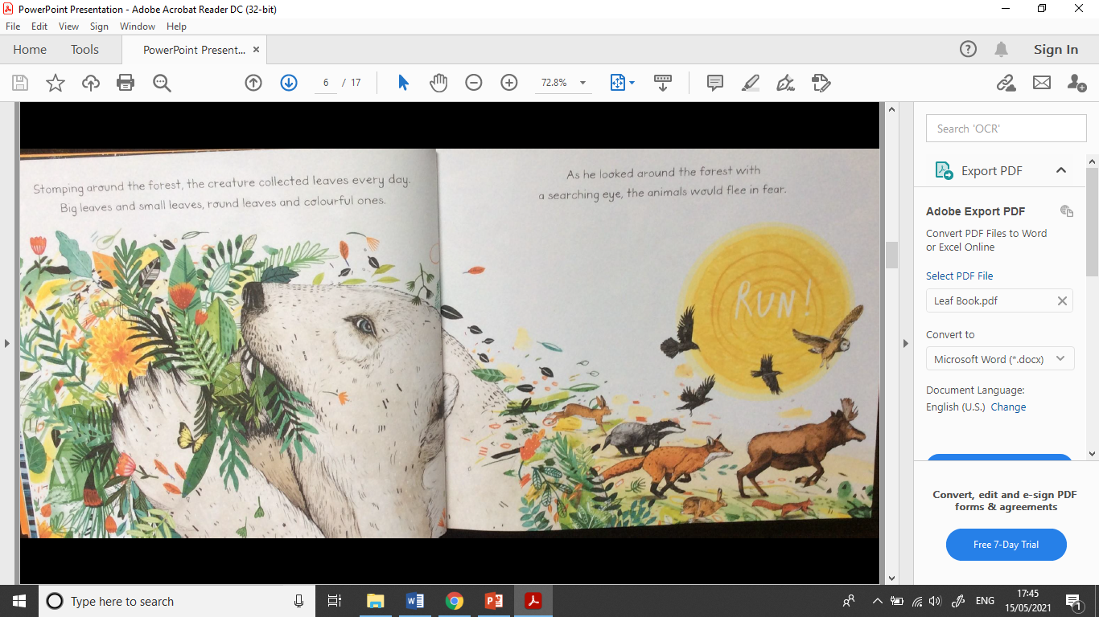

Slide 11
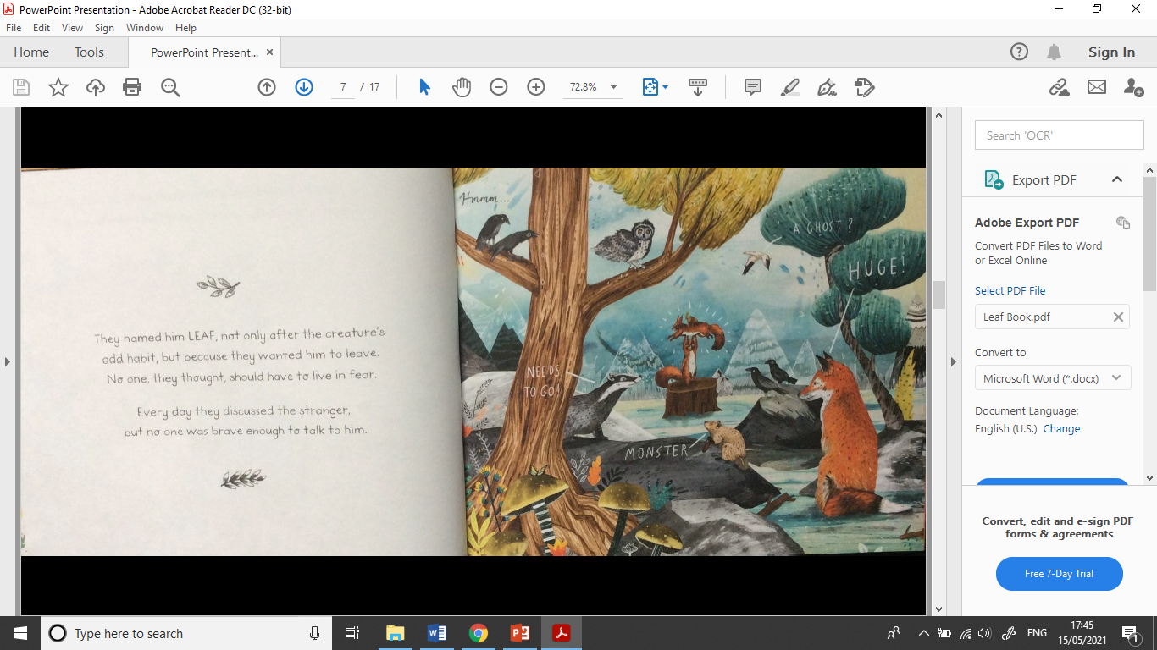

Slide 12
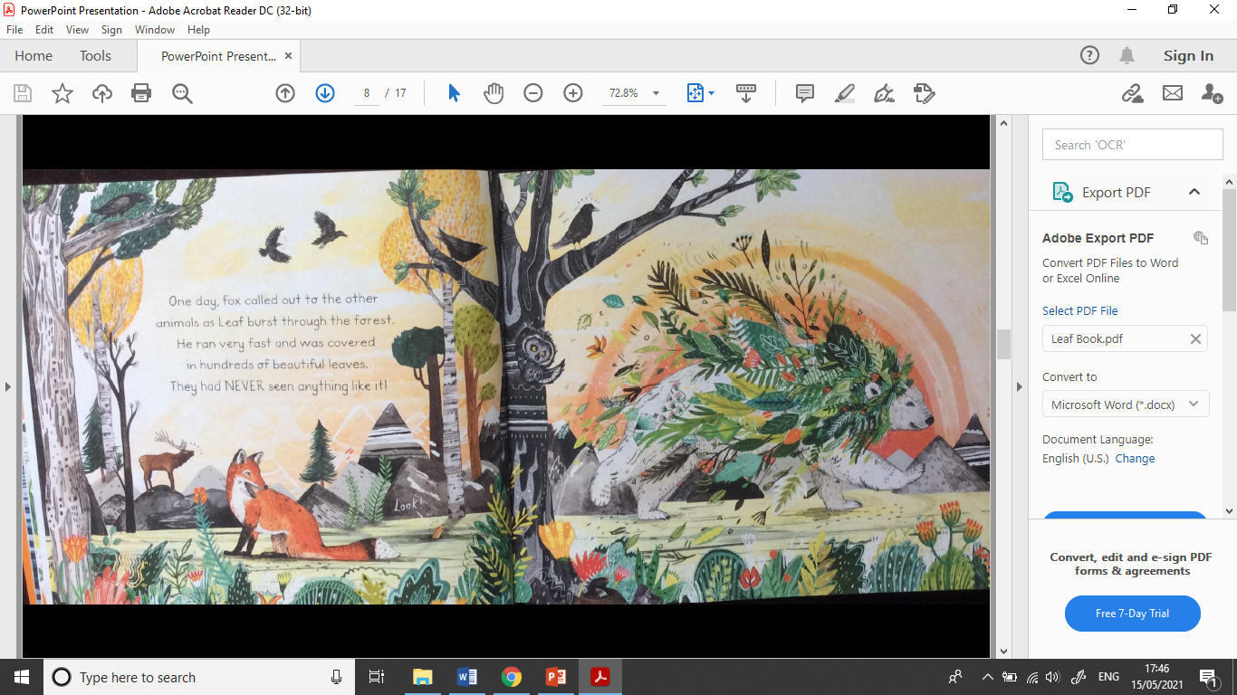

Slide 13
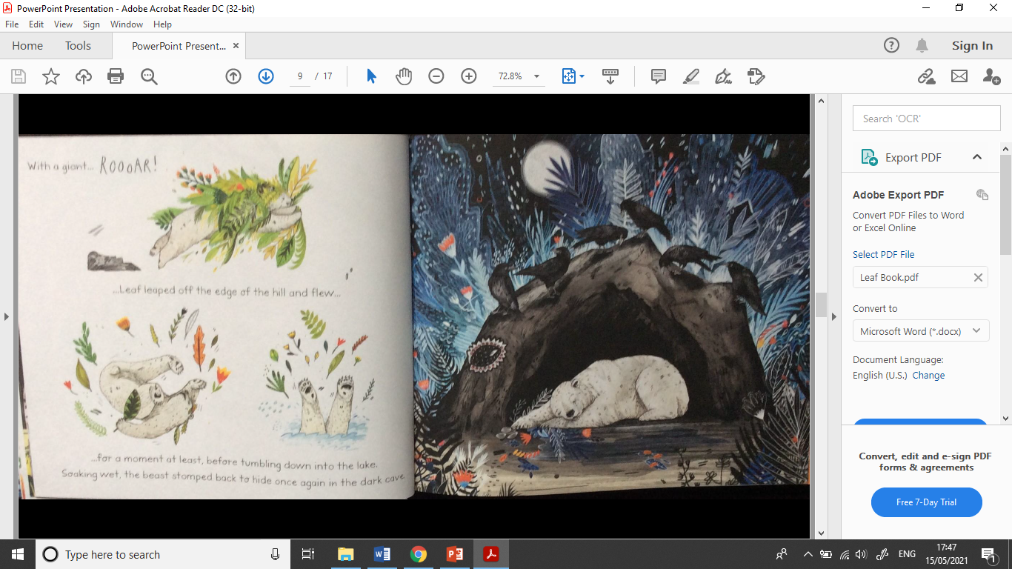

Slide 14
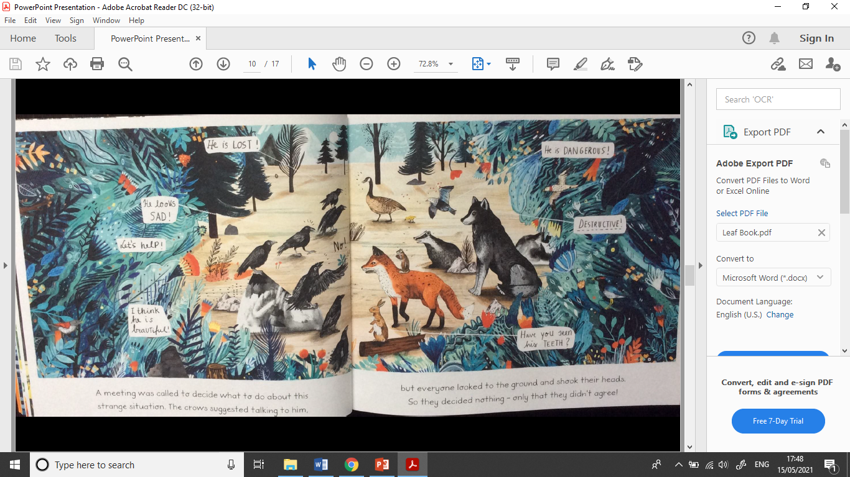

Slide 15
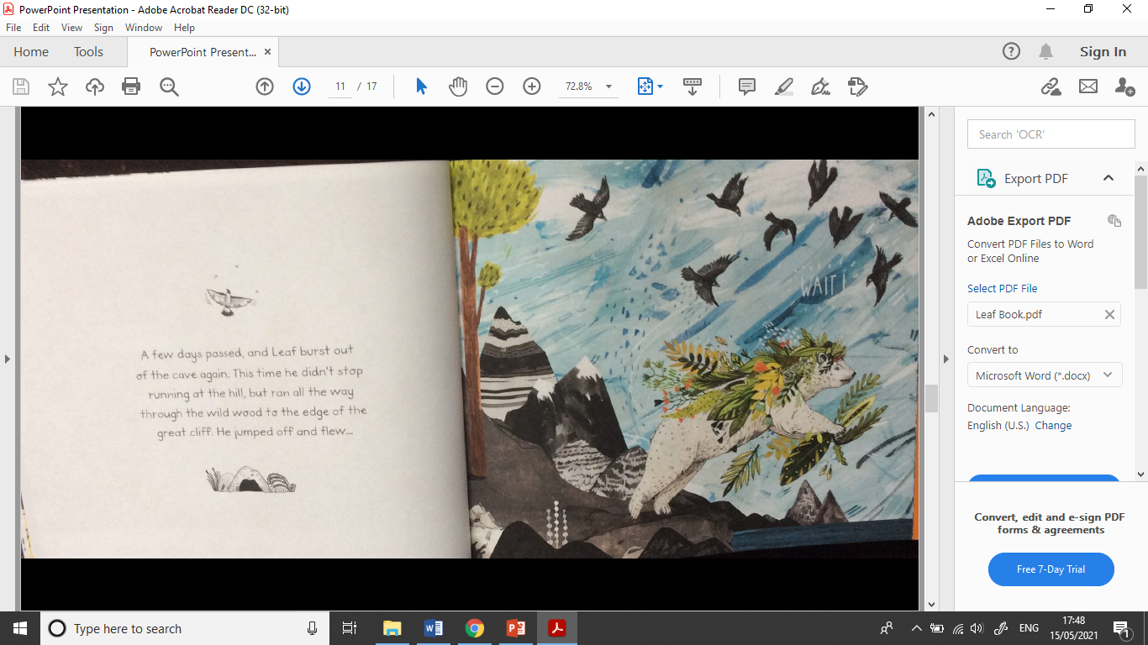

Slide 16
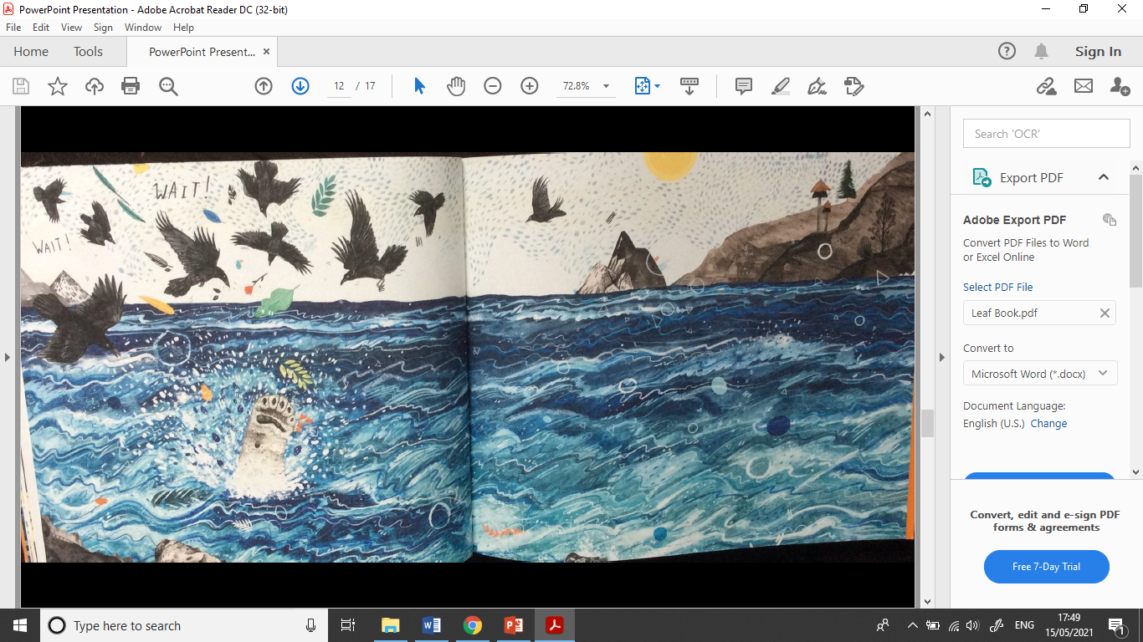

Slide 17
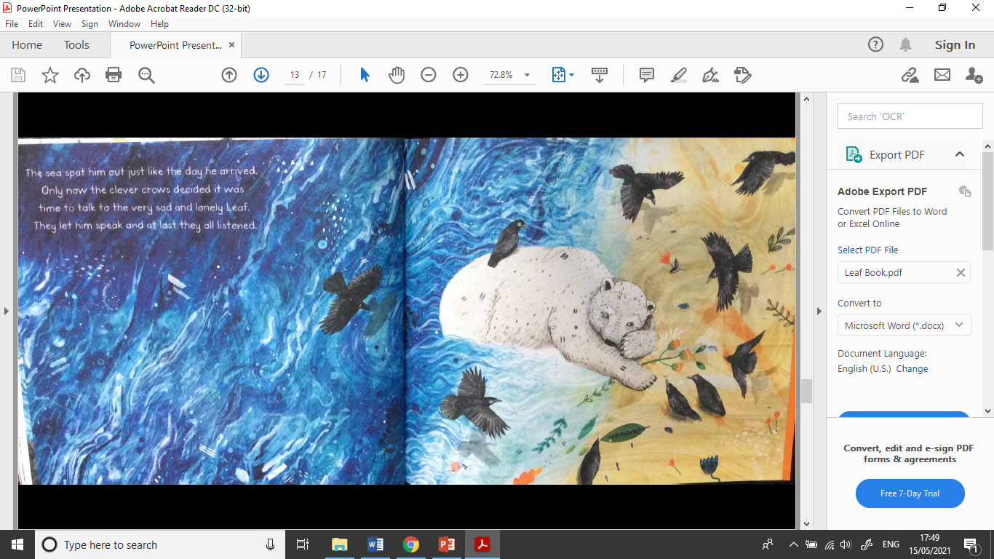

Slide 18
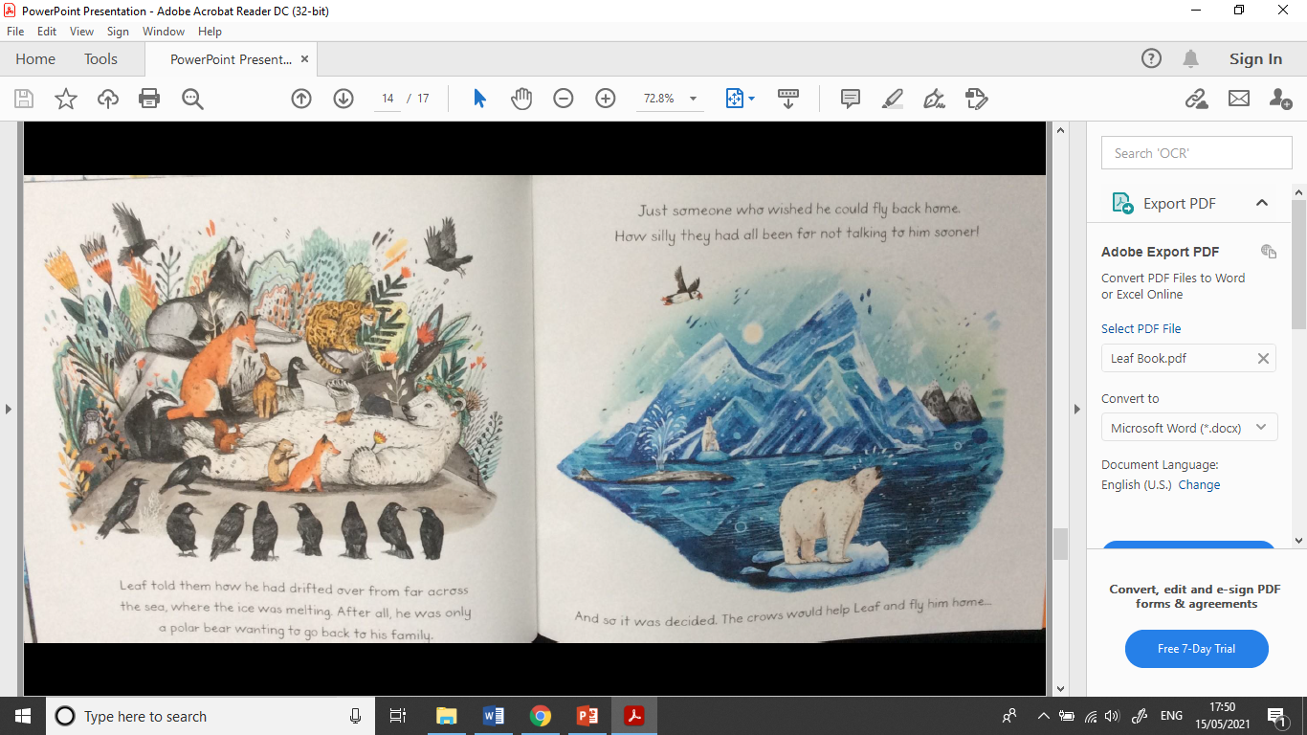

Slide 19
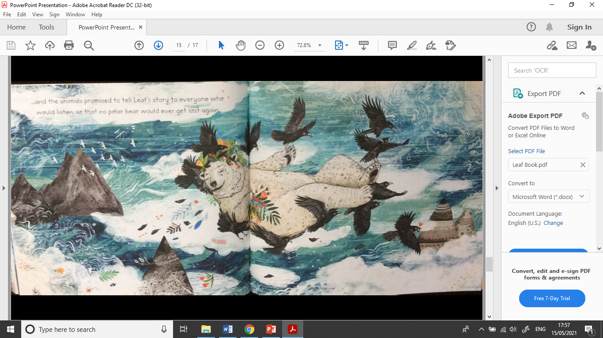

Slide 20


