Slide 1
Then create your own cartoon strip about Doris and a new adventure!

Slide 2
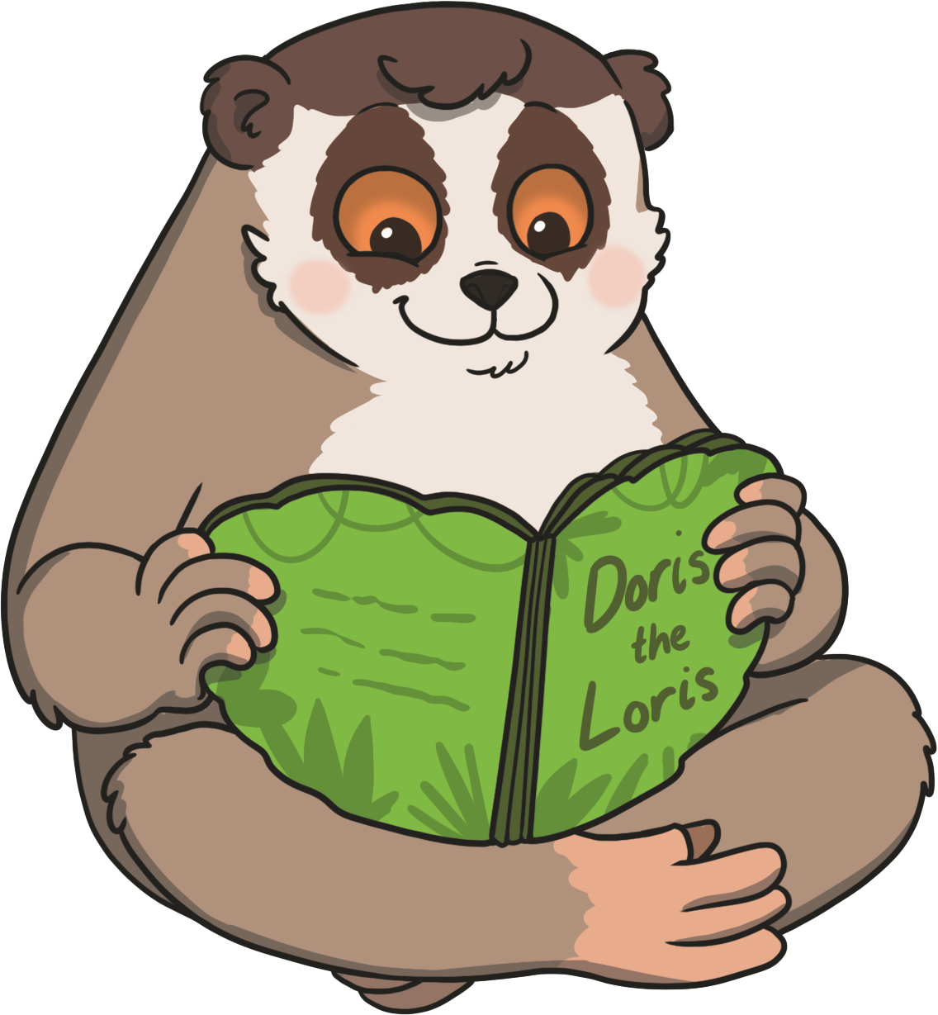
Doris the Loris
Read the story ‘Doris the Loris’ and look at the illustrations.
To see a question about the story, click this button:
?

Slide 3

?
What do you think this story is about?
?
Where do you think this story is set?
?
What is a loris?

Slide 4
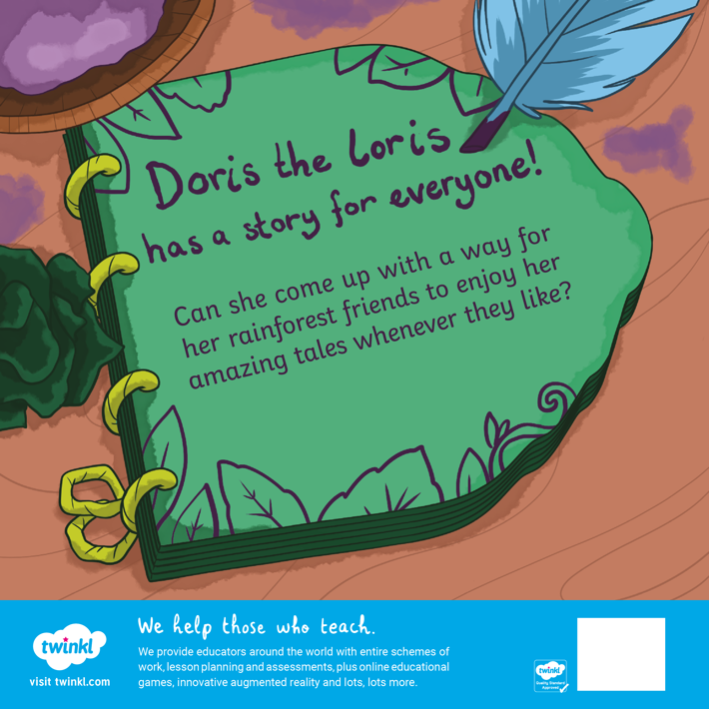
?
Who do you think Doris’s friends will be?
?
What is a ‘tale’?

Slide 5
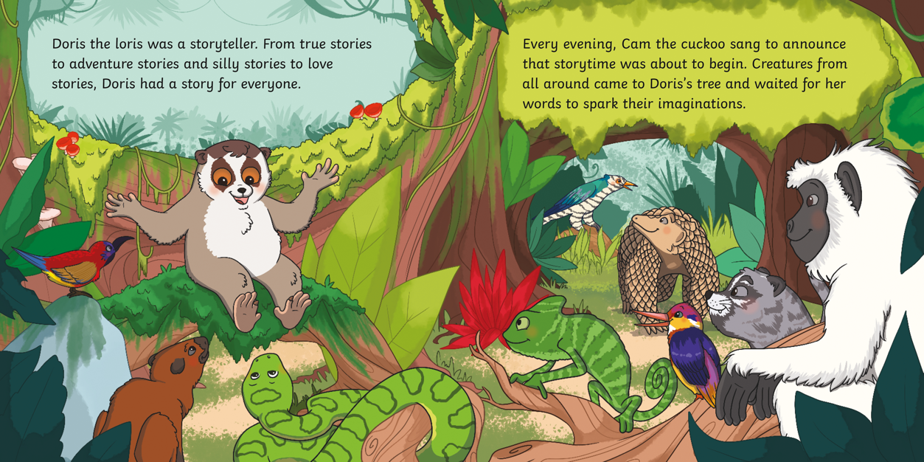
?
Which animal do you think is Doris? Why?

Slide 6
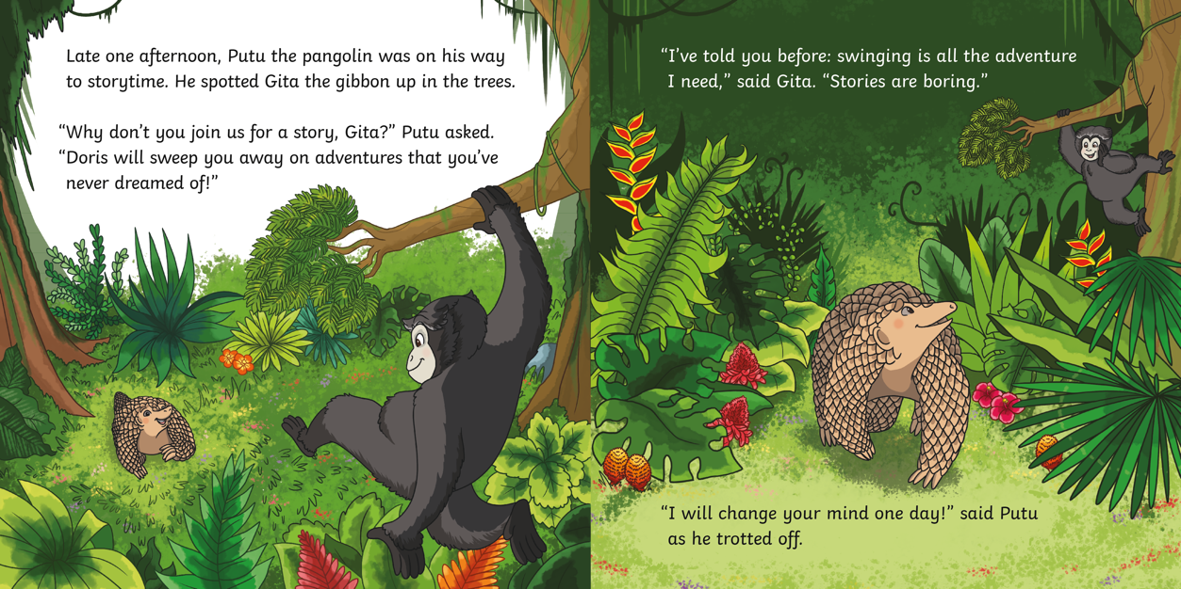
?
Where is Putu the pangolin going?

Slide 7
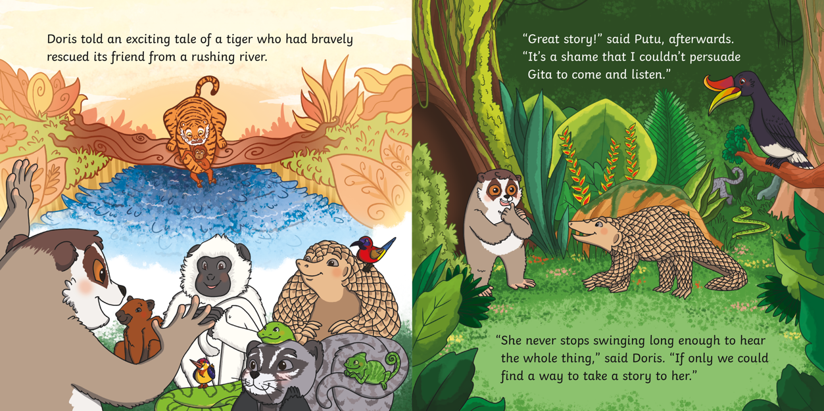
?
What is the tiger doing in Doris’s story?

Slide 8
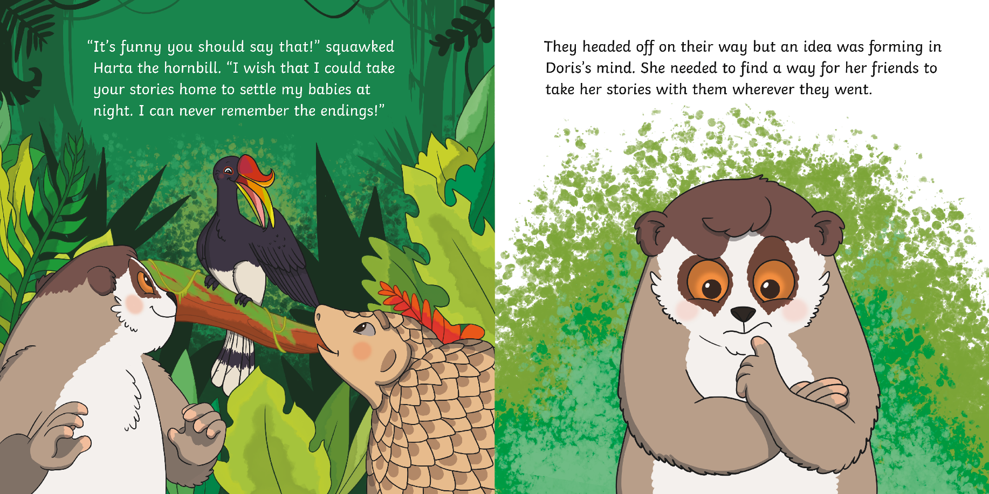
?
What do you think Doris is thinking?

Slide 9
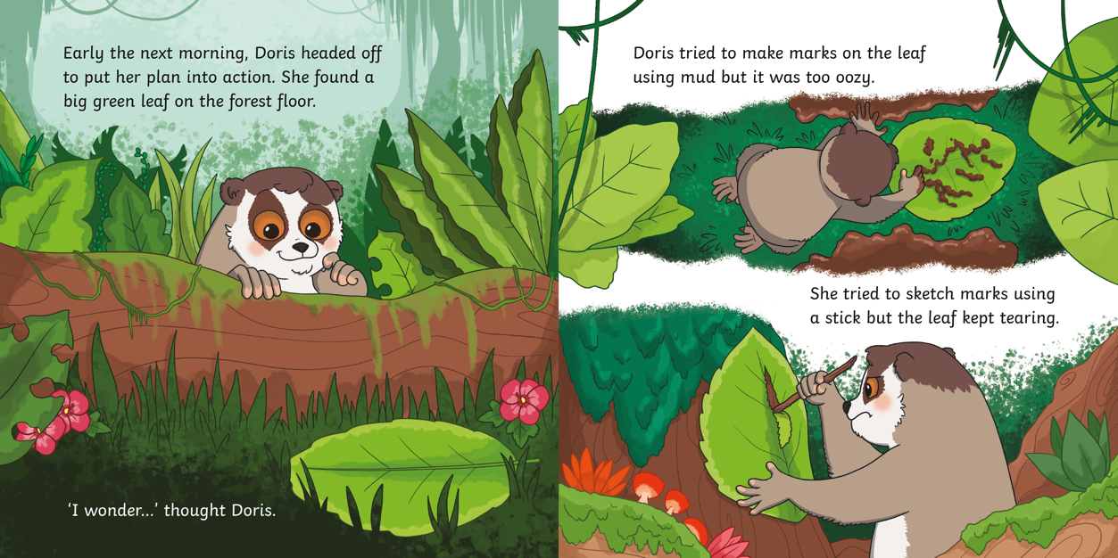
?
What do you think Doris is trying to do with the leaf?

Slide 10
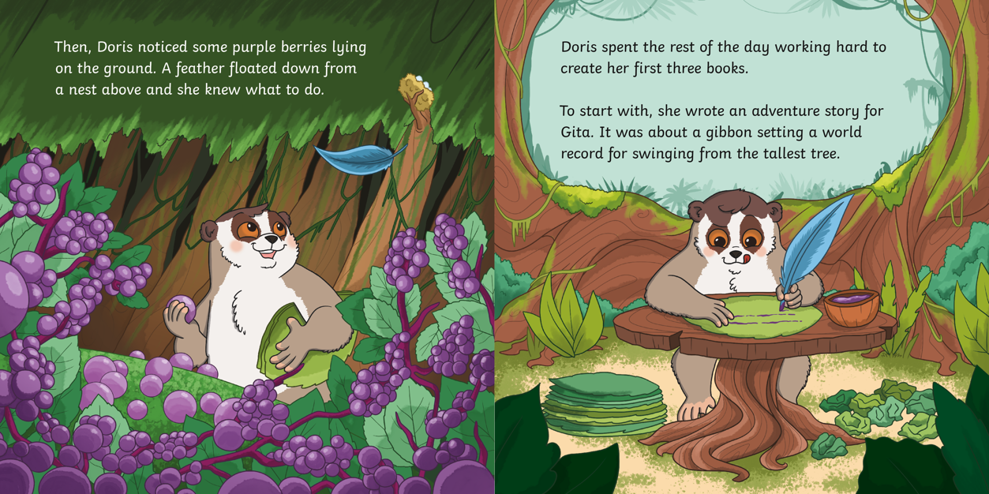
?
What type of story is Doris writing for Gita?

Slide 11
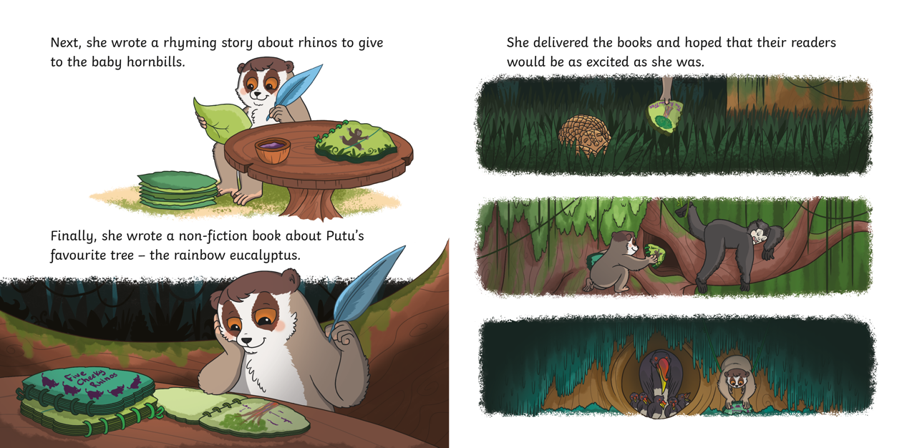
?
What is a non-fiction book?

Slide 12
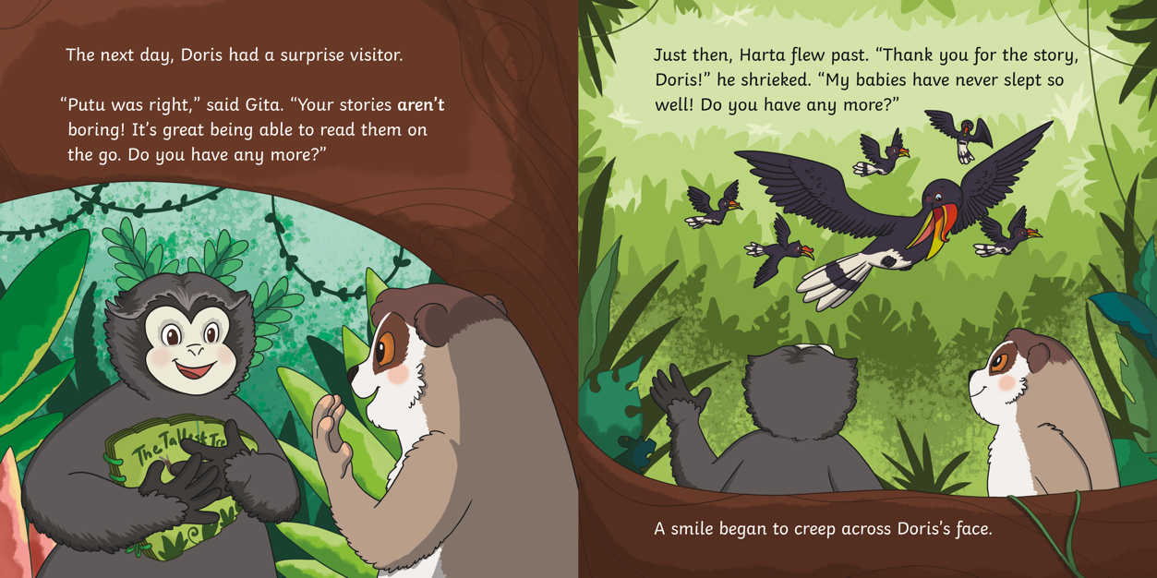
?
What was Putu ‘right’ about?

Slide 13
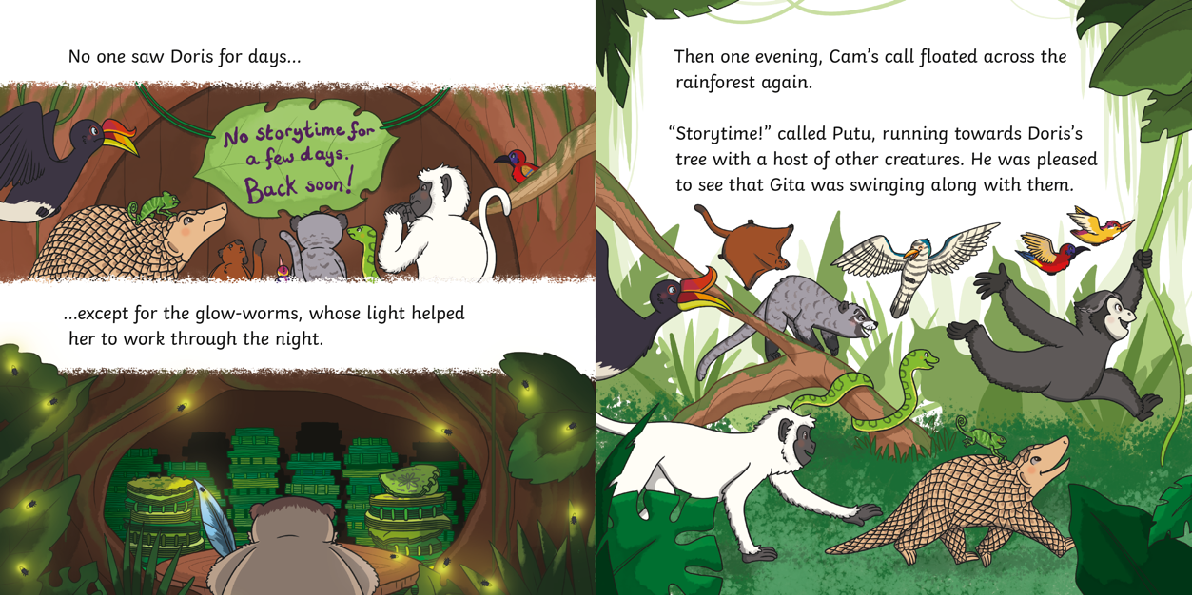
?
Why is Putu smiling?

Slide 14
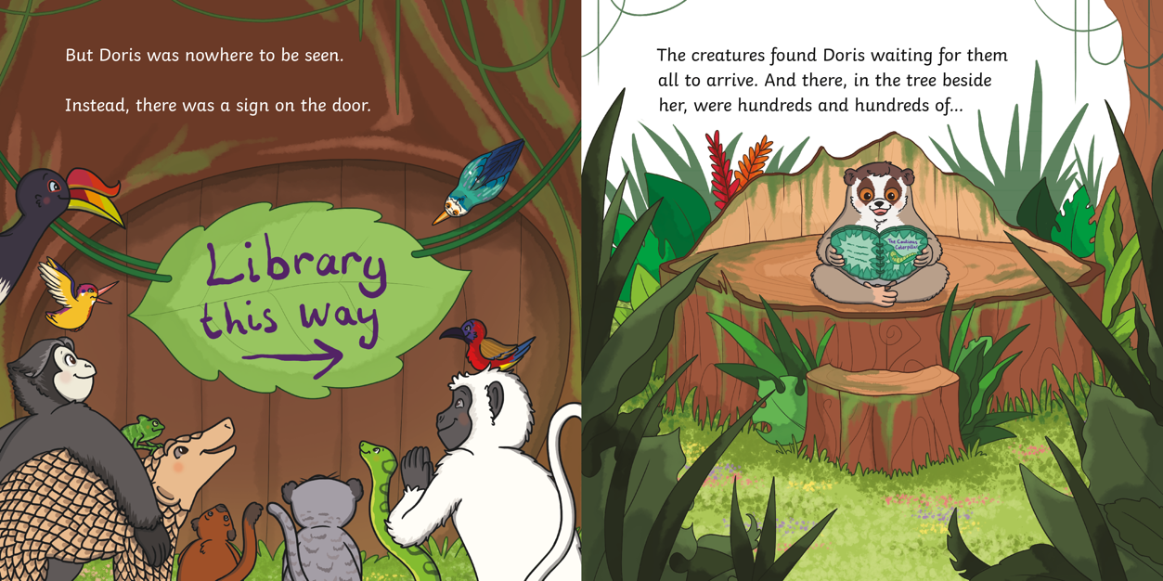
?
What do you think is going to be in the tree beside Doris?

Slide 15
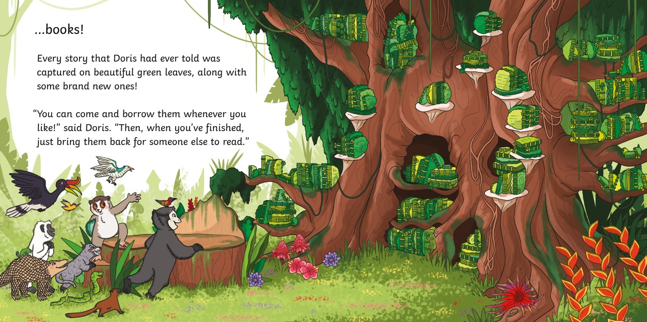
?
What does Doris say the animals should do when they have finished reading their story?

Slide 16
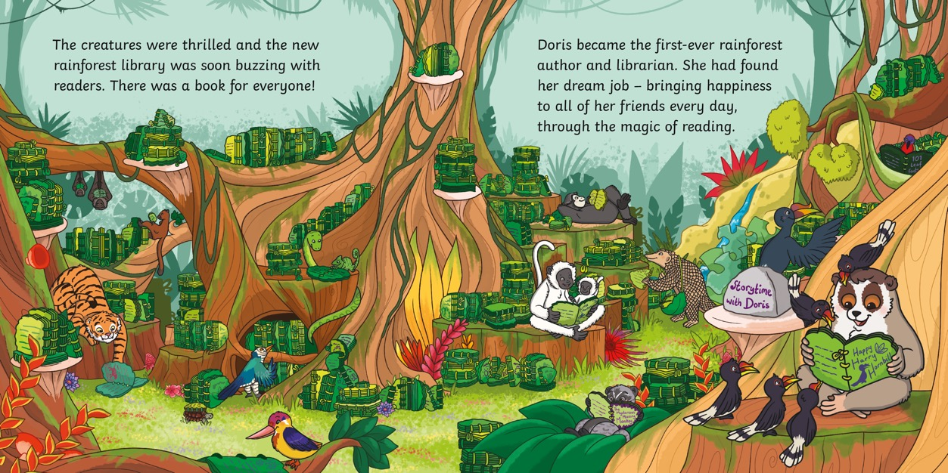
?
What is a library? Have you ever been to one?

Slide 17
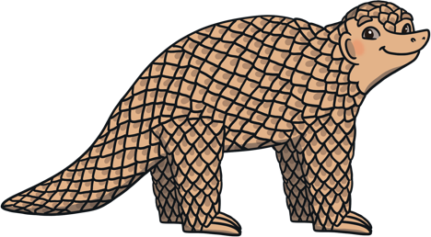
?
Who is the main character in this story?
Putu
the pangolin
Doris the loris
Harta
the hornbill

Slide 18
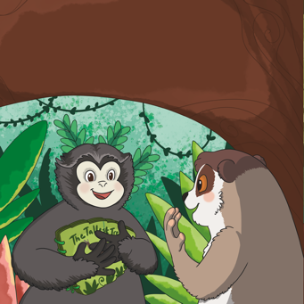
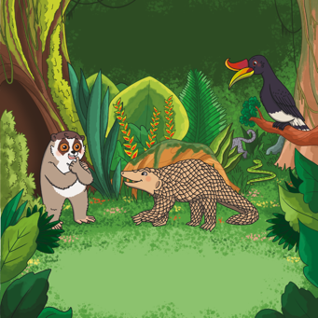
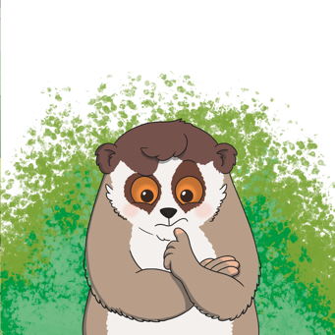
?
Why does Doris decide to make some books?
So her friends
can take them wherever they go.
Because she
is bored.
Because she keeps forgetting her stories.

Slide 19
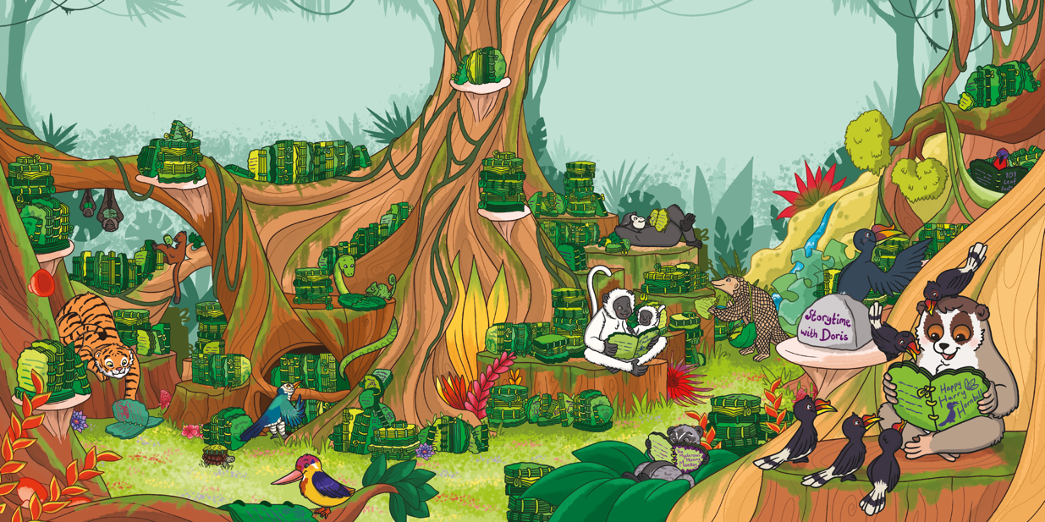
?
Do you think Doris’s idea was good? Why?

Slide 20
?
Did you enjoy this story? What was your favourite part?
?
Can you name all of the animals we meet?

Slide 21
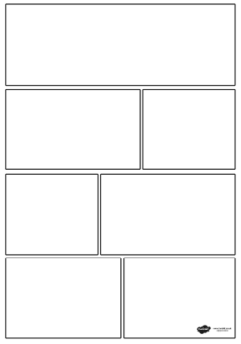
Using your cartoon strip template, think of your own story for Doris the Loris.

