Slide 1
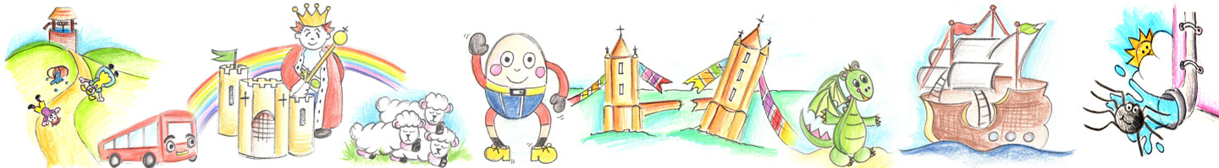
Nursery Rhymes and tongue twisters
Friday 30th April 2021

Slide 2
Incy Wincy Spider
Incy Wincy Spider climbed up the water spout,
Down came the rain and washed pour Incy out,
Out came the sunshine and dried up all the rain,
So Incy Wincy Spider climbed up the spout
again.

Slide 3
Wind the bobbin up
Wind the bobbin up, Wind the bobbin up,
Pull, pull, clap, clap, clap
Wind the bobbin up, Wind the bobbin up,
Pull, pull, clap, clap, clap
Point to the ceiling, point to the floor,
Point to the window, point to the door.

Slide 4
Humpty Dumpty
Humpty Dumpty sat on the wall,
Humpty Dumpty had a great fall,
All the king’s horses and all the king’s men
Couldn’t put Humpty together again.

Slide 5
Hey Diddle Diddle
Hey, diddle, diddle,
The cat and the fiddle,
The cow jumped over the moon.
The little dog laughed
To see such sport,
And the dish ran away with the spoon.

Slide 6
Hickory Dickory Dock
Hickory, dickory, dock,
The mouse ran up the clock.
The clock struck one,
And down he run,
Hickory, dickory, dock.

Slide 7
Jack and Jill
Jack and Jill
Went up the hill
To fetch a pail of water.
Jack fell down
And broke his crown
And Jill came tumbling after.

Slide 8
Little Bo Peep
Little Bo Peep has lost her sheep
And can't tell where to find them.
Leave them alone, And they'll come home,
Wagging their tails behind them

Slide 9
Little Miss Muffet
Little Miss Muffet, sat on a tuffet,
Eating her curds and whey;
Along came a spider,
Who sat down beside her
And frightened Miss Muffet away.

Slide 10
Mary Had a Little Lamb
Mary had a little lamb, little lamb, little lamb,
Mary had a little lamb, its fleece was white as
snow.
And everywhere that Mary went, Mary went, Mary
went, and everywhere that Mary went, the lamb
was sure to go.

Slide 11
One, Two, Buckle my Shoe
One, two, buckle my shoe;
Three, four, knock at the door;
Five, six, pick up sticks;
Seven, eight, lay them straight;
Nine, ten, a good fat hen;
Eleven, twelve, dig and delve;
Thirteen, fourteen, maids a-courting;
Fifteen, sixteen, maids a-kissing;
Seventeen, eighteen, maids a-waiting;
Nineteen, twenty, I've had plenty.

Slide 12
Pat a Cake
Pat-a-cake, pat-a-cake,
Baker's man!
So I do, master,
As fast as I can.
Pat it, and prick it,
And mark it with T,
Put it in the oven
For Tommy and me.

Slide 13
Peter Piper
Peter Piper picked a peck of pickled peppers.
A peck of pickled peppers Peter Piper picked.
If Peter Piper picked a peck of pickled peppers,
Where's the peck of pickled peppers Peter Piper picked?

Slide 14
She sells seashells
She sells seashells on the seashore.
The shells she sells are seashells, I'm sure.

Slide 15
She'll be comin' round the mountain
She'll be comin' round the mountain when she comes,
She'll be comin' round the mountain when she comes,
She'll be comin' round the mountain,
She'll be comin' round the mountain,
She'll be comin' round the mountain, when she comes.
She’ll be driving six white horses...

Slide 16
This Little Piggy
This little piggy went to market,
This little piggy stayed home,
This little piggy had roast beef,
This little piggy had none,
And this little piggy cried,
‘Wee, wee, wee’, all the way home

