Slide 1


Slide 3
What do you notice?

Slide 4








What do you notice?
3
3
4
3
$$+$$
3
$$=$$
6
4
$$−$$
3
$$=$$
1
3
$$+$$
4
$$=$$
7
7
$$+$$
3
$$=$$
1
0

Slide 6
Using what you’ve noticed, have a go at questions 1 - 3 on the worksheet

Slide 7
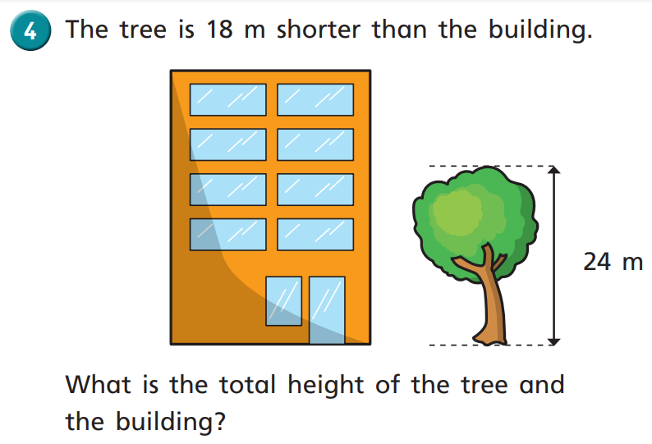

Have a think

Slide 8
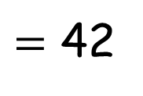
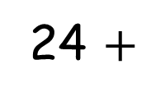
18
24
B
T
24 $+$
$=$ 42
18
42
Have a think

Slide 9
Have a think

Slide 10
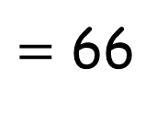
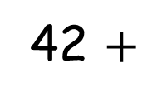
18
Have a think
42
42 $+$
24
$=$ 66
24
B
T

Slide 12


Slide 13
Have a go at the rest of the questions on the worksheet

