Slide 1
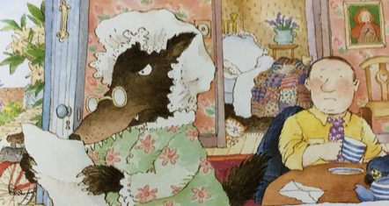
Thursday 29th April
L.O. To write an apology letter from the wolf to Little Red Riding Hood.

Slide 2
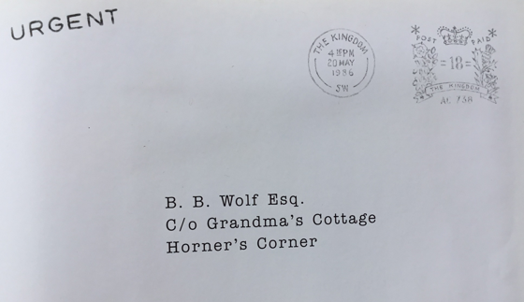
The Jolly Postman has a letter for the
Big, Bad Wolf.
Where is the wolf living?
Look at the address on the letter.

Slide 3
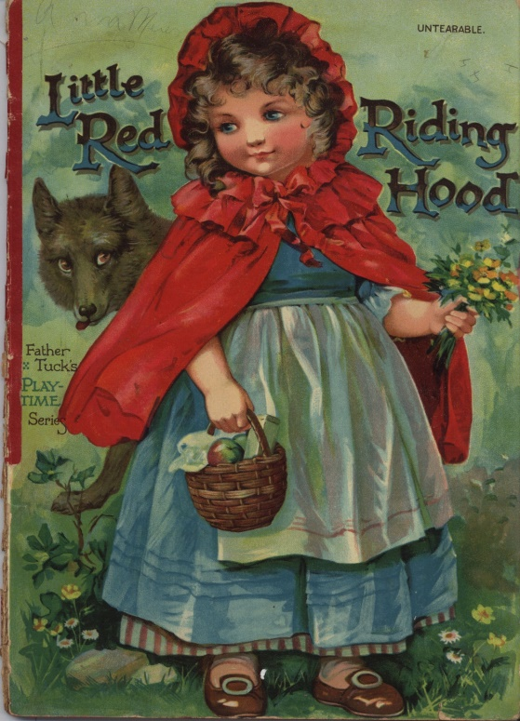
What fairy tale story is this wolf character from?
Little Red Riding Hood
We can recap on this story by
watching this clip.
https://www.youtube.com/watch?v=ivg_Yc-YDYo

Slide 4
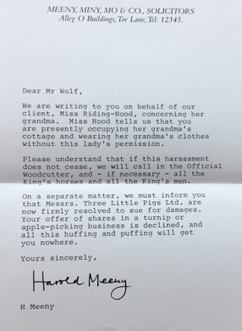
The letter is from a solicitor.
This is someone whose job is to know about all the laws of the country.
This solicitor, called Harold Meeny, is helping Little Red Riding Hood by telling the wolf all the ways he has broken the law.

Slide 5
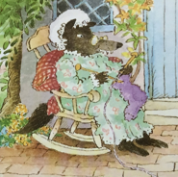
You are going to write the reply letter from the wolf.
You will be writing from the wolf’s point of view (so you will pretend to be the wolf).
The letter will be apologising, saying sorry, for the things that the wolf has done in the story.
You can also give excuses and explanations about why ‘you’ (the wolf) did the things you did.

Slide 6
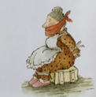
In your letter ‘you’ could apologise for:
capturing and tying up Granny
stealing her clothes
scaring Granny and Little Red Riding Hood
deceiving Little Red Riding Hood – this means making someone believe something that is not true.

Slide 7

What explanations & excuses could ‘you’ give?
Can you think of some funny ones?
I was incredibly hungry because I had not caught a deer or wild boar recently, which is my main prey (what I eat).
I am sorry for stealing the clothes but they were just my size and so very comfy!
I am sorry I deceived you. I was just trying to have a joke!
I did not mean to scare Granny. I was planning to untie her after I had shared some of the lovely food you brought from your Mummy.

Slide 8
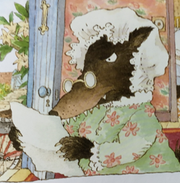
Remember how we begin and end a letter:
Begin with
Dear Little Red Riding Hood, ……
End with
Best wishes from
Mr Wolf

Slide 9
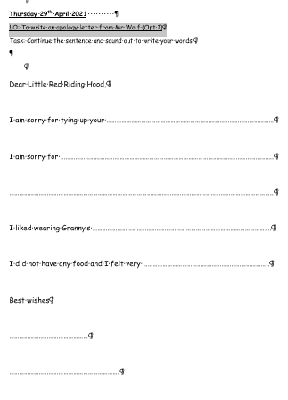
Option 1
Read the start of the sentence given.
Think about how you will continue the sentence.
Sound out your words to write them.

Slide 10
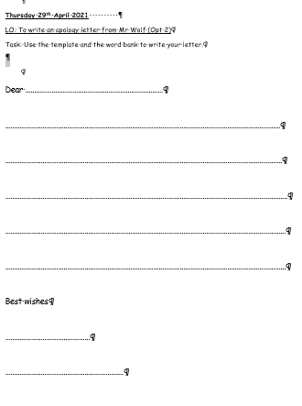
Option 2
Use the template to write your letter into.
Use the word bank to help to spell new words.
Option 3
Write your letter into your books.
Use the word bank to help write new words.

Slide 11
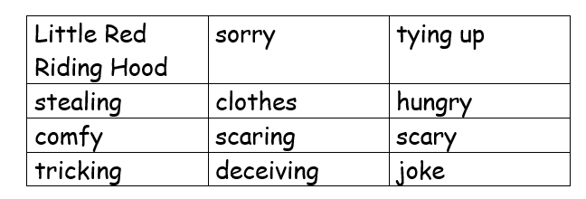
Word Bank

