Slide 1


Slide 3
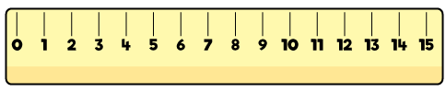
1) What is 3 cm plus 11 cm?
What is half of 10?
Find the difference between 12 and 8

Slide 4
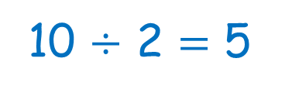
1) What is 3 cm plus 11 cm?
What is half of 10?
Find the difference between 12 and 8
1
4 cm
10 $÷$ 2 $=$ 5
4

Slide 6
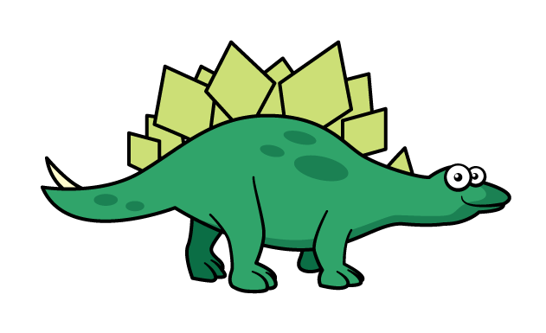

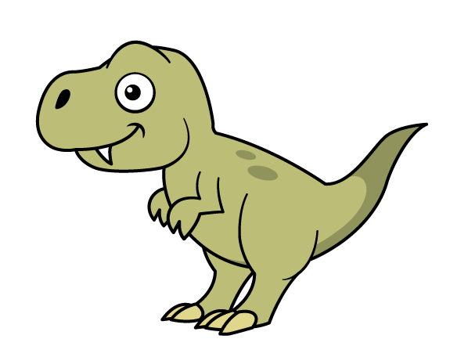

What do you notice?
The Stegosaurus is cm long.
11
The T-rex is
cm long.
8
Have a think

Slide 7
What do you notice?
The Stegosaurus is cm long.
11
The T-rex is
cm long.
8
Have a think

Slide 8

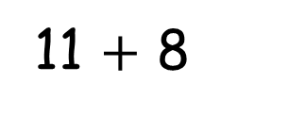
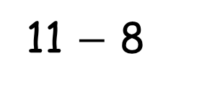
Alex makes her bar model out of pieces of paper.
Find the total.
11 $+$ 8
?
S
11
?
T
8
Find the difference.
11 $−$ 8

Slide 9
Have a go at questions 1 and 2 on the worksheet

Slide 10
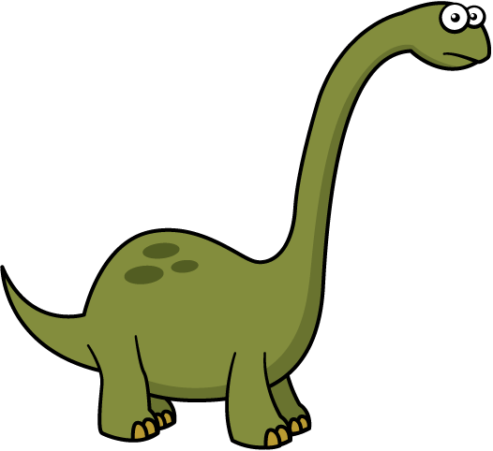
Brachiosaurus
Stegosaurus
Tyrannosaurs Rex
14 m
3 m
?
14 m
7 m
3 m

Slide 11
Have a go at the rest of the questions on the worksheet

