Slide 1
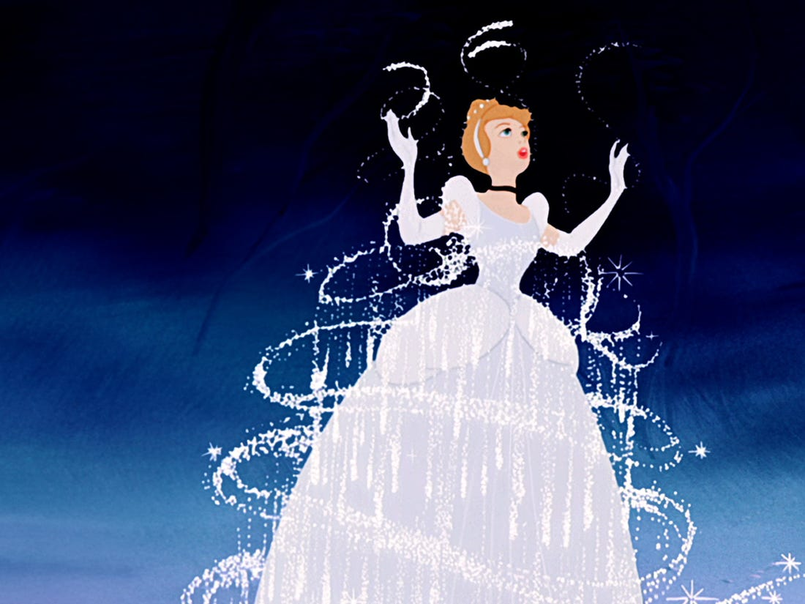
Wednesday 28th April
L.O. To retell a well known story. (Cinderella)

Slide 2
Yesterday you used story mapping techniques to sequence the events in the story Cinderella.
What can you remember about the story. Can you tell the main events to a partner?
Lets revisit the story.

Slide 4
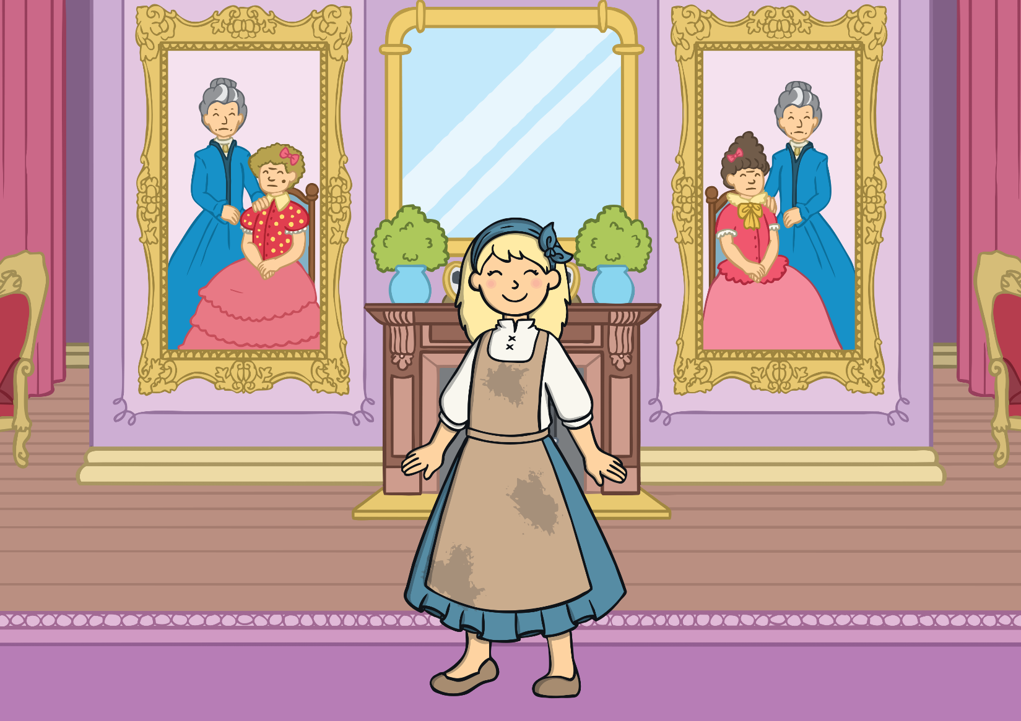
Once upon a time there lived a beautiful girl called Cinderella.

Slide 5
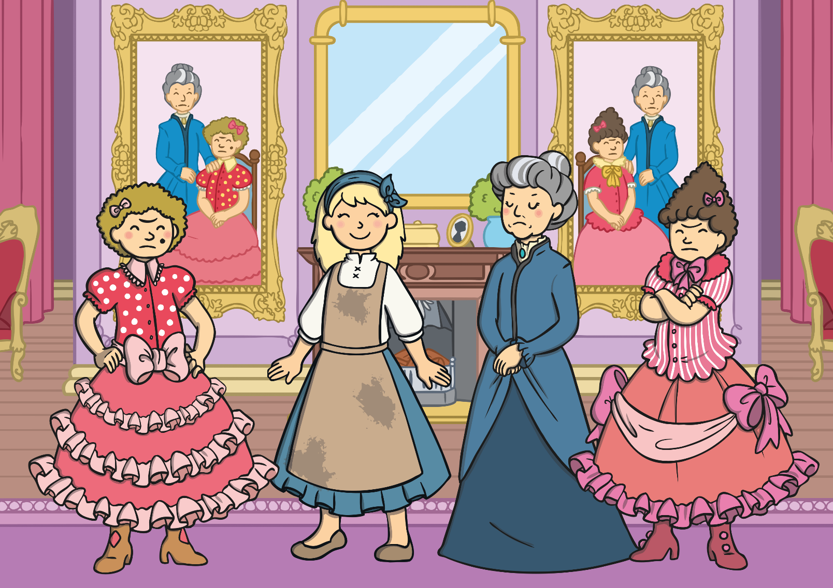
Cinderella lived with two ugly sisters and her wicked stepmother. They were very unkind to Cinderella and made her do a lot of hard work.

Slide 6
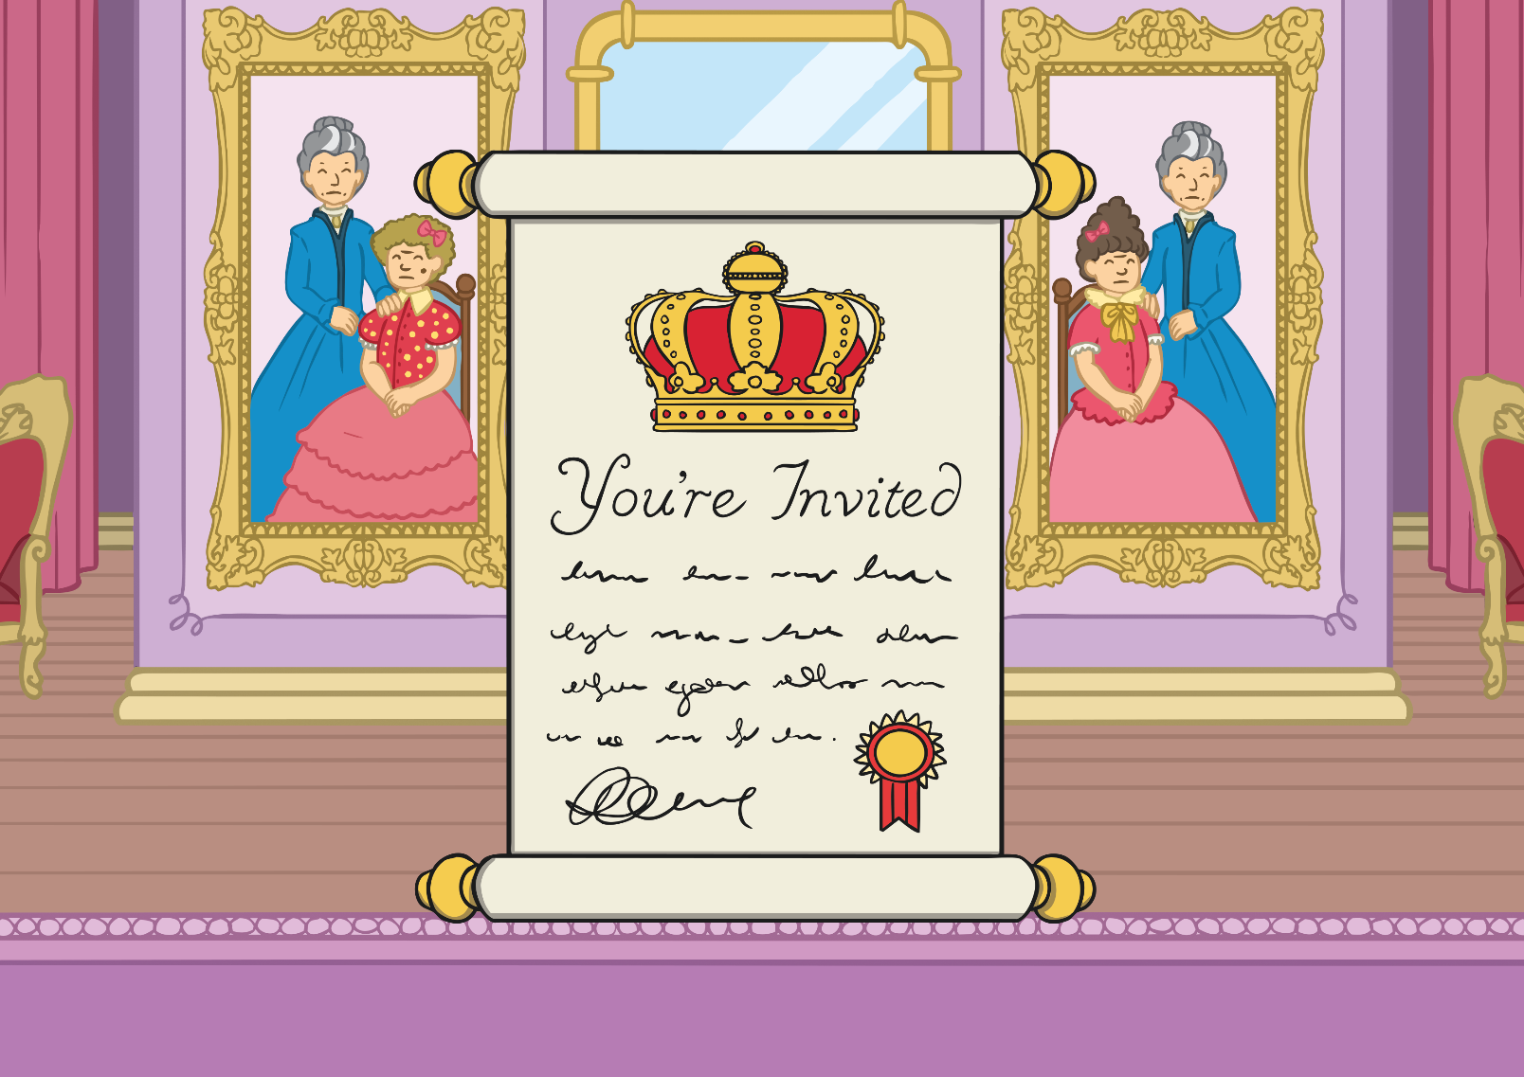
One day, an invitation came from the palace that
invited everyone to the prince’s ball.

Slide 7
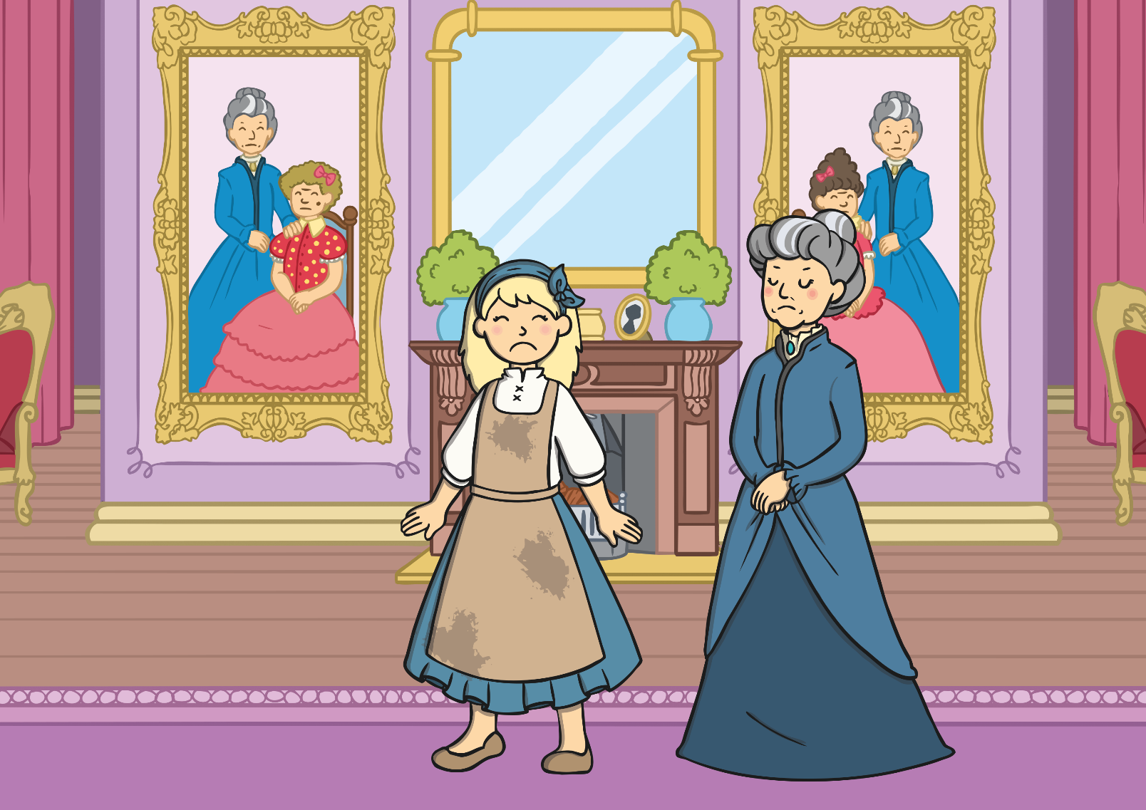
The wicked stepmother didn’t allow Cinderella to go.

Slide 8
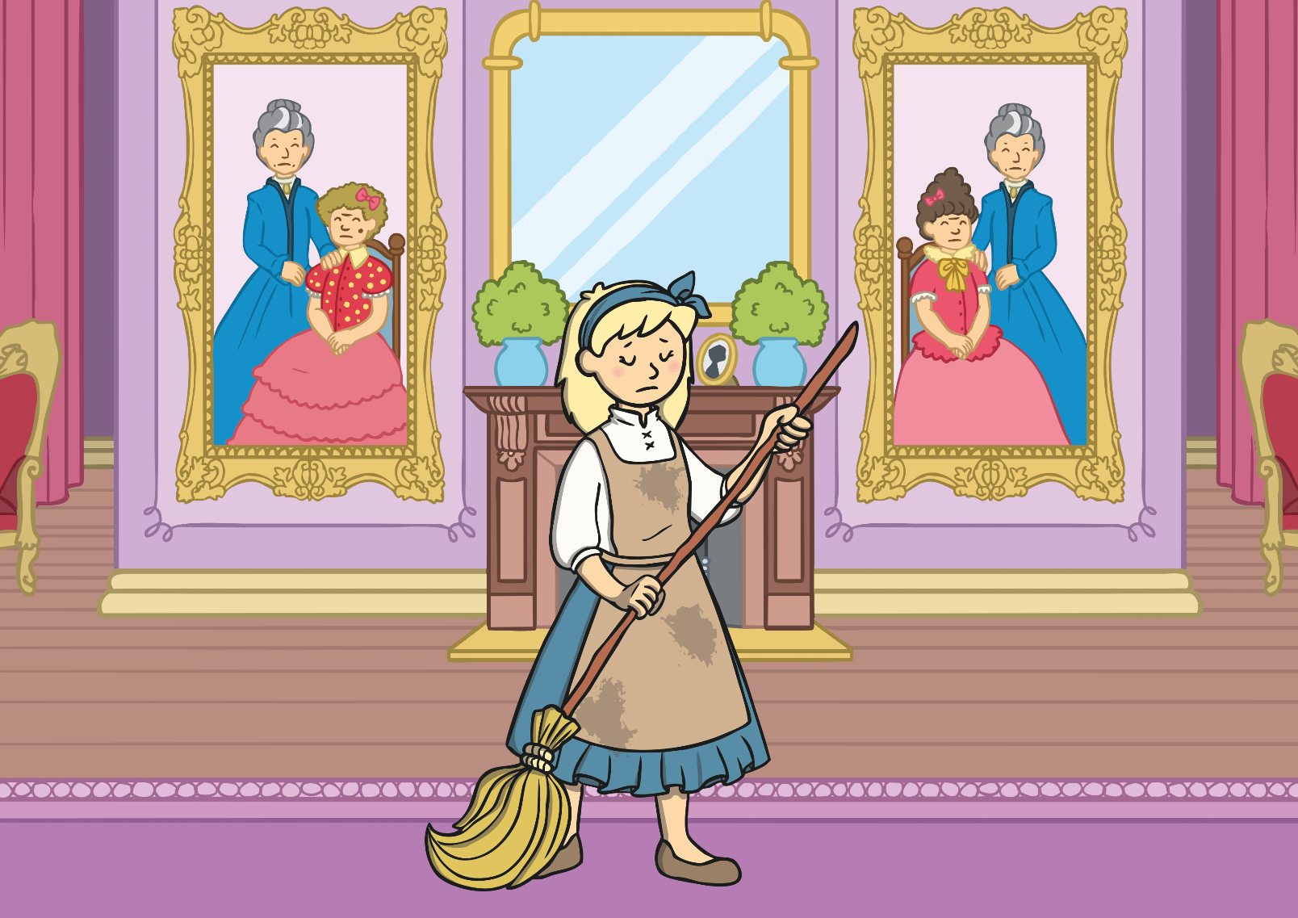
The day of the ball arrived and Cinderella was left at the house.
“I do wish I could go to the ball,” she said.

Slide 9
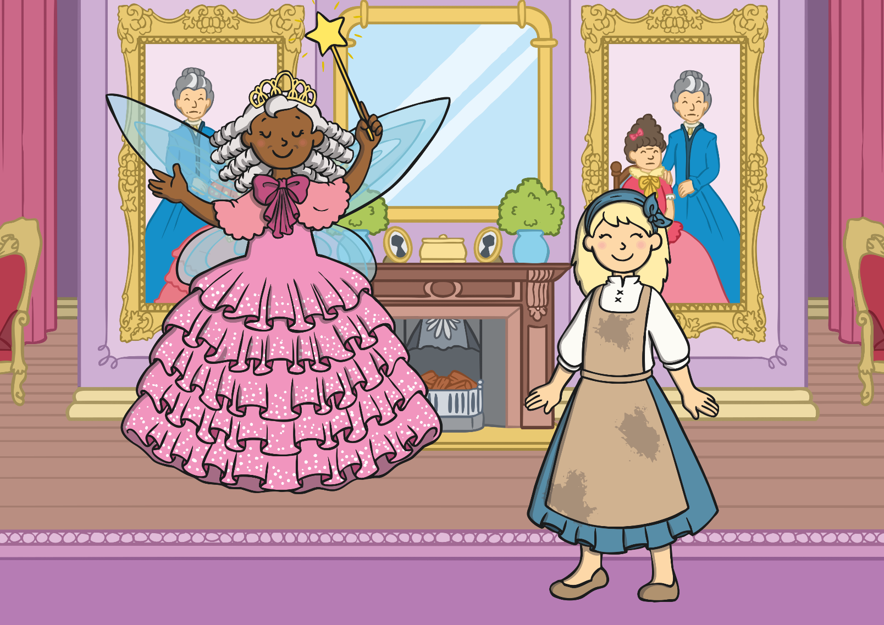
Just then, a lovely old lady with a gold wand in her hand appeared in the room. “I am your fairy godmother and you shall go to the ball!” she said.

Slide 10
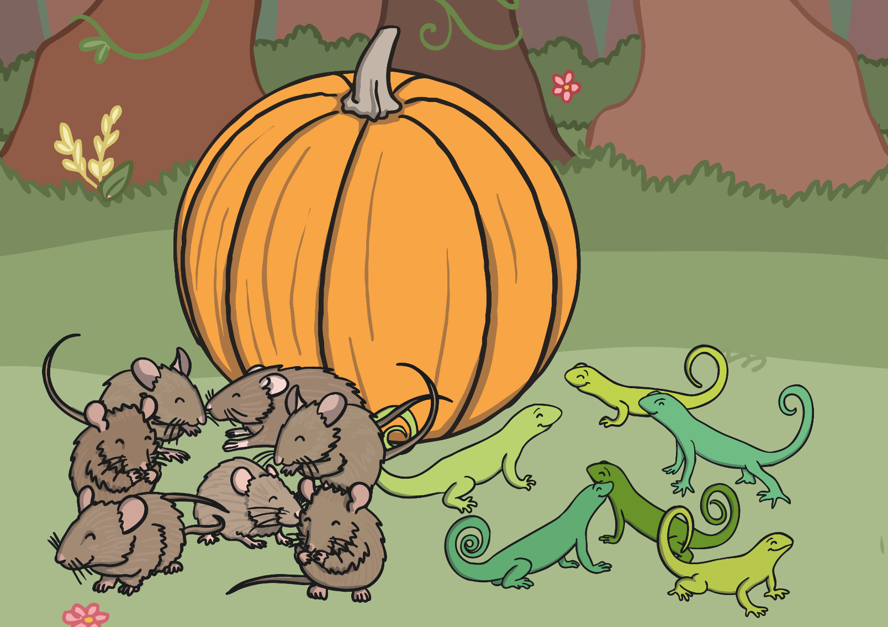
The fairy godmother asked Cinderella to find her a pumpkin,
six mice, a rat and six lizards.

Slide 11
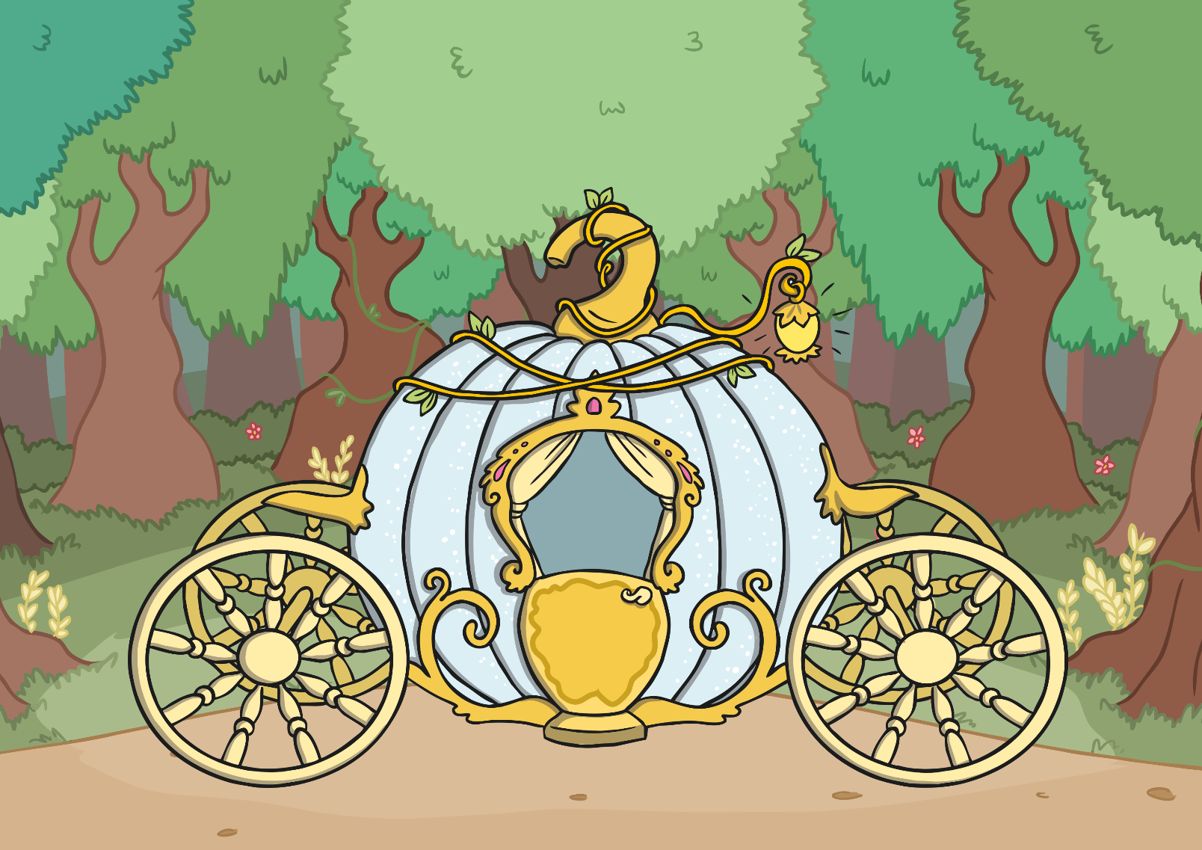
With the touch of her wand, the fairy godmother turned the pumpkin into a magnificent coach…

Slide 12
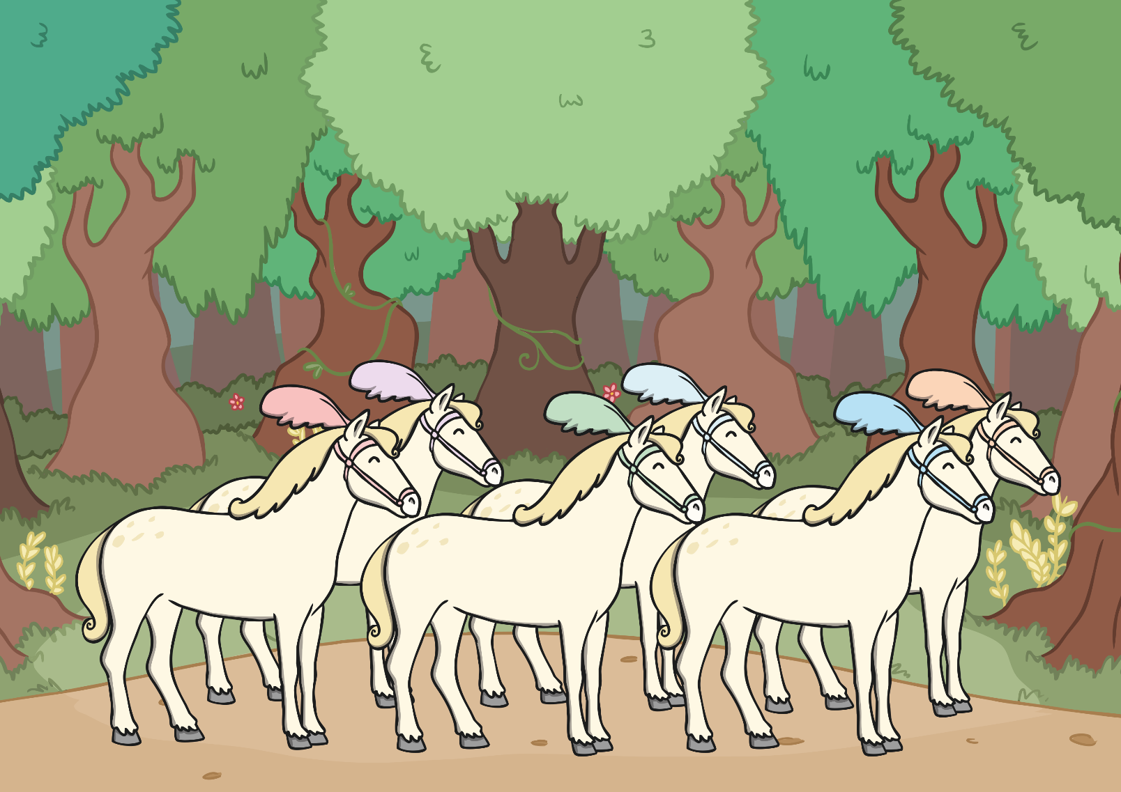
the mice into 6 magnificent horses…

Slide 13
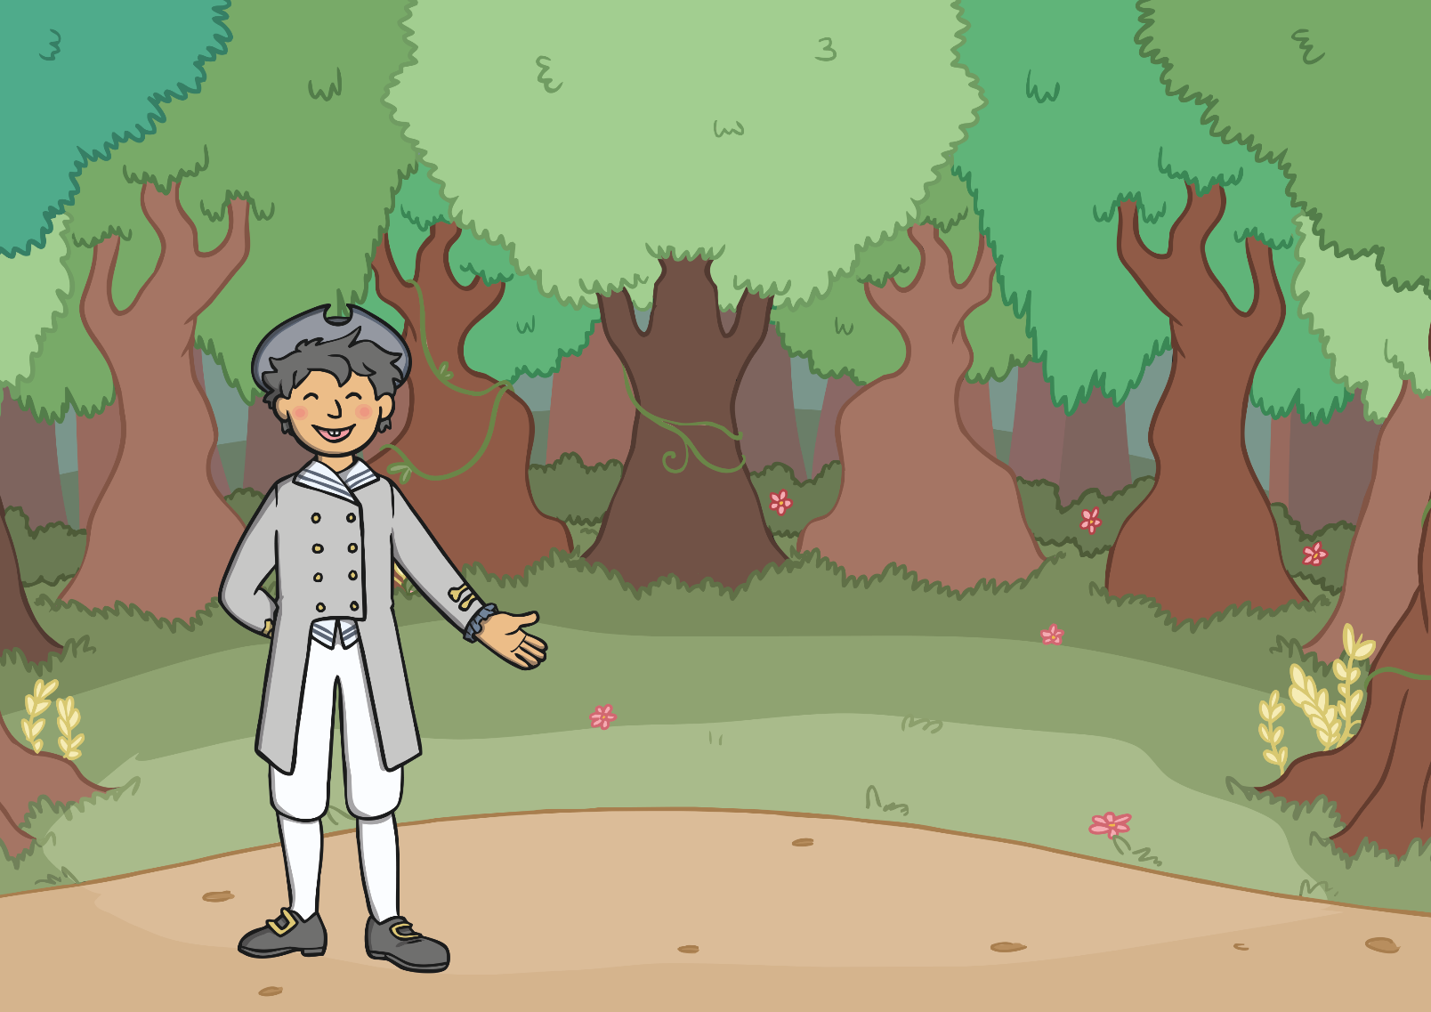
the rat into a coachman…

Slide 14
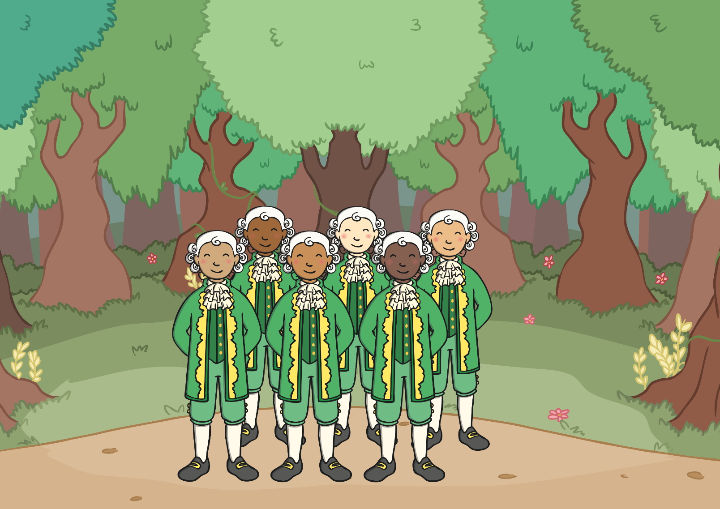
and the lizards into six footmen.

Slide 15
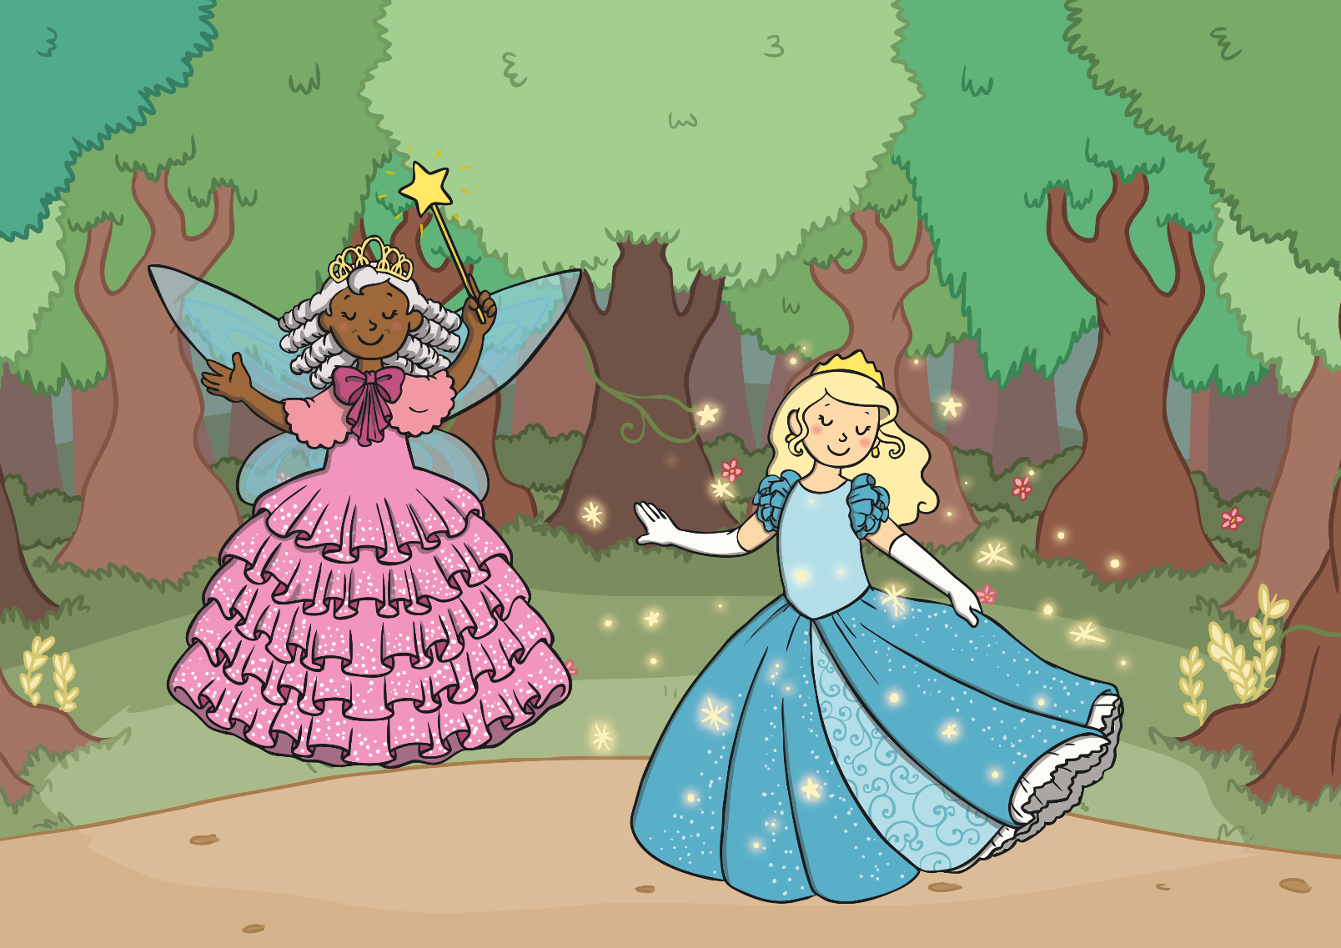
Then the fairy godmother touched Cinderella with her wand. Cinderella’s old dress turned into a beautiful gown and on her feet
were the prettiest glass slippers.

Slide 16
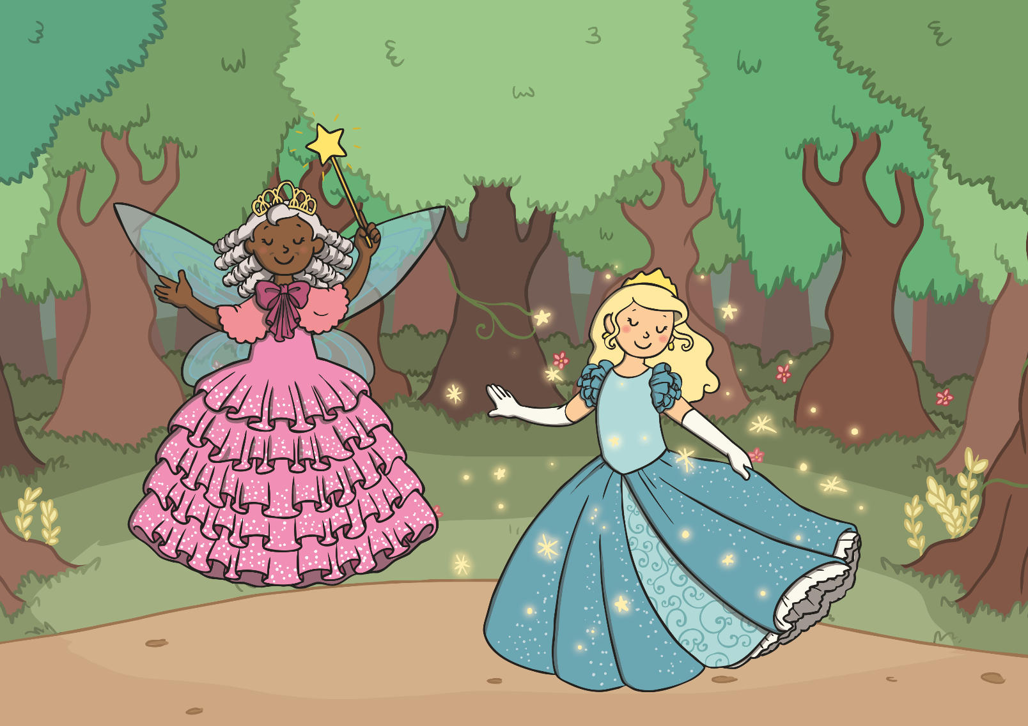
“Remember, you must leave the ball before the clock strikes twelve,” said the fairy godmother.

Slide 17
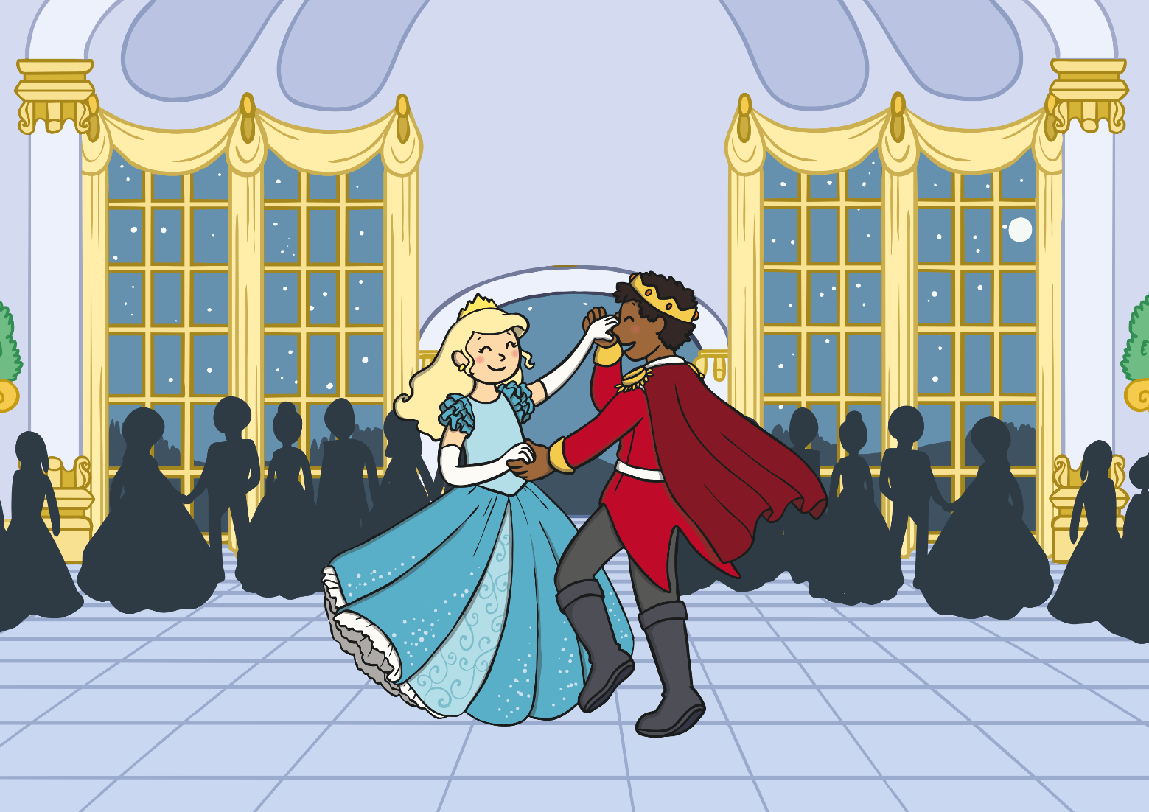
Cinderella arrived at the ball. She looked so beautiful that everyone wondered who she was. The prince asked Cinderella to dance
and they danced together all night.

Slide 18
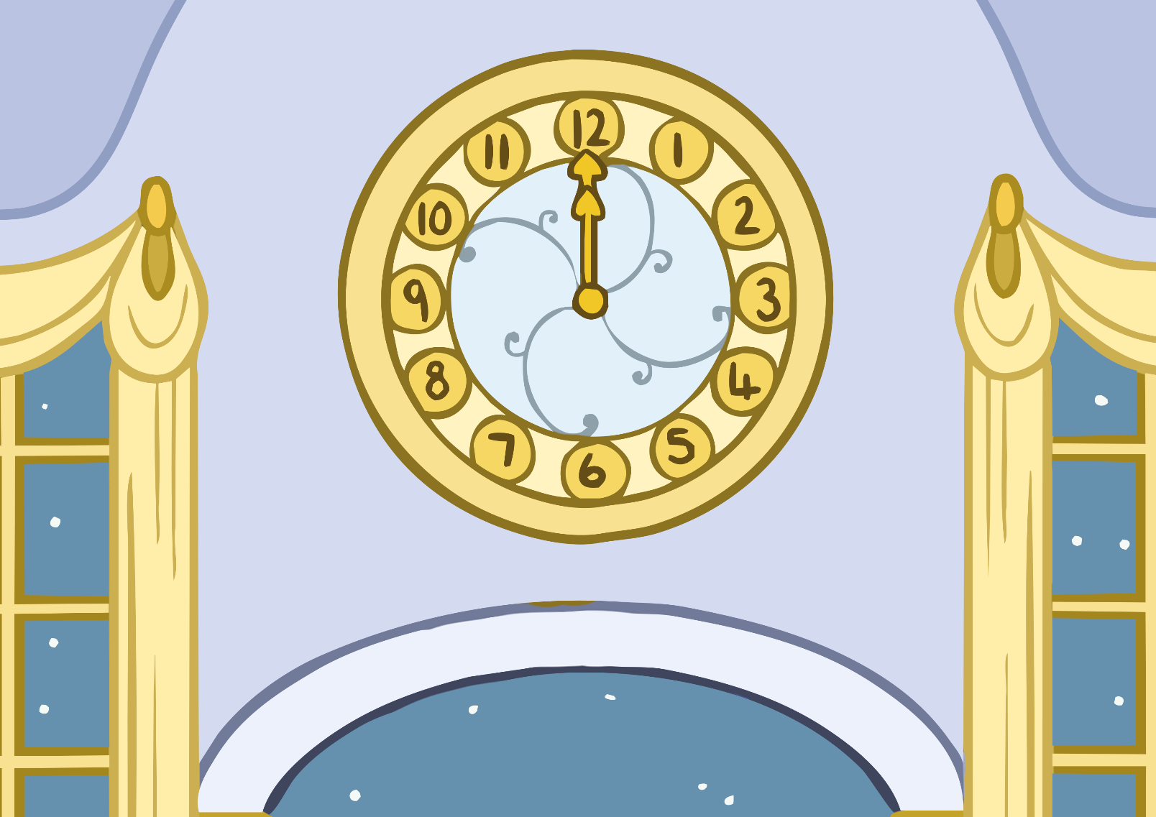
Cinderella was enjoying herself so much that she didn’t notice the time. Midnight approached and the clock began to strike…

Slide 19
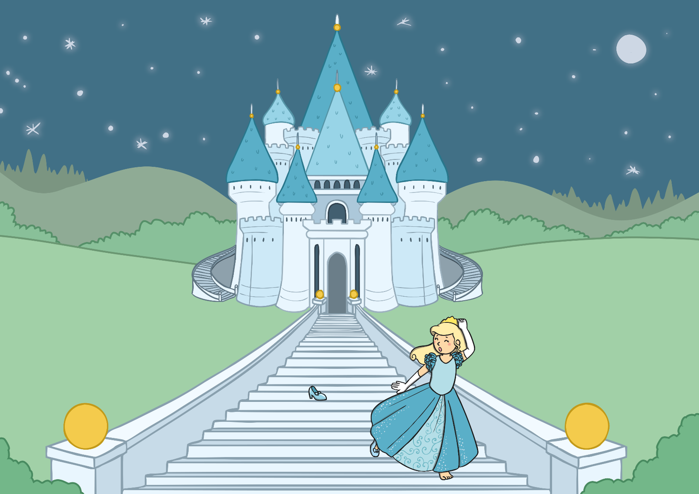
Cinderella ran out of the palace. As she ran down the stairs, one of her glass slippers fell off.

Slide 20
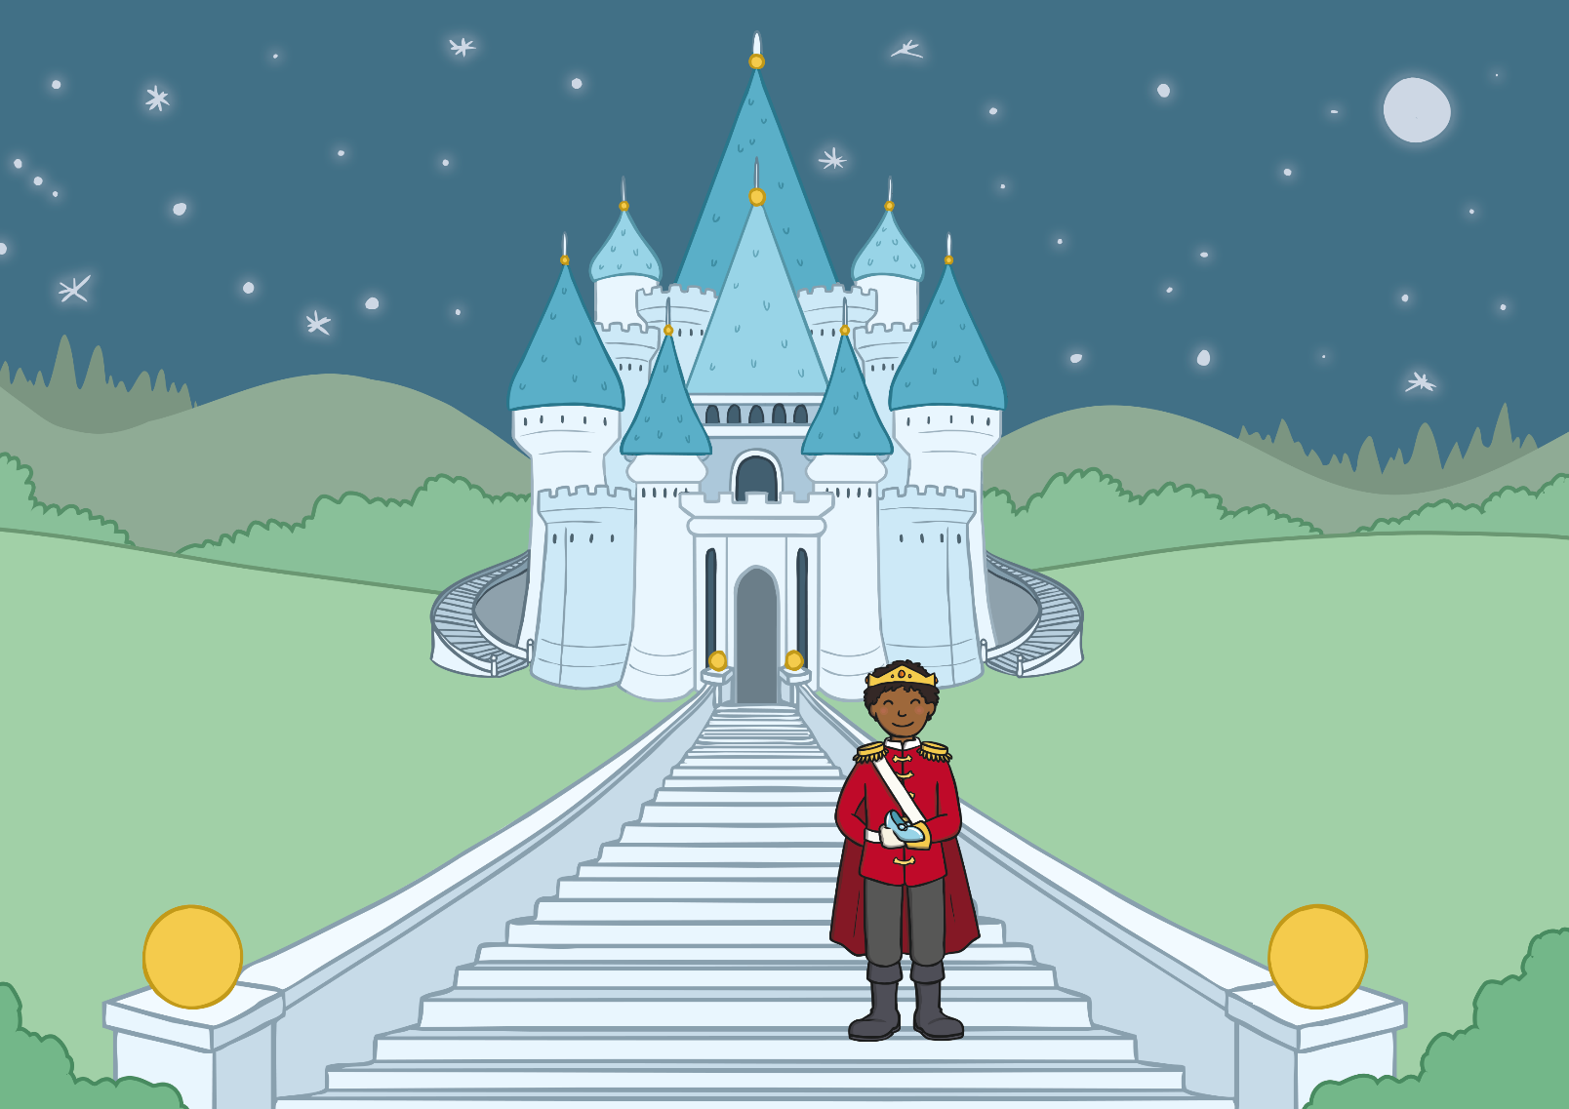
The prince ran after her but he was too late! He found her glass slipper on the steps.

Slide 21
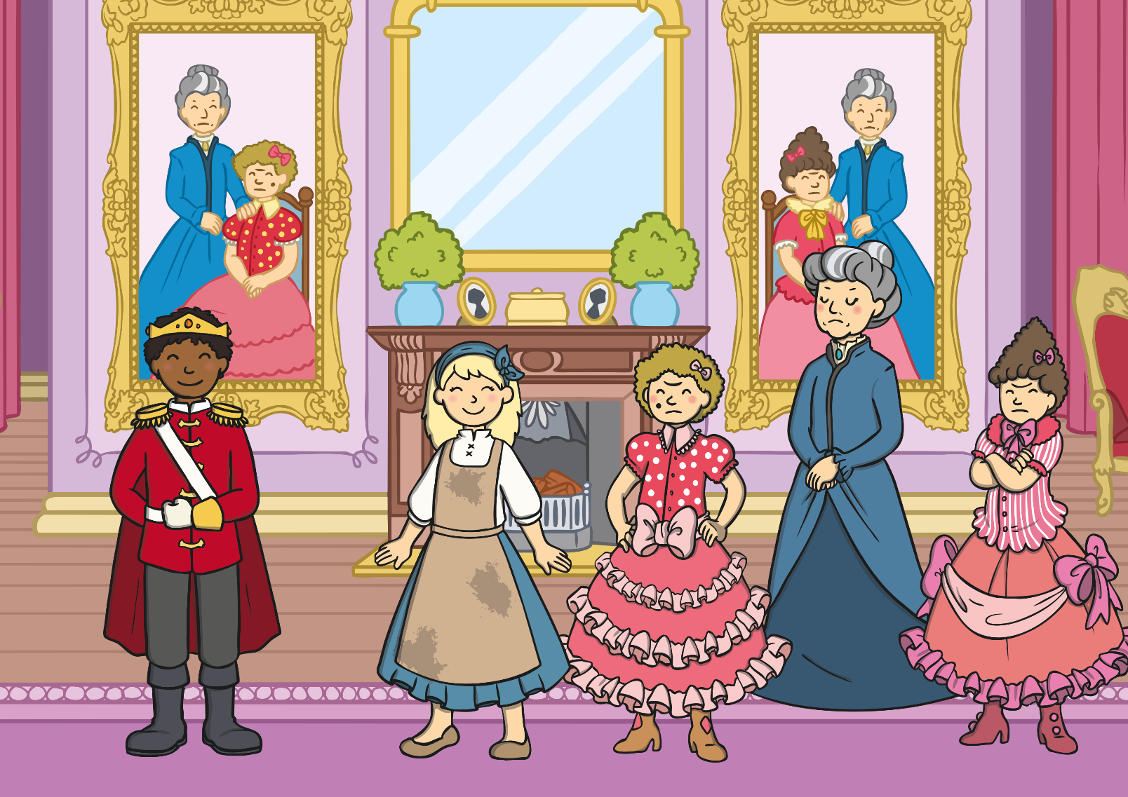
The next morning, the prince went from house to house with the glass slipper. At last the prince came to Cinderella’s house.

Slide 22
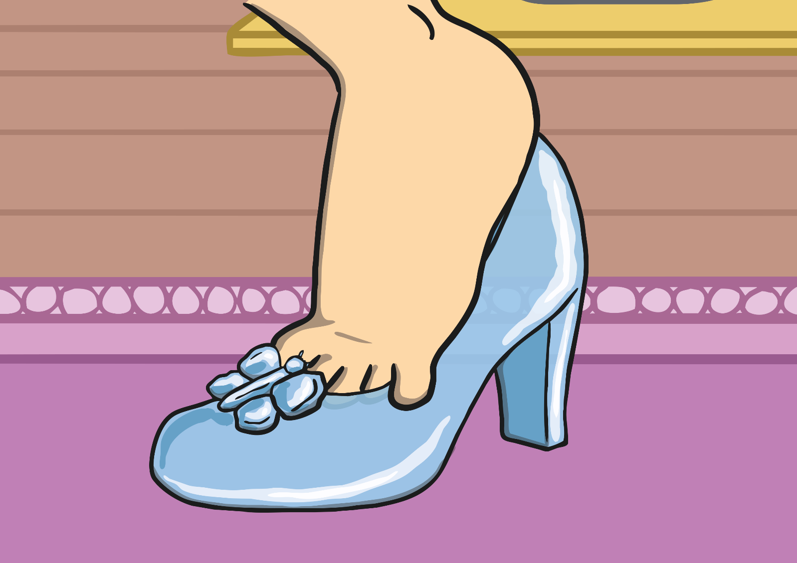
The first ugly sister tried on the slipper, but her foot was too wide.

Slide 23
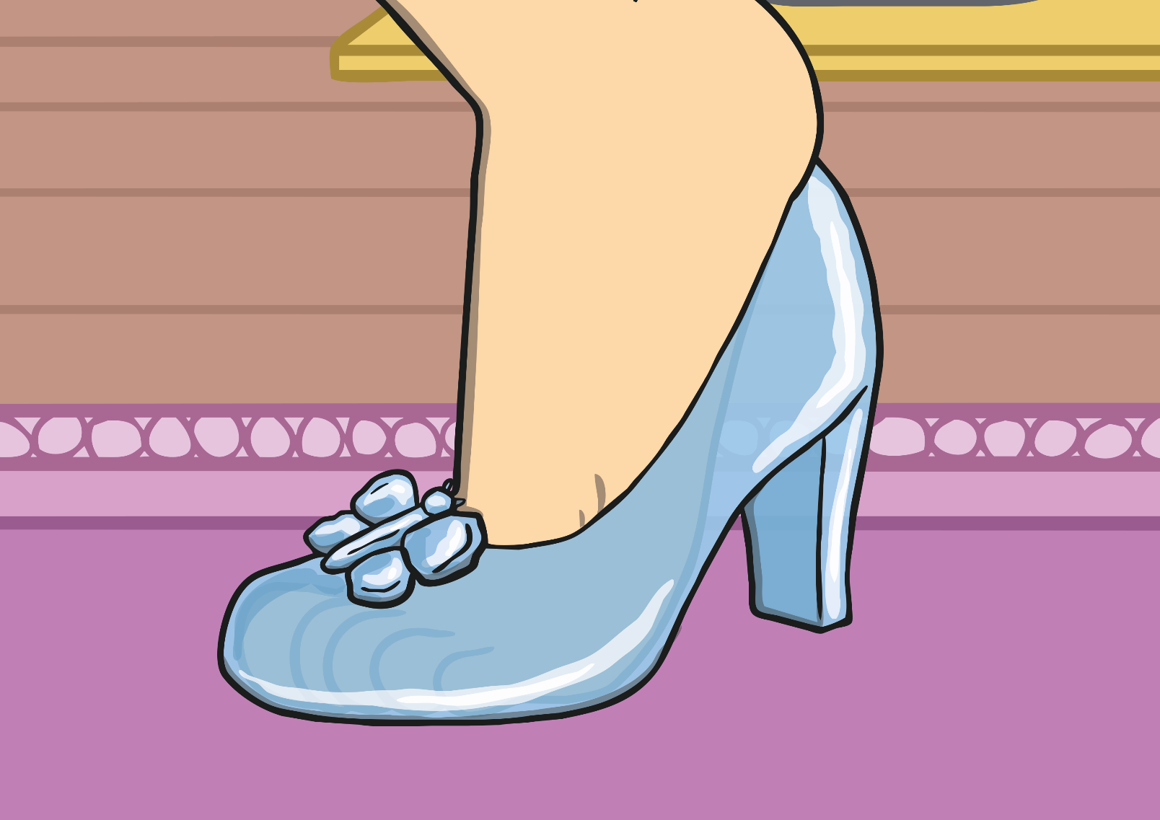
The second ugly sister tried on the slipper, but her foot was too long.

Slide 24
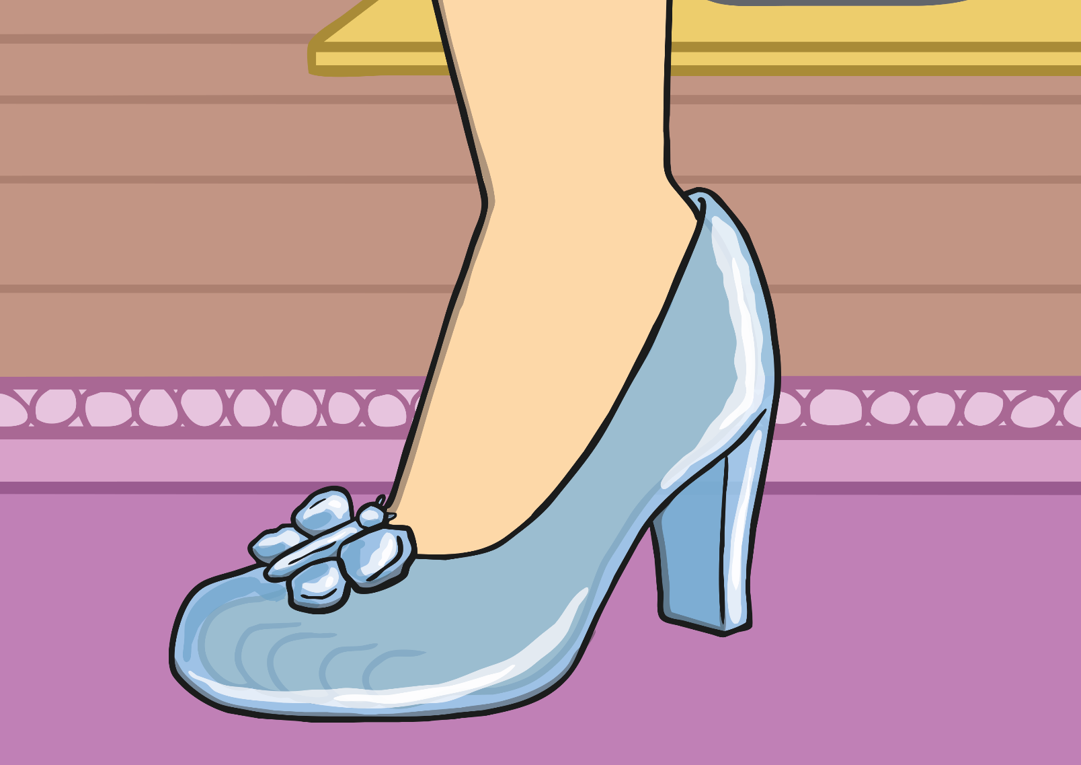
“Please may I try on the slipper?” asked Cinderella.
The slipper fit perfectly!

Slide 25
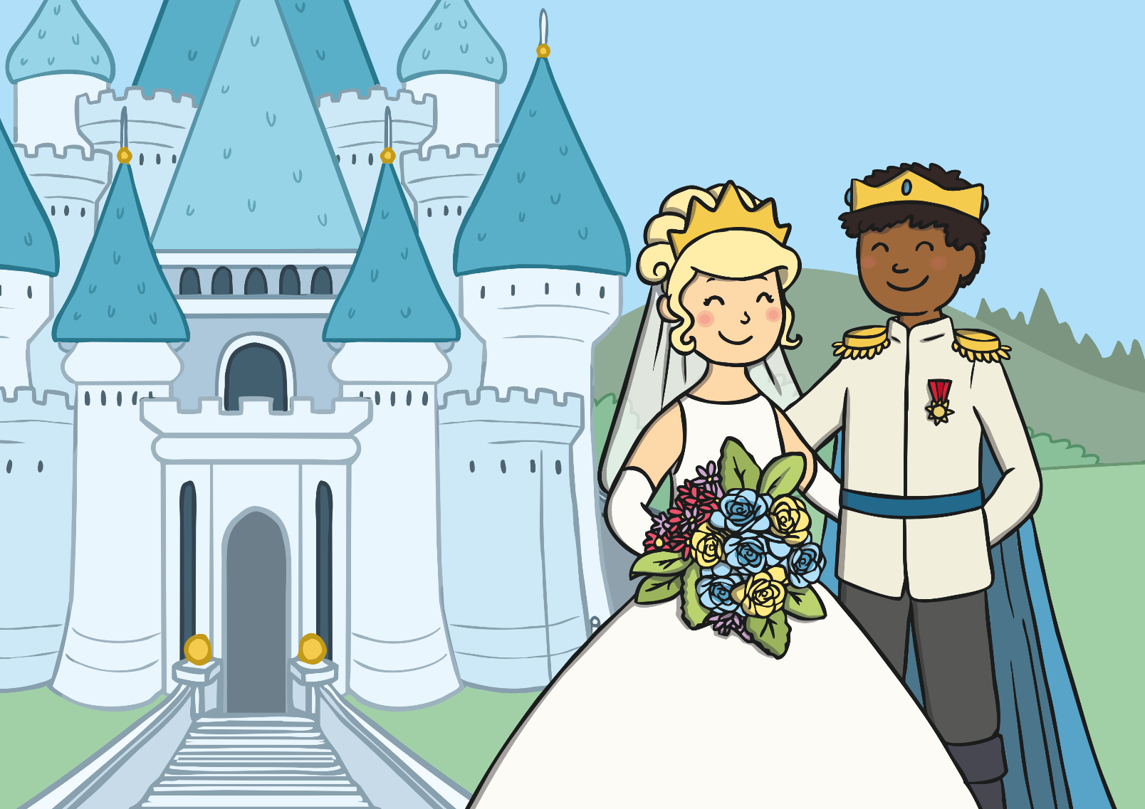
The prince asked Cinderella to marry him.
They both lived happily ever after.

Slide 27
Your Task
Today you are going to use your story map to write retell the story of Cinderella.
What do we need to remember when writing a fairytale?

Slide 28
Important things to remember
Use adjectives to describe the setting. (Where the story happens)
Use adjectives to describe the characters. (People in the story)
Use capital letters for names of people and places.
Use conjunctions e.g. and, so , then, as, when
Use story language.
Use the word bank on the next slide for support.

Slide 29
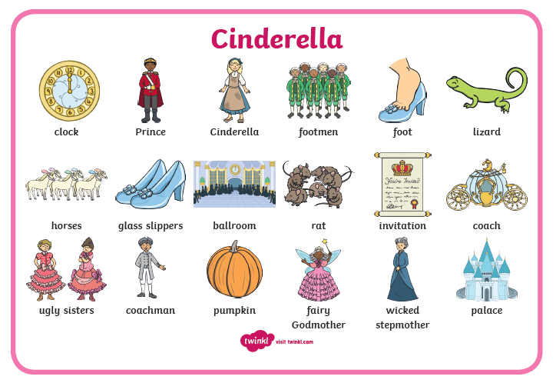
Once upon a time Happily ever after Long, long ago In a land far away
The end All of a sudden Out of nowhere With a little bit of magic

Slide 30
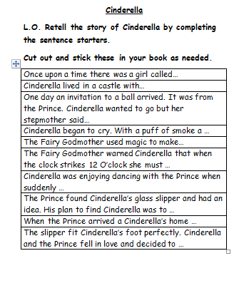
Option 1
Cut out, stick and complete the sentence starters to retell the story of Cinderella.
Option 2
Use the word bank to help you retell the story in your books.

