Slide 1


Slide 3
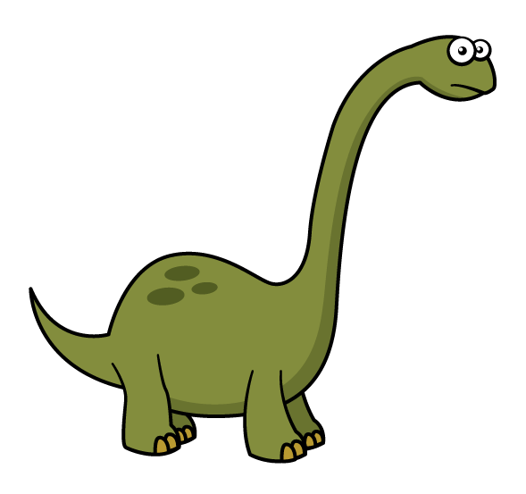

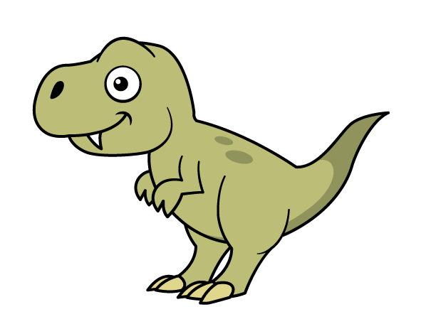
1) Use the words taller and shorter to describe the two dinosaurs.
2) How tall is each dinosaur?
taller
shorter
11 cm tall
5 cm tall

Slide 5
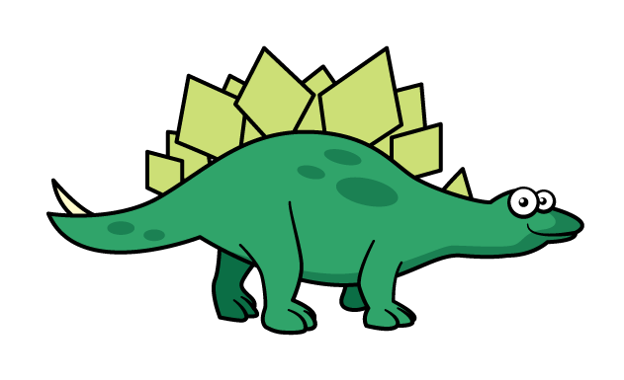

What do you notice?
The Stegosaurus is the longer of the two dinosaurs.
The T-rex is the shorter of the two dinosaurs.
Have a think

Slide 6
Have a go at question
1 on the worksheet

Slide 7


Someone has been eating the porridge…
Ron decides to gather up the suspects and take their photographs.

Slide 8







Slide 12
8 cm
15 cm

Slide 13

Have a go at questions 1, 2 and 3 on the worksheet

Slide 14





Slide 15

Rosie’s friend video calls her, she is very impressed and wants to know how big her rockets are.
28 cm
28 cm
?
?
?
?
?

Slide 16
28
20
8
B
28 cm
40
16
Y
?
6
5
R
?

Slide 17
28
20
8
B
28 cm
10
4
14 cm
Y
?
4
1
R
56 cm

Slide 18
Have a go at the final question on the worksheet

