Slide 1

Tuesday 27th April 2021
LO: To create a story map for the fairy tale Cinderella

Slide 2

Watch this short video of the story of Cinderella. https://www.youtube.com/watch?v=BXDsucz23OA
What do you already know about the story of Cinderella?

Slide 3
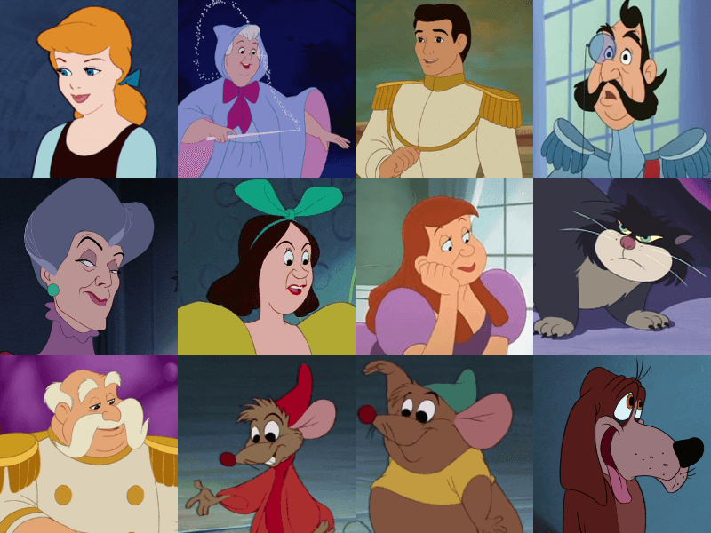
Who are the characters in the story?
Cinderella Fairy Godmother
The Prince The King
Evil Stepmother and
Step Sisters

Slide 4
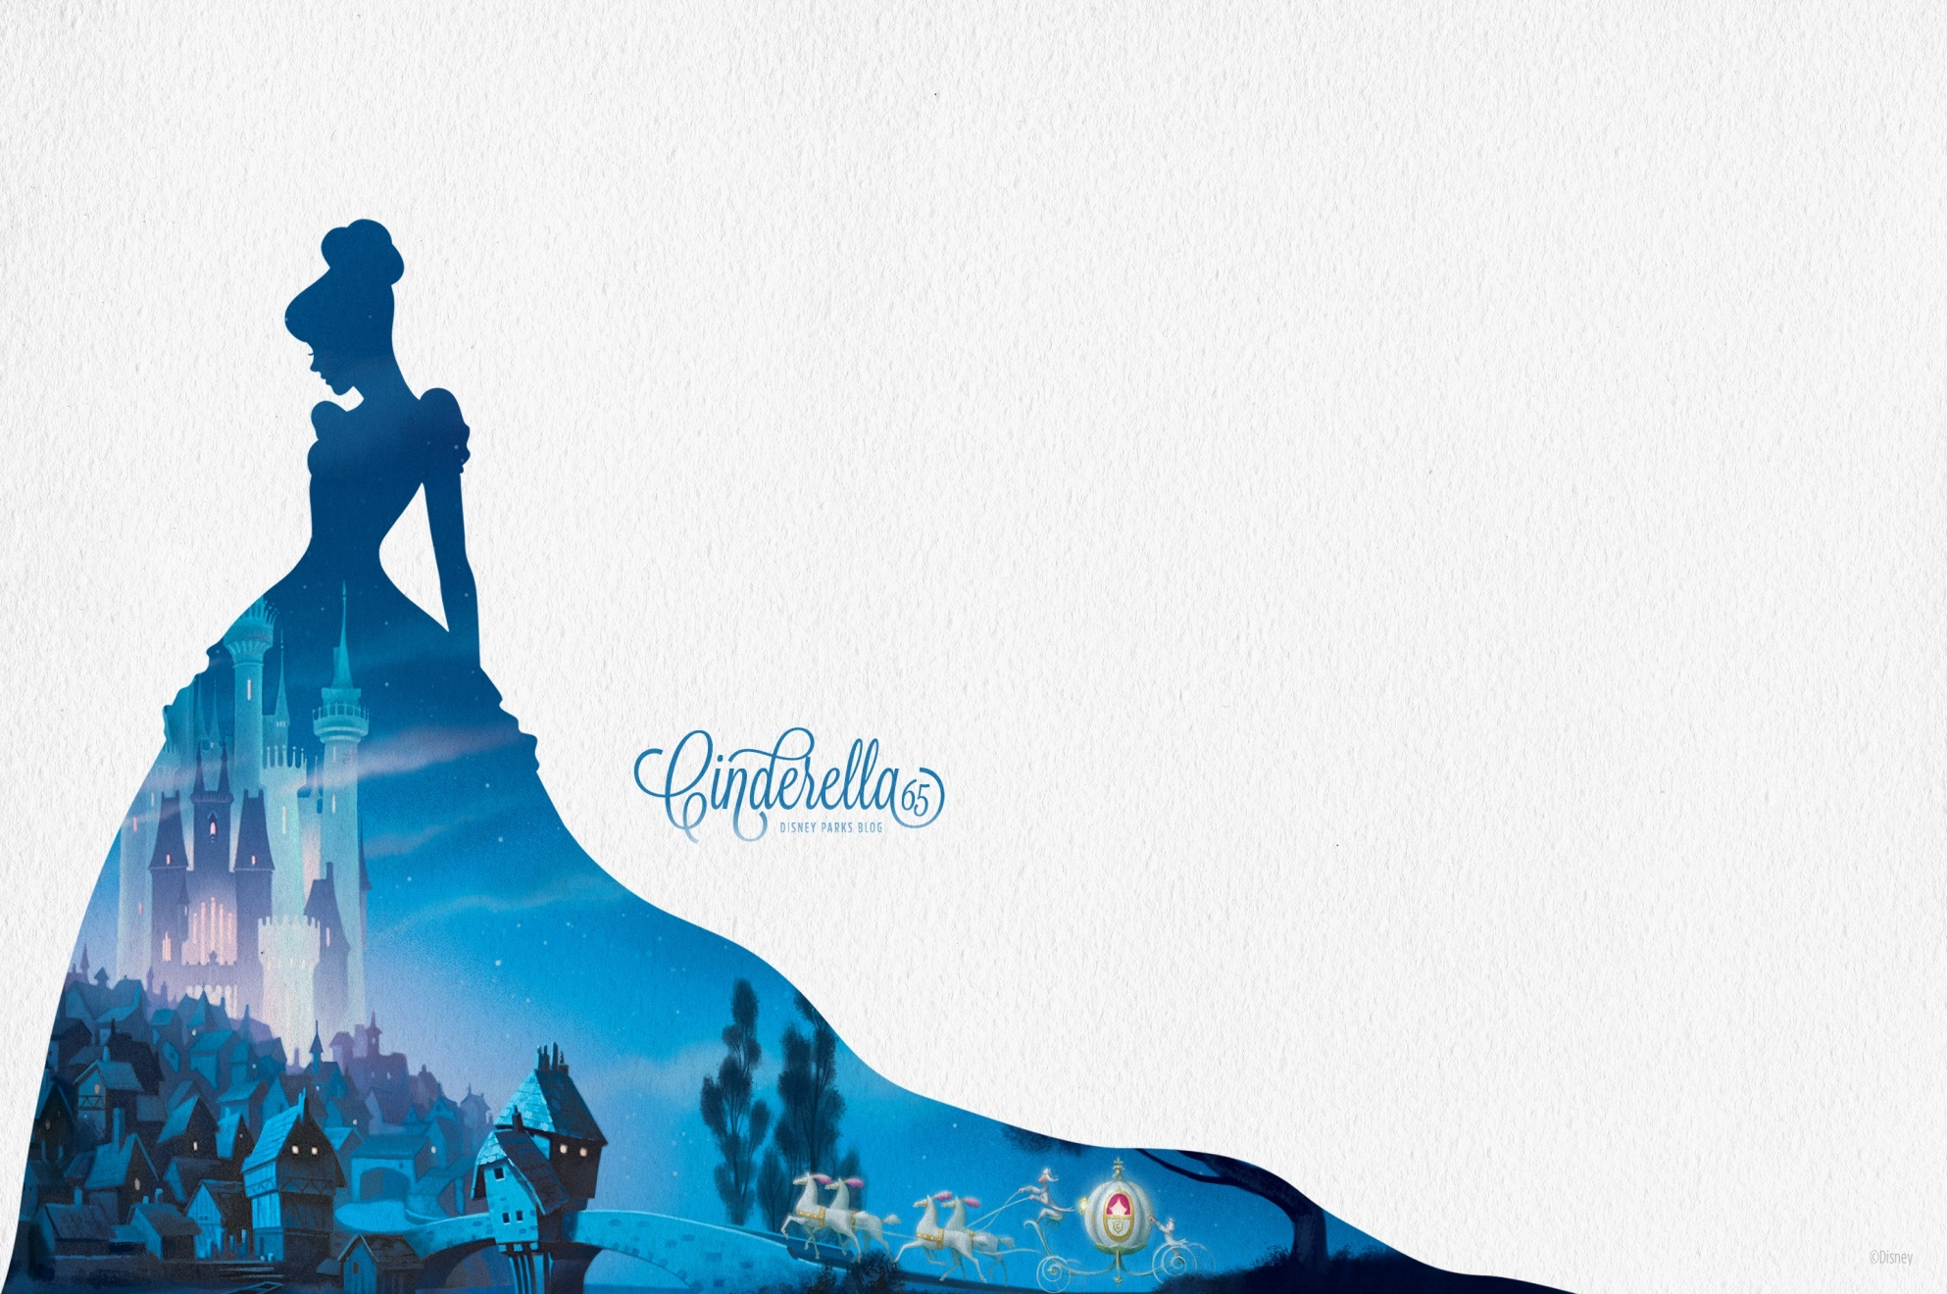
What happens in the story?
There lived a girl called Cinderella. She lived in a house with her stepmother and two step-sisters. They were unkind to her.
They were invited to a royal ball. Cinderella wanted to go but had nothing to wear. A Fairy Godmother came and made Cinderella a beautiful dress and sent her to the ball in a golden carriage.
When Cinderella arrived at the ball, she met the Prince. They danced together and then it was midnight and Cinderella had to leave. The Prince chased after her and found her glass slipper.
He searched all over the Kingdom until he found her and they got married.

Slide 5

Your Task
To complete a story map for the fairy tale Cinderella.
Think about what characters are in the story.
What happens at the beginning?
What happens in the middle?
What happens at the end?
You will be using this story map to help you to write the story tomorrow.

