Slide 1
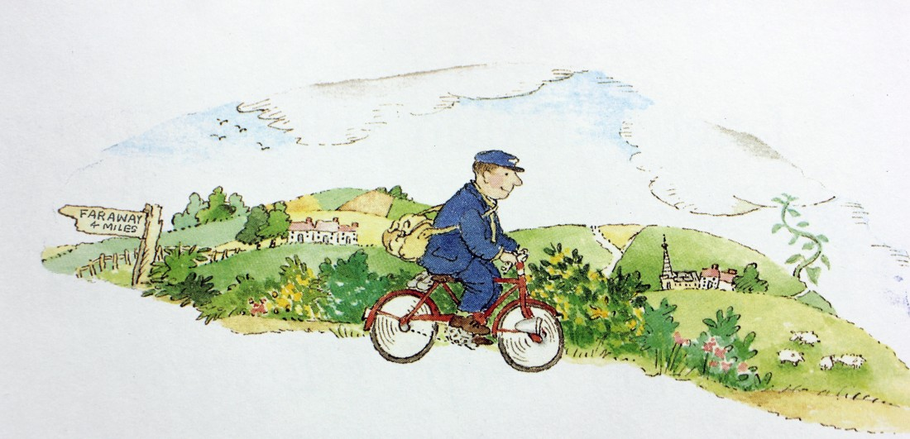
Thursday 22nd April 2021
LO: To describe the setting of the Gingerbread House

Slide 2
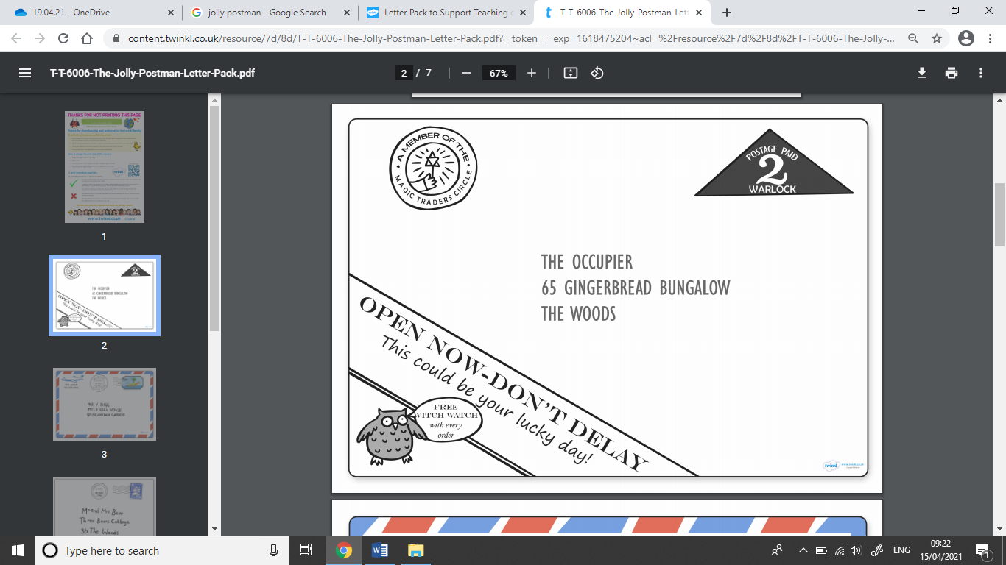
Read up to this letter in the story.

Slide 3
The next stop for the Jolly Postman was to deliver a letter to the Wicked Witch who lived in the Gingerbread Bungalow.
Your task today is to describe the Gingerbread Bungalow using adjectives and prepositions.

Slide 4
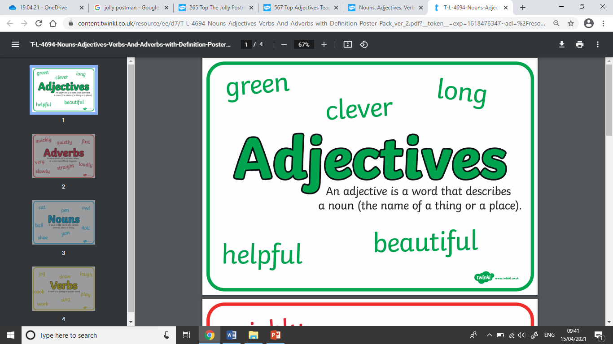
What are adjectives?

Slide 5
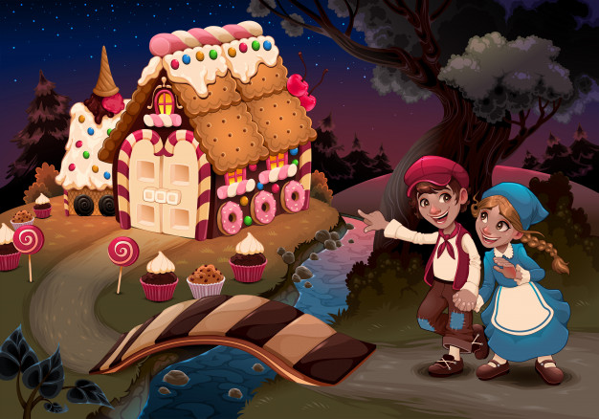
What other adjectives can we use to describe this picture?
Can you spot the adjectives in this sentence?
The tall door is made of two pink and white stripy candy canes.

Slide 6
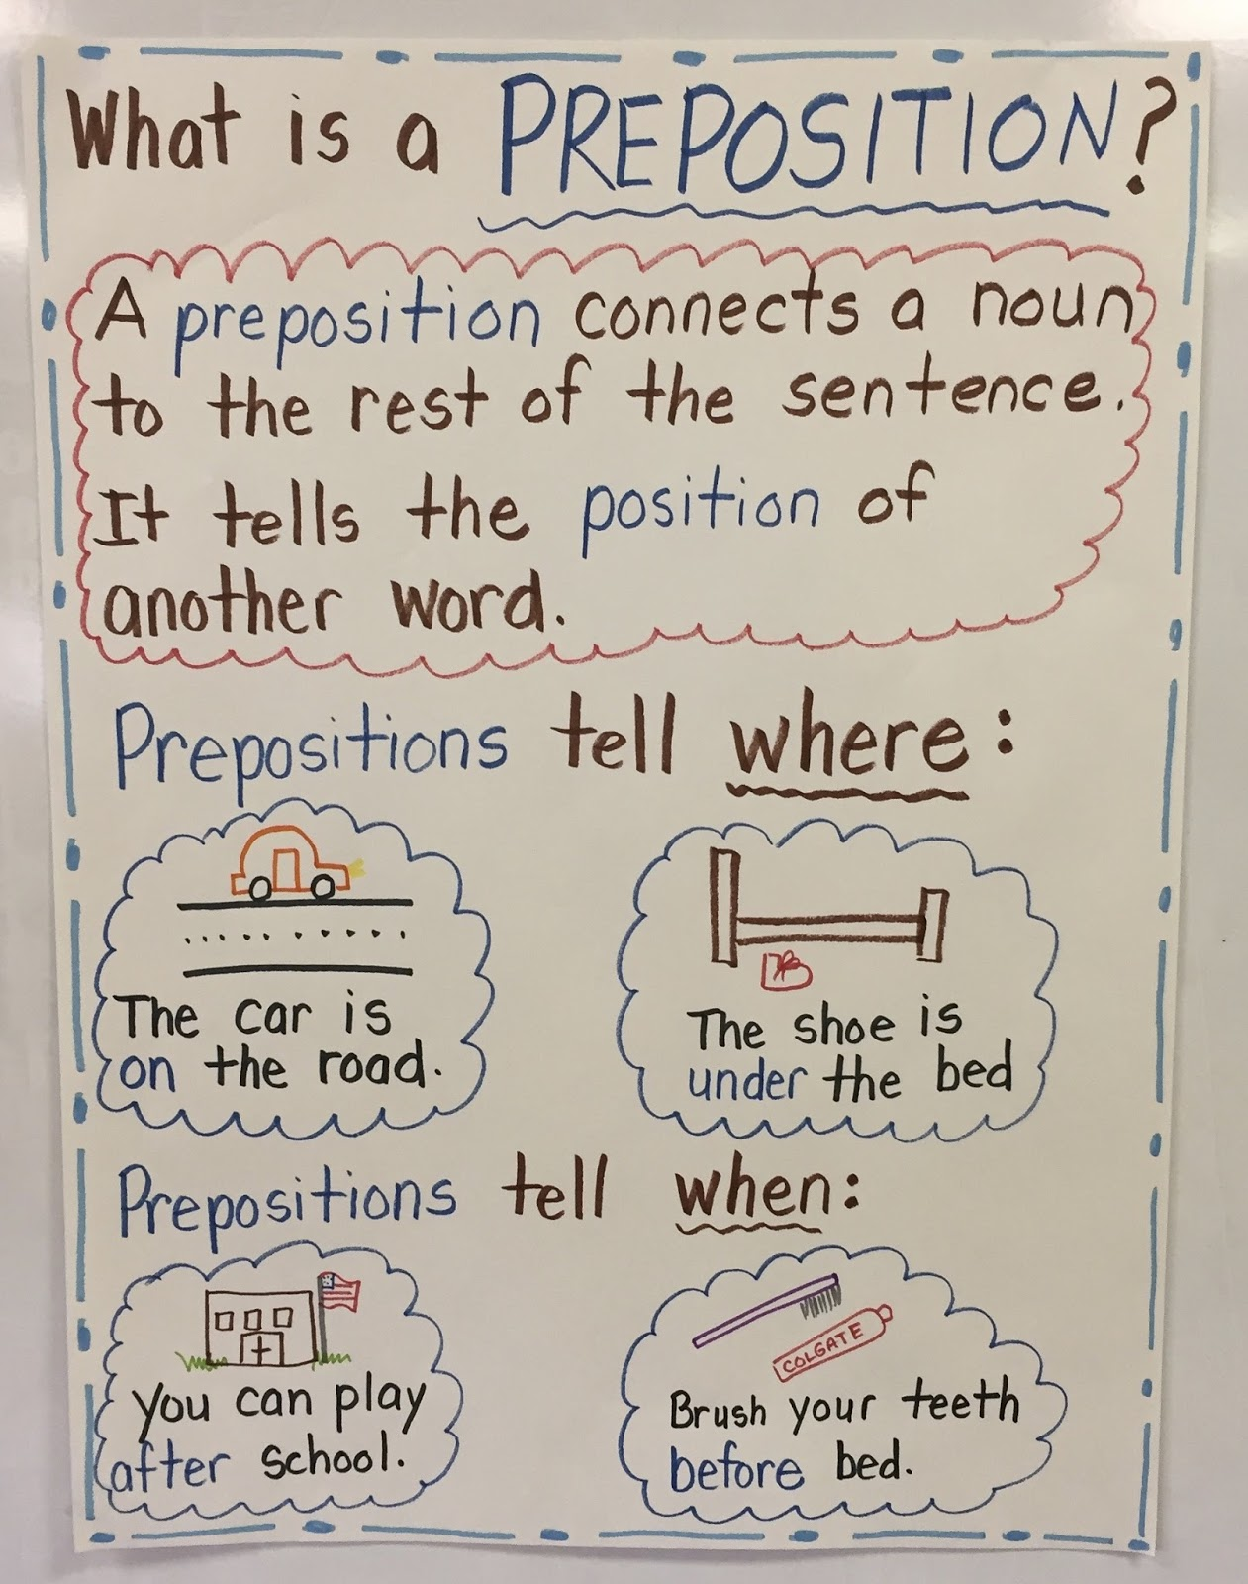
What are prepositions?

Slide 7
Can you find the prepositions in these sentences?
There are two lollipops in front of the small Gingerbread house.
A tall ice-cream cone is on top of the delicious looking Gingerbread house.
Can you think of anymore prepositions to use to describe this picture?

Slide 8
Your task today is to describe the Gingerbread Bungalow using adjectives and prepositions.
Example sentences:
On top of the brown spotty roof there are colourful smarties.
Next to the house there is a long flowing stream with large stones coming out of the water.

Slide 9


