Slide 1


Slide 3
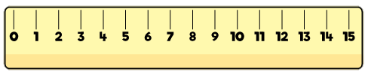

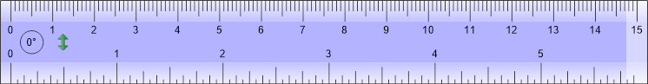
What is the same and what is different?
cm
cm
cm

Slide 5

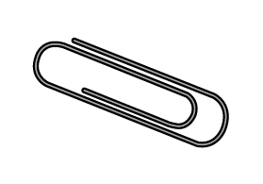

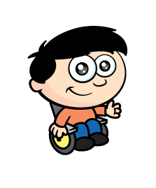
What can we use to measure?
cm

Slide 6
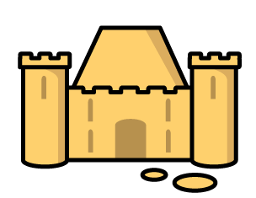
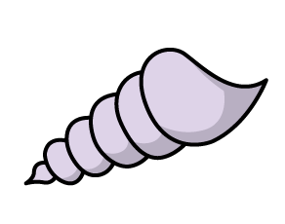
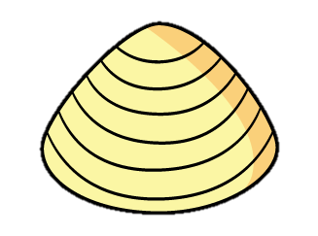
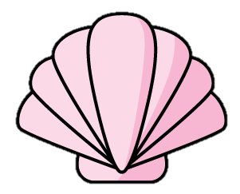
Why use a ruler?
cm
?
?
?
The sandcastle is 4 shells long.
No confusion!

Slide 7

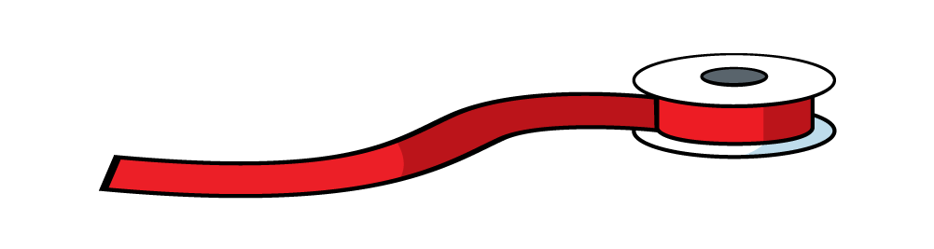
Why use a ruler?
Have a think
cm

Slide 8
Can you find a ruler?
What is the same? What is different?

Slide 9
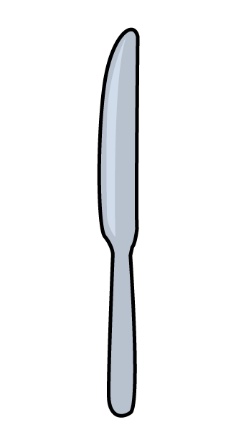

Be careful!
cm
Mind the gap!

Slide 10
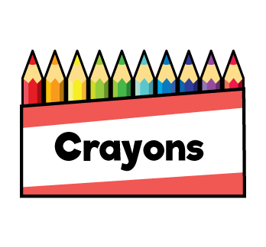
Where can you start?
Have a think
cm
5
Any number!

Slide 11
Can you measure your crayons?

Slide 12

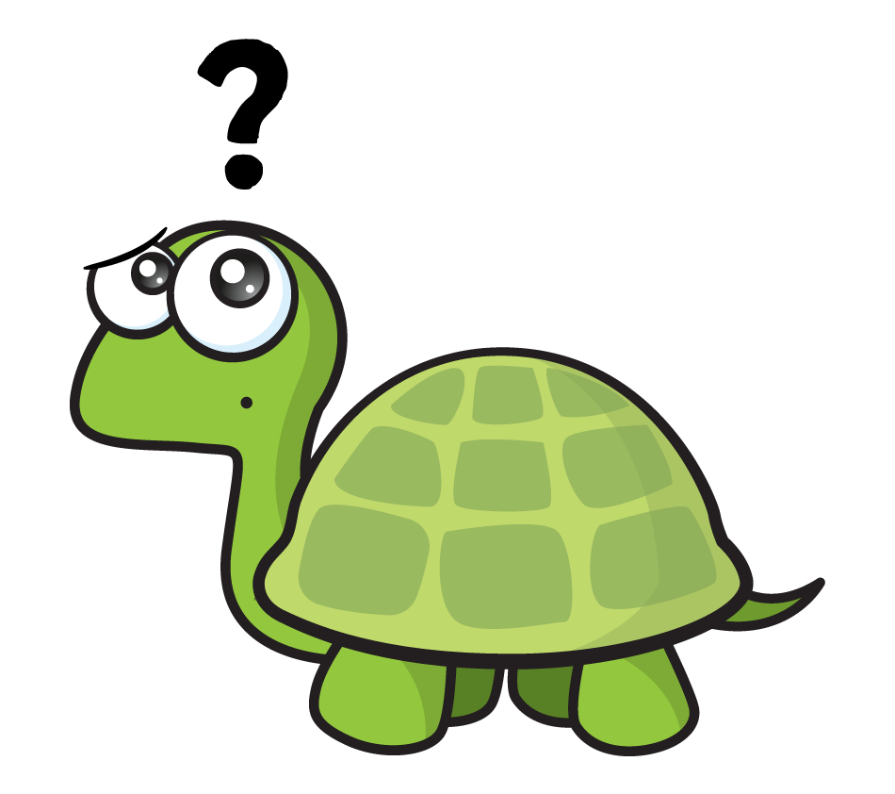
What if it isn’t perfect?
cm
Closest to…
Almost…

Slide 13
Measure length
Have a think
cm
The knife is 9 cm

Slide 14
Measure and compare length
cm
5 cm
6 cm
3 cm

Slide 15
Have a go at questions 1 and 2 on the worksheet

Slide 16
Which is longer?
Have a think
cm
cm
The red tower is 9 cm
The yellow tower is 10 cm

Slide 17
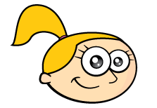

Which is longer?
Have a think
cm
They are the same length!
cm
The red tower is 10 cm
The pink tower is 10 cm

Slide 18
Which is longer?
Have a think
cm
cm
The red tower is 9 cm
The pink tower is 12 cm

Slide 19
Have a go at question 3 on the worksheet

Slide 20
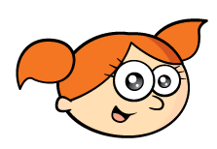
How can you make them the same length?
cm
Have a think
I can add 3 more
cm
The red tower is 9 cm
The red tower is 12 cm
The pink tower is 12 cm

