Slide 1


Slide 3





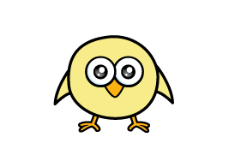



Which is longer?
Which is taller?
1)
3)
2)
4)

Slide 4
Which is longer?
Which is taller?
1)
3)
2)
4)

Slide 6
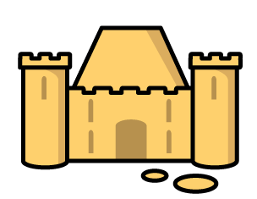
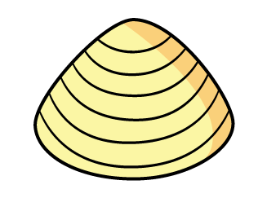
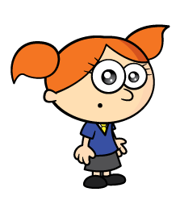
The shells have to be the same size.
The castle is 5 shells long.

Slide 7

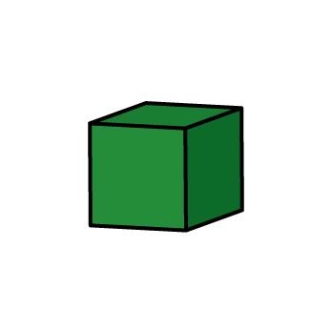
Have a think
Tiny, you cannot leave spaces.
The castle is 5 blocks long.

Slide 8
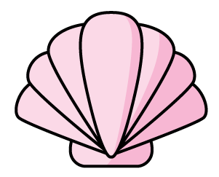
The sandcastle is 6 long.

Slide 9
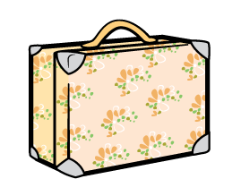
The giraffe is tall.
4

Slide 10

The giraffe is tall.
4
7
The giraffe is tall.

Slide 11
What objects can you find to measure with?

Slide 12

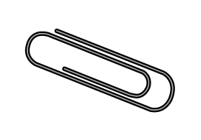
The spoon is long.
6

Slide 13
Have a think
How long is the spoon?
26
The spoon is shorter than 3 .
The spoon is 2 and 6 long.

Slide 14
Can you use blocks to measure your spoon?

Slide 15
Have a go at question 1 on the worksheet

Slide 16


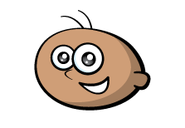

What is the length of the ?
Have a think
6
I think it is 7
I think it is 6
Who is correct?

Slide 17
Have a go at question 2 on the worksheet

Slide 18

What is the length of the ?
Have a think
I think it is 6
I think it is 3
Who is correct?

Slide 19
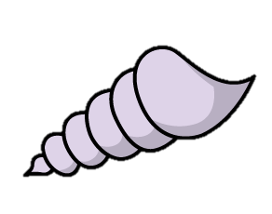

Which is longer?
Have a think
This is 5
That means it is longer!
The shell is 4
Do you agree?

Slide 20
Have a go at questions 3 and 4 on the worksheet

