Slide 1
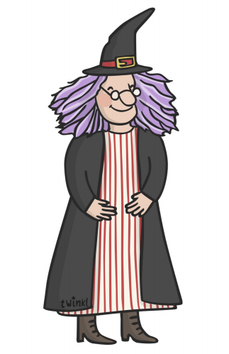
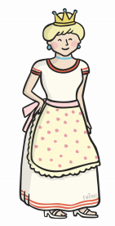

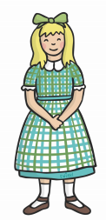
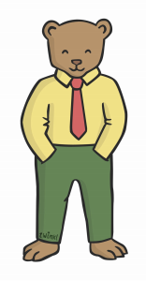
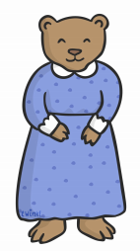
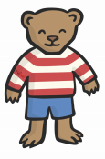
Easy: Cut out characters and match them to the labels.
witch
giant
princess
three bears
girl

Slide 2
Middle: Cut out characters and stick onto the letter that is for them. Talk about how they might feel and why.

Slide 3
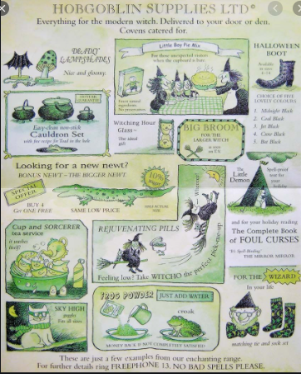
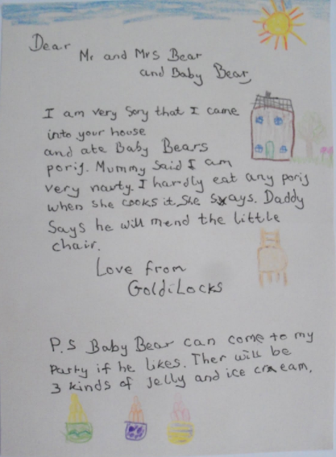
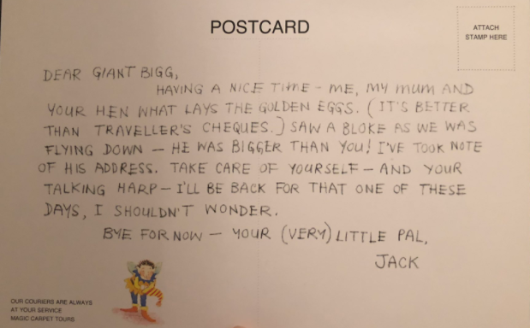

Slide 4
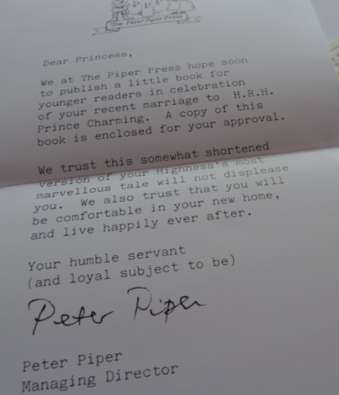
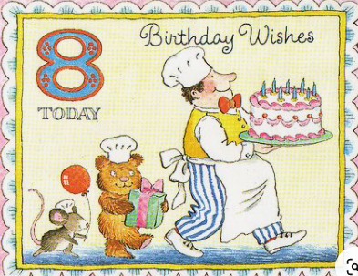
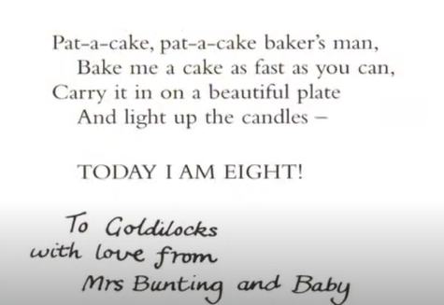

Slide 5
Hard: Read the letters. Cut out characters and stick them in your book. Write a sentence saying how the character would feel when they received it.
- Use ‘because’ and ‘and’ to link ideas.

