Slide 1
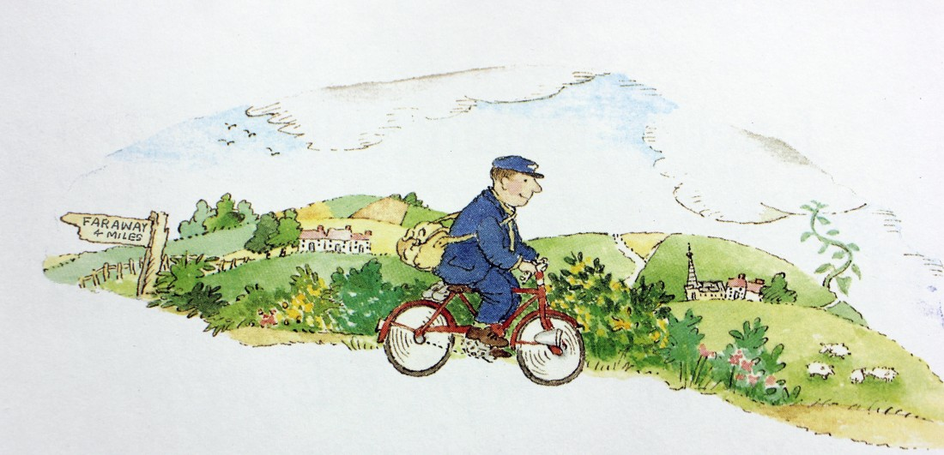
Tuesday 20th April
L.O. To match letters to characters

Slide 2
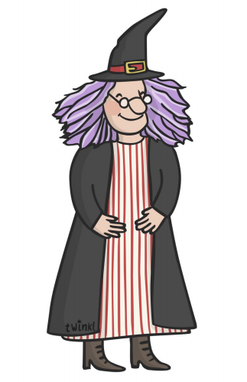
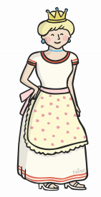
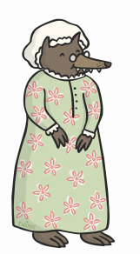

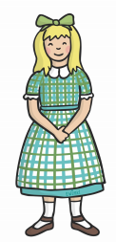
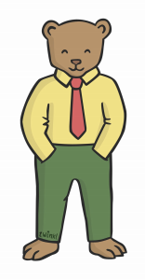
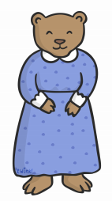
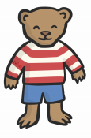
Who are these characters?

Slide 3
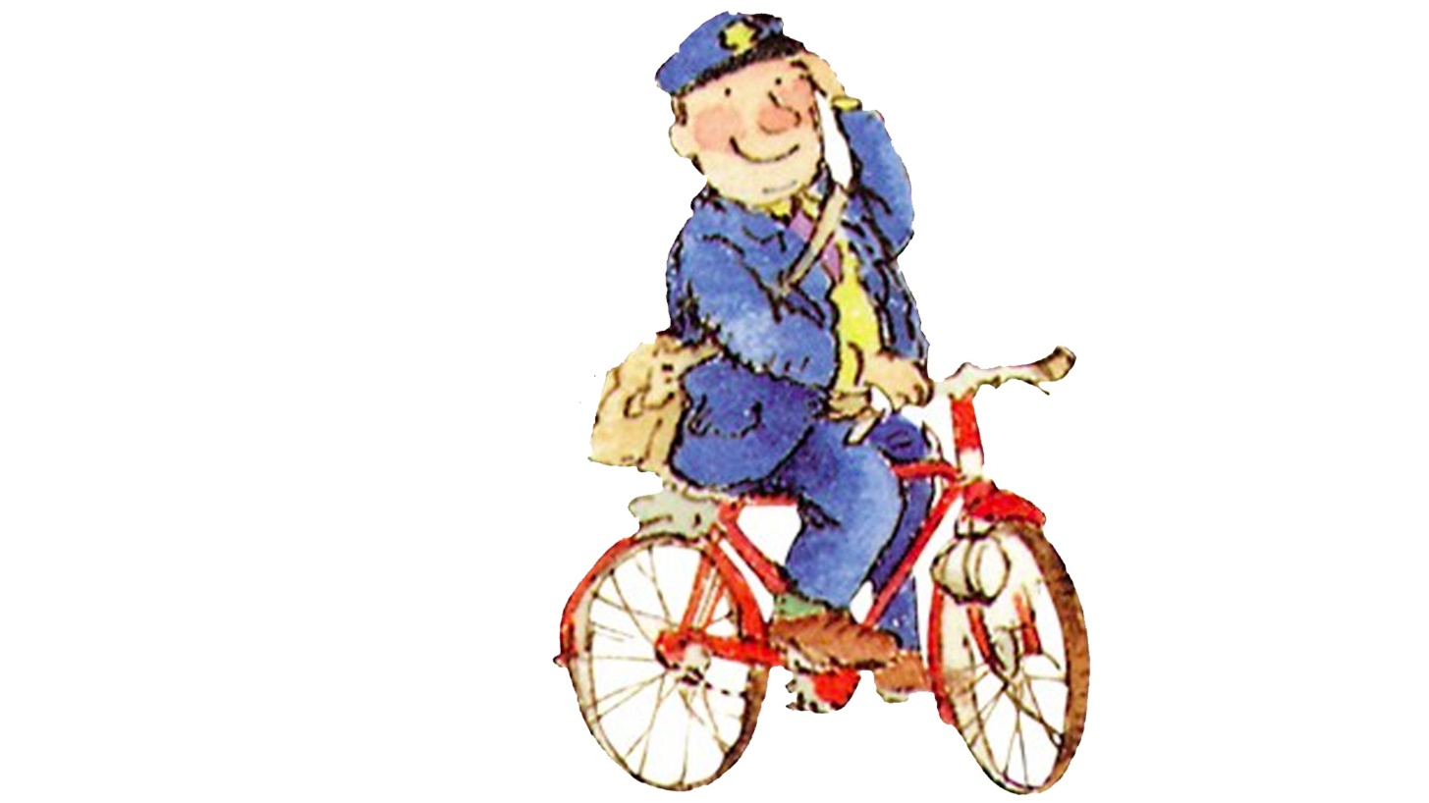
The Jolly Postman delivers letters to different fairy tale characters.

Slide 4
Look at the letters and decide which character the postman will give it to.
Make sure you read each letter carefully, who is it to? What is it about?

Slide 5
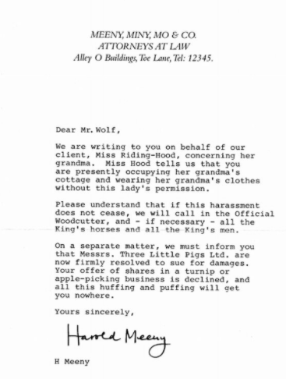
Your Task is to match the letters to the characters!

Slide 6
Extension write a sentence about how the character might feel about receiving the letter.

Slide 7
Mr. Wolf would feel cross because he won’t be able to stay in Grandma’s house and is in trouble.
Capitals for names!
Conjunctions
to link ideas!
Full stops at the end!

Slide 8

Let’s check if you got them right!
I bet you won’t get them right!
I bet they will!

Slide 9
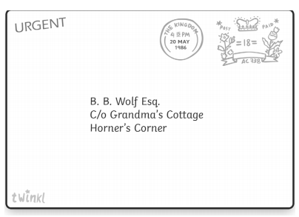
I felt angry.

Slide 10
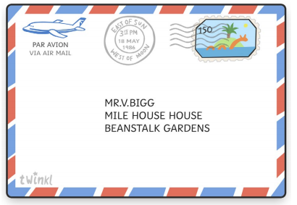
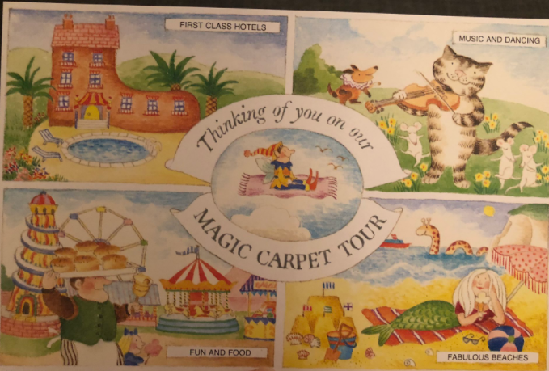
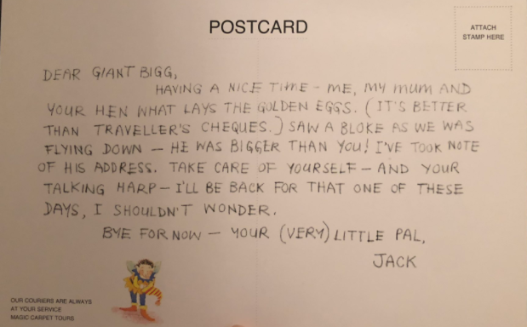
I felt jealous.

Slide 11
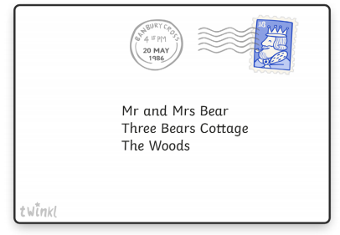
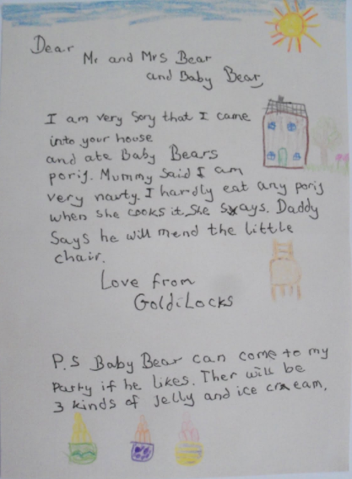
We felt happy.

Slide 12
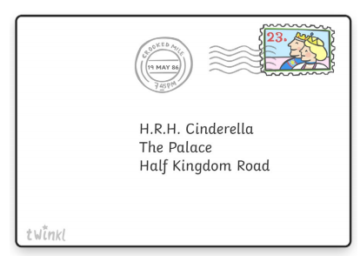
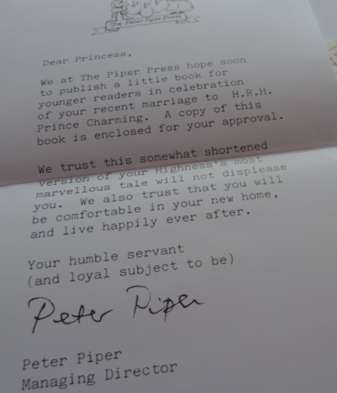

I felt excited.

Slide 13
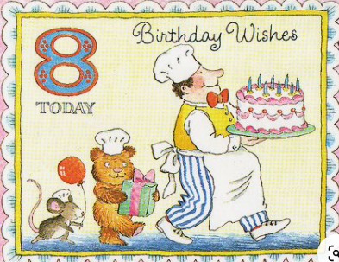
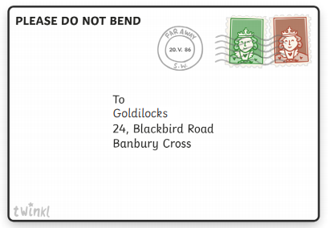
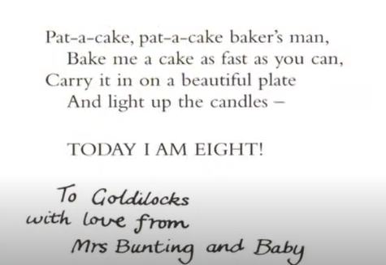
I felt loved.

Slide 14
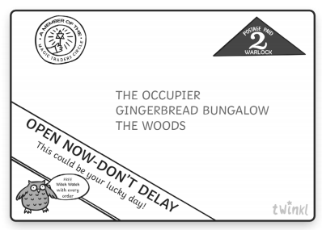
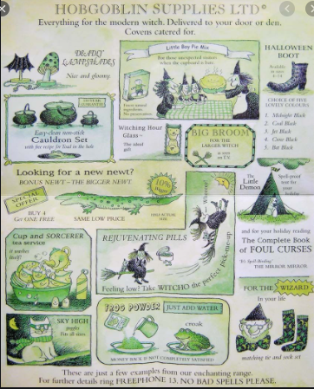
I felt excited.

Slide 15
How did each character feel?
What sentences did you write?

