Slide 1


Slide 3
Which words help us compare heights and which help up compare lengths?
tall
short
longer
longest
same
shortest
shorter
taller
tallest
long

Slide 5
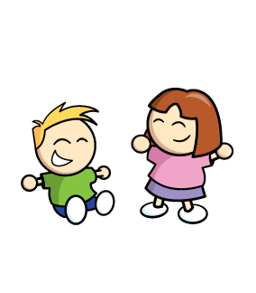
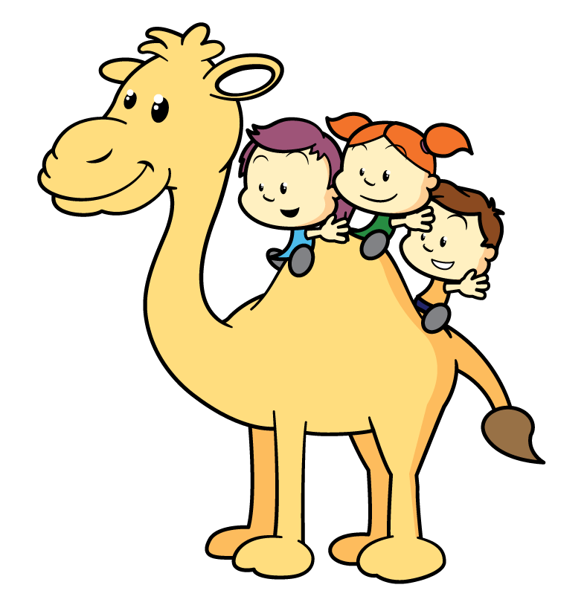

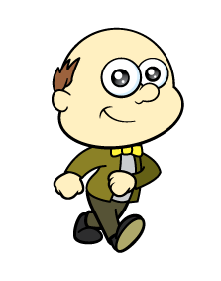

Who is tallest or taller?
I can see who is tallest!
Remember to stand up straight.

Slide 6


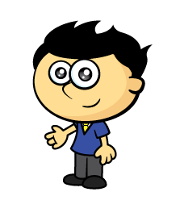



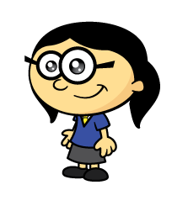
Who is the tallest?
Have a think
How can we compare?
Remember to stand up side by side.

Slide 7

Have a think
green
blue
The tower is taller.
The tower is shorter.

Slide 8
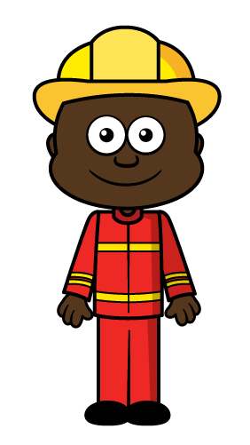
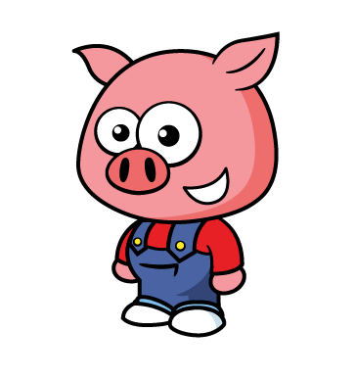
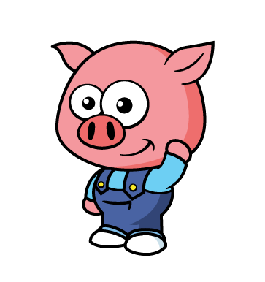
Let’s compare height
Who is shorter?
✓
✓

Slide 9

Have a think
✓
✓
Which is taller?

Slide 10
Have a think
How tall are you?
Can you find someone taller?
Can you find someone shorter?

Slide 11
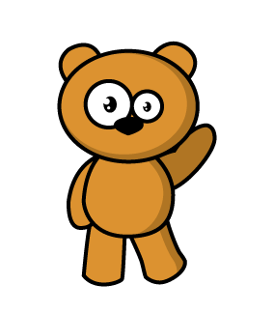
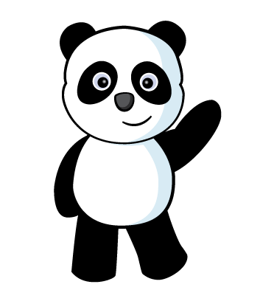
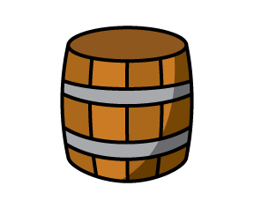
Have a think
I can see they are the SAME height.
Panda is shorter than
the brown bear.

Slide 12
Can you find 3 things shorter than you?

Slide 13
Can you find 3 things taller than you?

Slide 14
Can you find 3 things the same height as you?

Slide 15
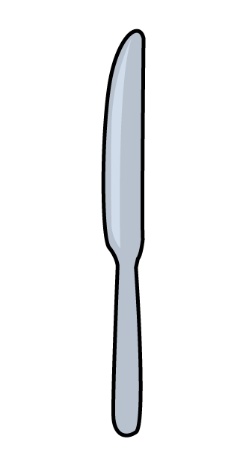

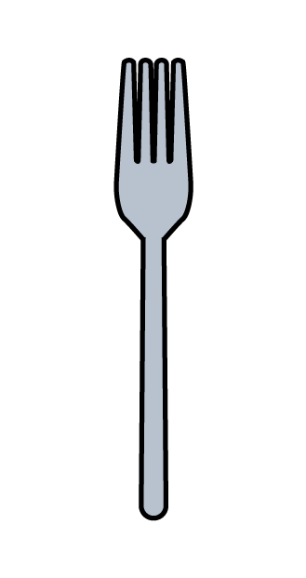
Which is the longest?
How can we compare?
Remember to line them up carefully.

Slide 16
Which is the shortest?
Remember to line them up carefully.

Slide 17
Can you find 3 things longer than your spoon?

Slide 18
Can you find 3 things shorter than your spoon?

Slide 19


Let’s compare fingers!
Have a think
I don’t have any fingers…
Which of your fingers is the longest?
Which of your fingers is the shortest?
Do you have 2 fingers the same length?

Slide 20


Can you put these in order from
longest to shortest?
Have a think
longest
shortest

Slide 21


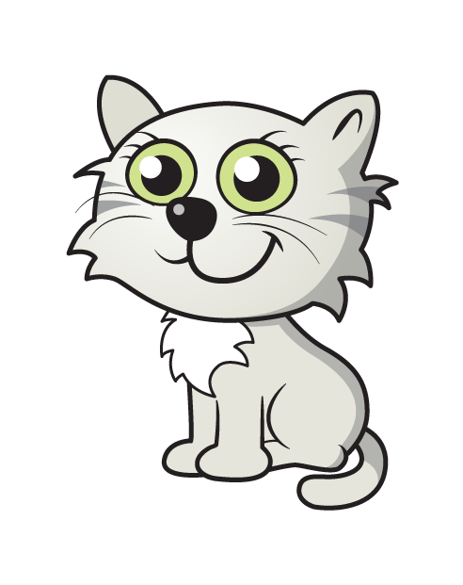
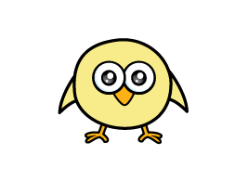
Have a think
The is taller than the
The is shorter than the

Slide 22
Have a think
The is the .
tallest
shortest
The is the .

Slide 23
Have a go at the questions on the worksheet

