Slide 1

Friday 5th February 2021
PSHE: Mental Health Week

Slide 2
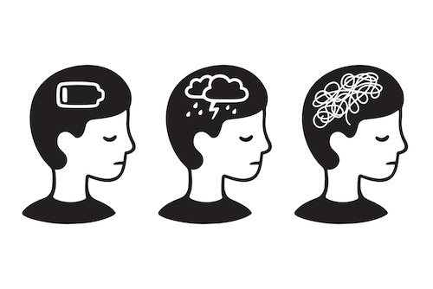
What is mental health?
Mental health is the way children think or feel about themselves and the world around them. It’s related to how children cope with life’s challenges and stresses.

Slide 3
Watch this animated version of the story ‘Lucy’s Blue Day’
https://www.youtube.com/watch?v=UmrUV8v-KQg

Slide 4
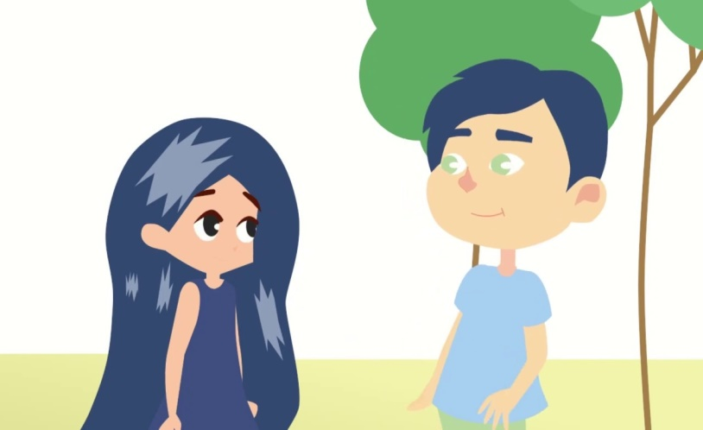
In the story ‘Lucy’s Blue Day’ Lucy goes through lots of different emotions. When her hair turns blue she is sad but she doesn’t know how to talk about it. Later she meets a boy who also has blue hair they feel comfortable saying they are sad which then gives Lucy the courage to talk to her parents.
Lucy learns that no matter how she is feeling it is important to talk to those you trust e.g. parents about how you are feeling and they will help you to understand why you feel this way and what you can do to change how you are feeling.

Slide 5
Talk to your grown up about how you are feeling now and if you know why you are feeling this way.
Remember it is good to share your emotions and feelings.

Slide 6
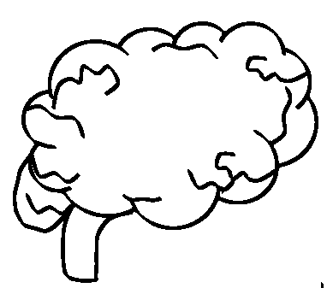


Your Task:
Create your own self care toolkit.
In your tool kit should be some ideas to show;
What makes your brain happy, what you can do to support your brain.
What makes your heart feel happy.
What makes your body happy.
You can then keep this toolkit safe and look at it anytime you are feeling down or want to reflect on your emotions.

Slide 7

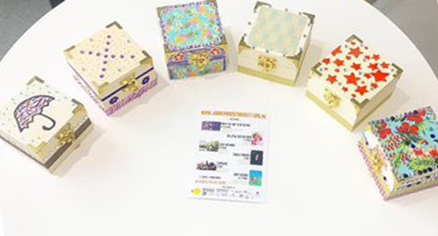

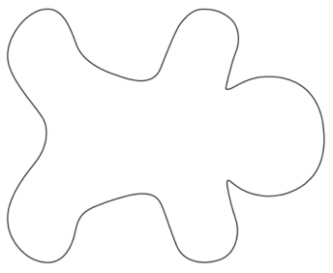
Miss King’s Self Care Toolkit
Reading and listening
to music
Speak to friends and
family.
Paint my nails.
Dancing and
going
out for a
long walk.
You could decorate a box,
envelope or a jar to
keep these in.

Slide 8
Templates you could print out

